Slide 1
World Population
Instructor: Bambo Bayo

Slide 2
What is World Population?
World population refers to the total of people currently living in the world or on the surface of the earth at a defined time. As at today, (September 2022), the total population of the world is over 7.9 billion people. The first billion was reached around 1800 and it took 2 million years of human history to get there while in just 200 years we’ve reached 7 billion milestone.
According to the United Nations Department of Economic and Social Affairs, these are the main population milestones:
  1 billion - 1804
  2 billion - 1927 (in 123 years)
  3 billion - 1960 (in 33 years)
  4 billion - 1974 (in 14 years)
  5 billion - 1987 (in 13 years)
  6 billion - October 12,1999 (in 12 years)
  7 billion – October 31, 2011(in 12 years)
  8 billion – 2024(in 13 years)
  9 billion – 2037(Projected figure in 13 years)
  10 billion- 2057(projected figure in 20 years)
The spatial distribution of population is one of the most significant topics of human geography. It is vital because man has brought huge changes over the earth’s surface. Currently, man is the most exclusive factor transforming the earth at an unequalled rate.

Slide 3
The world population has experienced continuous growth following the Great Famine of 1315–1317 and the end of the Black Death in 1350 when it was near 370 million.
The highest global population growth rates, with increases of over 1.8% per year, occurred between 1955 and 1975 – peaking at 2.1% between 1965 and 1970.
The growth rate declined to 1.2% between 2010 and 2015 and is projected to decline further in the course of the 21st century. The global population is still increasing, but there is significant uncertainty about its long-term trajectory due to changing rates of fertility and mortality.
The UN Department of Economics and Social Affairs projects between 9–10 billion people by 2050, and gives an 80% confidence interval of 10–12 billion by the end of the 21st century.

Slide 4
World Population (contd)
The presence of the large number of people living in the world is somewhat a recent event. In the early stage of human evolution, more than 95% of people were hunters(males) and gatherers(females). This method of food production couldn’t support large population. Births equaled deaths leading to no increase in the number of people on the planet. Population grew at a slow pace. Furthermore, their nomadic lifestyle, perilous climatic conditions and poor nutrition were unfavorable for population growth.
In the last ten thousand years, world population grew at three distinct eras. The first was when man commenced the practice of domestication of plants and animals better known as the Agricultural Revolution. This promoted large food supplies and settled lives which led to better nourishment and survival. Consequently, human population began to increase steadily.
The second time of population increase was in the 18th century at the dawn of the Industrial Revolution when man developed the steam engine and harnessed fossil fuel. Since then world population has continued to increase in the last few centuries.
The third era of rapid increase in world population began in 1950’s. This was brought about by advances in Medical Sciences, which helped to eliminate traditional causes of death in poorer countries.
The current population increase is estimated to be more than 90 million per year. The exponential growth in population is mostly due to technological advancement.

Slide 5
World Population Distribution
Population distribution is a term that is used to describe how people are spread across a specific area. In other words, population distribution shows where people live.
Population distribution can be measured across the entire world or a smaller region within a country or continent. World population distribution is uneven. Patterns of world population distribution can be grouped into three. They are:
Sparsely populated areas
Moderately populated areas
Densely populated areas
Sparsely populated areas tend to hostile environments and difficult places to live like Antarctica while densely areas are habitable environments like Europe.

Slide 6
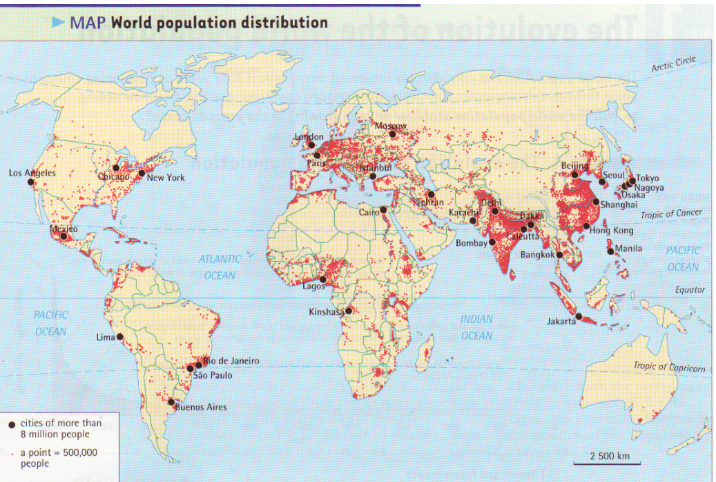

Slide 7
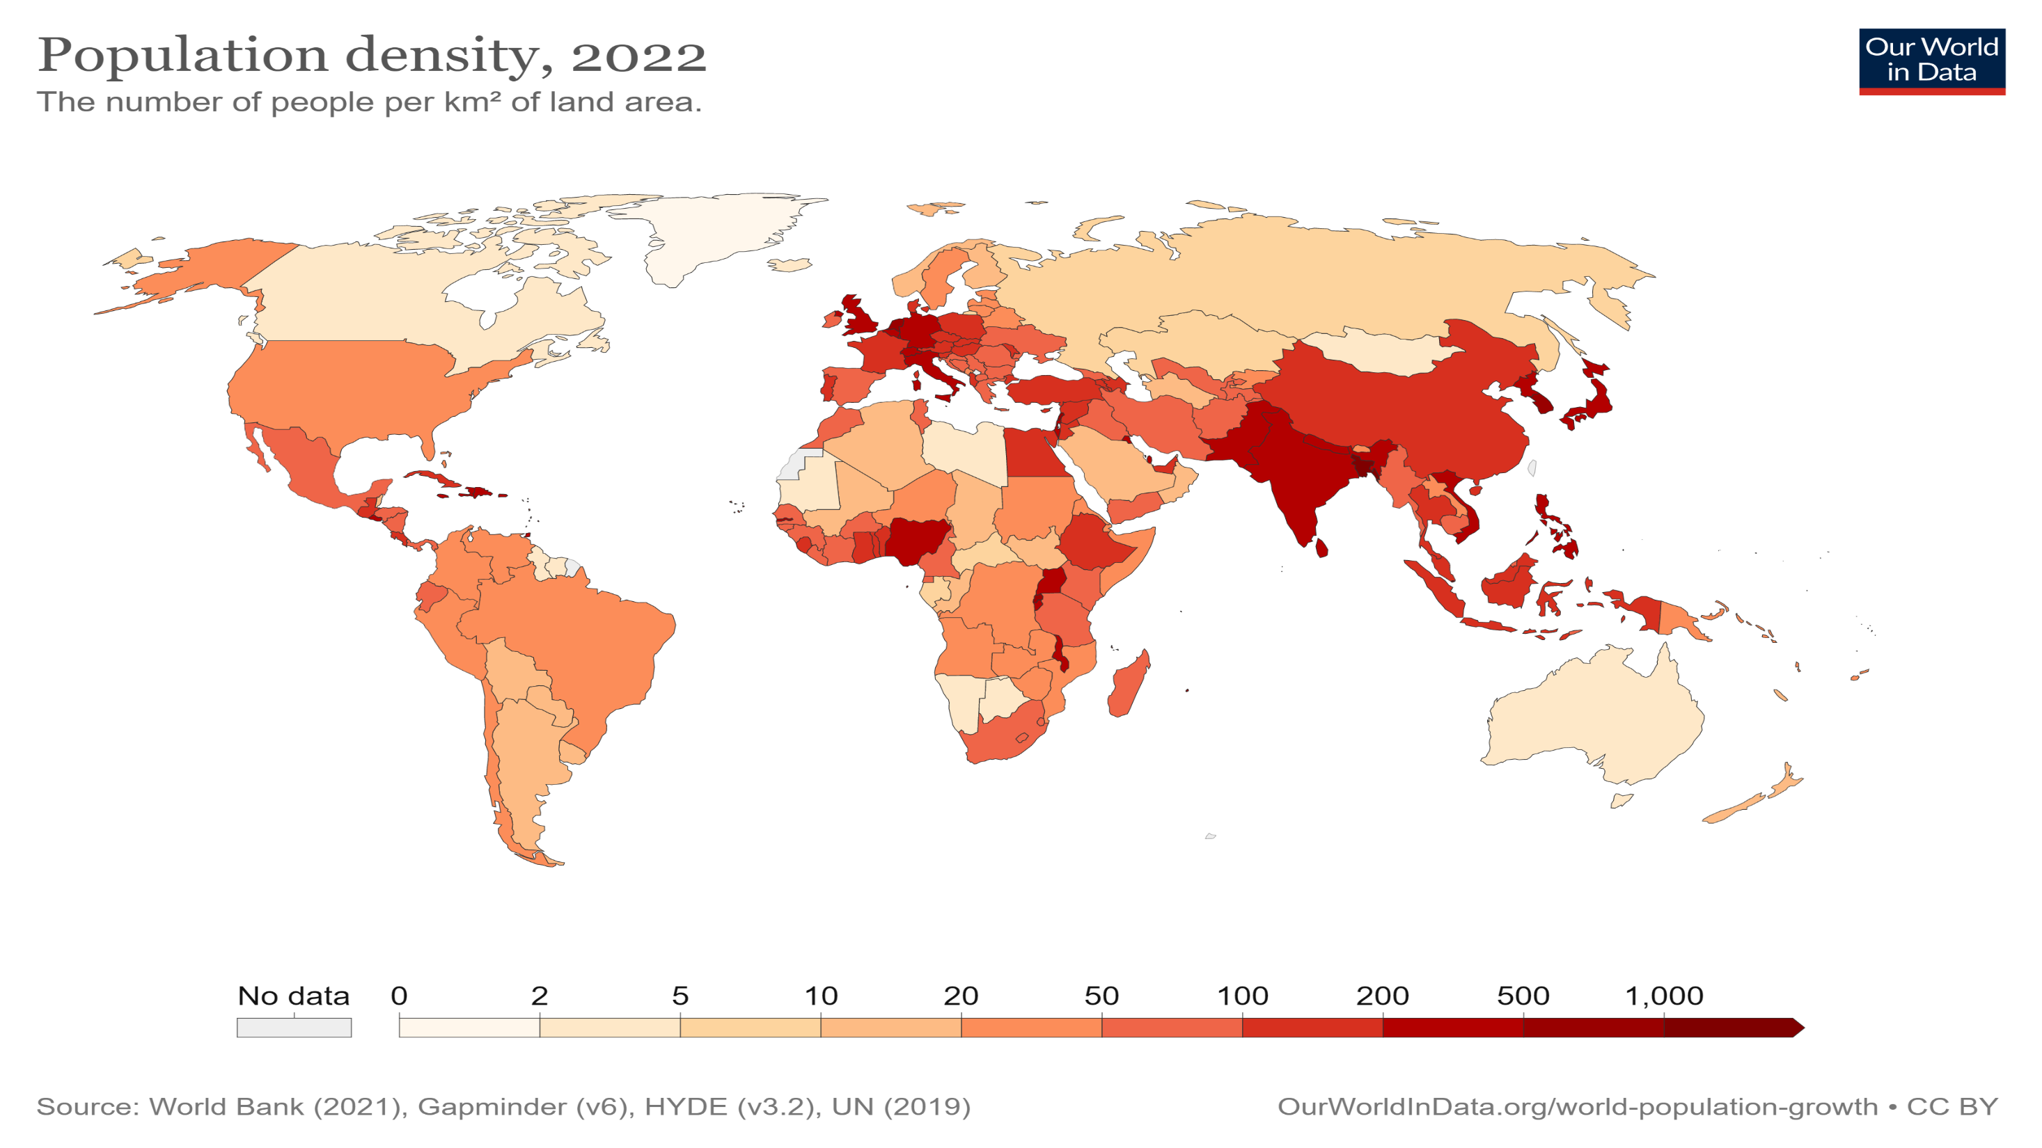

Slide 8
World Population distribution Cont’d
The population distribution of the world can be measured by calculating the population density. Population density is typically expressed as the number of persons per square kilometre or square mile of land area. In simple terms, population density is the ratio between population and area.
Formula for Population density= Total population/Total land area .
DENSELY POPULATED PARTS OF THE WORLD
Industrial North-West Europe: This includes countries like Great Britain, France, Germany, Denmark, Belgium, etc. These areas are highly industrialized due to the presence of coal and iron.
Industrial North-Eastern U.S.A: This is the great industrial belt of the United States and Canada stretching from the shore of the Great Lakes of Pittsburgh to New York which is very rich in coal and iron.
Agricultural Monsoon Asia: This includes populous countries like China, Indian, Japan, Pakistan, Indonesia (particularly Java), etc. This is the area of the largest population concentration of the world, known for its fertile soils, warm climate and abundant rainfall which promote agriculture.
The Nile Valley and Delta: This is essentially in Egypt. It is an area within the Sahara desert which through irrigation has converted a desert into an area of high agricultural activities and consequently high population.

Slide 9
MODERATELY POPULATED PARTS OF THE WORLD
These include areas of cool temperate forest of Europe, Canada and Asia.
The temperate and tropical grassland of southern continents.
Agricultural U.S.A.
Mediterranean Europe.
Africa
Most parts of South-East Asia.
SPARSELY POPULATED PARTS OF THE WORLD
The cold polar lands of Arctic and Antarctica which are not inhabited due to cold weather.
The Canadian and Eurasian tundra and Greenland also due to cold weather.
The high mountains of Himalayas, Rockies and parts of Andes due to rugged relief and cold weather.
The hot deserts of the world like Kalahari, Atacama, the Sahara, etc. due to hot weather and dryness with no rain.
The dense tropical rain forest like the Amazon basin (South America), Congo (Zaire) basin (Central Africa). Both are uninhabited jungles.

Slide 10
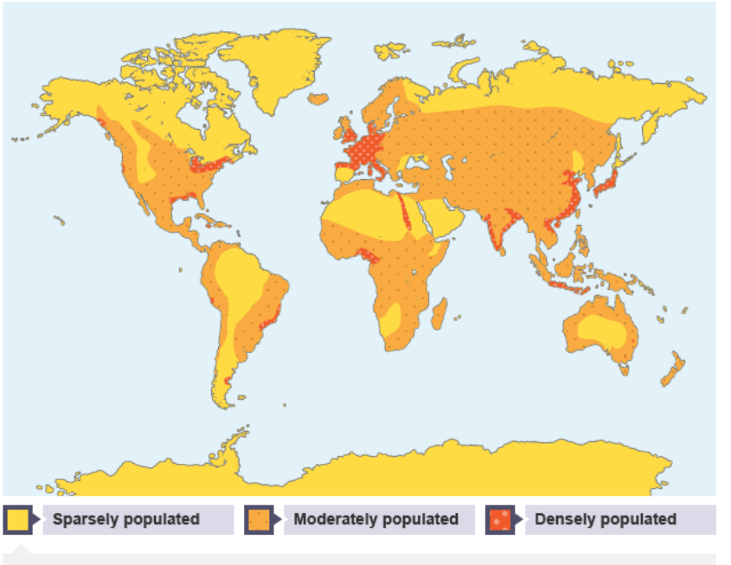

Slide 11
World Population Distribution Cont’d
Approximately, 75% of the world’s population live on 5% of the earth’s surface, 33% is uninhabited while the rest is covered by water.
The Global distribution of population among the continents are represented below:
Asia- 60.7% (China and India constitute about 36% of the world’s population)
Americas - 13.6% (North America, South America and Canada)
Africa - 13.2%
Europe - 12%
Oceania - 0.5% (Australia)

Slide 12
Factors Influencing the Distribution of Population
Geographical Factors
Availability of water
Landforms
Climate
Soil
Economic Factors
Minerals
Urbanization
Industrialization
Social and cultural Factors

Slide 13
Availability of Water
Water is the most important factor in life. So, people prefer to live in areas where freshwater is easily available. Water is used for drinking, bathing and cooking – and also for cattle, crops, industries and navigation. It is because of this that river valleys are among the most densely populated areas of the world.
Landforms
People prefer living on flat plains and gentle slopes. This is because such areas are favourable for the production of crops and to build roads and industries. The mountainous and hilly areas hinder the development of transport networks and hence initially do not favour agricultural and industrial development.
So, these areas tend to be less populated. The Ganga plains are among the most densely populated areas of the world while the mountains zones in the Himalayas are scarcely populated.
Climate
An extreme climate such as very hot or cold deserts is uncomfortable for human habitation. Areas with a comfortable climate, where there is not much seasonal variation attract more people. Areas with very heavy rainfall or extreme and harsh climates have low populations
Mediterranean regions were inhabited from early periods in history due to their pleasant climate..

Slide 14
Soils
Fertile soils are important for agricultural and allied activities. Therefore, areas that have fertile loamy soils have more people living on them as these can support intensive agriculture.
Economic Factors
Minerals
Areas with mineral deposits attract industries. Mining and industrial activities generate employment. So, skilled and semi-skilled workers move to these areas and make them densely populated. Katanga Zambia copper belt in Africa is one such good example.
Urbanisation
Cities offer better employment opportunities, educational and medical facilities, better means of transport and communication. Good civic amenities and the attraction of city life draw people to the cities. It leads to rural to urban migration and cities grow in size. Megacities of the world continue to attract a large number of migrants every year.
Industrialisation
Industrial belts provide job opportunities and attract large numbers of people. These include not just factory workers but also transport operators, shopkeepers, bank employees, doctors, teachers and other service providers. The Kobe-Osaka region of Japan is thickly populated because of the presence of a number of industries.

Slide 15
Social and Cultural Factors
Some places attract more people because they have religious or cultural significance. In the same way – people tend to move away from places where there is social and political unrest, religious persecution, famine, insecurity, wars and stringent government policies . Many times governments offer incentives to people to live in sparsely populated areas or move away from overcrowded places.
Historical Factors
How long people have been living there?
Impact of ancient civilization like Chinese dynasty, Egyptian civilization and Romans
Impact of Slave trade
How long industries have existed in a place

Slide 16
Overpopulation
This is when a country has more people than its available resources to support if the people to are enjoy an adequate living standard.
Causes: High birth rate and declining death rate. In developing countries, it is caused by high levels of immigration.
Advantages
A big labour force
A potential large market
Disadvantages
Declining standard of living(poor housing ,pressure on public facilities)
Unemployment
Congestion(development of slums and ghettos)
Environmental pollution and degradation
Hunger and mal nutrition
Sanitation problems
Social vices (crime, prostitution)

Slide 17
Measures to control over population
Increase food production
Use of modern contraceptives and birth control
Emigration or out migration
Encouraging housing projects.
Creation of employment avenues

Slide 18
Under population
This is when a country’s size of population is considered too small to fully exploit the available resources.
Causes: Physical disadvantages like climate, strict immigration policies, agricultural and manufacturing done with small indigenous people
Problems :
Small market size
Small labour force
Country relies on foreign labour force

Slide 19
Measures to control under population
Government incentives in the form of free maternity care, child welfare and free education.
Economic support for single parents.
Legislation against abortion
Discouragement of all forms of birth control
Encouraging early marriages
Relaxing Immigration policies.

Slide 20
Optimum population
This is when the number of people that can be supported by the available resources in an area so as to achieve the highest possible standard of living. It is dependent on
the number of people
the technical competence of the people
the natural resources available.
Countries with high standard of living are believed to have attained optimum population such as Germany, France and Britain.

Slide 21
Population Problems Faced by Developing and Developed Countries
The problems of developing and developed nations are dissimilar due to their different socio-economic and cultural systems.
Population Problems of Developing Countries:
Low Levels of Technological Development
Lack of Diversification of Economy
Lack of development of secondary and tertiary sectors leaves limited employment opportunities for the skilled and the educated who move to more developed towns or to foreign countries in search of better job opportunities.
Under-nourishment and Lack of Hygiene:
Low standards of living and poor living conditions are responsible for this. As a result, incidence of diseases is high leading to high rates of mortality, especially among children and pregnant mothers.

Slide 22
Inefficient Agricultural Sector:
The developing countries are characterized by agrarian based subsistence production. Traditional and obsolete methods and implements for cultivation, lack of capital for investment, fragmented holdings make the base of this type of economy very weak.
Weak Industrial Base:
Lack of capital, outdated technology and inadequate skilled manpower has resulted in a weak industrial base in most of the developing countries. This has prevented any substantial improvement in living standards of populations of these countries.
Rapid population growth
In most developing countries, birth rate is high and death rates have been checked because of available medical facilities. This situation has not only resulted in a large ratio of younger population dependent on the work force but also put pressure on social and economic amenities.

Slide 23
Population Problems of Developed Countries:
The developed countries are characterized by high levels of industrialization and urbanization, high per capita incomes, dependence of a major part of the workforce on secondary, tertiary and quaternary activities, and an efficient and productive agricultural sector.
The problems faced by these countries are:
1. High Proportion of Old Age Population:
This happens because of low death rates and high rates of life expectancy. As a result, a large section of population is above sixty years of age and is dependent on the relatively small workforce.
2. Shortage of Labour:
As standards of education improve, the children remain longer at school and join the workforce later. This implies slow expansion of the workforce. As a result, many countries of Europe face shortage of labour seeking external sources of labour from other countries.
3. Congestion in Towns:
As towns expand, the pressure on amenities, transport, housing etc. increases. Pollution and social tensions lead to various diseases.
4. Growth of Slums:
Unregulated growth of urban centres leads to growth of slums which creates many social and environmental problems. The productive agricultural land is encroached by urban houses, roads and industries.

Slide 24
Solving World Population problems
Through Migration it will help to redistribute population
Through increased food production
Reducing birth rate by
    Improvement of women education
    Incentive for fertility control
    Monogamy
    Family planning clinic
    Legislation regarding marriage age
    Penalty for large families
Population policies
    China has a one child policy
    In Singapore, the official policy is two children.(not any more)
    In Nigeria is four children but not enforced. The government is completely silent on Polygamy.

Slide 25
Important Terminologies in Population Studies
Population Density. Also referred to as Arithmetic Population Density: The ratio between number of people and land area.
Physiologic Population Density: refers to the number of people per unit area of arable land, a basic indicator of a country's food-producing capability—and the human pressures placed upon it.
Population distribution: Refers to how people are spread over space or the pattern of where people live.
Birth Rate: This is the number of live births observed in a population to the size of the population during the reference period. The rate is usually stated per 100, 000 and the most usual period is one year.
Fertility: The ability of a person to conceive children.

Slide 26
Total Fertility Rate (FTR) on the other hand refers to the average number of children that are born to a woman over her lifetime
Fecundity: The reproductive capacity of a woman or the possible number of offspring that can be produced over a lifetime
Crude Fertility Rate: Crude birth rate indicates the number of live births occurring during the year, per 1,000 population estimated at midyear. Formula: (Number of live births / Estimated midyear Population) * 1,000.
Crude Death Rate: Number of deaths per 1,000 population: (Number of deaths / Estimated midyear population) * 1,000.
Life Expectancy: The number of years on average on is expected to live in a particular country.
Population Census: This is the process of collecting and processing of basic social, demographic, and economic data for the entire population of the country. It normally takes place every 10 years.

Slide 27
Population Structure: The distribution of the Population by sex and age groups.
Population Composition: the number of men and women and their ages in a population.
Aging Index: The number of people aged 65 and above per 100children aged 0-14 years. The proportion of older population (65 years and above) to the younger population (0-14 years)
Infant mortality: Number of children who died after birth before reaching 1 year. While child mortality is number of children who died between the ages of 1 and 5 years.
Maternal Mortality Rate: the number of female deaths that occurred during pregnancy, child birth, or within 42 days of termination of pregnancy because of any cause related to or aggravated by the pregnancy or its management but not from accidental or incidental causes.

