Slide 1
Schools of Thought in Human Geography

Slide 2
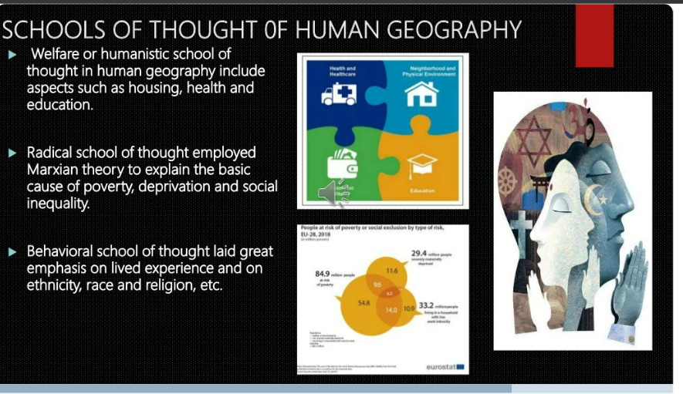
What is a School of Thought?
There have been various schools of thought in the history of geographical registry.
A school of thought is the view or perspective of a group of people who share common opinions or outlook on a philosophy or discipline. In Human Geography, we have different schools of thought. They are:
But there are three perspectives/school of thought in human geography that explains the relationship between the physical environment and man, namely:
Environmental Determinism
This is the first and the oldest perspective in Human Geography. The other two are:
Possibilism
Neo-determinism

Slide 3
DETERMINISM
Environmental Determinism was the dominant school of thought until the second world war and presented the point of view that the natural environment notably physical factors like landforms and climate determine human action, his thoughts and way of life. Simply put, Environmental Determinism is the idea that the physical environment shapes the destinies of humans and society. The concept emphasizes the influence of the environment on man and his activities where man is subject/subordinate to nature. When nature dominates man, it is termed determinism. Friedrich Ratzel(1882) and E.C. Semple were the main propagators of Determinism. Ellsworth Huntington coined it. In the early stage of human evolution, there was no technology to modify the environment by man. Human beings adapted to the dictates of nature. At this stage, man was perceived as naturalized human who listened to nature, was afraid of its fury and some worshipped the forces of fire, floods, rains and so on.
Human beings were directly dependent on nature for resources for their sustenance. The physical environment for such primitive societies becomes ‘Mother nature’. Determinism removes opportunities, no possibilities at all, only one certainty that the natural/physical environment is Supreme.
Characteristics of Environmental Determinism
Environment controls human action and activities. Acceptance of the superiority of the environment.
Humans are directly dependent on the natural environment.
Humans are not free, they are in a state of absolute necessity where there is no choice or alternative and forced to live under the conditions of the environment.
Humans are naturalized(to bring into conformity with nature)they are afraid of natural forces.
It considers man as a passive agent whose attitudes and decision making is influenced by the physical environment.

Slide 4

Examples of Determinism
Eskimos make igloos with Ice.

Slide 5

Cactus and other hardy plants grow in the desert

Slide 6
(Contd) Examples of Determinism
Hot climate of Sub Saharan Africa caused dark human skin.
White European nations believe that people from warmer climates were lazier because they did not have to work as hard to survive.
Rivers decided the settlement pattern.
Topography decided the livelihood activities.
People living in flood affected areas prefer to build houses in high altitude
Criticism of Environmental Determinism:
Environmental determinism considered humans as passive agent but humans are not passive agents, humans can create and change the natural environment. The following are ways humans have changed the natural environment through:
  Dam building
  Earthquake resistant houses
  Irrigation and Sprinkler systems
  Green Revolution
  Hydroculture, Soilless farming
  Greenhouse Agriculture

Slide 7
2. The same Environment has a different meaning to different people, it is up to people to know how they are using it.
Examples:
  The locations and climate of Israel and Jordan are the same, but Israel is more developed due to innovation and people's attitude whereas Jordan is lacking in development.
  Natural and mineral resources are lacking in Japan, however, they are developed while Africa is full of rich natural resources, however, they are poor.
  3. The idea that the environment is the only deciding factor of human action is untrue.
  4. Spate criticized determinism, saying that environments themselves are meaningless without man. Humans shape the environment.
  5. After much development process post world war, determinism lost much of its relevance and has long been discredited in academic circles.
  Possibilism
  The concept of Possibilism came about as a reaction to environmental determinism. In environmental determinism, human beings are treated as a passive element. But the concept of Possibilism believed that man was always an active agent in the environment. The French geographer, Paul Vidal de la Blache[1845 to 1918] was the founder of French's human geography. He was credited with introducing possibilism in geography.

Slide 8
Possibilism is a concept that believes that man has the skill necessary to adjust or modify the environment. Humans are the masters/architects of the environment although the environment gives us options that we may choose from.
With the passage of time, there were advancement of knowledge, science, and technology, man was able to change the environment according to their own accord. When man dominates nature it is called possibilism or humanization of nature. Agriculture is an example of this. Human activity is not controlled by only environmental factors.
The theory of possibilism states that the world is full of possibilities, it is up to humans to know how they use it.
Characteristics of Possibilism
Possibilism approach states that:
The world is full of possibilities. Humans were free to choose or decide.
Nature provides conditions of absolute freedom/possibilities, and possibilities can be increased through knowledge, innovation, and technological advancement
Man is not a passive element, man is the active agent. Man can create, alter, destroy the environment.
Man is the not product of the environment, man is the product of culture and the environment.
Nature got humanized

Slide 9
Examples of Possibilism
Israel lacks basic natural resources such as water. They innovated drip irrigation systems and vertical farming to overcome the food shortage in the country. Israel's agricultural techniques for farming today are world-class, they are far ahead in terms of agricultural productivity and they are now exporting many agriculture products.
In India, rice is cultivating through canal irrigation in Rajasthan while it is desert. The above activity is happening because the environment is allowing us to do it in other ways.
When a mountain acts as a barrier, it is not possible to move the mountain, but man can build a bridge, rail track or road to create a passage across the mountain.
Under hydroponics technology, humans can grow vegetables without using soil.
Tea, coffee, rubber can be cultivated in the tundra under artificial environmental conditions created by humans.
Air conditioning used in hot climates and central heating in areas that are cold regions.
Industrial Revolution
Nowadays, the school of possibilism is becoming widely accepted since it recognizes human’s ability to change it’s environment using the latest or better technology.

Slide 10


Slide 11
Criticism of Possibilism
Possibilism can create environmental problems if we act against nature. Examples are:
  We are facing climate change problems due to pollution and Greenhouse gas emissions.
  Facing the problem of Landslide, earthquakes, etc due to dam building in a hazardous prone area.
  Facing floods due to silting of the river from mining and deforestation.
  Facing dengue outrage in part of Rajasthan, Punjab, Haryana due to waterlogging around the canal.
There are no unlimited possibilities in the all-region. Possibilities vary from region to region.
Possibilities are not economically viable against the environment all the time. For example, rice cultivation in the rain-fed area is possible but not economically viable.

Slide 12
Neo-Determinism
The concept of Neo-determinism was put forward by Griffith Taylor, a leading Australian Geographer. Neo-determinism is also called "Stop and go determinism" because it believes that if human activities (pollution) cause long-term damage to the environment, then such activities should be stopped otherwise humans will continue to do everything that the environment allows without paying attention to the warning or red signals such as global warming, climate change, pollution, degrading lands, receding glaciers, ozone layer depletion and much more..
Neo determinism is a middle path between the idea of environmental determinism and possibilism. That neither is there a situation of absolute necessity nor is the a condition of absolute freedom. The concept emphasizes that possibilities can be created or problems can be solved within the limit which do not damage the environment and there should be accountability.
For instance a company cuts down trees as a resource, you must plant trees and further checks by some authority on over utilization of resources and there should be some sort of accountability for damages.( Introducing the idea of Sustainable development)

Slide 13
One way the environment is fighting back is through climate change. The wrong activities [pollution] by human beings are harming the environment. But polluting the environment has a limit. Through climate change, nature is forcing humans to correct their actions towards the environment.
Characteristics of Neo-Determinism
The concept reflects a middle path between the idea of Determinism and Possibilism.
Neo-Determinism emphasizes on solving problems without damaging the environment.
Neo-determinism advocates balance between development and nature. Nature is not an absolute dictator, nature can be neutral. The best course of action for mankind to conquer nature is to obey and co-operate with it.

