Slide 1
Languages
Course instructor: BAMBO BAYO

Slide 2
Introduction
Language is the fundamental element of local and national culture
Language shapes our very thoughts
It is a set of signs and symbols that is used for communication
It is an integral part of culture , reflecting and shaping it.
Language helps to bind cultural identity as it makes people visible in to each other and the rest of the world.
People’s thoughts, expressions, and dreams are articulated in their language; to lose that ability is to lose a lot.

Slide 3
Language
A language is a system of communication that persons within a community use to convey ideas and emotions.
The study of languages is called linguistics.
Language is a system of communication that provides meaning to a group of people through speech.
Most nations have an official language. Most citizens of a nation with an official language speak and write in that language. Additionally, most official or governmental documents, monetary funds, and transportation signs are communicated in the official language. However, some regions, such as the European Union have 23 official languages

Slide 4
Pidgin Language
There are other forms and uses of language as well. In places where two or more languages are spoken, a pidgin language may develop.
Pidgin languages are simplified versions of a language or several languages that help people communicate, especially in matters of trade or business.
Lots of pidgin languages have formed around the world, especially in border areas and in places where colonial empires were built. Sometimes a pidgin will become more complex and evolve into a language in its own right; a native tongue.

Slide 5
Difference between Language & Dialects
The term language is commonly used to refer to the idealized “standard” of a variety of speech with a name, such as English, Turkish, Swedish, Swahili, or Urdu.
Dialect is a regional variety of a language. The word dialect is often applied to a subordinate variety of a language.
If you observe, people from different countries can speak a particular language but in different forms. English is probably the best example to understand this concept. English spoken in Britain (British English) and the U.S. (American English) are significantly different but they’re not considered separate languages. It’s the dialect where the difference comes from.

Slide 6
Let’s take an example again from the English language that’s spoken around the world. A British might say “hello” whereas a South American English speaker says “howdy” but both of them are able to understand each other easily despite using different dialects.

Slide 7
Language & Culture are Mutually Interlinked
Language and culture have a complex, homologous relationship.
Language is complexly intertwined with culture (they have evolved together, influencing one another in the process, ultimately shaping what it means to be human).
In this context, A.L.Krober (1923) said, “culture, then, began when speech was present, and from then on, the enrichment of either means the further development of the other.”

Slide 8
Language Tree
A language family is a collection of languages related through a common prehistorical language that makes up the main trunk of language identity.
A language tree will have language branches, a collection of languages related through a common ancestral language that existed thousands of years ago.
There are three main language families:
Indo-European (Includes English)
Sino-Tibetan (Includes Chinese)
Afro-Asiatic (Includes Arabic)

Slide 9
Largest Language Family Groups
The six largest language families by language count are
Niger-Congo, Austronesian, Trans-New Guinea, Sino-Tibetan, Indo-European, and Afro-Asiatic.
Of the 142 different language families, these six stand out as the major language families of the world. They can be found throughout the world, spreading uniquely to different regions and countries.
Each of these families has at least 5% of the world’s languages, and together account for two-thirds of all languages. Niger-Congo and Austronesian are the two largest from this perspective, each with over 1,000 languages due to the incredible language diversity in sub-Saharan Africa and Southeast Asia, respectively.

Slide 10
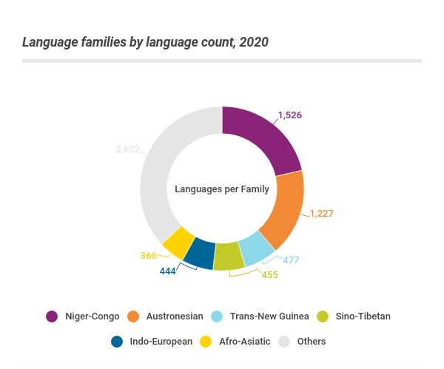
Source: https://www.ethnologue.com/guides/largest-families

Slide 11
Based on Speaker Count
These six families also make up five-sixths of the world’s population.
Based on speaker count, Indo-European and Sino-Tibetan are the largest two language families, with over 4.6 billion speakers between them.
The two most spoken languages are in these families – English is classified as Indo-European, and Mandarin Chinese is classified as Sino-Tibetan

Slide 12
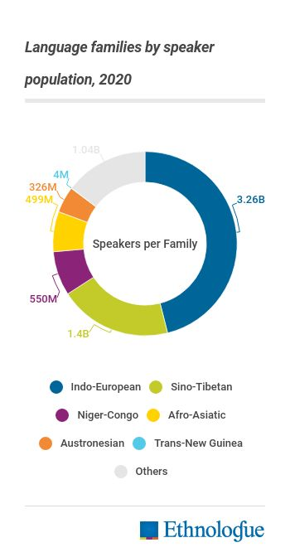
Source: https://www.ethnologue.com/guides/largest-families

Slide 13
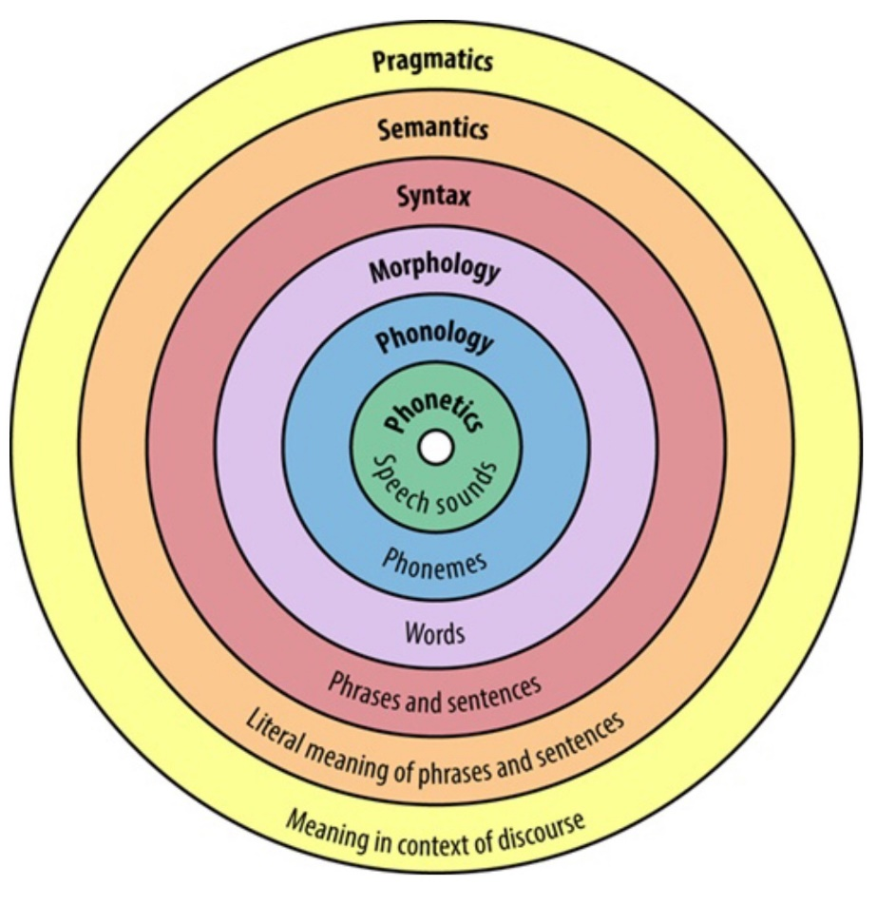
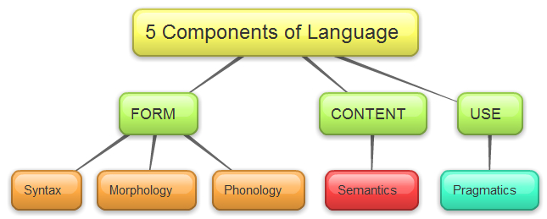
Components of Language

Slide 14
1.Phenology & Phonemes
Phonology: The system of the sound segments that humans use to build up words. Each language has a different set of these segments or phonemes, and children quickly come to recognize and then produce the speech segments that are characteristic of their native language.
Other examples: Sound produced by saying THIS and THIN.
Phonemes are the individual sounds in a language, the distinctive units that “make a difference” when sounds distinguish words. For example, in English the initial consonant sounds /p/ and /b/ are the only difference between the words park and bark and thus are phonemes

Slide 15
2. Morphology & Morphemes
Morphology is the study of word formation. This component of language focuses on the internal structure of words. Knowledge of the morphology of our language is critical to vocabulary development and reflects the smallest building blocks for comprehension. Morphemes are small units that cannot be further subdivided, are the basic building blocks of meaning
Lexical and Grammatical Morphemes
Lexical morphemes have meaning and can stand alone. Examples are man, girl, play, etc.
Grammatical morphemes, conversely, are mostly used to specify a relationship between 2 lexical morphemes or modify one. Examples are at, and, the, etc.
Morphemes are of different types and serve different purposes. Free morphemes can stand alone (envelope, the, through), whereas bound morphemes occur only in conjunction with others (-ing, dis-, -ceive), either as affixes or as bound roots. Affixes at the beginnings of words are prefixes (un- in the word unafraid); those added at the ends are suffixes (-able in the word believable); and infixes are morphemes inserted between other morphemes (-s- in mothers-in-law)

Slide 16
3.Syntax
The study of how individual words and their most basic meaningful units are combined to create sentences is known as syntax.
As words are grouped together when we communicate, we must follow the rules of grammar for our language, in other words, its syntax.
The English language has a certain word order we have to follow if we want to create useful language. The basic sentence in English consists of subject, verb, and object (SVO) as is represented in this simple sentence:
I eat breakfast. This sentence is grammatically correct because the words are presented in the right order.
Syntax also determines which word combinations are acceptable. For example, if I say “He went to town.” it is acceptable, however, if I say, “town to went he” it does not work because of the syntax of English.

Slide 17
Semantics: study of word meanings; not just “dictionary definitions,” but also the underlying meaning of words
Pragmatics: study of words-as-actions, the effects of utterances

