Slide 1
Providing Physical Security for Information Assets/Systems
Week 4
Lecture 4
10.20.20

Slide 2
Securing Information Systems
Learning Objectives
  Why are information systems vulnerable to destruction, error, and abuse?
  What is the business value of security and control?
  Physical Security
  Site access controls including
  Securing a site
    Identifying and avoiding threats and
    Risks associated with a building site
  Equipment protection from theft
  Environmental controls
10.20.20

Slide 3
Securing Information Systems
Why are information systems vulnerable to destruction, error, and abuse?
  If an entity’s Information Systems security is compromised probably due lo lack of a firewall or antimalware, leading to an attack, then
    Your computer would be disabled in a few seconds, and it might take you many days to recover.
    You might not be able to sell to your customers or place orders with your suppliers while it was down.
    And you might find that your computer system had been penetrated by outsiders, who perhaps stole or destroyed valuable data
    Your customer payment information might be compromised.
    If too much data were destroyed or divulged, your business might never be able to recover!
10.20.20

Slide 4
Securing Information Systems
Definitions
  Security refers to the policies, procedures, and technical measures used to prevent unauthorized access, alteration, theft, or physical damage to information systems.
  Controls are methods, policies, and organizational procedures that ensure the safety of the organization’s assets, the accuracy and reliability of its records, and operational adherence to management standards.
10.20.20

Slide 5
Securing Information Systems
Why information systems are vulnerable
  When large amounts of data are stored in electronic form, they are vulnerable to many kinds of threats.
  Through communications networks, information systems in different locations are interconnected.
  The potential for unauthorized access, abuse, or fraud is not limited to a single location but can occur at any access point in the network.
10.20.20

Slide 6
Site Access Security

Slide 7
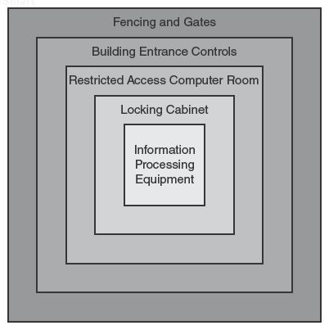
Site Access Controls
Purpose
  To restrict the movement of people, so only authorized personnel enter secure areas
  To record movements of people
Defense in Depth
  Layers

Slide 8
Categories of Controls
  Detective
  Deterrent
  Preventive
  Corrective
  Recovery
  Compensating

Slide 9
Types of site access controls
  Key & card access systems,
  biometrics,
  video surveillance,
  Guard Dogs
  fences and walls,
  notices, and
  exterior lighting

Slide 10
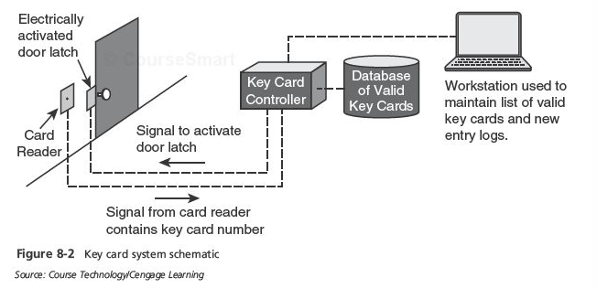
Key Card System

Slide 11
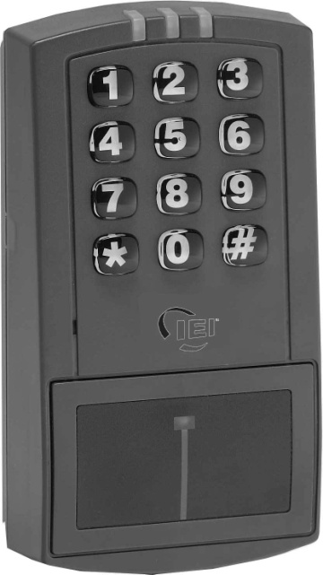
Key cards
  Centralized access control consists of
  card readers, central computer, and electronic door latches
  Pros: Easy to use, provides an audit record, easy to
  change access permissions
  Cons: Can be used by others if lost, people may
  "tailgate"
  Note: Better if combined with a PIN
Photo by IEI Inc.

Slide 12
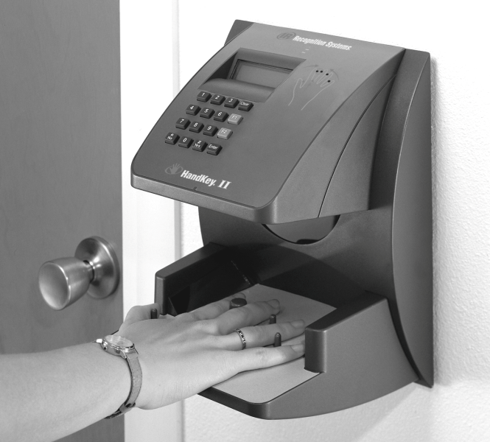
Biometric Access Controls
Based upon a specific biometric measurement
Greater confidence of claimed identity
  Fingerprint, iris scan, retina scan, hand scan, voice, facial recognition, others
More costly than key card alone
Photo by Ingersoll-Rand Corporation

Slide 13
Metal Keys
Pros:
  suitable backup when a key card system fails.
  Uses in limited areas such as cabinets
  Best to use within keycard access areas
Cons
  Easily copied, cannot tell who used a key to enter, many locks can be opened with bump keys

Slide 14
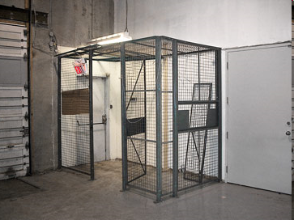
Man Trap
Double doors, where only one can
be opened at a time
Used to control personnel access
Manually operated or automatic
Only room for one person

Slide 15
Guards
Trained personnel with a variety of duties:
  Checking employee identification, handling visitors
  Checking parcels and incoming/outgoing equipment
  Manage deliveries, apprehend suspicious persons
  Call additional security personnel or law enforcement
  Assist persons as needed
  Advantages: flexible, employ judgment, mobile

Slide 16
Guard Dogs
Serve as detective, preventive, and deterrent controls
Apprehend suspects
Detect substances

Slide 17
Access Logs (Log Register)
Record of events e.g.,
  Personnel entrance and exit
  Visitors
  Vehicles
  Packages
  Equipment moved in or out

Slide 18
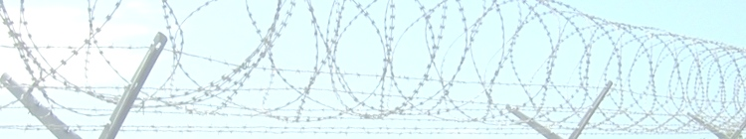
Fences and Walls
Effective preventive and deterrent control
Keep unwanted persons from accessing specific areas
Better when used with motion detectors, alarms, and/or surveillance cameras
Height | Effectiveness
3-4 ft | Deters casual trespassers
6-7 ft | Too difficult to climb easily
8 ft plus 3 strands of barbed or razor wire | Deters determined trespassers

Slide 19
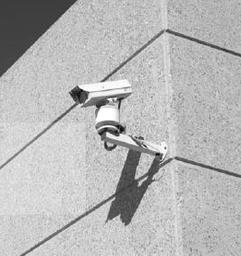
Video Surveillance
Supplements security guards
Provide points of view not easily achieved with guards
Locations (i.e., Where are they placed?)
  Entrances
  Exits
  Loading bays
  Stairwells
  Refuse collection areas

Slide 20
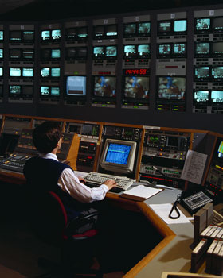
Video Surveillance (cont.)
Camera types
  CCTV, IP wired, IP wireless
  Night vision
  Fixed, Pan / tilt / zoom
  Hidden / disguised
Recording capabilities
  None; motion-activated; periodic still images; continuous

Slide 21
Intrusion, Motion, and Alarm Systems
  Automatic detection of intruders
  Central controller and remote sensors
    Door and window sensors
    Motion sensors
    Glass break sensors
  Alarming and alerting
    Audible alarms
    Alert to central monitoring center or law enforcement

Slide 22
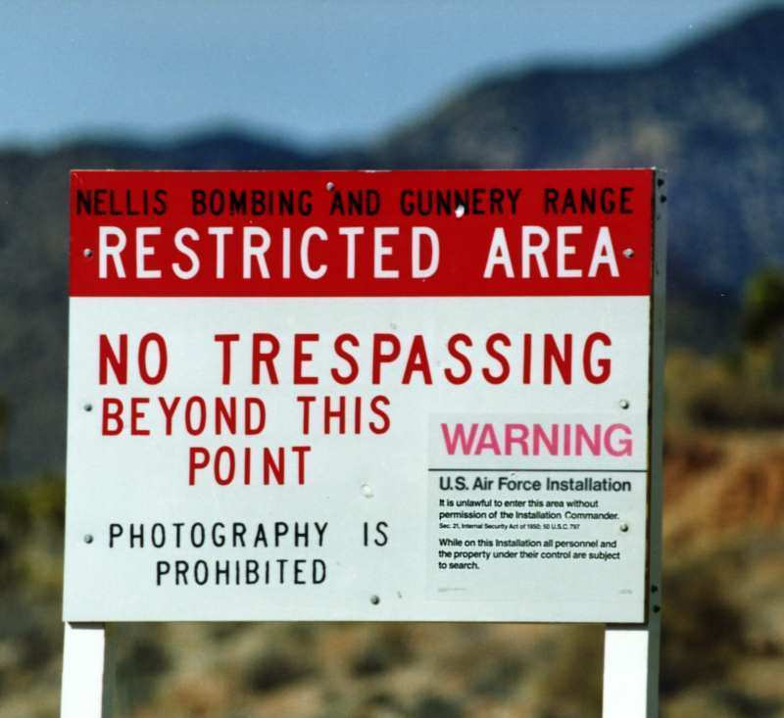
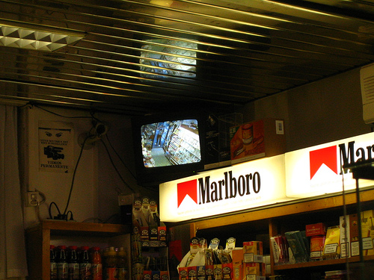
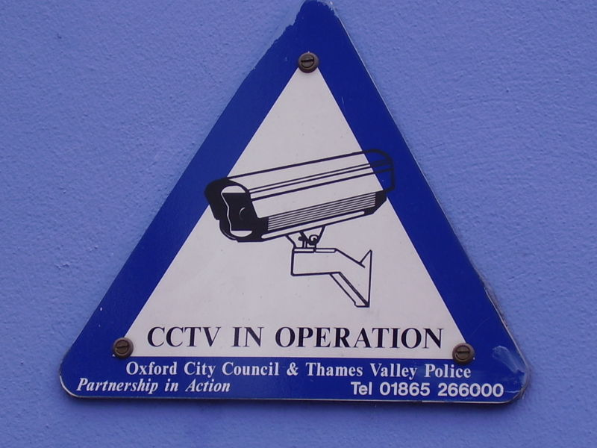
Visible Notices
No Trespassing signs
Surveillance notices
  Sometimes required by law
Surveillance monitors
These are deterrent controls

Slide 23
Exterior Lighting
Discourage intruders during nighttime hours, by lighting intruders’ actions so that others will call authorities
NIST standards require 2 foot-candles of power to a height of 8 ft
Note: This is a deterrent control

Slide 24
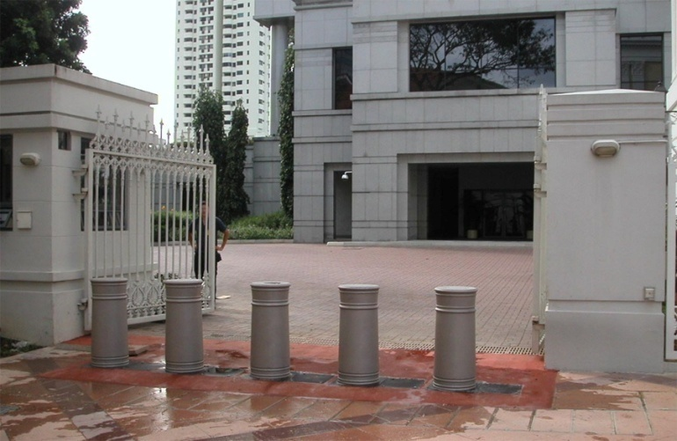
Other Physical Controls
Bollards
Crash gates
  Prevent vehicle entry
  Retractable

Slide 25
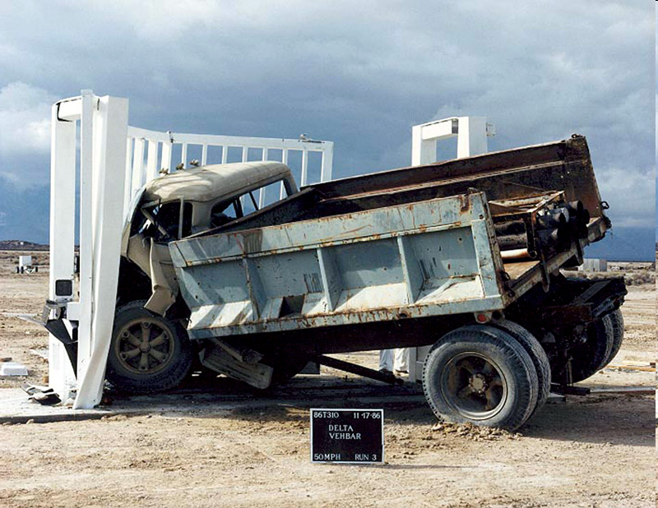
Crash Gates
Some are so strong they can stop a truck at 50 mph

Slide 26
Secure Siting

Slide 27
Secure Siting
Locating a business at a site that is reasonably free from hazards that could threaten ongoing operations
Identify threats
  Natural: flooding, landslides, earthquakes, volcanoes, waves, high tides, severe weather
  Man-made: chemical spills, transportation accidents, utilities, military base, social unrest

Slide 28
Secure Siting (cont.)
Other siting factors
  Building construction techniques and materials
  Building marking
  Loading and unloading areas
  Shared-tenant facilities
  Nearby neighbors

Slide 29
Protection of Equipment

Slide 30
Asset Protection
Laptop computers
  Anti-theft cables
  Defensive software (firewalls, anti-virus, location tracking, destruct-if-stolen)
  Strong authentication such as fingerprint
  Full encryption
  Training

Slide 31
Asset Protection (cont.)
Servers and backup media
  Keep behind locked doors
  Locking cabinets
  Video surveillance
  Off-site storage for backup media
    Secure transportation
    Secure storage

Slide 32
Asset Protection (cont.)
Protection of sensitive documents
  Locked rooms
  Locking, fire-resistant cabinets
  “Clean desk” policy (Reduced chance that a passer-by will see and remove a document containing sensitive information)
  Secure destruction of unneeded documents (e.g., by shredding)
Equipment check-in / check-out
  Keep records of company owned equipment leaving the premises
  Improves accountability
  Recovery of assets upon termination of employment

Slide 33
Asset Protection (cont.)
Damage protection
  Earthquake bracing
    Required in some settings (environment, locales, locality)
    Equipment racks, storage racks, cabinets
  Water detection and drainage
    Alarms

Slide 34
Asset Protection (cont.)
Fire protection
  Fire detection: smoke alarms, pull stations
  Fire extinguishment
    Fire sprinklers
    Inert gas systems
    Fire extinguishers

Slide 35
Sprinkler Systems
Wet pipe - filled with pressurized water
Dry pipe - fills with water only when activated
Deluge - discharges water from all sprinklers when activated
Pre-Action - Dry pipe that converts to a wet pipe when an alarms is
activated
Foam water sprinkler - Uses water and fire-retardant foam
Gaseous fire suppression - displaces oxygen

Slide 36
Asset Protection (cont.)
Cabling security
On-premises
  Place cabling in conduits or away from exposed areas
Off-premises
  Select a different carrier
  Utilize diverse / redundant network routing
  Utilize encryption

Slide 37
  End of Lecture 4
10.20.20

