Slide 1
Ethical & Social Issues in Information Systems
Week 3
Lecture 2
12.03.24

Slide 2
Ethical & Social Issues in Information Systems
What ethical, social, and political issues are raised by Information Systems?
In the past 10 years, we have witnessed, arguably, one of the most ethically challenging periods for U.S. and global business.
Lapses in ethical and business judgment occurred across a broad spectrum of industries.
In today’s new global legal environment, managers who violate the law and are convicted may spend time in prison.
12.03.24

Slide 3
IT standards
Technology Management
The manageability of your technology environment will depend to a large extent on how well you are able to define and adhere to a set of standards.
What requires Standards?
You need to define your standards across the entire IT environment, including
  the different types of Hardware (server, desktop/laptop, storage, network, etc.),
  Software
  Peripherals
  Operating Systems
  Network Protocols
  Development Languages
  Telephony and Conferencing etc

Slide 4
Technology Management
IT standards (Cont’d)
Note:
This will undoubtedly be one of the more challenging efforts you will undertake in transforming your organization.
That said, the resulting impact on the efficiency and effectiveness of your team will make this well worth the effort.
12.03.24

Slide 5
Technology Management
IT standards (Cont’d)
Consequences of not defining or enforcing standards
Disaster (E.g., System Crash or Malfunction)
Not managing the standardization of the user workstation platform can cause havoc when
deploying a new application or an application upgrade.
E.g., Different processor speeds, different memory configurations and disk capacities, as well
as different operating system versions can all cause programs to crash or behave badly.
Security Risk
Different types or levels of software on different machines can cause all sorts of issues.
Issues that may have been corrected on a later version will be present on the older versions.
Security exposures may exist and put the entire organization at risk.
Budgetary Impact
An entity may lose the price advantage of the single large purchase. You will need to
purchase support for a multitude of different pieces of hardware and software, increasing
the overall cost.
12.03.24

Slide 6
Technology Management
IT standards (Cont’d)
Consequences of not defining or enforcing standards
Business related issues
Different Applications being used for the same function in different organizations may appear
to work well at a purely functional level but they may cause more business related issues at a
higher level.
For example, multiple financial systems is the usual CIO’s nightmare. You can almost be
guaranteed that multiple financial systems will result in differences in charts of accounts.
12.03.24

Slide 7
Technology Management
IT standards (Cont’d)
Choosing Standards
In some cases, choosing standards will be a trivial exercise.
A good example might be selecting Microsoft Office as the standard Office productivity platform.
A slightly more difficult issue will be that ongoing quasi-religious war … Apple vs. PC.
Do you select PC only? Apple Only? PC with some Apple in managed deployments
where they are specifically needed (imaging, video, and web design)?
Note:
You can see how this starts getting a bit more complex.
12.03.24

Slide 8
Technology Management
IT standards (Cont’d)
Choosing Standards
We may Group standards into 5 classes thus
  Absolute Standards – E.g., Model of a PC, Browser, Network OS, Server/Database platform
  Non-Standard Standards – Items on the list of supported products e.g., Adobe Photoshop
  Special request Standards – Based on special request by management/customer/vendor
  Don’t care – Have no meaningful impact on operations in the entity
  Not Allowed – E.g., Personal hotspots or connecting a personal wireless router to the network
12.03.24

Slide 9
Technology Management
IT standards … (Cont’d)
Criteria for selecting Standards
    Fitness for purpose
    Adoption by the industry
    Percent of the organization that will need this
    Criticality of the item to the business
    Reliability
    Manageability
    Scalability
    Skill set requirements
    Outside Support Availability
    Ease of upgrade or migration to the standard
    Level of Customization Required
12.03.24

Slide 10
Technology Management
Standard Operating Procedures
The need for defined and documented Standard Operating Procedures cannot be overstated. You will undoubtedly find this to be one of the more challenging aspects of managing an IT organization.
The place of POLICIES
IT Policies must flexibly address an ever changing technology landscape, and therefore must be reviewed and updated at least on an annual basis.
If you happen to work in an industry that is required to comply with various Federal regulations and International Standards, (such as Sarbanes-Oxley, COBIT, ITIL,ISO 27000, ISO 2000 etc), a comprehensive set of well defined policies is a requirement.
12.03.24

Slide 11
Technology Management
Standard Operating Procedures … (Cont’d)
Benefits/Purpose of IT Policies
Beyond the regulator aspect, IT Policies are essential to:
  Successfully managing your IT environment
  They will define what types of hardware and software can be used in the organization
  The processes for adding or removing users, adding accounts
  The acceptable use of company assets
  How to report security incidents etc
12.03.24

Slide 12
Technology Management
Standard Operating Procedures … (Cont’d)
Typical set of POLICIES an Organization must create
    Acceptable User of Information Technology Resources Policy
    Desktop Computer Standards Policy (IT Infrastructure Standards)
    Software License Compliance Policy
    EMAIL Use Policy
    Cell Phone Policy
    Password Policy
    Internet Use Policy
    Bring Your Own Device (BYOD) Policy
    Mobile Security Policy
    Mobile Data Synchronization Policy
    Wireless Network Policy
    Technology Incident Notification and Escalation Procedure
    IT Security Incident Reporting Policy
    IT Security Standards and Policy
12.03.24

Slide 13
Technology Management
Standard Operating Procedures … (Cont’d)
Typical set of POLICIES an Organization must create
    Information Privacy Policy
    New Equipment Request Procedure
    New Employee Setup Procedure
    Employee Termination Procedure
    EMAIL Account Request Form
    Change Management Procedure
    Data Center Access Policy
    Equipment Disposal Policy
    Records Management and Retention Policy
    Software Installation Request Procedure
    Event and Media Support Request Form
    Interactive Video Room Scheduling and Support Procedure
    Macintosh Support Procedures
    Inventory Control Procedure
12.03.24

Slide 14
Technology Management
Standard Operating Procedures … (Cont’d)
Points to note
  As a first step, a check of what IT policies that already exists in an entity is mandatory
  If any IT policies exist, then when they were written and last updated and
  When and how they have been communicated to the staff.
  Suggestion/Hint:
If you find your organization has few documented policies you can purchase IT Policy template packages from a number of sources.
12.03.24

Slide 15
Technology Management
Communicating and Enforcing IT Standards & Policies
Quick Facts
  Standards and Policies are worthless without the proper enforcement.
  You need to be able to deliver a rational and articulate argument on why the standards and policies are in place and why they need to be enforced.
  That said, you will need a commonsense approach to making exceptions.
  There will be circumstances when someone cannot do their job without utilizing a piece of technology that is not on your standards list. You should include a process for vetting the reasons why people are asking for a standard or policy exception and receiving the proper approvals to get that exception.
  .
12.03.24

Slide 16
Technology Management
Communicating and Enforcing IT Standards & Policies
Steps to follow in Enforcing Standards
    Get approval of Senior IT and Management & communicate to staff & customers
    Document standards and Policies
    Document reasons behind the standards
    Provide for periodic re-distribution & communication of standards (Always with a confirmation feedback)
    Ensure standards are updated periodically
    Apply a ‘common sense’ approach to approving standards
12.03.24

Slide 17
Technology Management
Service Level Agreements (SLAs)
A Service Level Agreement (SLA) is the service contract component between a service provider and customer. A SLA provides specific and measurable aspects related to service offerings. E.g., SLAs are often included in signed agreements between ISPs and customers.
Features of SLAs
SLA features include:
  Specific details and scope of provided services, including priorities and guarantees
  Specific, expected and measurable services at minimum or target levels
  Informal or legally binding
  Descriptive tracking and reporting guidelines
  Detailed problem management procedures
  Detailed fees and expenses
  Customer duties and responsibilities
  Disaster recovery procedures
  Agreement termination clauses
12.03.24

Slide 18
Technology Management
Service Level Agreements (SLAs)
Types of SLAs
SLA types include:
  Services TO YOU from Equipment vendors and other service providers
    Equipment vendors will provide guarantees for such items as Time to Respond, Time to Repair/Resolution, time to provide replacement parts, etc.
    A Data Center colocation site will provide guarantees around such items as power and cooling availability, temperature range, humidity range, etc
  b) Services FROM YOU to your customers
    This group of SLAs is more important for you to fully understand and to focus on meeting or exceeding them (Service level)
    The SLA to your users is the definition of what services and service levels they can expect from you.
    At one level this is defined to manage the expectations of your user community.
12.03.24

Slide 19
Technology Management
Service Level Agreements (SLAs)
    Benefits of SLAs
    The SLA provides a bar that can deflect undue criticism.
    The SLA also is used to define to your technical staff what the minimum acceptable performance is for the things that they do.
    Setting a reasonable SLA allows the business to manage the tradeoff between cost and speed.
    It reduces the level of uncertainty the customer has with the process.
12.03.24

Slide 20
Technology Management
IT Asset Management
    IT asset management (ITAM) is the set of business practices that join financial, contractual and inventory functions to support life cycle management and strategic decision making for the IT environment.
    Assets include all elements of software and hardware that are found in the business environment.
IT asset management (also called IT inventory management) usually involves gathering detailed hardware and software inventory information which is then used to make decisions about hardware and software purchases and redistribution.
12.03.24

Slide 21
Technology Management
IT Asset Management … (Cont’d)
Questions an Asset Management system should be able to answer
  How many of each type of device do I have deployed across the enterprise?
  How many are deployed by site?
  What is the cost of all of the assets I have deployed?
  What is their current value?
  What is the lease expiration date of each of the leased assets?
  How many copies of each type of software do I have deployed across the enterprise?
  How many licenses do I own for each type of software?
  What is the function that each device I have deployed is performing in the environment?
  For example, if the device is a server, what application or applications reside on the box?
  How many virtualized servers do I have in my environment?
  What operating system resides on each device in the environment?
  What is the serial number of the asset deployed at each location (extra credit)
12.03.24

Slide 22
Technology Management
IT Asset Management … (Cont’d)
Asset Management is a Collection of Processes
Implementing Asset Management can be accomplished in a variety of ways, but it comes
down to Tools and Processes.
From a process standpoint, Asset Management is focused in three areas:
  Physical Inventory of Devices
  Contracts and Finance
  Software Compliance
12.03.24

Slide 23
Technology Management
IT Asset Management … (Cont’d)
  Physical Inventory of Devices
  A precise inventory is almost a foundational requirement onto which other management processes are built.
  This is about capturing the basics:
    What assets are on hand
    Where they reside and who owns them
    It’s about maintaining an accurate, up-to-date view of deployed hardware and software assets, so that at any time you can see an “actual state” of the components that comprise your infrastructure.
12.03.24

Slide 24
Technology Management
IT Asset Management … (Cont’d)
  (b) Contracts and Finance
  This involves Costs control and reduction
  This layer allows you to control IT spend, optimize purchasing strategies, as well as laying the foundation for Software Compliance Management.
  This component of the IT Asset Management process is what distinguishes it from a simple inventory system.
  When Contracts and Finance information is added to the database, you are positioned to manage the assets from initial purchase through decommissioning and disposal.
12.03.24

Slide 25
Technology Management
IT Asset Management … (Cont’d)
  (c) Software Compliance
  Software Compliance layer enables the organization to respond to an audit, control the licensing position, and avoid uncontrolled costs.
  This layer also enables Software License Management which includes the full capability around purchasing and deployment strategies to actually reduce the overall spend on expensive IT software.
12.03.24

Slide 26
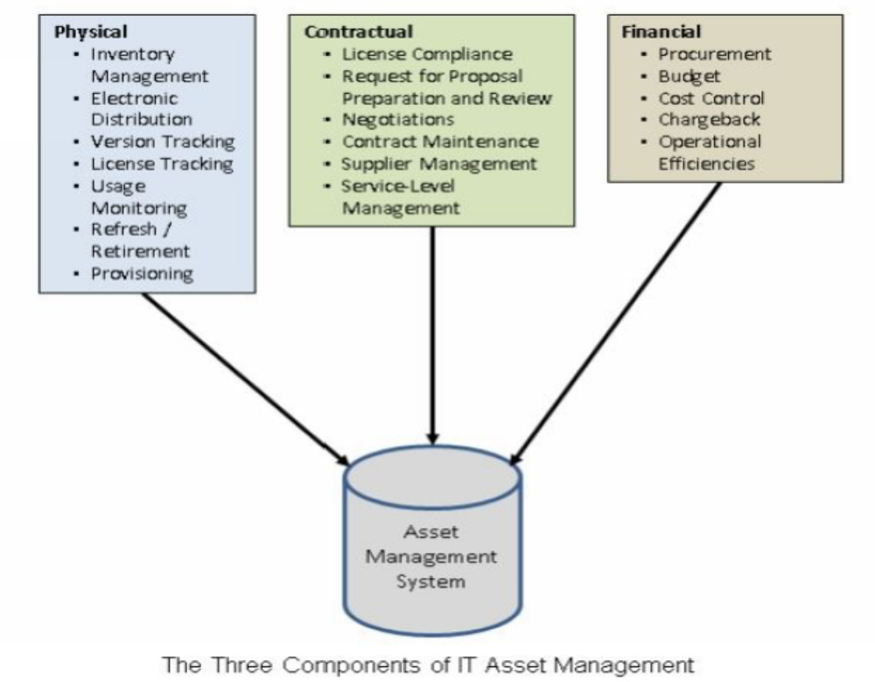
Technology Management
IT Asset Management … (Cont’d)
12.03.24

Slide 27
Technology Management
Best practices for Asset Management
  Have a Process Owner
  Ensure Stakeholder Alignment
  Establish IT Asset Management project milestones
  Set specific operational and financial goals
  Standardize on hardware configurations and software license titles
  Conduct internal audits
12.03.24

Slide 28
Technology Management
Best practices for Asset Management … (Cont’d)
  Good Inventory Practices Start With An Accurate Baseline
(A baseline identifies in ITAM which assets need to be redeployed, reused or retired.)
    Doing a physical baseline is a first necessary step to make sure you have all connected and non-connected IT assets in your repository.
    Perform an automated inventory first, which you will validate during the physical Inventory. In this fashion you only need to manually add the items that were not captured during the automated sweep.
  Go deep and then go Wide
    A winning strategy for companies is the start of an inventory practice around one asset class, such as servers. This way, you can put processes in place to capture and reconcile the detail you need and test the processes though regularly scheduled updates to ensure they are thorough and yield the right results.
12.03.24

Slide 29
Technology Management
Best practices for Asset Management … (Cont’d)
  Have a Process Owner
    Inventory management needs a single process owner who can consider the needs and requirements from all stakeholders and assure accountability throughout the entire process.
  Ensure Stakeholder Alignment
    Going beyond stakeholders in IT operations, IT Asset Management has stakeholders in contracts, procurement, finance and compliance. Because each department is involved in discrete parts of the IT Asset Management lifecycle, defining cross-departmental processes upfront helps meet multiple goals.
  Establish IT Asset Management project milestones
    Best practices call for setting project milestones for process definition, software implementation, integrations, training, testing and rollout.
12.03.24

Slide 30
Technology Management
Best practices for Asset Management … (Cont’d)
  Set specific operational and financial goals
    Most IT Organizations initiate IT Asset Management projects to gain specific, measurable results in three areas: (a) Cost control (b) Risk mitigation and (c) Service level improvement.
    You must set specific operational and financial goals to show incremental progress against each of these.
    Defining, collecting and communicating a comprehensive set of metrics around IT budget impact assessments, service quality levels and decreased risk of compliance irregularities attributable to the IT Asset Management process will demonstrate the impact.
12.03.24

Slide 31
Technology Management
Best practices for Asset Management … (Cont’d)
  Standardize on hardware configurations and software license titles
    Instituting standardized configurations means selecting fewer hardware configurations and software titles, which enables significant volume purchase leverage and also reduces the burden on the service desk and End User Support.
  Conduct internal audits
    Regularly review asset management practices to ensure cross-functional processes are supported by automation as much as possible.
    Regular physical audit of asset inventory of Computers in University of The Gambia for example, will lead to early detection of theft of PCs from the Computer Labs.
12.03.24

Slide 32
Technology Management
  End of Lecture 2
12.03.24

