Slide 1

C “CULTURE”
Course instructor: Bambo bayo

Slide 2
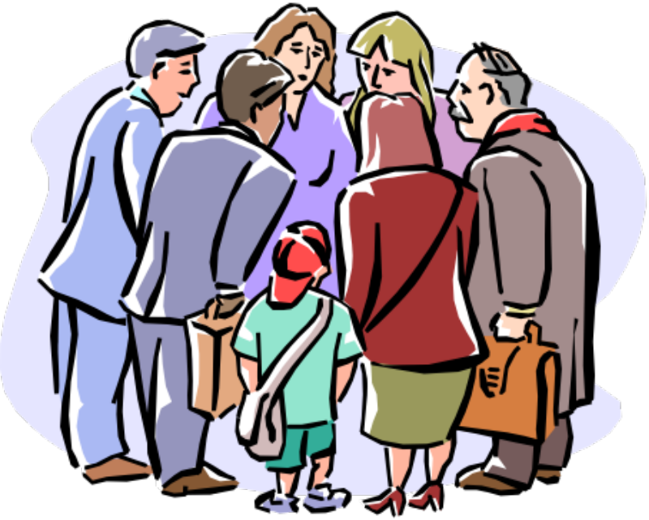
Contents:
Components of Culture
Interaction of People and Environment
Culture Hearths
The Structure of Culture
Culture Change
Contact between Regions

Slide 3
Culture:
British anthropologist Edward Tylor.
“That complex whole which includes knowledge, belief, art, morals, law, custom and any other capabilities and habits acquired by man as a member of society”.
According to J.P. Lederach,
“Culture is the shared knowledge and schemes created by a set of people for perceiving, interpreting, expressing, and responding to the social realities around them”.

Slide 4
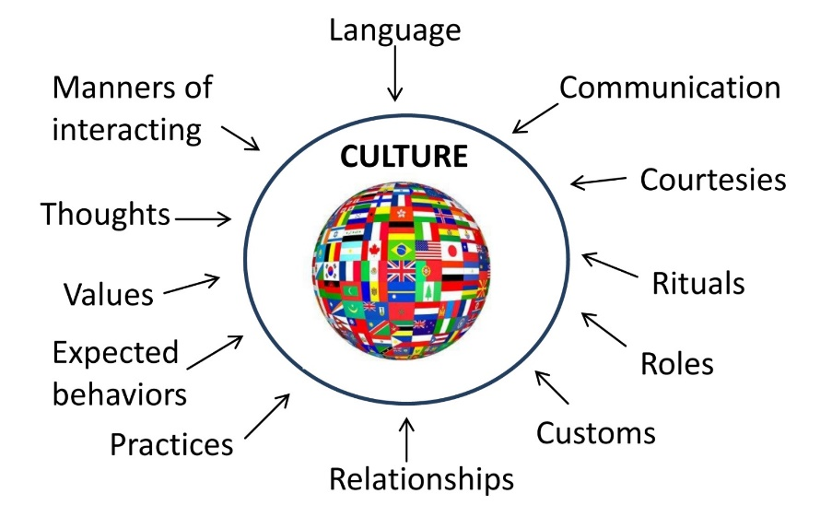

Slide 5
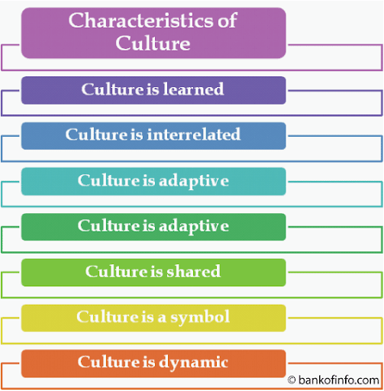
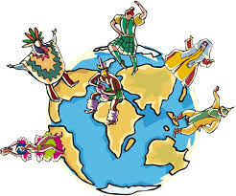

Slide 6
Two Aspects of Culture
According to Ellwood, culture is of two types viz. material and non-material culture.
Material Culture
Non-Material Culture

Slide 7
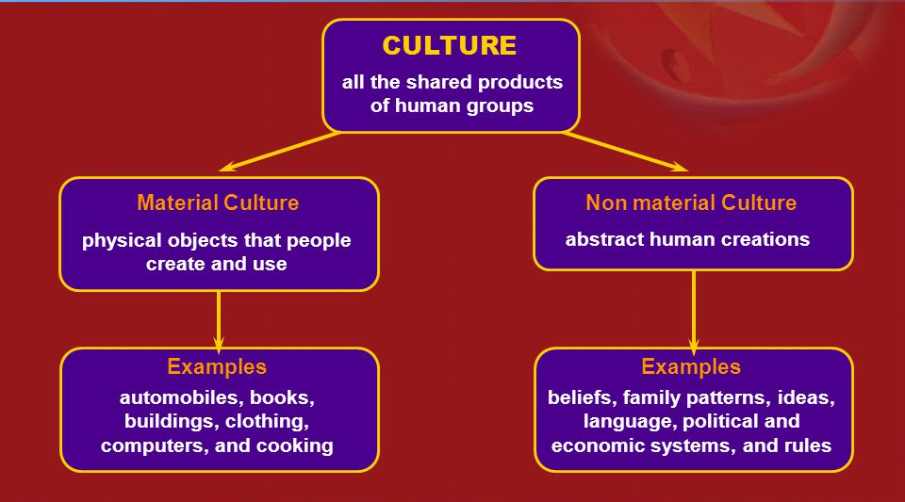

Slide 8
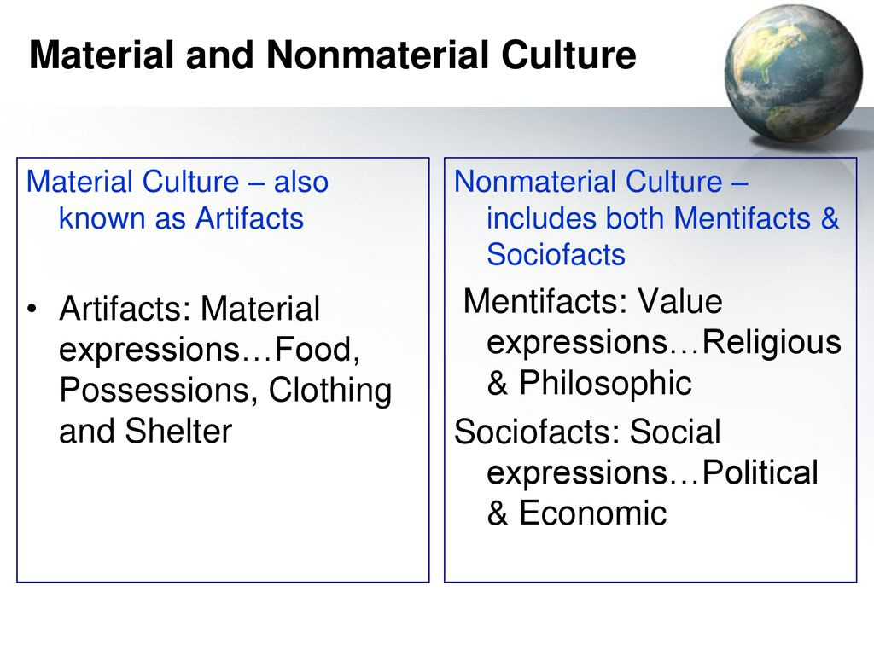
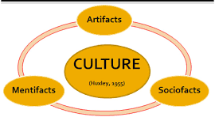

Slide 9
Artifacts (Material based)
An artifact is an object made by a human being. Artifacts include art, tools, and clothing made by people of any time and place.
The term can also be used to refer to the remains of an object, such as a shard of broken pottery or glassware.
Artifacts are immensely useful to scholars who want to learn about a culture.

Slide 10
Example
Artifacts have provided essential clues about life in ancient Egypt.
The tomb of King Tut is perhaps the most famous. In 1922, British archaeologist Howard Carter came upon the tomb of the Egyptian Pharaoh known as King Tut.
King Tut’s tomb had been undisturbed since he was buried around 1323 B.C.E. The tomb also included more than 5,000 artifacts, including perfumes and oils, jewelry, statues, and even toys from Tut’s childhood. Carter led a team of archaeologists in cataloging the items from King Tut’s tomb. This work took the archaeologists over a decade, but the artifacts continue to help historians better understand life in Egypt during the era of King Tut.

Slide 11
Socio facts
The sociological subsystem of a culture is the sum of the expected and accepted patterns of interpersonal relations that find their outlet in economic, political, military, religious, kinship: and other associations. These socio facts define the social organization of a culture.
They regulate how the individual functions relative to the group, whether it be family, church, or state.

Slide 12
Mentifacts
The ideological subsystem consists of ideas, beliefs, and knowledge of a culture and of the ways in which these things are expressed in speech or other forms of communication.
Mythologies and theologies, legend, literature, philosophy, and folk wisdom make up this category. Passed on from generation to generation, these abstract belief systems, or mentifacts, tell us what we ought to believe, what we should value, and how we ought to act. Beliefs form the basis of the socialization process. Often we know-or think we know-what the beliefs of a group are from their oral or written statements.

Slide 13
Components (structure) of Culture
Culture Traits
Culture Complex
Culture Region
Culture Realm
Globalization
Small
Large

Slide 14
Structure of Culture
Cultural Traits
Smallest item of culture-building block of culture.
Learned behavior ranging from language spoken to tools to games.
They can be objects, techniques, beliefs, or attitudes.
Cultural Complex
Individual cultural traits that are functionally interrelated.
Examples include: religious complexes, business behavior complexes, sports complexes.

Slide 15
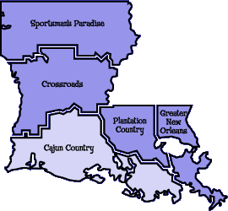
Culture Regions
Culture traits and complexes have areal (spatial) extent.
Used to show the spatial extent of similar cultural areas.
Regions can be of three types
Formal Region
Functional Region
Vernacular Region

Slide 16
Cultural Change
Culture Change
Acculturation
Assimilation
Syncretism
Transculturation

Slide 17
Acculturation
Acculturation typically involves a host culture and a minority culture.
Acculturation is the process of the minority culture adopting some of the values, customs, or behaviors of the host culture.
The host culture is the larger group into which the minority culture moved.
For example, immigrants may adopt the language and maybe several other customs of their host group, but they still may retain many of the distinctive customs and traditions of their culture. A good example would be a Somali living in the United States who speaks English in America but Somali to his friends and from Somalia.

Slide 18
Assimilation
A group can lose part of its culture when the immigrants become totally integrated into the host culture.
In this case, the dominant culture completely absorbs the less dominant one. This process is called assimilation.
Picking up new ideas about a culture might include learning how to prepare food, learning what types of acceptable clothing is worn, or adopting new habits.
A person who fully assimilates has picked up all the habits and attributes of their non-native culture. In a global context, assimilation can be benign when the host country incorporates immigrant minorities into their host societies, which is the case in the United States.

Slide 19
Syncretism
Syncretism is the birth of a new culture trait from blending two or more culture characteristics. These changes lead to a wide range of differences, including languages and religions.
A good example of syncretism comes from Japan with the blending of religious practices of the Buddhist and Shinto. This syncretic religion is known as Shin-Buddhist co practice.

Slide 20
Transculturation
The concept of transculturation is different than acculturation because in transculturation there is an equal exchange, or two-way flow, of traits between two cultural groups. For example, Buddhism originated in India, but diffused throughout Eastern Asia and interacted with Confucianism. Transculturation occurred because both religions were strong and Buddhism and Confucianism remained in place to influence large populations throughout East Asia.

Slide 21
Local Culture
A group of people in a particular place who see themselves as a collective or a community, who share experiences, customs and traits, and who work to preserve those traits and customs in order to claim uniqueness and to distinguish themselves from others. Local culture is also called folk culture popular culture.
Folk culture, is small , incorporates homogenous population, typically rural, and is cohesive in rural traits.
Examples???
Popular culture is large, incorporates heterogenous population, is typically urban, and experiences quickly change cultural traits.
Examples???
Members of rural and urban cultures, who preserve their cultural traits better and why?

Slide 22
Cultural Landscape
The impact of cultural ideas and beliefs on the physical environment.
Observing cultural landscapes helps geographers understand the culture of a place.
It includes cultural attributes such as buildings, theaters, and places of worship.
The cultural landscape is the imprint humans place on their environment.

Slide 23
Conclusions
Advances in transportation and communication technology helped popular cultures to diffuse easily around the world today
Popular cultures change quickly offering new music, food, fashion and sports
They evolve and infiltrate local cultures thereby causing challenges for their members
Customs from local cultures are often commodified, propelling them into popular cultures.
The search for “authentic” local culture custom generally results in promoting stereotype local culture and glorification of a single aspect of that local culture.
Both local and popular cultures are dynamic and pursuit of authenticity disregards the complexity and fluidity of cultures.

