Slide 1
SCHOOL OF INFORMATION AND COMMUNICATION TECHNOLOGY
DATABASE

Slide 2
What is Database ?
The Database is an essential part of our life. As we encounter several activities that involve our interaction with databases, for example in the bank, in the railway station, in school, in a grocery store, etc. These are the instances where we need to store a large amount of data in one place and fetch these data easily.
A database is a collection of data that is organized, which is also called structured data. It can be accessed or stored in a computer system.
It can be managed through a Database Management System (DBMS), a software used to manage data.

Slide 3
Database
Data: statistics it is raw and unprocessed . ex- name , class , marks etc.
Information: when data is processed . ” record is also information “. example – pass or fail table etc.
Database : an organized collection of data and information or interrelated data collected at one place.
DBMS: Collection of interrelated data and set of program to access data example – MySql, Oracle, Sybase, MongoDB, Informix, PostgreSQL, SQL Server, Microsoft Access, Dbase, SQLite, MariaDB, LibreOffice Base etc.
Application : Company Information , Account information, manufacturing, banking ,finance transactions, telecommunications.

Slide 4
database
In a database, data is organized into tables consisting of rows and columns and it is indexed so data can be updated, expanded, and deleted easily.
There are different kinds of databases, ranging from the most prevalent approach, the relational database, to a distributed database, cloud database, and NoSQL databases.

Slide 5
Relational Database:
A relational database is made up of a set of tables with data that fits into a predefined category.

Slide 6
Distributed Database:
A distributed database is a database in which portions of the database are stored in multiple physical locations, and in which processing is dispersed or replicated among different points in a network.

Slide 7
Cloud Database:
A cloud database is a database that typically runs on a cloud computing platform. Database service provides access to the database. Database services make the underlying software-stack transparent to the user.

Slide 8
DBMS
Database management system is software that is used to manage the database.
Database management system is a software which is used to manage the database. For example: MySQL, Oracle, etc are a very popular commercial database which is used in different applications.
Our DBMS will includes all topics of DBMS such as introduction, ER model, keys, relational model, join operation, SQL, functional dependency, transaction, concurrency control, etc.

Slide 9
DBMS
DBMS provides an interface to perform various operations like database creation, storing data in it, updating data, creating a table in the database and a lot more.
It provides protection and security to the database. In the case of multiple users, it also maintains data consistency.

Slide 10
DBMS allows users the following tasks:
Data Definition: It is used for creation, modification, and removal of definition that defines the organization of data in the database.
Data Updating: It is used for the insertion, modification, and deletion of the actual data in the database.
Data Retrieval: It is used to retrieve the data from the database which can be used by applications for various purposes.
User Administration: It is used for registering and monitoring users, maintain data integrity, enforcing data security, dealing with concurrency control, monitoring performance and recovering information corrupted by unexpected failure.

Slide 11
Characteristics of DBMS
It uses a digital repository established on a server to store and manage the information.
It can provide a clear and logical view of the process that manipulates data.
DBMS contains automatic backup and recovery procedures.
It contains ACID properties which maintain data in a healthy state in case of failure.
It can reduce the complex relationship between data.
It is used to support manipulation and processing of data.
It is used to provide security of data.
It can view the database from different viewpoints according to the requirements of the user.

Slide 12
Advantages of DBMS
Controls database redundancy
Data sharing
Easily Maintenance
Reduce time
Backup
multiple user interface

Slide 13
Disadvantages of DBMS
Cost of Hardware and Software
Size
Complexity
Higher impact of failure

Slide 14
Applications of Database Management System
How a Database Management System (DBMS) is used in various sectors with applications like :
Banking
Manufacturing
Finance
Universities
Airlines

Slide 15
Structured Query Language (SQL)
SQL or Structured Query Language is used to operate on the data stored in a database. SQL depends on relational algebra and tuple relational calculus.

Slide 16
Evolution of Databases
The database has completed more than 50 years of journey of its evolution from flat-file system to relational and objects relational systems. It has gone through several generations

Slide 17
The Evolution
File-Based
  introduced in 1968.
  data was maintained in a flat file.
  It requires extensive programming in a third-generation language such as COBOL, BASIC.

Slide 18
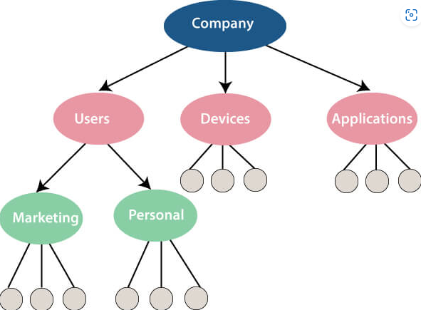
Hierarchical Data Model
Prominent hierarchical database model was IBM's first DBMS. It was called IMS (Information Management System).
In this model, files are related in a parent/child manner.

Slide 19
Network data model
Network data model by Charles Bachman
It was developed in the early 1960s, but it was standardized in 1971 by the CODASYL group (Conference on Data Systems Languages).

Slide 20
Network data model identified the following components:
Network schema (Database organization)
Sub-schema (views of database per user)
Data management language (procedural)
This model also had some limitations like system complexity and difficult to design and maintain.

Slide 21
Relational Database
In 1970, the relational model was proposed by E.F. Codd.
Relational database model has two main terminologies called instance and schema.
  The instance is a table with rows or columns
  Schema specifies the structure like name of the relation, type of each column and name.

Slide 22
Cloud database
Cloud database facilitates you to store, manage, and retrieve their structured, unstructured data via a cloud platform.
This data is accessible over the Internet.
Cloud databases are also called a database as service (DBaaS) because they are offered as a managed service.

Slide 23
Cloud database
Some best cloud options are:
AWS (Amazon Web Services)
Snowflake Computing
Oracle Database Cloud Services
Microsoft SQL server
Google cloud spanner

Slide 24
Cloud database
Advantages of cloud database
Lower costs
Automated- recovery, failover, auto-scaling etc
Increased accessibility

Slide 25
NoSQL Database
NoSQL stands for "not only SQL." It is an alternative to traditional relational databases in which data is placed in tables, and data schema is perfectly designed before the database is built.
Some examples of NoSQL database system with their category are:
  MongoDB, CouchDB, Cloudant (Document-based)
  Memcached, Redis, Coherence (key-value store)
  HBase, Big Table, Accumulo (Tabular)

Slide 26
NoSQL Database
Advantage of NoSQL
High Scalability
High Availability
Disadvantage of NoSQL
Open source
Management challenge
GUI is not available
Backup

Slide 27
The Object-Oriented Databases
Object-oriented databases hold the rules of object-oriented programming. An object-oriented database management system is a hybrid application
Object-oriented programming properties
  Objects
  Classes
  Inheritance
  Polymorphism
  Encapsulation

Slide 28
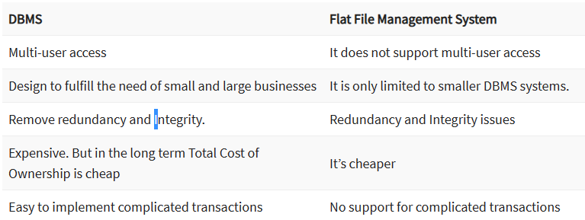
DBMS vs. Flat File

Slide 29
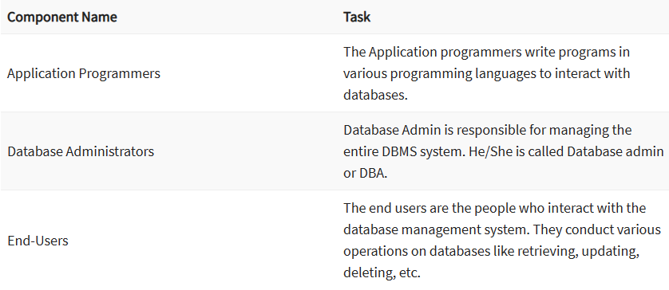
Users of DBMS

