Slide 1
Introduction to computing and IS
ICT 102

Slide 2
String Processing
String processing refers to the operations performed on strings that allow them to be accessed, analyzed, and updated.

Slide 3
String-Applicable Sequence Operations
Strings (unlike lists) are immutable.
Thus, sequence-modifying operations are not applicable to strings.
For instance, one cannot add, delete, or replace characters of a string.

Slide 4
String-Applicable Sequence Operations
All string operations that “modify” a string return a new string that is a modified version of the original string.
Some of sequence operations relevant to string processing are:
Select concatenation
Length Membership
Slice Minimum value
Count Maximum Value
Index Comparison

Slide 5
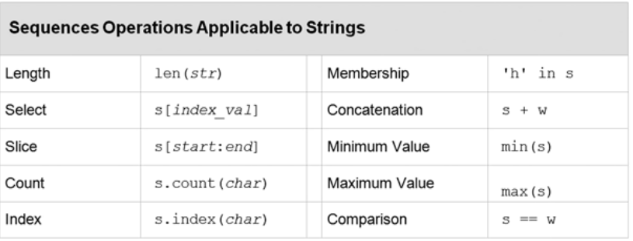

String-Applicable Sequence Operations

Slide 6
String-Applicable Sequence Operations
Slice operator s[start:end]
s[start:end] returns the substring starting with index start, up to but not including index end.
s.index(chr) returns the index of the first occurrence of chr in s
min and max return the smallest (largest) character based on the underlying Unicode encoding.
For instance, all lowercase letters are larger (have a larger Unicode value) than all uppercase letters

Slide 7
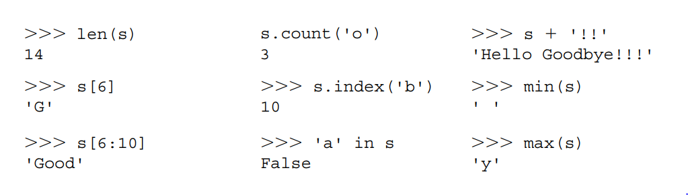
String-Applicable Sequence Operations
operations for s = 'Hello Goodbye!'

Slide 8
Conclusion
Because strings are immutable, sequence modifying operations do not modify the string they applied to.
Rather, they construct new strings that are a modified version of the original.

Slide 9
String Methods
There are a number of methods specific to strings in addition to the general sequence operations.
Checking the Contents of a String
Searching the Contents of a String
Replacing the Contents of a String
Removing the Contents of a String

Slide 10
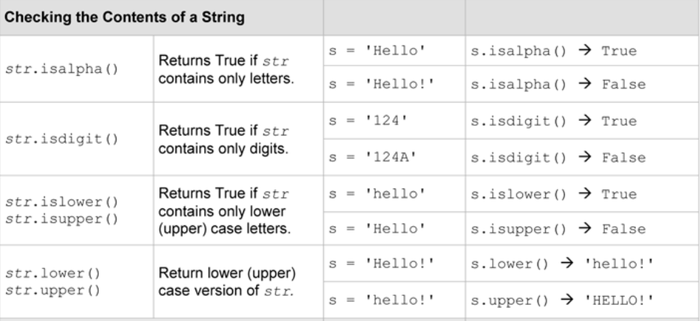

Slide 11
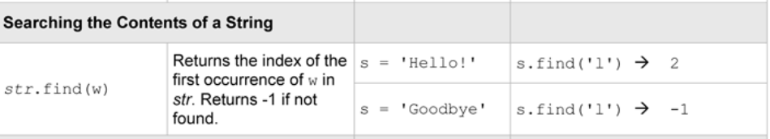
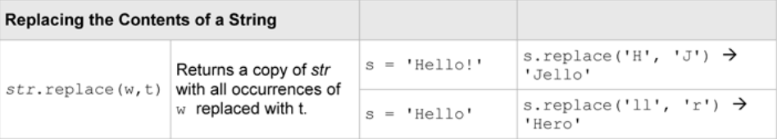

Slide 12
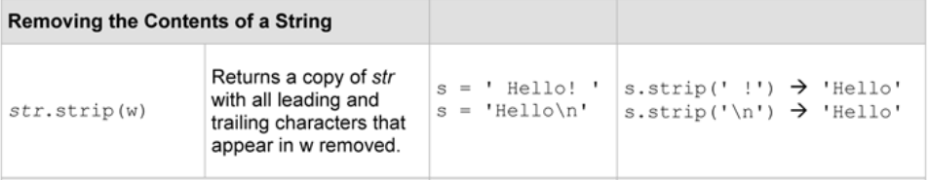

Slide 13
Checking the Contents of a String
There are times when the individual characters in a string (or substring) needs to be checked.
For instance to check whether a character is an appropriate denotation of a musical note.

Slide 14

Checking the Contents of a String
Since the in operator can also be applied to strings, it can also do the following:
char in 'ABCDEFGHIJKLMNOPQRSTUVWXYZ'

Slide 15
Checking the Contents of a String
A similar approach for determining if a given character is an Lowercase/Uppercase.
  Determining uppercase
  If char not in 'ABCDEFGHIJKLMNOPQRSTUVWXYZ':
  print (‘the character is not in uppercase’)
  Determining Lowercase
  if char not in 'abcdefghijklmnopqrstuvwxyz‘:
  print (‘the character is not in lowercase’)

Slide 16

Checking the Contents of a String
If char not in '0123456789‘:
print (‘invalid input’)
Checking for uppercase/lowercase and digit characters is common in programming.
Thus, string methods isalpha, isdigit, isupper, and islower, etc. are been provided.
For instance, to perform error checking on an entered credit card number.

Slide 17

Checking the Contents of a String
The method isdigit returns True if and only if each character in string credit_card is a digit.
If only part of a string is to be checked, then a method can be applied to a slice of a string
For instance, if the part numbers of a given company all begin with three letters.

Slide 18
Checking the Contents of a String
isalpha returns True if and only if the first three characters in part_num are letters.

Slide 19
Checking the Contents of a String
There are a number of methods specific to strings, in addition to the general sequence operations.

Slide 20
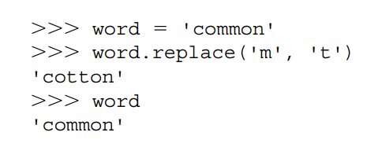
Searching and Modifying Strings
The find method returns the index location of the first occurrence of a specified substring.
The replace method produces a new string with every occurrence of a given substring within the original string replaced with another

Slide 21
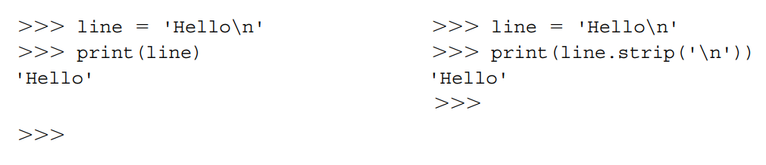
Searching and Modifying Strings
Note that for all string modifications, the variable references the same string until it is reassigned.
Strip method “strips off” characters leading and trailing a string.

Slide 22
Searching and Modifying Strings
The find, replace, and strip methods can be used to search and produce modified string

Slide 23
Exception Handling
Various error messages can occur when executing programs.
Such errors are called exceptions
these errors are handled by reporting them on the screen.
Exceptions can be “caught” and “handled” by a program to:
1- correct the error and continue execution
2- terminate the program

Slide 24
What Is an Exception?
An exception is a value (object) that is raised (“thrown”) signalling that an unexpected, or “exceptional,” situation has occurred.
There are a predefined set of exceptions referred to as standard exceptions

Slide 25
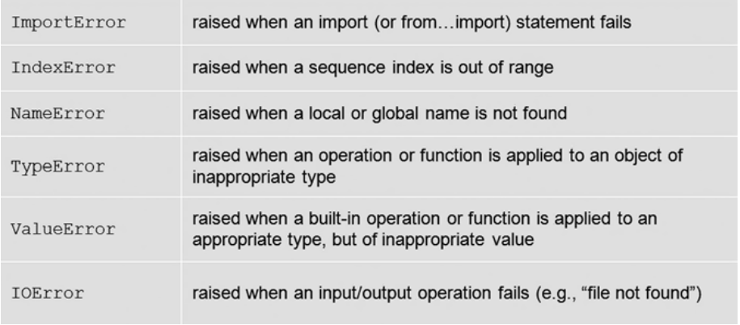
What Is an Exception?

Slide 26
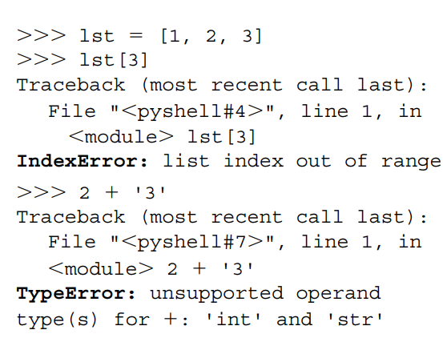
What Is an Exception?

Slide 27
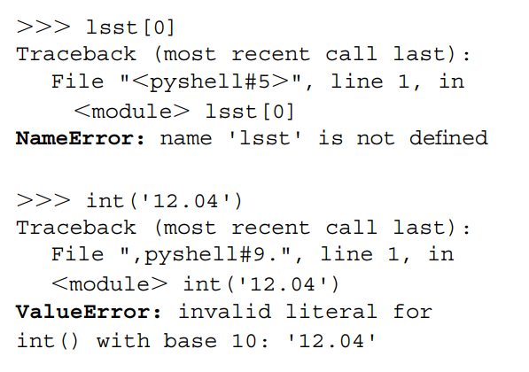
What Is an Exception?

Slide 28
What Is an Exception?
Raising an exception is a way for a function to inform its client a problem has occurred that the function itself cannot handle.
suppose a function called getYN prompts a user to enter
'y' or 'n'.
If the user enters something other than these two values, the function can simply instruct the user to re-enter.

Slide 29
What Is an Exception?
If a function called isEven is to be passed a numeric value, but is passed a string instead, it cannot correct the problem.
It can only notify the client of the problem, leaving it up to the client to determine what to do.

Slide 30
Conclusion
An exception is a value (object) that is “raised” by a function signalling that an unexpected, or “exceptional,” situation has occurred that the function itself cannot handle.

Slide 31
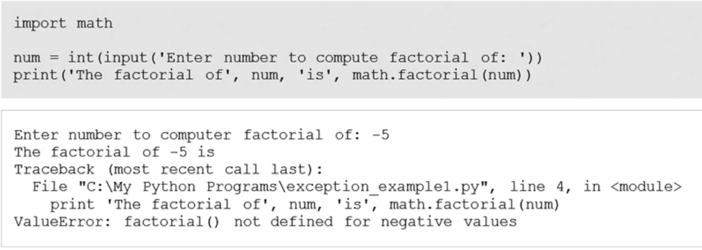
Catching and Handling Exceptions
Many of the functions in the Standard Library raise exceptions.
For example, the factorial function of the math module raises a ValueError exception when a negative value is passed to it

Slide 32
Catching and Handling Exceptions
When -5 is passed to the factorial function, an exception is raised, thrown back to the client code to catch and handle.
The client code (here, the code in the main module) does not attempt to catch the exception.
The exception is caught by the interpreter, causing the program to terminate and display an error message indicating the exception type.

Slide 33
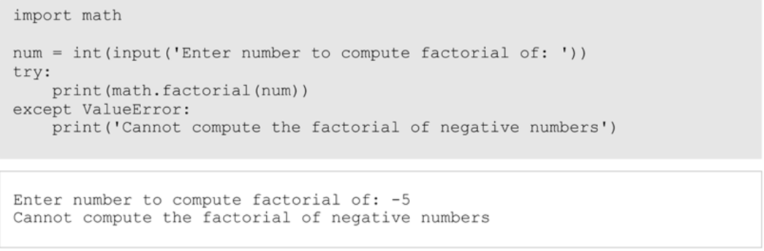
Catching and Handling Exceptions
The last line of the message indicates that a ValueError exception occurred within the factorial function.

