Slide 1
Introduction to computing science and IS
ICT 102

Slide 2
Lists

Slide 3
Fundamental Concepts
A list is a linear data structure, meaning that its elements have a linear ordering.
That is, there is a first element, a second element, and so on.
Each item in the list is identified by its index value.

Slide 4
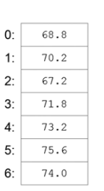
List
The location at index 0 stores the temperature for Sunday.
The location at index 1 stores the temperature for Monday, and so on.
The Figure illustrates a list storing the average temperature for each day of a given week.

Slide 5
Conclusion
A list is a linear data structure, thus its elements have a linear ordering.

Slide 6
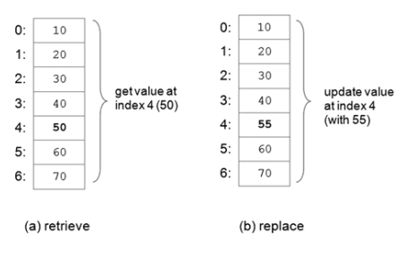
List Operations
Operations usually executed on lists consist of retrieve, update, insert, delete (remove) and append.

Slide 7
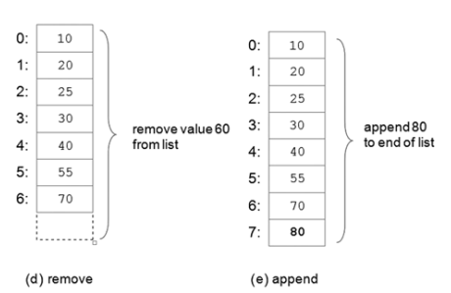
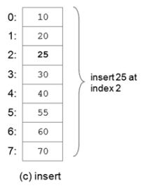
List Operations

Slide 8
List Operations
(a) Retrieves elements of a list by index value.
the value 50 is retrieved at index 4.
(b) Updates the current value at index 4, 50, with 55.
(c) Inserts the new value 25 at index 2.
  Shifting down all elements below that point and lengthening the list by one.
(d) The remove operation deletes the element at index 6.
  Shifting up all elements below that point and shortening the list by one.

Slide 9
List Operations
(e) adds a new value, 80, to the end of the list.
Operations commonly performed on lists include retrieve, update, insert, remove, and append.

Slide 10
List Traversal
A list traversal is a means of accessing, one-by-one, the elements of a list.
For instance to add up all the elements in a list of integers
To find a particular value in a list

Slide 11
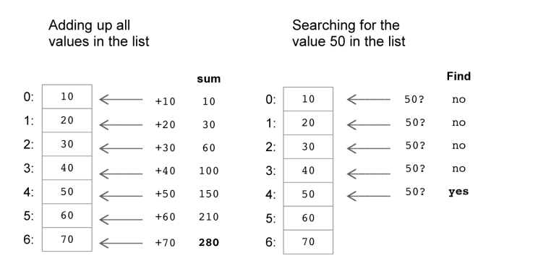
List Traversal

Slide 12
List Traversal
list traversal is a means of accessing, one-by-one, the elements of a list.

Slide 13
Lists
List Type
A list is a mutable, linear data structure of variable length, allowing mixed-type elements.
Mutable means that the contents of the list may be changed
Lists use zero based indexing.
all lists have index values 0 ... n-1.
Lists are denoted by a comma-separated list of elements within square brackets
[1, 2, 3] ['one', 'two', 'three'] ['apples', 50, True]

Slide 14
List Type
An empty list is denoted by an empty pair of square brackets, [].
Elements of a list are accessed by using an index value within square brackets.
Lst = [1, 2, 3]
lst [0] ➝ 1 access of first element
lst [1] ➝ 2 access of second element
lst [2] ➝ 3 access of third element

Slide 15
List Type
print(lst[0]) prints the first element of list lst
sum = lst [0] + lst [1] + lst [2]
Elements of a list can be updated (replaced) or deleted (removed).
lst = [1, 2, 3]
lst [2] = 4 [1, 2, 4] replacement of 3 with 4 at index 2
del lst [2] [1, 2] removal of 4 at index 2
Methods insert and append also provide a means of altering a list
lst.insert (1, 3) [1, 3, 2] insertion of 3 at index 1
lst.append (4) [1, 3, 2, 4] appending of 4 to end of list
Methods sort and reverse reorder the elements of a given list

Slide 16
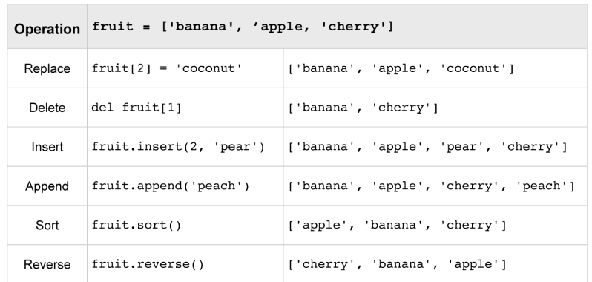
methods sort and reverse reorder the elements of a given list

Slide 17
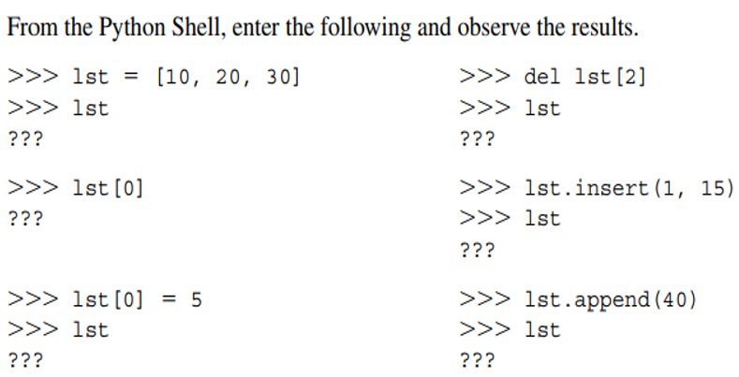
Homework

Slide 18
Conclusion
A List is mutable linear data structure, denoted by a comma-separated list of elements within square brackets, allowing mixed-type elements.

Slide 19
Tuples
A tuple is an immutable linear data structure
Cannot be altered
Tuples are denoted by parentheses instead of square brackets.
nums = (10, 20, 30)
student = ('John Smith', 48, 'Computer Science', 3.42)
If not the parenthesized element will not be made into a tuple

Slide 20
Tuples
An empty tuple is symbolize by a set of empty parentheses, ()
The elements of tuples are accessed the same as lists, with square brackets
nums = (10, 20, 30)
nums[0]
10
student 5 ('John Smith', 48, 'Computer Science', 3.42)
student[0]
'John Smith'

Slide 21
Tuples
Any effort to modify a tuple is unacceptable
delete, update, insert, and append operations are not defined on tuples
Tuples are used when the information to represent should not be altered

Slide 22
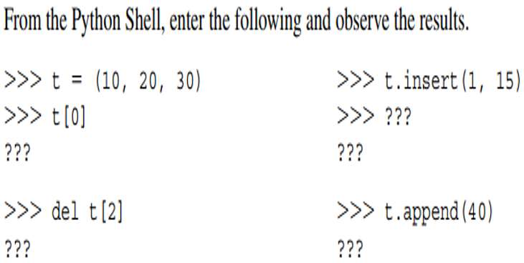
Homework

Slide 23
Tuples
A tuple is an immutable linear data structure, denoted by a comma-separated list of elements within parentheses, allowing mixed-type elements.

Slide 24
Sequences
A sequence is a linearly ordered set of elements accessed by an index number.
Lists, tuples, and strings are every single one sequences.
Strings, similar to tuples, are immutable.
Sequence s, len (s)gives its length
s[k] retrieves the element at index k
s[index1:index2], returns a subsequence of a sequence

Slide 25
Sequences
s[index:] returns a string containing all the list elements starting from the given index location to the end of the sequence.
Count method returns how many instances of a given value occur within a sequence

Slide 26
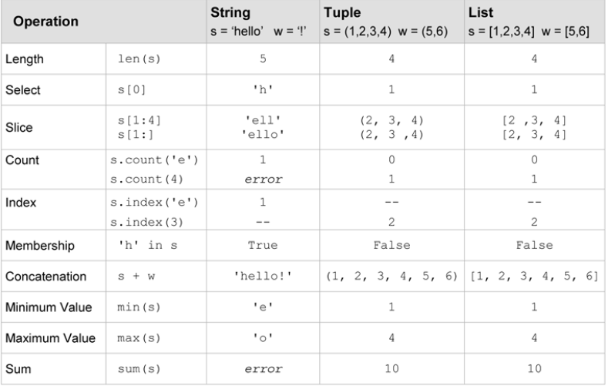

Slide 27
Sequences
+ operator is used to denote concatenation.
+, is referred to as an overloaded operator
  addition and concatenation
Addition is performed when both operands are numeric
Concatenation is performed when both operands are sequence types
Mix of numeric and sequence operands displays an error

Slide 28
Sequences
min/max return the smallest/largest value of a sequence.
sum returns the sum of all the elements (numeric type)
==, returns True if the two sequences have the same length, and their subsequent elements are equivalent to each other.

Slide 29
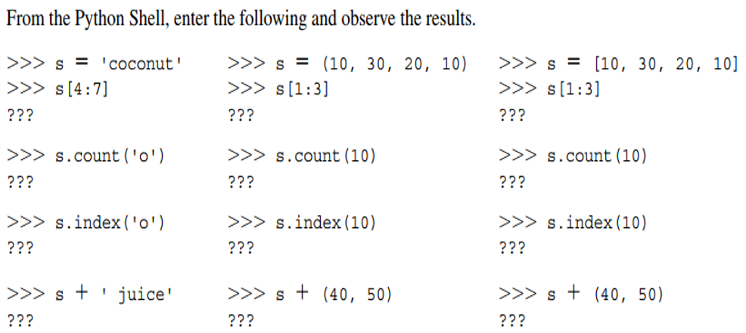
Homework

Slide 30
Sequences
A sequence is a linearly ordered set of elements accessed by index value.
Lists, tuples, and strings are sequence types

Slide 31
Nested Lists
lists and tuples can be nested to generate randomly compound data structures.
For instance grades for each student
class_grades = [ [85, 91, 89], [78, 81, 86], [62, 75, 77], ...]
class_grades[0] will generate [85, 91, 89]
class_grades[1] will generate [78, 81, 86]

Slide 32
Nested Lists
First grades of the first student can be accessed.
student1_grades = class_grades[0]
student1_exam1 = student1_grades[0]
Intermediate variables student1_grades and student1_exam1 were not necessary.
It can be accessed straightforwardly.
class_grades[0][0] ➝ [85, 91, 89][0] ➝ 85

Slide 33
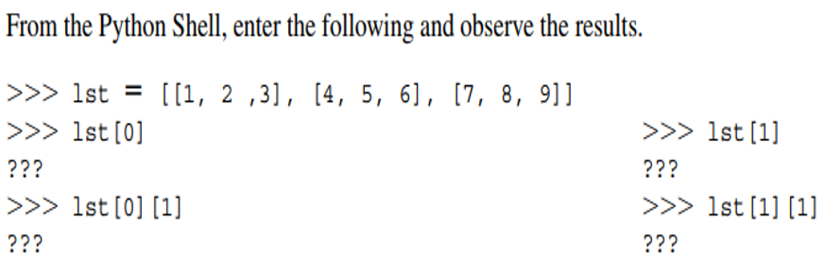
Homework

Slide 34
Conclusion
Lists and tuples can be nested within each other to construct arbitrarily complex data structures.

Slide 35
Functions

Slide 36
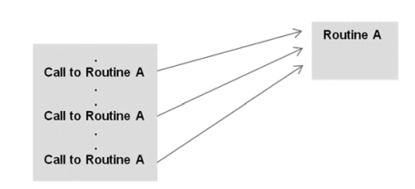
Fundamental Concepts
Function Routine
A routine is a named collection of instructions performing some assignment.
It can be invoked (called) lots of times as required in a given program.

Slide 37
Function Routine
As soon as a routine ends, execution automatically returns to the point from which it was called.
Routines may possibly be predefined, or designed and implemented.
A function is a version of a program routine.
A function may return a value or may be intended for other purposes.

Slide 38
Conclusion
A program routine is a named group of instructions that accomplishes some task
A routine may be invoked (called) as many times as needed in a given program.
A function is version of a program routine.

Slide 39
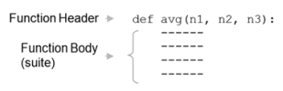
Defining Functions
It is possible to define new functions in addition to predefined function .
Such type of functions can be general or specific to a certain program

Slide 40
Defining Functions
A function header starts with the keyword def, followed by an identifier (avg).
  (avg) is the function’s name.
(n1, n2, n3) is a collection of identifiers called parameters.
The body (program block) contains the function’s instructions.
The number of items in a parameter list indicates the number of values that must be passed to the function.
The values passed are known as arguments

Slide 41
Defining Functions
Variables are num1, num2, and num3
num1 = 10
num2 = 25
num3 = 16
avg (num1,num2,num3)
Normally, functions are defined at the peak of a program
Functions must be defined before it is called.

Slide 42
Defining Functions
Actual arguments, or simply “arguments,” are the values passed to functions to be operated on.
Formal parameters, or simply “parameters,” are the “placeholder” names for the arguments passed.

Slide 43
Value-Returning Functions
A value-returning function is a program routine called for its return value
For instance the mathematical function f(x) = 2x
“x” stands for any numeric value that function f may be applied to.
f(2) = 2x = 4
Similarly, avg takes three arguments (n1, n2, and n3) and returns the average
Function call avg(10, 25, 16) is an expression that evaluates to the returned function value

Slide 44
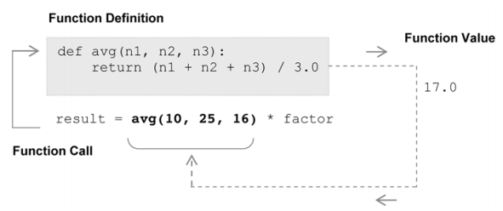
Value-Returning Functions

Slide 45
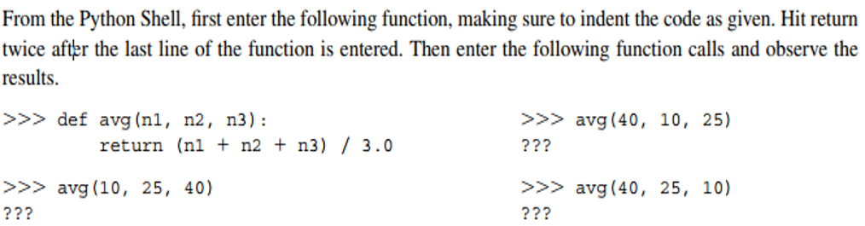
Homework

Slide 46
Conclusion
A value-returning function is a program routine called for its return value, and is therefore similar to a mathematical function

Slide 47
Non-Value-Returning Functions
Called not for a returned value, but for its side effects
Side effect is an action other than returning a function value
For instance, displaying output on the screen
Different from value-returning function
Call to value-returning function is an expression while non-value-returning is a statement

Slide 48
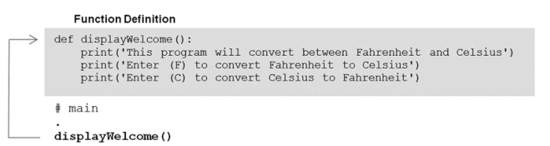
displayWelcome is called only for the side-effect of the screen output produced.

Slide 49
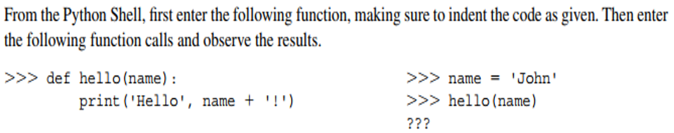
Homework

Slide 50
Conclusion
A non-value-returning function is a function called for its side effects, and not for a returned function value.

Slide 51
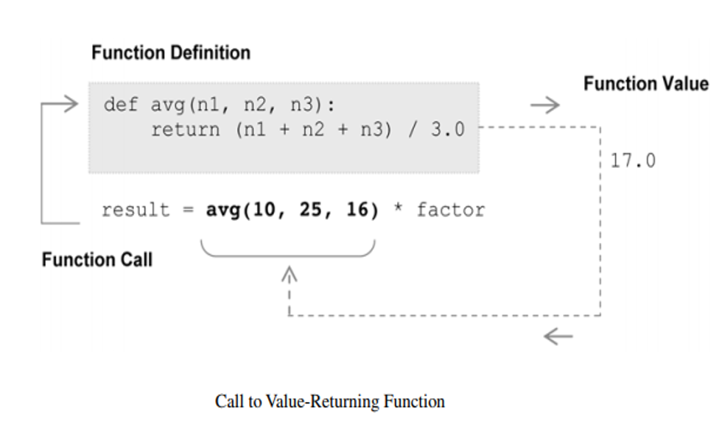
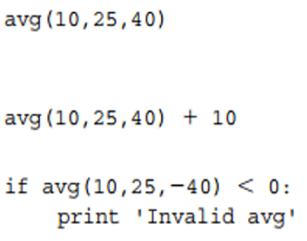
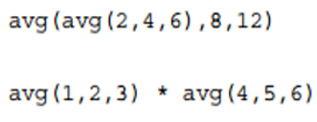
Calling Value-Returning Functions
Value-returning functions can be call anywhere that a function’s return value is appropriate

Slide 52
Calling Non-Value-Returning Functions
Non-value-returning functions are called not for a return value but for a side effects.
Function calls like that are statements.
Can be utilised anywhere that an executable statement is allowed.
displayWelcome()
The function call like this cannot be called expression because no important value is returned.
Value none is returned
welcome_displayed = displayWelcome()

Slide 53
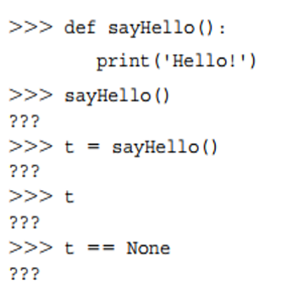
Calling Non-Value-Returning Functions
Function calls to non-value-returning functions can be used anywhere that an executable statement is allowed.

Slide 54
Variable Scope
Local Scope and Local Variables
A local variable is a variable that is only accessible from within a given function.
Variables of such are said to have local scope
Variable assigned a value in a function becomes a local variable of the function.

Slide 55
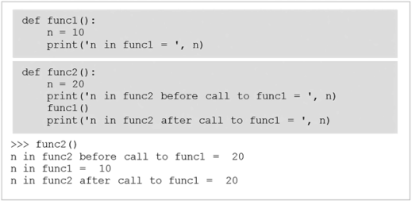
Variable Scope
Local Scope and Local Variables
Defining Local Variables

Slide 56
Local Scope and Local Variables
func1 and func2 contain identifier n
func1 assigns n to 10
func2 assigns n to 20
Both functions display the value of n when called
func2 displays the value of n both before and after its call to func1
The value of n remains 20 after the call to func1.

Slide 57
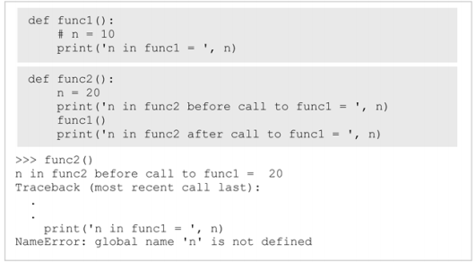

Slide 58
Local Scope and Local Variables
An error indicating that variable n is not defined within func1
Variable n defined in func2 is inaccessible from func1
n is expected to be a global variable

Slide 59
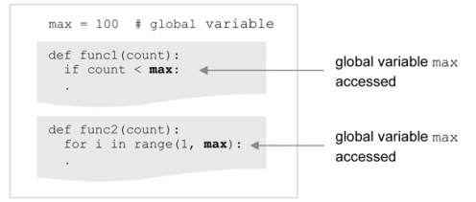
Global Variables and Global Scope
A variable that is defined external of any function definition
A global scope variable
max is defined outside func1 and func2 and it makes it “global” to each
Both functions can directly access it.

Slide 60
Global Variables and Global Scope
A global variable is a variable defined outside of any function definition.
Such variables are said to have global scope.

