Slide 1
WRITING PROCESS
INTRODUCTION

Slide 2
Writing is a form of communication. It is a means people communicate message(s) to achieve a certain purpose(s). Writing also serves other important role for those who bother engage in it.

Slide 3
Enables them to discover and learn new things:-start with the known and connect to new ideas and information.
It enables them to think and consolidate their ideas and experience, and reflect on these.
It enables them to produce and share knowledge.
It enables them to participate in important critical issues in the society and the world.

Slide 4
People write for different purposes:
to express themselves—expressive writing;
to inform others—informative writing;
to persuade others—persuasive writing, or
to express their creative imagination—literary writing.

Slide 5
“Writing is really writing – making the story better, clearer, truer.”
-Robert Lipsyte
“Writing is the most powerful means of discovery available to all of us throughout life.”
-Peter Stillman

Slide 6
Writing is not trying to figure out everything you want to say before you put pen to paper or figures to the keyboard. Working in this way will result in having very little to say, or worse yet, having nothing to say at all.
Writing almost always works best when it springs from the discoveries you make during the writing process (writing is discovering).
(C.f. A student handbook for writing and learning, 2001)

Slide 7
Writing situation
Writing situation for any writing activity are important questions on the following:
Topic: what topic will you be writing about?
Purpose: what is the purpose of writing?
Audience: who is your special audience?
Special requirements: how much time is required to complete the task? What length of time is allowed?

Slide 8
Organisation methods
Every writing activity must follow a certain organisation pattern. Your paragraphs have to follow a consistent:
Chronological order—according to time
Spatial order (order of location)
Order of importance
Cause and effect
Compare and contrast

Slide 9
Organisation methods cont.
Classification
Problem solution
Illustration
Climax

Slide 10
Stages in the writing process
There are three main stages in the writing process:
Stage 1: Prewriting:
—choosing and narrowing topic,
-shaping (brainstorm)—listing, organising your ideas and material; clustering; freewriting .

Slide 11
Stages in the writing process
Stage 2: planning outline
-Drafting outline
Organise your ideas/material into paragraphs
-identify and write topic sentences of possible paragraphs
-do essay outline

Slide 12
Stages in writing process
Stage 3: writing and revising draft
-writing first draft
-revising first draft
-rewriting second draft
-revising second draft
-proofreading second draft
-writing final copy

Slide 13
Stage 1
specific writing about assignments with specific given subjects are already limited.
On the other hand, when you are given a free choice of topics and you choose to write about something you are interested in, then you must narrow the topic to a particular aspect of that general subject.

Slide 14
Cont.
Suppose you are interested in the environment.
narrow the topic to perhaps environmental pollution if that is your interest.
you might even further narrow the topic to a type of environmental pollution, such as pollution of the oceans.
ocean pollution is still too broad because it would include pollution by oil. chemicals, sewage. and garbage.

Slide 15
Cont.
you might decide to write about oil as a source of ocean pollution.
you might make this topic even narrower by writing only about the effects of oil spills on sea life.
The point is, you must narrow the subject to a specific focus so that you can write about it clearly and completely.

Slide 16
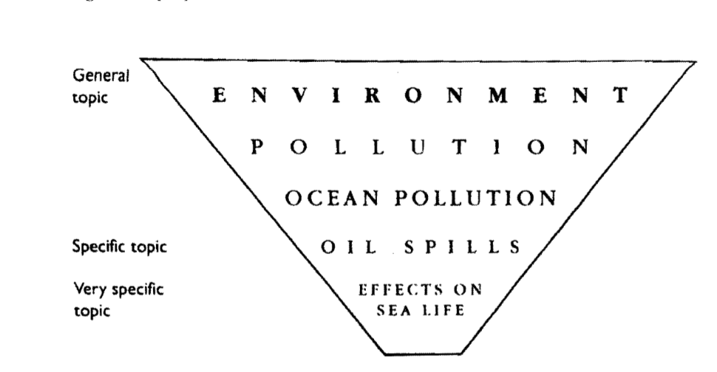
Cont.

Slide 17
Brainstorming
the next prewriting step is to generate ideas.
Three useful brainstorming techniques are listing, free writing, and clustering.
listing is a brainstorming technique in which you think about your topic and quickly make a list of whatever words or phrases come into your mind.
Your purpose is to produce as many ideas as possible in a short time, and your goal is to find a specific focus for your topic.

Slide 18
Cont.
Write down the general topic at the top of your paper.
make a list of every idea that comes into your mind about that topic.
Keep the ideas flowing, stay on the' general topic; however, if you write down information that is completely off the topic, don't worry you can cross it out later.
Use words, phrases. or sentences, and don't worry about spelling or grammar.

Slide 19
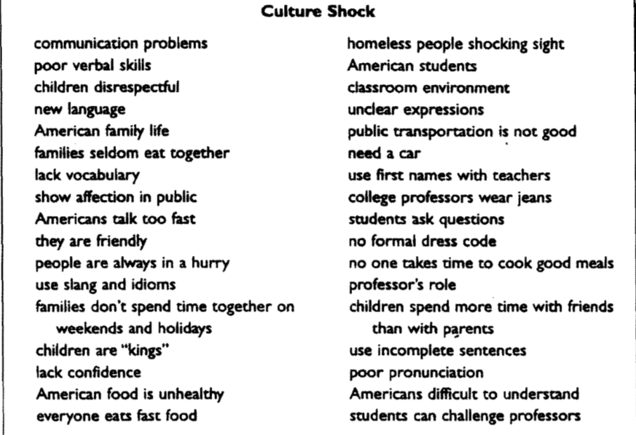
Brainstorming

Slide 20
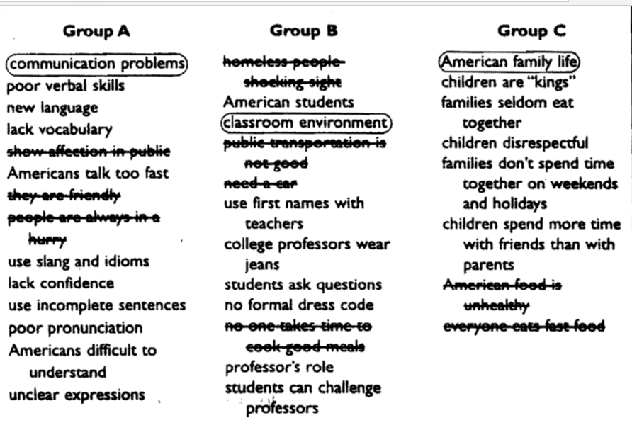
rewrite list, group similar ideas together, Cross out items that don't belong or that are duplications

Slide 21
freewriting
Free writing is a brainstorming activity
you write freely about a topic because you are looking for a specific focus.
the purpose of free writing is to generate as many ideas as possible
to write them down without worrying about appropriateness. grammar, spelling, logic, or organization.

Slide 22
Freewriting cont
Write the topic at the top of your paper.
Write as much as you can about the topic until you run out of ideas. Include such supporting items as facts, details, and examples that come into your mind about the subject.
if you run out of ideas, reread your paper and circle the main idea(s) that you would like to develop.
Take that main idea and free write again.

Slide 23
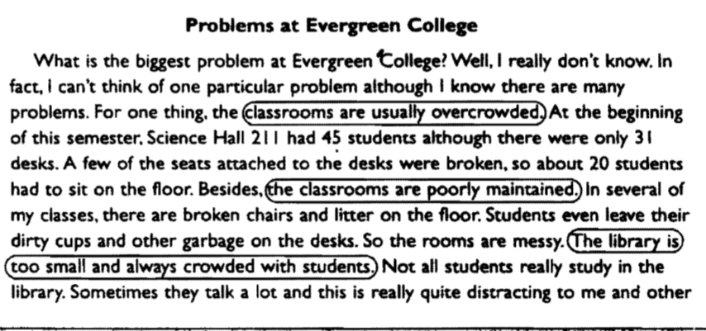
Freewriting cont.

Slide 24
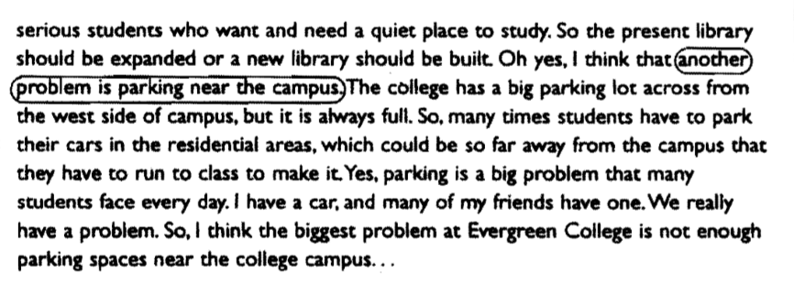
Freewriting cont.

Slide 25
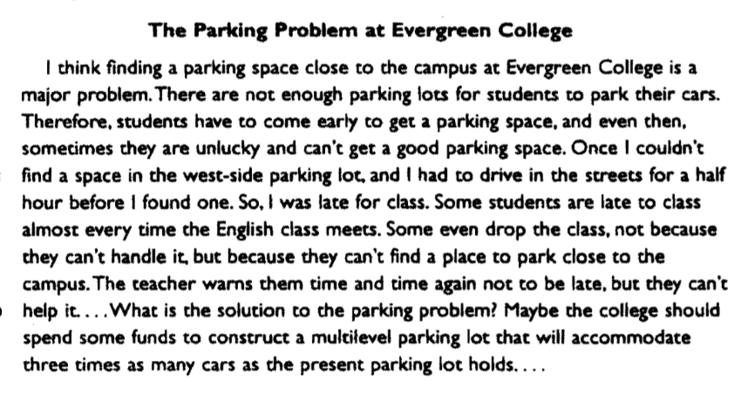
Freewriting cont.

Slide 26
clustering
Clustering is another brainstorming activity that you can use to generate ideas
In the center of your paper, write your topic and draw a "balloon" around it. This is your center, or core, balloon, Then write whatever ideas come to you in balloons around the core.
Think about each of these ideas and make more balloons around them.

Slide 27
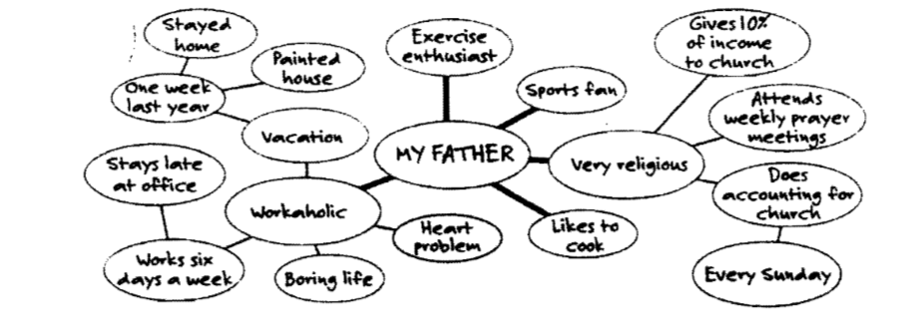
Clustering cont.

Slide 28
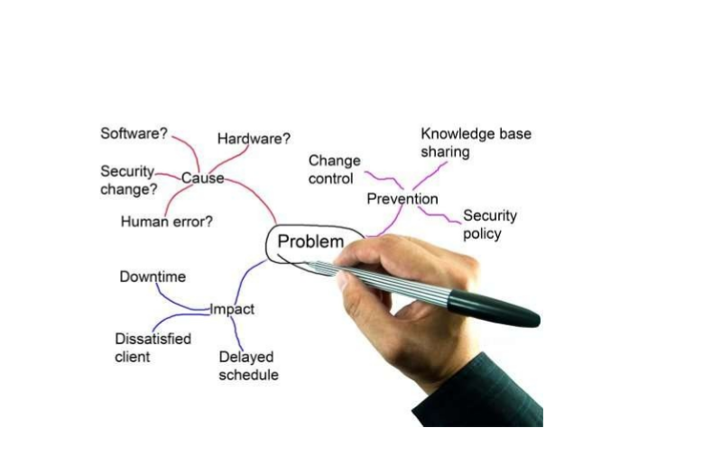
Clustering cont.

Slide 29
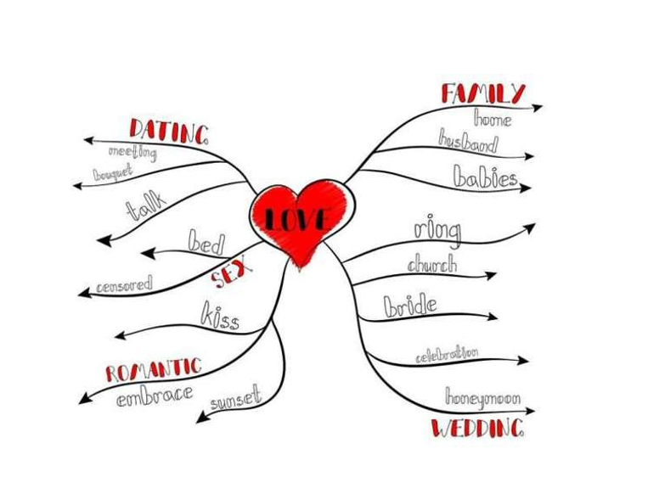
clustering

Slide 30
Stage 2: planning outline culture shock model
Using the culture shock model as example
divide the ideas in the "communication problems" list further into sublists; cross out any items that don't belong or that aren't useable.

Slide 31
Communication Problems
Poor verbal skill"
use incomplete sentences
New language
lack vocabulary
Lack confidence

Slide 32
2.Americans difficult to understand
unclear expressions
poor pronunciation
Americans talk too fast
use slang and idioms

Slide 33
Preliminary outline
Communication Problems
A. poor verbal skills
-lack vocabulary
-poor pronunciation
B. Americans difficult to understand
-use incomplete sentences
-use unclear expressions ~
-talk too fast
-use slang and idioms

Slide 34
Topic sentence
One problem that many international students face in the United States is communication with Americans.
or
International students in the United States face communication problems with Americans.

Slide 35
Topic sentence
International students in the United States face communication problems with Americans.
A. International students have poor verbal skills.
I. lack vocabulary
2. have poor pronunciation
B. Americans are difficult to understand.
I. use incomplete sentences
2. use unclear expressions
3. talk too fast
4. use slang and idioms

Slide 36
The Writing Process, Stage III: Writing and Revising Drafts
Step 1: Writing the First Rough Draft
Write down the topic sentence and underline it.
Skip one or two lines per line of writing and leave margins of one inch on both sides of the paper.
add comments such as "define," "check spelling," "add an example," etc in the margins for your attention later on.
Write your paragraph, following your outline

Slide 37
Step 3: Revising Content and Organization
Check to see that you have achieved your stated purpose.
• Check for general logic and coherence. Your audience should be able to follow your ideas easily and understand what you have written.
• Check to make sure that your paragraph has a topic sentence and that the topic sentence has a central (main) focus. :
• Check for unity. Cross out any sentence that does not support the topic sentence.

Slide 38
Step 3: Revising Content and Organization cont.
Check to make sure that the topic sentence is developed with sufficient supporting details.
Be certain that each paragraph gives the reader enough information to understand the main idea; if not make notes in the margin such as "add more details" or"add an example."

Slide 39
Step 3: Revising Content and Organization cont.
Do not use general statements for support.
• Check your use of transition signals.
Finally, does your paragraph have or need a concluding sentence?
If you wrote a final comment, is it on the topic?
Now rewrite your paragraph, incorporating all of the necessary revisions.

Slide 40
Step 3: Revising Content and Organization cont.
Step 3: Proofreading the Second Draft
Step 4: Writing the Final Copy

Slide 41
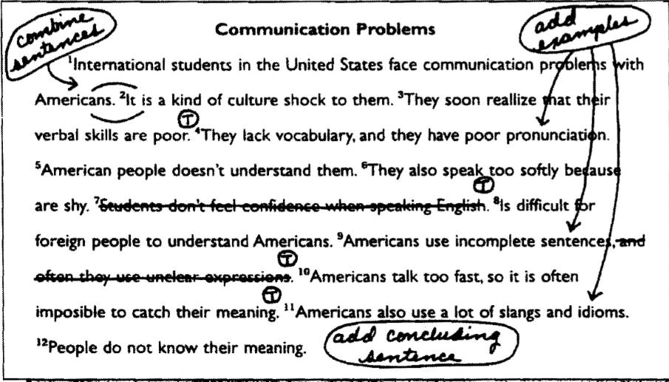
Step 3: Revising Content and Organization

Slide 42
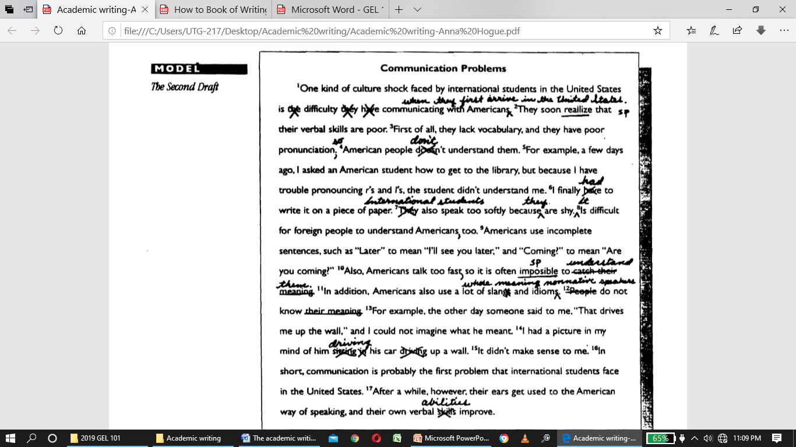
Step 3: Revising Content and Organization cont.

Slide 43
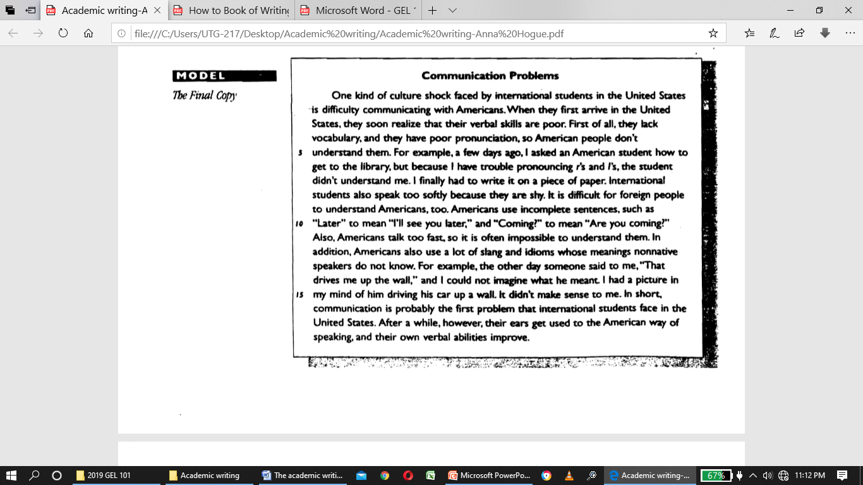
Step 3: Revising Content and Organization cont.

Slide 44
summary
STEP I· Prewriting :Brainstorming:
STEP 2. Planning: Develop an outline. including a topic sentence.
STEP 3.Writing: Write a rough draft.
STEP 4. Revising: Edit your rough draft for content and organization.
STEP 5. Rewriting: Write a second draft, and proofread it for grammar and mechanics.
STEP 6 : Write a final copy to hand in.

