Slide 1
Introduction to Information and Communication Technology
CPS 111

Slide 2
Computer Security and Safety, Ethics, and Privacy

Slide 3
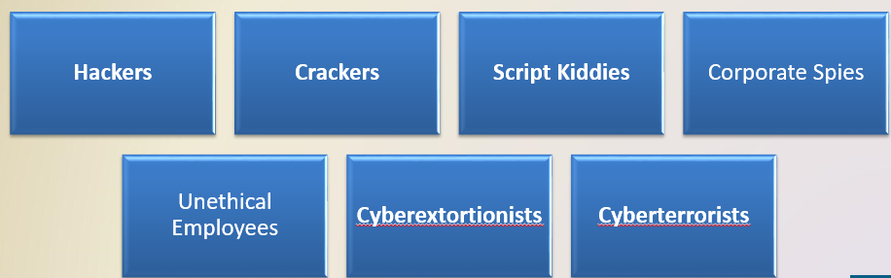
Computer Security Risks
A computer security risk is any event or action that could cause a loss of or damage to computer hardware, software, data, information, or processing capability
A cybercrime is an online or Internet-based illegal act

Slide 4
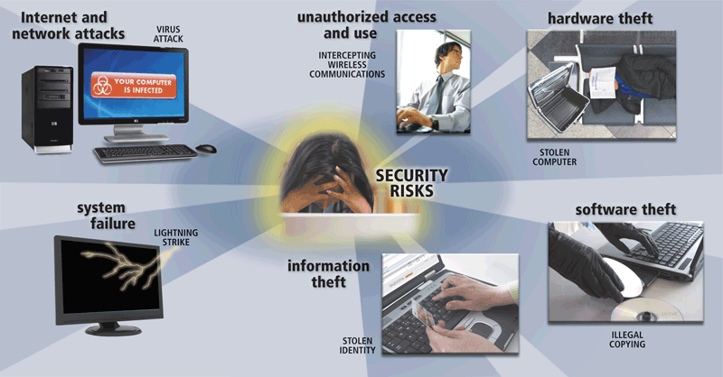
Computer Security Risks

Slide 5
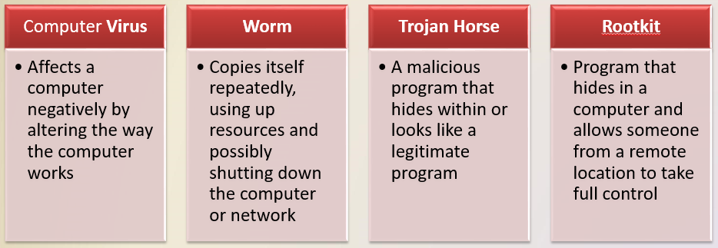
Internet and Network Attacks
Information transmitted over networks has a higher degree of security risk than information kept on an organization’s premises

Slide 6
Internet and Network Attacks
An infected computer has one or more of the following symptoms:
Operating system runs much slower than usual
Available memory is less than expected
Files become corrupted
Screen displays unusual message or image
Music or unusual sound plays randomly
Existing programs and files disappear
Programs or files do not work properly
Unknown programs or files mysteriously appear
System properties change
Operating system does not start up
Operating system shuts down unexpectedly

Slide 7
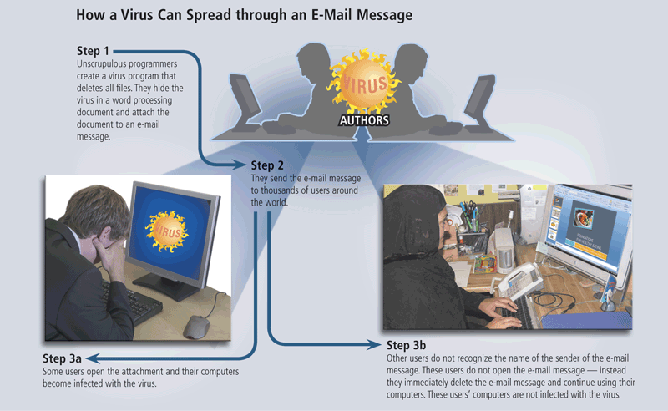
Internet and Network Attacks

Slide 8
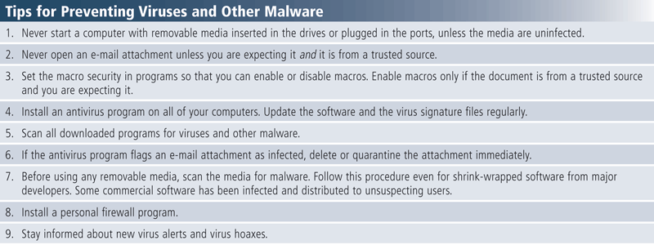
Internet and Network Attacks
Users can take several precautions to protect their home and work computers and mobile devices from these malicious infections

Slide 9
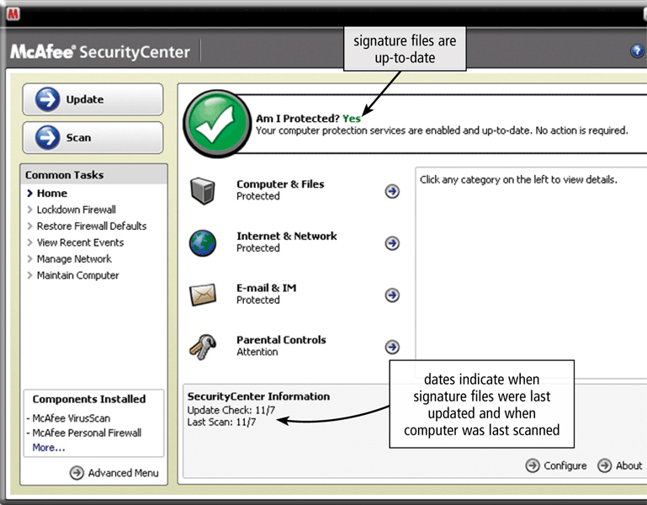
Internet and Network Attacks

Slide 10
Internet and Network Attacks
A botnet is a group of compromised computers connected to a network
  A compromised computer is known as a zombie
A denial of service attack (DoS attack) disrupts computer access to Internet services
A back door is a program or set of instructions in a program that allow users to bypass security controls
Spoofing is a technique intruders use to make their network or Internet transmission appear legitimate

Slide 11
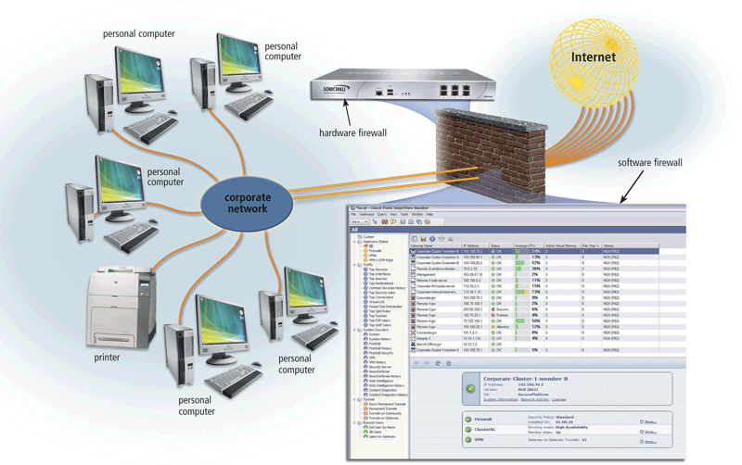
Internet and Network Attacks
A firewall is hardware and/or software that protects a network’s resources from intrusion

Slide 12
Internet and Network Attacks
Intrusion detection software
Analyzes all network traffic
Assesses system vulnerabilities
Identifies any unauthorized intrusions
Notifies network administrators of suspicious behavior patterns or security breaches

Slide 13
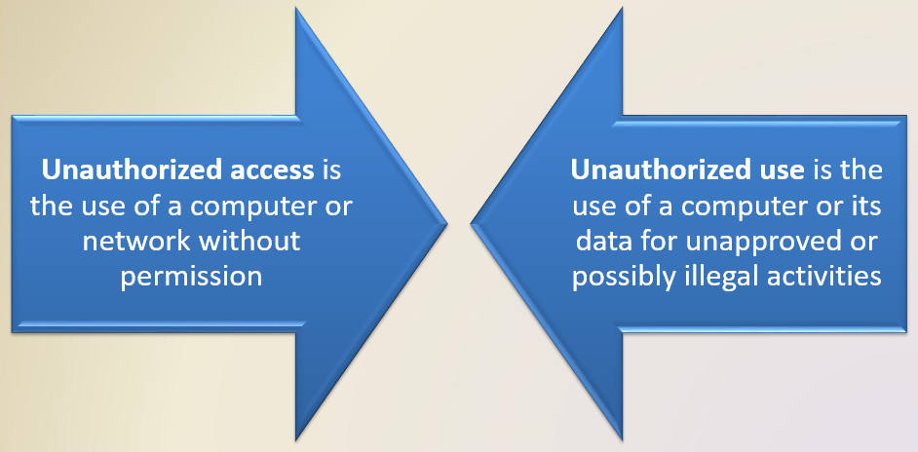
Unauthorized Access and Use

Slide 14
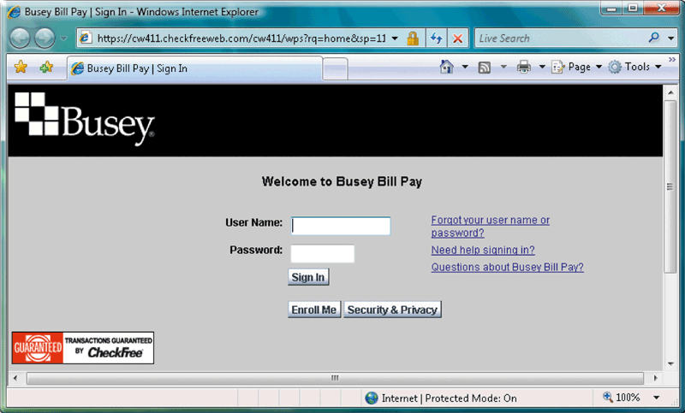
Unauthorized Access and Use
Access controls define who can access a computer, when they can access it, and what actions they can take
  Two-phase processes called identification and authentication
  User name
  Password
  CAPTCHA

Slide 15
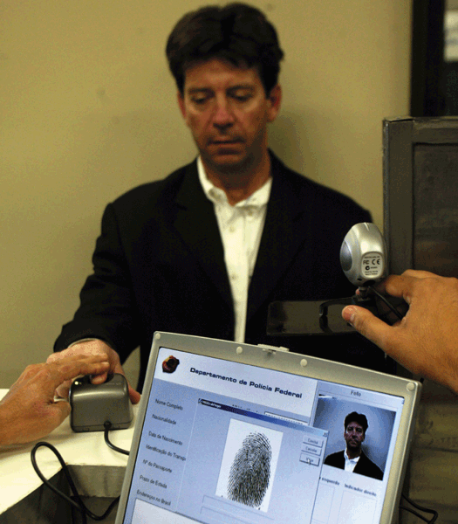
Unauthorized Access and Use
A possessed object is any item that you must carry to gain access to a computer or computer facility
  Often are used in combination with a personal identification number (PIN)
A biometric device authenticates a person’s identity by translating a personal characteristic into a digital code that is compared with a digital code in a computer

Slide 16
Unauthorized Access and Use
Digital forensics is the discovery, collection, and analysis of evidence found on computers and networks
Many areas use digital forensics
Law enforcement
Criminal prosecutors
Military intelligence
Insurance agencies
Information security departments

Slide 17
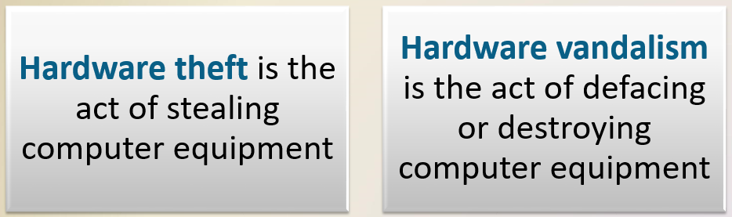
Hardware Theft and Vandalism

Slide 18
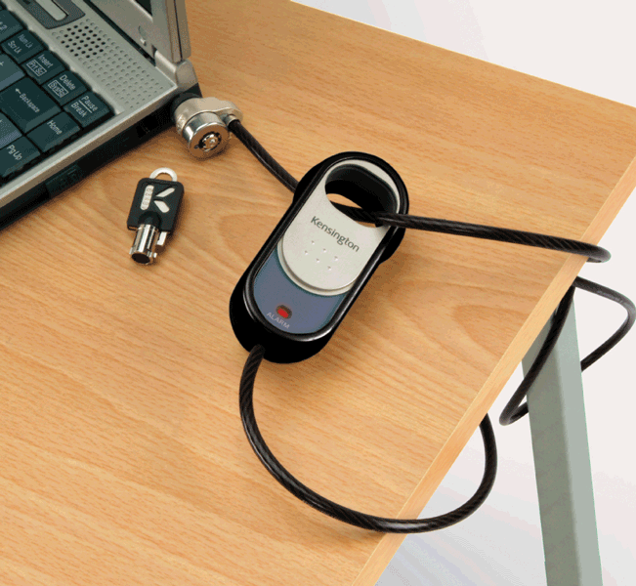
Hardware Theft and Vandalism
To help the reduce of chances of theft, companies and schools use a variety of security measures
Physical access controls
Alarm systems
Cables to lock equipment
Real time location system
Passwords, possessed objects, and biometrics

Slide 19
Software Theft
Software theft occurs when someone:
Steals software media
Intentionally erases programs
Illegally copies a program
Illegally registers and/or activates a program

Slide 20
Software Theft
A single-user license agreement typically contains the following conditions:
Permitted to
  Install the software on one computer
  Make one copy of the software
  Remove the software from your computer before giving it away or selling it
Not permitted to
  Install the software on a network
  Give copies to friends or colleagues while continuing to use the software
  Export the software
  Rent or lease the software

Slide 21
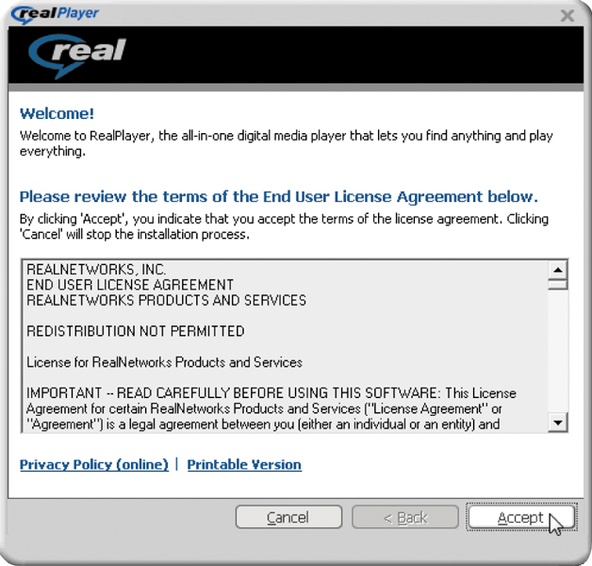
Software Theft
Copying, loaning, borrowing, renting, or distributing software can be a violation of copyright law
Some software requires product activation to function fully

Slide 22
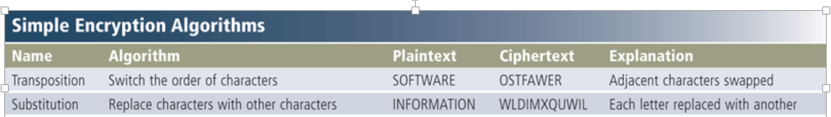
Information Theft
Information theft occurs when someone steals personal or confidential information
Encryption is a process of converting readable data into unreadable characters to prevent unauthorized access

Slide 23
Information Theft
A digital signature is an encrypted code that a person, Web site, or organization attaches to an electronic message to verify the identity of the sender
A digital certificate is a notice that guarantees a user or a Web site is legitimate
  Issued by a certificate authority

Slide 24
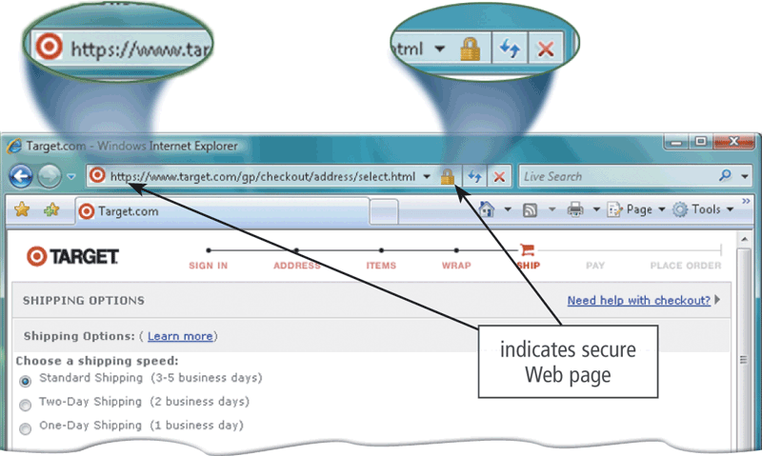
Information Theft

Slide 25
System Failure
A system failure is the prolonged malfunction of a computer
A variety of factors can lead to system failure, including:
  Aging hardware
  Natural disasters
  Electrical power problems
  Errors in computer programs

Slide 26
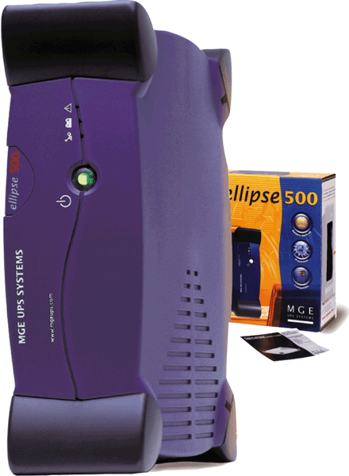
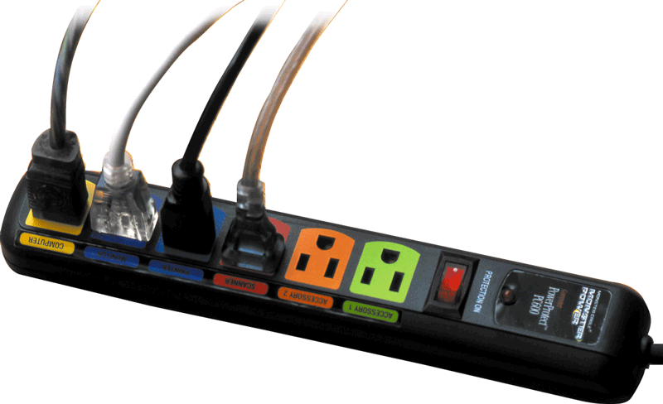
System Failure
Two ways to protect from system failures caused by electrical power variations include surge protectors and uninterruptable power supplies (UPS)

Slide 27
Backing Up – The Ultimate Safeguard
A backup is a duplicate of a file, program, or disk that can be used if the original is lost, damaged, or destroyed
  To back up a file means to make a copy of it
Offsite backups are stored in a location separate from the computer site
Cloud Storage

Slide 28
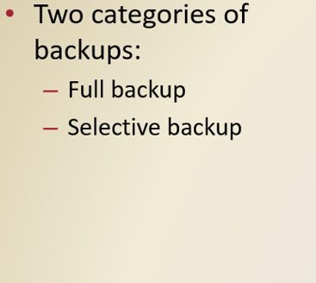
Backing Up – The Ultimate Safeguard

Slide 29
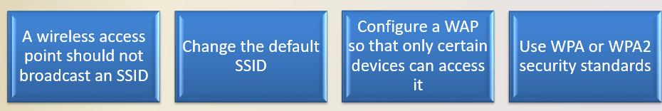
Wireless Security
Wireless access poses additional security risks
  About 80 percent of wireless networks have no security protection
War driving allows individuals to detect wireless networks while driving a vehicle through the area

Slide 30
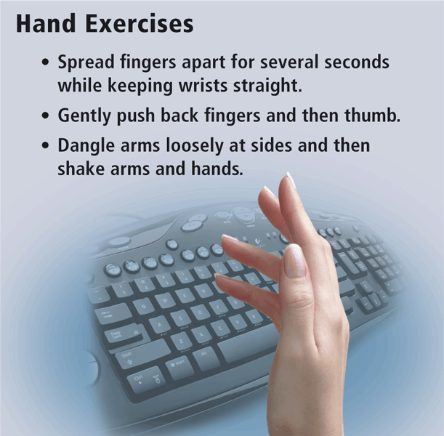
Health Concerns of Computer Use
The widespread use of computers has led to health concerns
  Repetitive strain injury (RSI)
  Carpal tunnel syndrome (CTS)
  Computer vision syndrome (CVS)

Slide 31
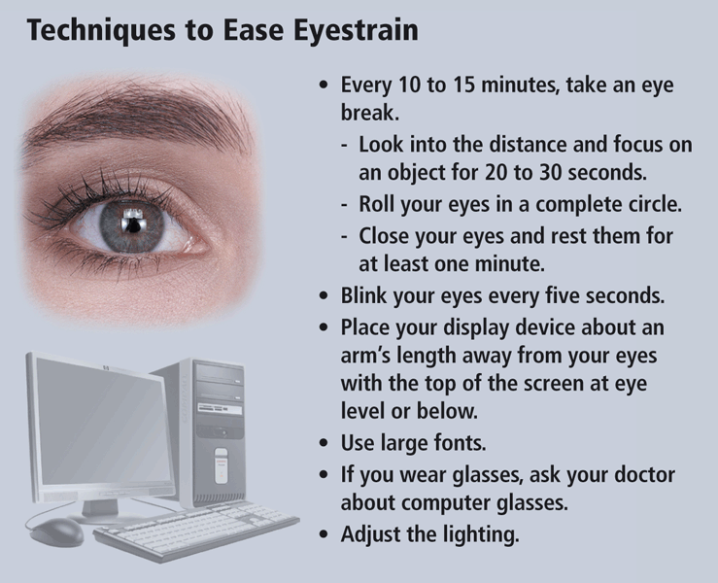
Health Concerns of Computer Use

Slide 32
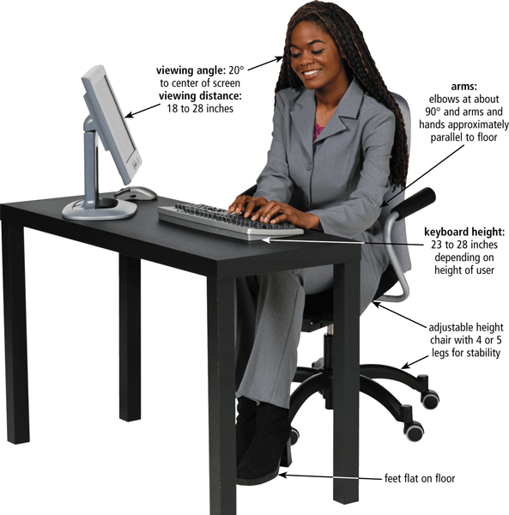
Health Concerns of Computer Use
Ergonomics is an applied science devoted to incorporating comfort, efficiency, and safety into the design of items in the workplace

Slide 33
Health Concerns of Computer Use
Computer addiction occurs when the computer consumes someone’s entire social life
Symptoms of users include:
Craves computer time
Overjoy when at the computer
Unable to stop computer activity
Irritable when not at the computer
Neglects family and friends
Problems at work or school

Slide 34
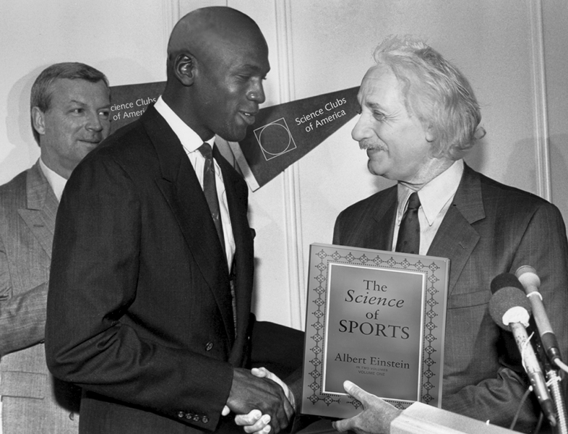
Ethics and Society
Computer ethics are the moral guidelines that govern the use of computers and information systems
Information accuracy is a concern
  Not all information on the Web is correct

Slide 35
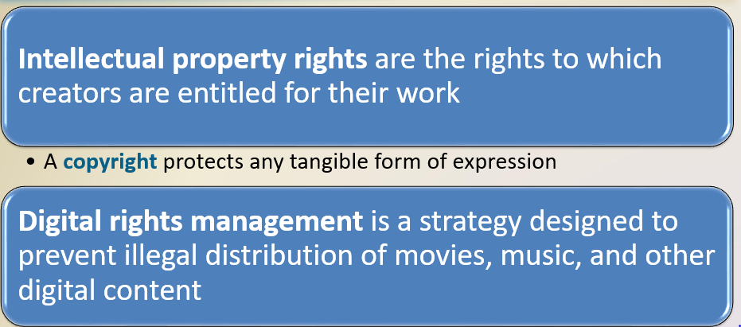
Ethics and Society

Slide 36
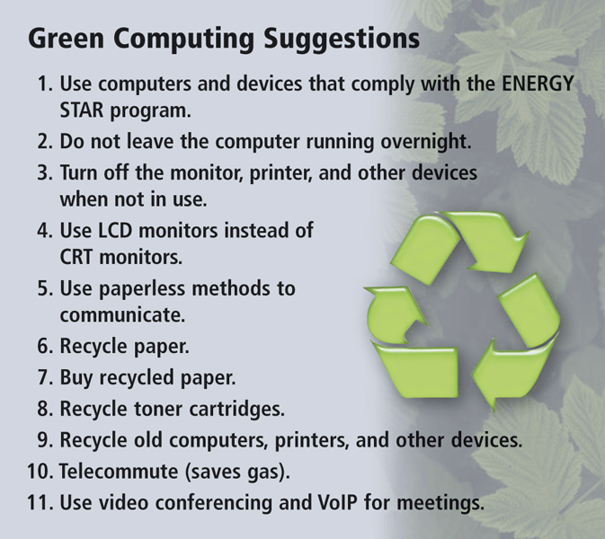
Ethics and Society
Green computing involves reducing the electricity and environmental waste while using a computer
  ENERGY STAR program

Slide 37
Ethics and Society
Information privacy refers to the right of individuals and companies to deny or restrict the collection and use of information about them
Huge databases store data online
It is important to safeguard your information

Slide 38
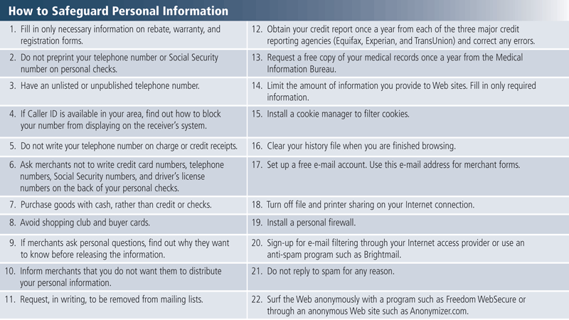

Slide 39
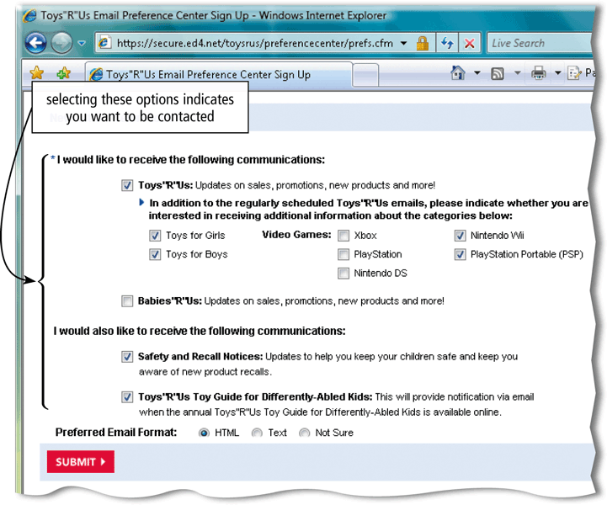
Ethics and Society
When you fill out a form, the merchant that receives the form usually enters it into a database
Many companies today allow people to specify whether they want their personal information distributed

Slide 40
Ethics and Society
A cookie is a small text file that a Web server stores on your computer
Web sites use cookies for a variety of reasons:
Allow for personalization
Store users’ passwords
Assist with online shopping
Track how often users visit a site
Target advertisements

Slide 41
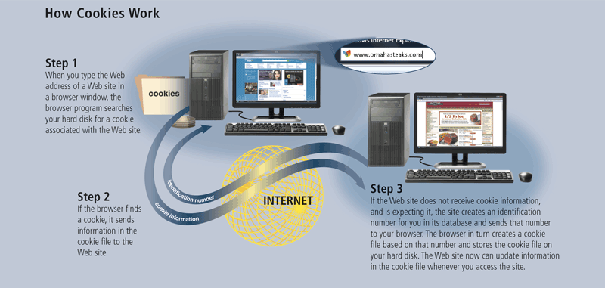

Slide 42
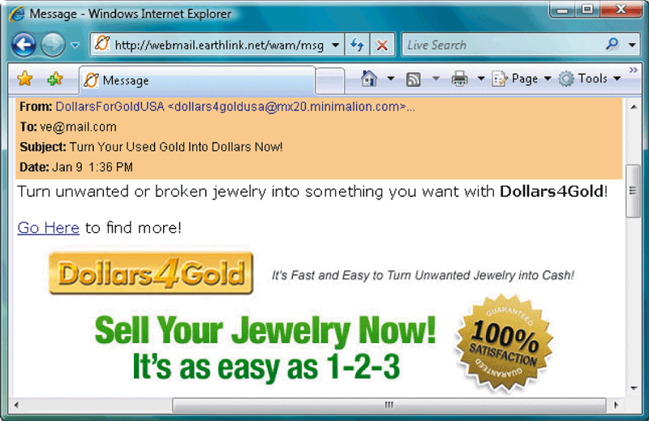
Ethics and Society
Spam is an unsolicited e-mail message or newsgroup posting
E-mail filtering blocks e-mail messages from designated sources
Anti-spam programs attempt to remove spam before it reaches your inbox

Slide 43
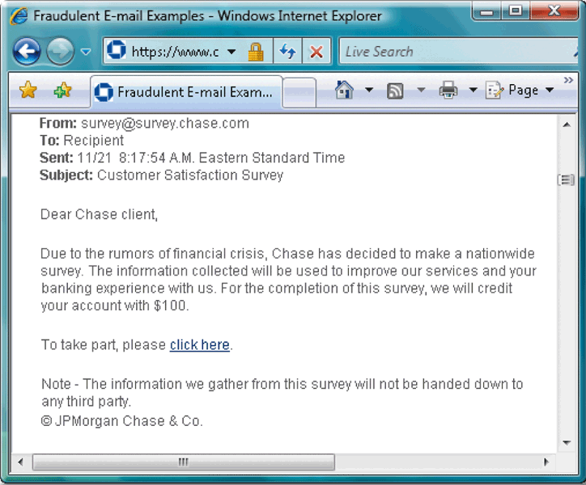
Ethics and Society
Phishing is a scam in which a perpetrator sends an official looking e-mail message that attempts to obtain your personal and financial information
Pharming is a scam where a perpetrator attempts to obtain your personal and financial information via spoofing

Slide 44
Ethics and Society
The concern about privacy has led to the enactment of federal and state laws regarding the storage and disclosure of personal data

Slide 45
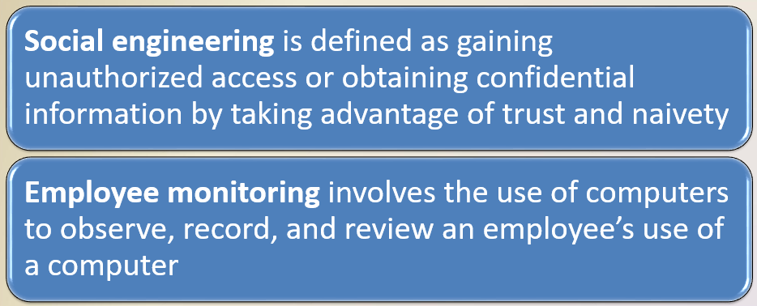
Ethics and Society

Slide 46

Ethics and Society
Content filtering is the process of restricting access to certain material on the Web
Many businesses use content filtering
Web filtering software restricts access to specified Web sites

