Slide 1

Lecture 3
Ethics for IT Professionals and IT Users

Slide 2
Objectives
What key characteristics distinguish a professional from other kinds of workers, and what is the role of an IT professional?
What relationships must an IT professional manage, and what key ethical issues can arise in each?
How do codes of ethics, professional organizations, certification, and licensing affect the ethical behavior of IT professionals?

Slide 3
Objectives (continued)
What are the key tenets of four different codes of ethics that provide guidance for IT professionals?
What are the common ethical issues that face IT users?
What approaches can support the ethical practices of IT users?

Slide 4
IT Professionals
Profession is a calling that requires
specialized knowledge
long and intensive academic preparation

Slide 5
Are IT Workers Professionals?
Partial list of IT specialists
programmers
systems analysts
software engineers
database administrators
local area network (LAN) administrators
chief information officers (CIOs)

Slide 6
Are IT Workers Professionals?
Legal perspective
IT workers are not recognized as professionals
not licensed
IT workers are not liable for malpractice

Slide 7
Professional Relationships That Must Be Managed
IT professionals have many different relationships with:
employers
clients
suppliers
other professionals
IT users
society at large

Slide 8
Relationships Between IT Professionals and Employers
IT professionals must set an example and enforce policies regarding the ethical use of IT
Software piracy is the act of illegally making copies of software or enabling others to access software to which they are not entitled
Software piracy is an area in which IT professionals can be tempted to violate laws and policies
The Business Software Alliance (BSA) is a trade group that represents the world’s largest software and hardware manufacturers
its mission is to stop the unauthorized copying of software produced by its members
penalties can be up to $100,000 per copyrighted work

Slide 9
The Software Alliance
The Software Alliance, also known as BSA, is a trade group established (by Microsoft in 1988) to represent commercial software makers.
Its principal activity is trying to stop copyright infringement of software produced by its members.
Founded as the Business Software Alliance, it dropped "Business" from its name in October 2012, and styles itself "BSA | The Software Alliance“
It is funded through membership dues based on member company's software revenues and through settlements and from companies it successfully brings action against

Slide 10
Relationships Between IT Professionals and Employers
Trade secret
information used in business
generally unknown to the public
company has taken strong measures to keep confidential
examples are the formula for Coke, Intel manufacturing process for P4 chip
employees must sign a non-disclosure agreement (NDA)
problems due to high IT employee turn-over
Whistle-blowing
attracts attention to a negligent, illegal, unethical, abusive, or dangerous act that threatens the public interest

Slide 11
Relationships Between IT Professionals and Clients
IT professional provides
hardware, software, or services at a certain cost and within a given time frame
Client provides
compensation
access to key contacts
work space
Note: The Relationship is usually documented in contractual terms

Slide 12
Relationships Between IT Professionals and Clients
Ethical problems arise if a company recommends its own products and services to remedy problems they have detected
but a company is unable to provide full and accurate reporting of a project’s status
company hired as consultants may recommend its affiliated ptroducst

Slide 13
Legal Overview
Fraud, misrepresentation
crime of obtaining goods, services, or property through deception or trickery
fraud is proven in court
Breach of contract
one party fails to meet the terms of a contract
schedule slippage, cost overruns, better product may be released by competitor during contract execution
can generate trials which are often settled out of court to minimize reputation damage

Slide 14
Relationships Between IT Professionals and Suppliers
Develop good relationships with suppliers
deal fairly with them
do not make unreasonable demands
Bribery
providing money, property, or favors to someone in business or government to obtain a business advantage
at what point does a gift become a bribe?
no gift should be hidden
perceptions of donor and recipient can differ

Slide 15
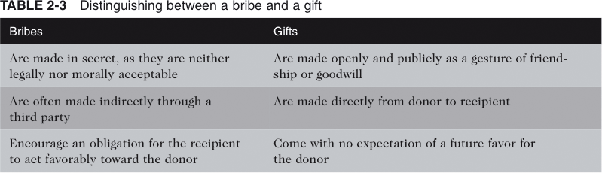
Distinguishing Between a Bribe and a Gift

Slide 16
Relationships b/w IT Professionals & Other Professionals
Professionals owe each other adherence to a profession’s code of
conduct
there is a sense of mentorship and community
Ethical problems between members of the IT profession
résumé inflation
inappropriate sharing of corporate information due to IT access

Slide 17
Relationships Between IT Professionals and IT Users
IT user
is a person for whom a hardware or software product is designed
IT professionals’ duty
understand users’ needs and capabilities
deliver products and services that best meet those needs
establish an environment that supports ethical behavior by users

Slide 18
Relationships Between IT Professionals and Society
Actions of an IT professional can affect society
society expect professionals to not cause harm (=trust)
society expects professionals to provide benefits
so there must be a sense of responsibility, also not to damage a professional sector’s reputation
Note:
Corporations are taking actions to ensure good business ethics among employees

Slide 19
Professional Codes of Ethics
Professional Code of Ethics
A professional code of ethics states the principles and core values that are essential to the work of a particular occupational group
Note: a law does not provide complete guide to ethical behavior
Main parts/components of Professional Ethics:
outlines what the professional organization aspires to become
lists rules and principles by which members of the organization are expected to abide
Benefits for individual, profession, and society
improves ethical decision making
promotes high standards of practice and ethical behavior
enhances trust and respect from the general public
provides an evaluation benchmark

Slide 20
Professional Organizations
No universal code of ethics for IT professionals
No single, formal organization of IT professionals has emerged as preeminent
Professional organizations enable
building of professional and working relationships
sharing of useful information (stay up-to-date)
provides a stamp of adhering to defined standards
Most prominent organizations include:
Association for Computing Machinery (ACM)
Association of Information Technology Professionals (AITP)
Computer Society of the Institute of Electrical and Electronics Engineers (IEEE-CS)
Project Management Institute (PMI)

Slide 21
Certification
Indicates a professional possesses a particular set of skills, knowledge, or abilities in the opinion of a certifying organization
Can also apply to products
Carries no requirement to adhere to a code of ethics
Can serve as a benchmarks for mastery of a certain skill set and knowledge
good way to document and structure the acquisition of new skills and knowledge
get re-certified to stay up-to-date

Slide 22
Certification: Vendor Certifications
Vendor certifications
Cisco, IBM, Microsoft, etc.
some certifications substantially improve IT workers’ salaries and career prospects
relevant for narrowly defined roles
may require passing a written exam
workers are commonly recertified as newer technologies become available

Slide 23
Certification: Industry Association Certifications
Industry association certifications
require a certain level of experience and a broader perspective than vendor certifications
lag in developing tests that cover new technologies

Slide 24
Government Licensing
Generally administered at the state level in the United States
examples: CPAs, doctors, lawyers, etc.
but also engineers that perform engineering services for the public
Case for licensing IT professionals
encourage IT professionals to follow the highest standards of the profession
practice a code of ethics
violators would be punished by law
without it there is no incentive for heightened care and no concept of malpractice
licensing of IT professionals may improve today’s very complex IT systems

Slide 25
Government Licensing
Adverse issues associated with government licensing of IT professionals
there are few international or national licensing programs for IT professionals
no universally accepted core body of knowledge
unclear who should manage content and administration of licensing exams
no administrative body to accredit professional education programs
no administrative body to assess and ensure competence of individual professionals

Slide 26
IT Professional Malpractice
Negligence:
not doing something that a reasonable man would do, or doing something that a reasonable man would not do
Duty of care:
the obligation to protect people against any unreasonable harm or risk
Note: Courts consistently reject attempts to sue individual parties for
computer-related malpractice

Slide 27
Common Ethical Issues for IT Users
Software piracy
copying work software for use at home (even when doing some
work at home) is considered piracy
Inappropriate use of computing resources
surf work-unrelated websites
send questionable email
etc
Inappropriate sharing of information
private data
confidential information

Slide 28
Supporting the Ethical Practices of IT Users
Policies that protect against abuses:
establish boundaries of acceptable and unacceptable behavior
enable management to punish violators
Policy components include:
defining and limiting the appropriate use of IT resources
establishing guidelines for use of company software
structuring information systems to protect data and information
installing and maintaining a corporate firewall

Slide 29
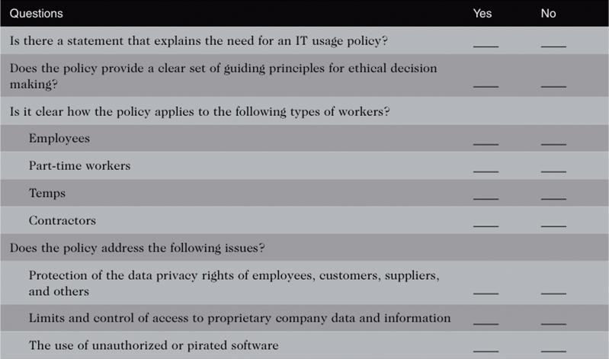
Manager’s Checklist of Items to Consider when Establishing an IT Usage Policy

Slide 30
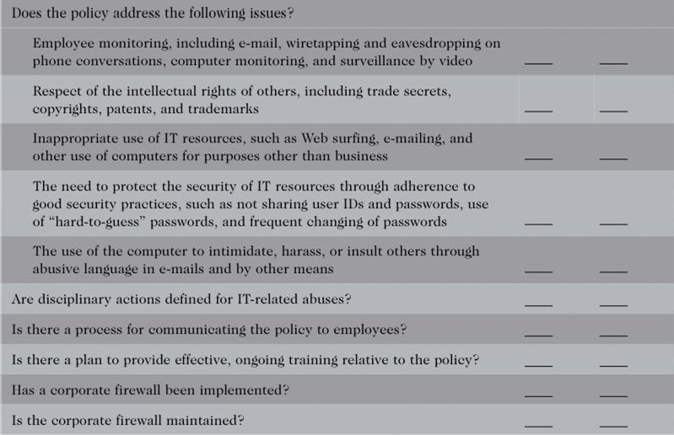
Manager’s Checklist of Items to Consider when Establishing an IT Usage Policy

Slide 31
Summary
A professional from a legal standpoint
has passed the state licensing requirements
has earned the right to practice there
IT professionals have many different relationships
each with its own set of ethical issues and potential problems
Professional code of ethics
states the principles and core values essential to the work of an occupational group

Slide 32
Summary (continued)
Licensing and certification of IT professionals
many people feel that certification will increase the reliability and
effectiveness of information systems
raises many issues
IT-related professional organizations have developed a code of ethics
IT usage policy defines appropriate and inappropriate IT user behavior

Slide 33
End_of_Lecture_[3]
End_of_Lecture_[3]

