Slide 1
Introduction to Information and Communication Technology

Slide 2
  ICT Introduction
ICT is an abbreviation of a term "Information and Communication Technology".
It generally refers to use of new or modem technologies to aid in analysis, storage, processing as well as communication of information.
The world is growing rapidly through an explosion of Information Technology.

Slide 3
ICT Introduction
    Information: organized and interpreted data with a context that convey meaning.
    Communication: the transfer of ideas and messages among people through different systems, devices or media such as computer, internet, cell phone, telephone, television or radio etc.
    Technology: making, modification, adaptation and usage of tools, techniques, systems or machines for the purpose of solving problems or achieving goals in less time period.

Slide 4
What is ICT?
"Any system, which can receive, store or transmit data/information electronically in digital form".
Personal computers, digital television or internet can be considered the best examples of ICT.

Slide 5
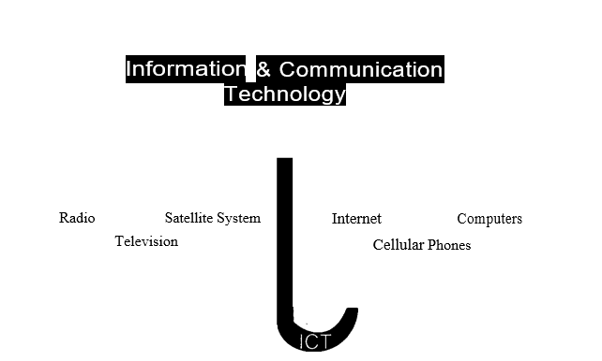
What is ICT?
ICT is just like an umbrella comprising of different communication devices or applications such as radio, television, satellite systems, internet, cellular phones or computer etc.

Slide 6
What is ICT?
Created a global village by which people can easily communicate and share their ideas with each other.
Internet and cell phones are the best examples of communication technologies and also the best communication medium today.

Slide 7
Role of ICT in Society
The importance and positive influences of can be easily seen in various fields such as:
  education, business,
  training, health, environment,
  employment or government (public administration) etc.

Slide 8
  ICT Applications
ICT applications enable people to communicate with each other in real time all over- the world
    Computer and Internet
    People can communicate with each other through various ways using computer and internet
    Can play games, listen music, watch videos, solve many problems related to their education
    Communicate with each other through email facility/social networking websites etc.

Slide 9
ICT Applications
The internet has become basic need of everyone in the society. Following are few common advantages:
  Online sale and purchase
  Source of entertainment (movies/music)
  Software's and document's downloading
  Documents sharing with each other through internet
  Searching through various search engines like Google or Yahoo
  People's communication through email, Skype or social networking websites (Face-Book, Linked-In or Twitter) etc.

Slide 10
ICT Applications
Cell phone
Another well-known ICT device which allows users to communicate with each other
Provides many facilities to the users such as:
  calling, instant messaging,
  listening music, watching videos,
  playing games, using internet,
  maintaining phonebook and many more

Slide 11
ICT Applications
ICT in Teaching and Learning
ICT have put a lot of positive effects in educational areas where teaching and learning are most important aspects
ICT enables teachers as well as learners to:
  Teach well
  Learn well
  Present well
  Work efficiently
  Share ideas easily
  Solve different problems easily
  Gain precise knowledge
  Achieve goals in less time period

Slide 12
OVERVIEW AND ORGANIZATION OF COMPUTER

Slide 13
  Introduction:
History and the development of Computer help the students to keenly observe the evaluation of the computer.
This part describes different parts of computer and their working and coordination among each other.
It includes- different components of the computer like Bus, Port, Microprocessor, and Main Memory.

Slide 14
  Objectives
After completing this part, the students will be able to:
  Describe history and development of computer.
  Distinguish different generations of the computer.
  Classify different types of computers.
  Have knowledge about applications and different parts of the computer

Slide 15
  History and Development of Computer:
The history of computer describes the advancements and growth of computer technology
It is divided into different eras and has its roots starting from pre­history era

Slide 16
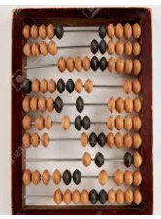
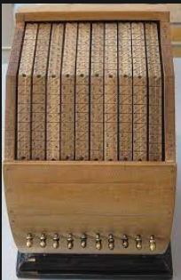
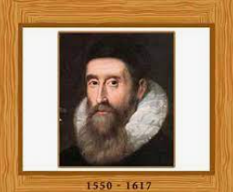
  Pre-History Era 4th Century B.C. to 1930s
    Abacus Machine
A mechanical device which can perform basic arithmetic problems like addition etc.
The first machine invented in 4th century B.C.
    Napier's Bones
    John Napier a Scottish theologian and mathematician invented logs in 1614
    Perform multiplication and division.

Slide 17
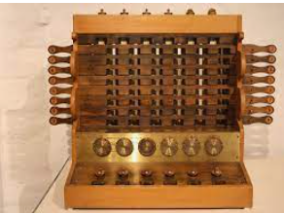
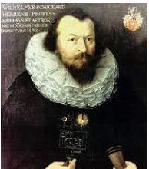
Pre-History Era 4th Century B.C. to 1930s
Mechanical calculator
Wilhelm Schickard, built a mechanical calculator in 1623 which was able to perform the process of multiplication.
The device supported 6-digit capacity.

Slide 18
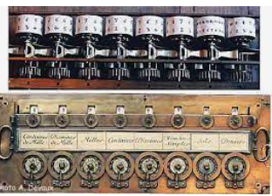
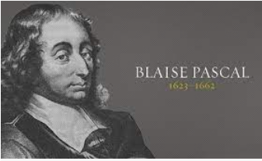
Pre-History Era 4th Century B.C. to 1930s
Blaise Pascal’s Mechanical Calculator
French mathematician built a mechanical calculator in 1642
Could add and subtract two numbers directly and multiply and divide by repetition .
Device support 8 digit capacity

Slide 19
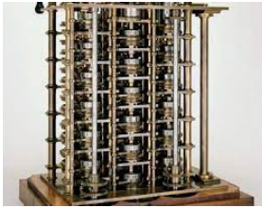
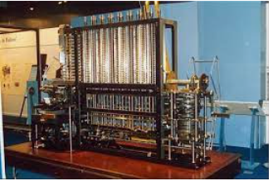
Pre-History Era 4th Century B.C. to 1930s
Difference Engine
Designed by Charles Babbage in 1820
Could perform mathematical and statistical tables
Analytical Engine
Invented another device with the name of "Analytical Engine", in 1842
A mechanical computer that could perform basic mathematical problem at an average speed of 60 additions per minute

Slide 20
Generations of Computer
With the passage of time, several changes were made in computer technology to meet the challenges of the age
These changes or modifications were classified into different periods and later on these periods were also named as" Generations" of the Computer.

Slide 21
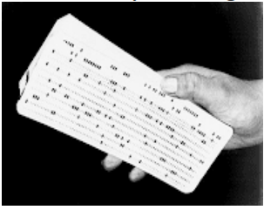
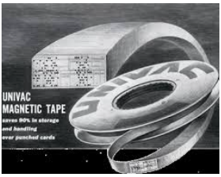
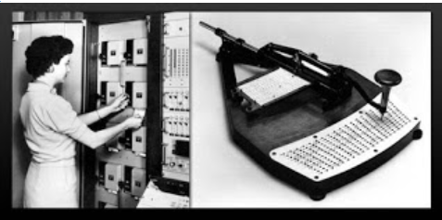
First Generation of Computer (1951 -1958)
Used Vacuum tubes technology
Vacuum tubes were like fragile glass tubes
Consumed more electricity due to more glowing time on glass tubes
Used punch card and magnetic tape as an input device.
Used sequential processing called Batch processing technique
Data was processed in the form of bundles or batches
Relied on machine language –binary (0s or 1s)
Cards allowed companies to store and access information by entering the card into the computer.

Slide 22

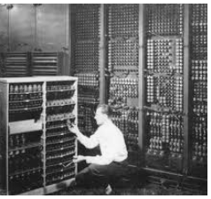
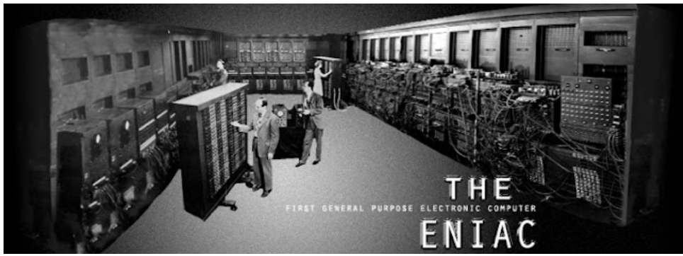
First Generation of Computer (1951 -1958)
Limitations
Vacuum tubes generated much heat and covered a lot of space.
Punched cards technology consumed large number of cards even for small programs.
Magnetic tapes were unable to retrieve large amount of data quickly, being a sequential medium.

Slide 23
    Second generation of Computer, 1959 - 1964
Transistors replaced vacuum tubes
Transistor is an electronic component, which is used for amplification and switching of electrical signals
Punched cards were used as an input device to feed the computer programs or instruction
Magnetic tapes were also used as an input/output storage.
Some high level languages like FORTRAN, COBOL and BASIC were also used.

Slide 24
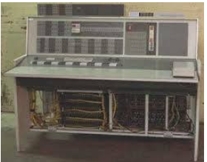
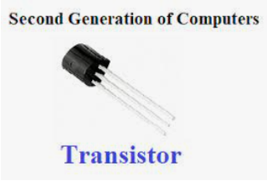
Second generation of Computer, 1959 - 1964
      Advantages
      Transistors were much more reliable and have greater computational speed.
Transistors required no warm-up time and consumed less electricity

Slide 25
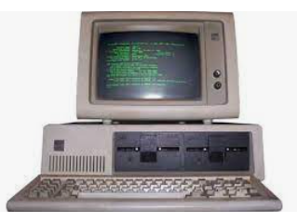
    Third Generation (1965-1970):
Integrated Circuit(IC) replaced Transistor
Integrated circuit was consisted of thousands of transistors fabricated in a single silicon chip.
ICs were smaller in size and had better performance than transistors.
Keyboard and monitors were used as input and output devices.
PASCAL was used as a high level language.

Slide 26
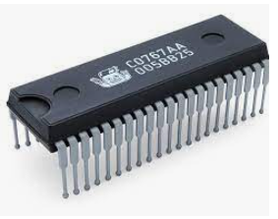
Third Generation (1965-1970):
      Advantages
        Integrated circuits were more reliable.
        Silicon chips were cheap because of their small size and they also consumed less electricity.

Slide 27
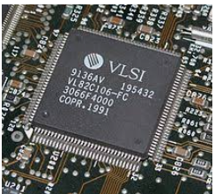
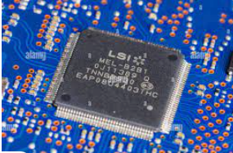
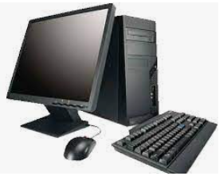
  Fourth Generation (1980)
Was based on two technologies:
Large Scale Integration (LSI) and Very Large Scale integration (VLSI).
      Large Scale Integration (LSI): about 30,000 electronic components were fabricated in a single chip
      Very Large Scale integration (VLSI): VLSI technology about one million electronic components were fabricated in a single chip.
    Keyboard and monitors were used as primary input /output devices
    Magnetic drives were used as primary storage

Slide 28
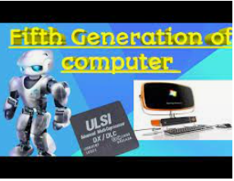
Fifth Generation (late 1990's)
Voice recognition was used as an additional special feature.
Uses Ultra Large Scale integration (ULSI): Over 1 million transistors
Optical fiber technology was introduced for communication.
Artificial Intelligence technology was also introduced.
  For example Robot Artificial Intelligence made the computers to have thinking power and reasoning.

Slide 29
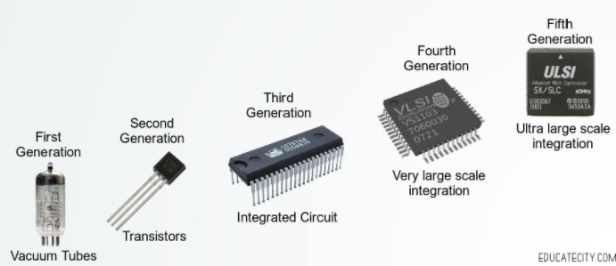

Slide 30
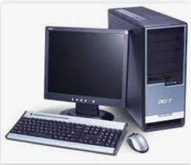
  Classification of Computers
Classification of computer fall into two broad categories
    Size (Physical Appearance)
    Purpose.( Objectives)
    Size (Physical Appearance)
      Microcomputer
          Called a personal computer
          Used in the homes for general purpose tasks
          Microcomputer uses microprocessor as its central processing unit

Slide 31
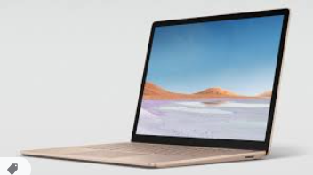
Classification of Computers
      Laptop Computer
    Also called a notebook Computer
    Popular because it is portable in Size and easy to carry
    Used with the help of internal battery
    All components are place in one unit

Slide 32
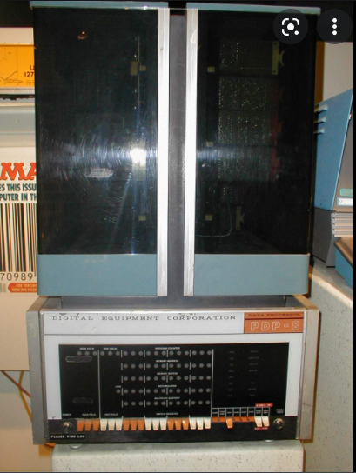
Classification of Computers
      Minicomputer
    Usually falls between a microcomputer and a mainframe
    Supports hundreds of users simultaneously

Slide 33
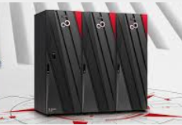
Classification of Computers
      Mainframe
Mainframes were in cupboard size computers than PC / mini computers / laptop computers.
Expensive and their processing speed was extremely high.
Used to store, manage, and process large amounts of data that need to be reliable, secure, and centralized.
Capable of supporting thousands, of users simultaneously
Had the capability to execute many programs run at the same time.

Slide 34
Classification of Computers
  Purpose
According to purpose computers are divided into following sub classes.
  Digital Computer
  Analog Computer
  Hybrid Computer

Slide 35
Classification of Computers
    Digital Computer
  Processes information in the form of characters and digits
  Displays output in the form of characters, digits, charts & graphics
  Also called personal or general purpose

Slide 36
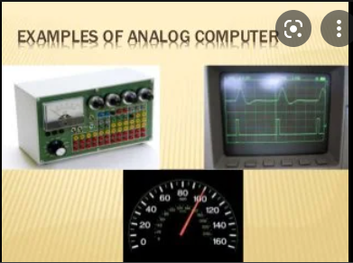
Classification of Computers
    Analog Computer
    Used for special purpose applications such as:
      Measuring temperature
      Measuring velocity etc.
Deal with continuous type of data rather than digits
Display their output in the form of electrical waves rather than digits
Mostly used in the scientific laboratories

Slide 37
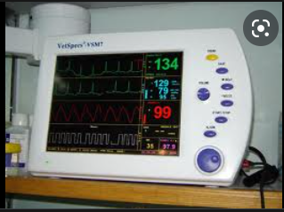
Classification of Computers
    Hybrid Computer
  Have the capability to process both the digital data as well as analog data.
  Helpful in the science laboratory where both analog and digital data is required for processing.

Slide 38
Applications of Computer
Useful almost in every aspect of life.
    Education
    Business
    Banking
    Defense
    Entertainment

Slide 39
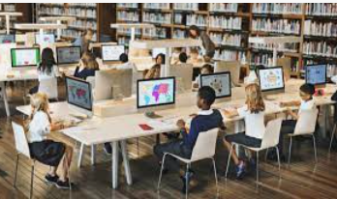
Applications of Computer
    Education
Technology is playing a very vital role in education sector
Students get their:
  Study notes
  Tutorials
  Text books
  Solution manuals
Enhances the student's learning and help to improve the quality of education.
One of the great evolutions in education is the e-learning

Slide 40
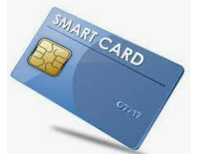
Applications of Computer
    Business
    Plays a very important role in productivity and competitiveness of Businesses
Internet has become a very vital tool for the sale and marketing.
A customer can now easily buy and purchase products and the payments can be made just by using:
  Smart cards
  Internet banking
  Electronic deposit or even can pay his bills online

Slide 41
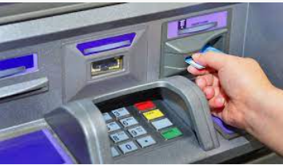
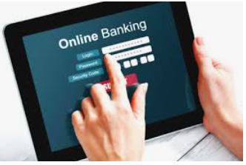
Applications of Computer
Banking
Internet banking is an example of modern banking
A Customer can easily:
  Check balance while sitting at his home
  Can transfer fund without any queuing or physical fatigue
ATM (automated teller machine) is another example of modern banking sector

Slide 42
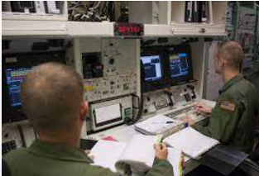
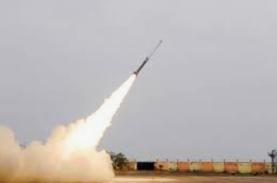
Applications of Computer
Defense
Used in Intercontinental Ballistic Missiles, Rocket etc. that uses GPS (Global Position System) to help the missile to hit the specified target
Used to track incoming missiles and also help the weapons systems to locate incoming target.
Used in tanks and aeroplanes and ships to target the specified targets of the opponent

Slide 43
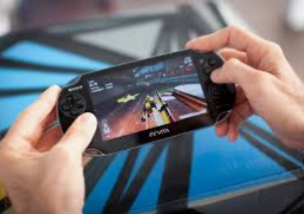
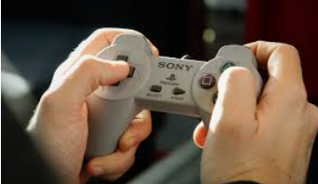

Applications of Computer
    Entertainment
    Provided enormously high opportunities for entertainment and pleasure

Slide 44
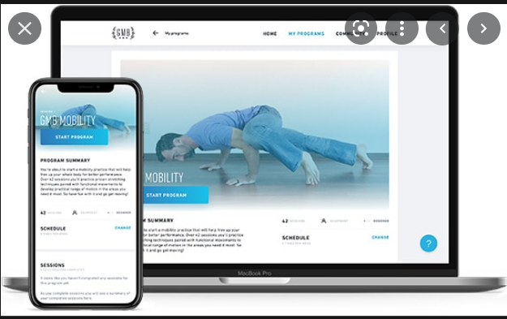

Applications of Computer
    Sports
Used to collect and analyze the statistics and displays the updated score
Helps to sell tickets
Create training programs for athletes
Suggests diets for athletes.

Slide 45
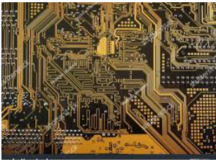
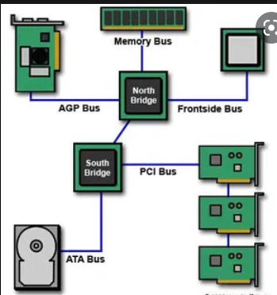
Important Terms
    Buses
Electrical paths through-which data is transferred from one location to another location within a computer system.

Slide 46
Important Terms
Data Bus
Data bus uses the combination of wires, to transfer the data. Data bus is bi- directional
Address Bus
Also called memory bus
carries the memory addresses, which are required by the microprocessor for reading and writing the data
Works only in one direction

Slide 47
Important Terms
Control Bus
Called Command bus
Carries all kind of travelling within the computer
Works in both directions

Slide 48
Important Terms
Two important terminologies which are used to define the operations of computer buses:
Width
  Size of the bus is also called its width
  It means the data transfer rate
Clock speed
  Speed of the bus
  called a clock speed
  measured in Mega Hertz (MHz)

Slide 49
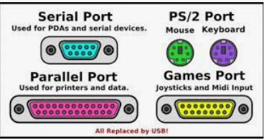
Important Terms
Computer Ports
An interface or a link through which data or information is communicated.
The three types of ports:
  Serial Port
    Called male port
    Uses 9 to 24 pins
    Known as communication ports or RS232C ports
    Used to connect devices like mouse and modem.
  Parallel Port
    Also known as female port and consists of 25 pins
    Used for connection of printers and scanners etc.
    Capable to transfer 8 bits of data at one time
    Faster-than serial port
  USB Port
    Does not use the concept of Pins like serial or parallel
    Easy ·to use and portable
    Every device is now converted to USB port like printer, scanner, digital camera etc.

Slide 50
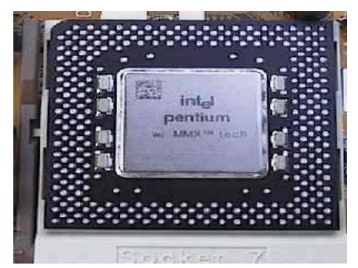
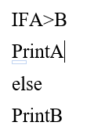

Important Terms
    Microprocessor
Called brain of computer
Normally in the form of a silicon chip containing millions of transistors fabricated on it
Called CPU (Central Processing Unit)
Microprocessor consists of the following different components:
      ALU (Arithmetic &Logical Unit)
      Has the capability to do arithmetic and logical operations
Example of arithmetic operation: 2+5=7, 6-5=1
Control Unit
Supervises all the components of the computer
Selects the input /output device and then it flows the data between the1/0devices and the memory device.
Brings instructions from memory unit and then executes them in an appropriate order.

Slide 51
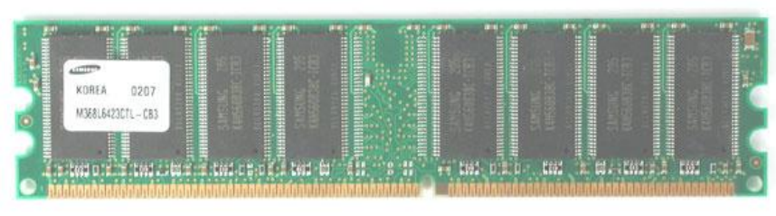
Important Terms
    Memory
Temporary stores data and programs during the data processing
    Two types: Primary Memory and Secondary Memory
    Primary Memory
  Called main memory of the computer
  Primary memory keeps several storage locations, which are called cells and the data or programs are stored in these memory locations.
  Called volatile memory
  Memory is measured in term of bytes
Further divided into the following categories:
  Dynamic Random Access Memory(DRAM)
  Static Random Access Memory(SRAM)

Slide 52
Important Terms
  Dynamic Random Access Memory(DRAM)
  Cheaper and dynamic in the sense that it is refreshed after every few milliseconds.
  DRAM is slower than SRAM memory, since DRAM has to be refreshed many times
  Static Random Access Memory(SRAM)
  Does not need refreshing
  Static RAM is generally used for cache memory, which can be accessed more quickly than DRAM.
  Faster than DRAM because it is not refreshed as DRAM

Slide 53
Important Terms
    Secondary Memory
      Called secondary storage or auxiliary storage
      Used to store large amount of data permanently
      Called non-volatile memory, because after shutting off the computer, the data is not erased.
    Types of Storage Media
      Hard Disks
      Optical Disks
      Magnetic Tape

Slide 54
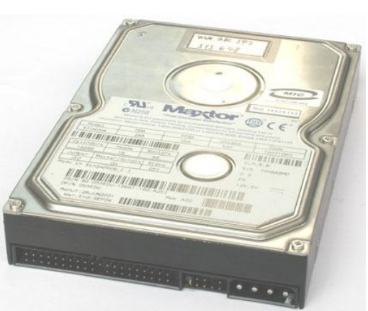
Important Terms
      Hard Disks
  Also called a hard drive or fixed drive
  Primarily used to store large amount of data and also provides a very quick access to retrieve the data or programs
  Available in different sizes. Like 320 GB (Gigabyte) & 400 GB etc.

Slide 55
Important Terms
Optical disks
Used as an electronic data storage medium
Available in different formats:
    Compact Disk (CD)
    Digital Versatile Disk (DVD)
    Compact Disk (CD)
Non-volatile storage medium
Used for recording, storing, and playing back audio, video, and computer data
Available in the following types:
    CD-R
    CD-RW

Slide 56
Important Terms
CD-R (CD-ROM)
    Data can be written only once
    Called read only memory
    Data cannot be erased from CD-R.
CD-RW (CD-Re-writeable)
    Write the data more than one time
    Can also erase the previous contents of data.
    Expensive than CD-R.

Slide 57
Important Terms
DVD (Digital Versatile Disk)
    Has the capability to store large amount of data than CD
    DVDs are rapidly replacing CDs because of higher capacity and performance
DVDs are further classified into the followings:
    DVD-R(Recordable)
    DVD-RW(Rewriteable)

Slide 58
Important Terms
DVD-R(Recordable)
    Used to record the data only one time
    Can't be recorded or rewritten again
DVD-RW(Rewriteable)
    Used to record the data multiple times.
    Previous data can also be erased from it.

Slide 59
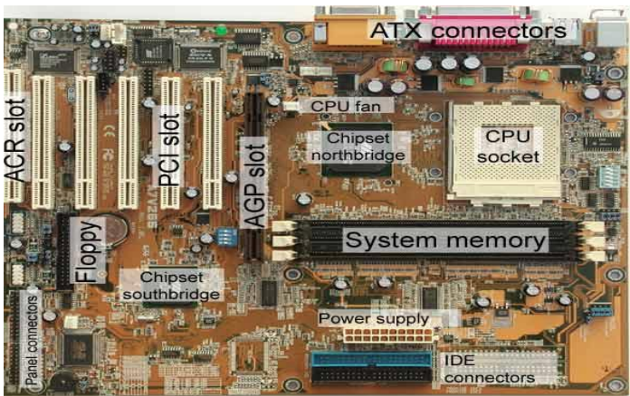
Important Terms
Motherboard of Computer system
The circuit board of the computer is called a mother board
It contains the key elements or components due to which a computer can't work properly
Key elements mounted on motherboard include
  Microprocessor
  Computer memory
  Serial & parallel ports
  Expansion slots etc.

