Slide 1
Introduction to Information and Communication Technology
CPS 111

Slide 2
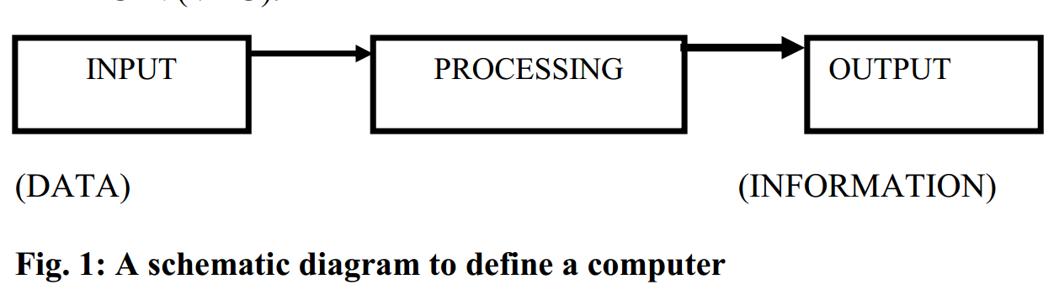
Computer
A computer is basically a tool or machine used for processing data to give required information.
It is capable of:
    Taking input data through the keyboard (input unit)
    Storing the input data in a diskette, hard disk or other medium
    Processing it in the central processing unit (CPU)
    Giving out the result (output) on the screen or the Visual Display Unit (VDU)

Slide 3
Data and Information
Data: refers to facts about a person, object or place, e.g. name, age, complexion, school, class, height etc.
Information: processed data or a meaningful statement, e.g.
  Net pay of workers
  Examination results of students
  list of successful candidates in an examination or interview etc.

Slide 4
Methods of Data Processing
The Manual method: involves the use of chalk, wall, pen, pencil and the like
The Mechanical method: involves use of machines such as the typewriter, roneo machines, adding machines etc
    Facilitate efforts in recording, classifying, manipulating, sorting and presenting data or information.
    Noisy, hazardous, error prone and untidy.
    Cannot processing of large volumes of data continuously and timely.

Slide 5
Methods of Data Processing
Computer method: Has the following major features:
  Data can be steadily and continuously processed
  The operations are practically not noisy
  There is a temporal and permanent storage for data and instructions
  Errors can be easily and neatly corrected
  Accuracy and reliability are highly enhanced
  Output reports are usually very neat, decent and can be produced in various forms such as adding graphs, diagrams and pictures

Slide 6
Characteristics of a Computer
Speed: manipulate large data at incredible speed and responds very fast.
Accuracy: Its accuracy is very high and its consistency can be relied upon.
Storage: It has both internal and external storage facilities for holding data and instructions.
Automatic: Once a program is in the computer’s memory, it can run automatically each time it is opened
Reliability: a computer does not suffer human traits of tiredness and lack of concentration.
Flexibility: It can perform any type of task once it can be reduced to logical steps.

Slide 7
The Computing System
Computing system: made up of the computer system, user and environment in which the computer is operated.
The Computer System: made up of the hardware and the software.
The Hardware: comprises the input unit, the processing unit and the output unit.
Input unit: comprises those media through which data is fed into the computer. Examples include the keyboard, mouse, joystick, trackball and scanner.
The processing unit: made up of the Arithmetic and Logic Unit (ALU), the control unit and the main memory.
The main memory: also known as the primary memory is made up of the Read Only Memory (ROM) and the Random Access Memory (RAM).

Slide 8
The Computing System
Output unit: made up of those media through which data, instructions for processing the data (program), and the result of the processing operation are displayed for the user to see.
Examples of the output unit are the monitor (Visual Display Unit) and the printer.

Slide 9
Software
Series of instructions that enable the computer to perform a task or group of tasks.
A program: made up of a group of instructions to perform a task
Software: series of programs linked together
Computer programs could be categorised into system software, utility software, and application programs.

Slide 10
Computer Users
Computer users are the different categories of personnel that operate the computer
  Expert users and casual users
The expert: computer engineers, computer programmers and computer operators

Slide 11
The Computing Environment
Includes the building housing the other elements of the computing system namely:
  The computer
  The users
  Furniture
  auxiliary devices such as:
    voltage stabiliser
    Uninterruptible Power Supply System (UPS)
    Fans
    Air conditioners etc.

Slide 12
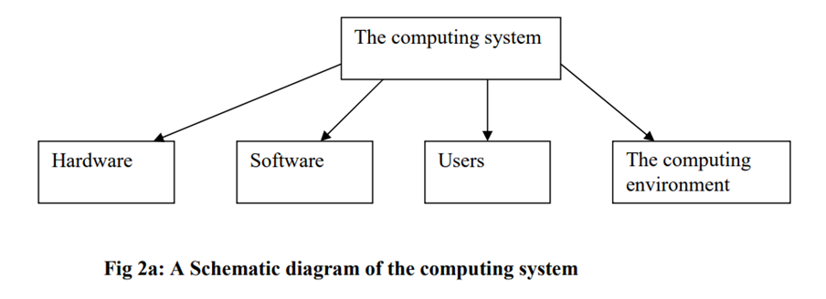
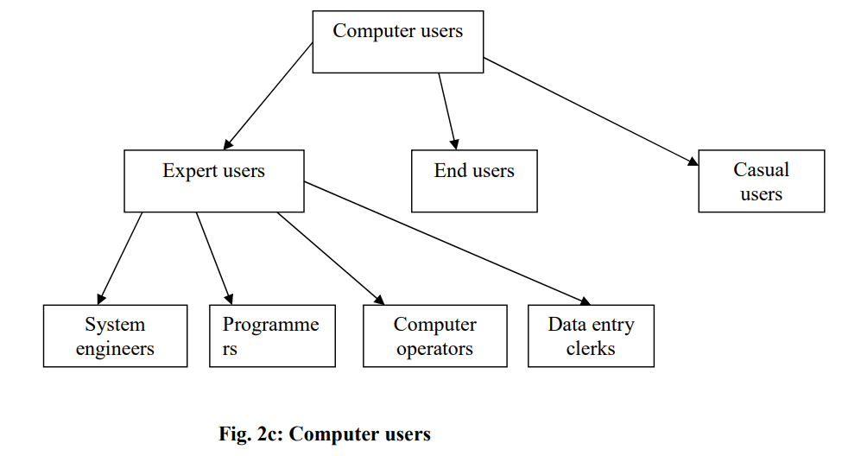
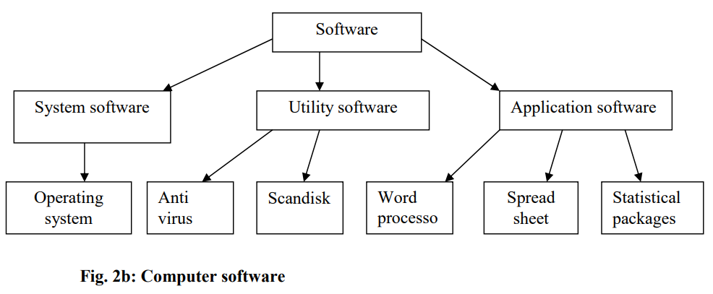

Slide 13
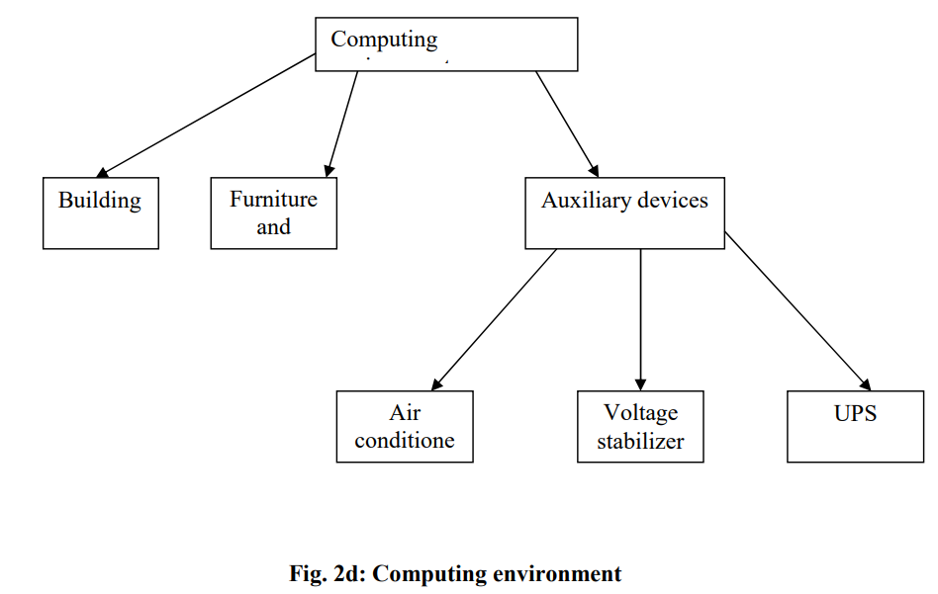

Slide 14
INPUT and OUTPUT DEVICES
CPS111

Slide 15
INPUT DEVICES
  Introduction
  Input devices are used to feed data into a computer
  Keyboard and mouse are most popular input devices
  This session is focused on different input devices and their uses.

Slide 16
INPUT DEVICES
  Objectives
After completing the session the student would be in position to:
Describe the purpose of Input devices.
Distinguish between different Input devices.
Have knowledge about advance Input devices like speech recognition systems and image scanning.

Slide 17
  INPUT DEVICES
Input devices are used to enter data and instructions into the computer
Following are most widely used Input devices.
      Keyboard Device
      Point and Draw Devices
      Speech Recognition Device
      Data Scanning Devices

Slide 18
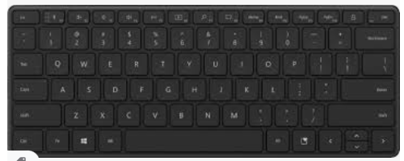
INPUT DEVICES
    Keyboard Device
A standard input device readily available for us to feed the data.
Similar to a conventional type writer with about 101 keys
  Function Keys
  Numeric Keys
  Alphabetic Keys

Slide 19
INPUT DEVICES
      Function Keys:
        Function keys are 12 in numbers labeled as F1 to Fl2
        Perform a specific stored function
          Example: F1 key is used for help option
      Numeric Keys
        Used for entering numeric data
        Switched "on” and switch "Off' by pressing ''Numlock" key
        Can also be used for "Arrow keys" and page up & down tasks
      Alphabetic Keys
        Used to type the character data
        It is used for normal typing work.

Slide 20
INPUT DEVICES
    Point and Draw Devices
  Helps to rapidly point and select an icon to display on the screen
  Some of the most popular point and draw devices

Slide 21
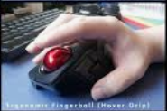
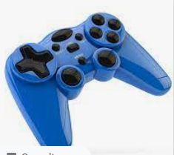
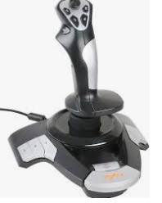
INPUT DEVICES
      Trackball
  Works just like a mouse
  Trackball contains only one ball instead of different buttons like left or right etc
  Uses this ball to move the cursor position
      Joy Stick
        Used by the children to play their games
        Also used as a control stick in the aeroplanes to control the movements.
        Consists of a handle, which can be used to move the cursor position left, right, up and down

Slide 22
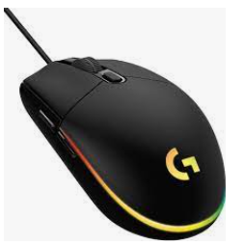
INPUT DEVICES
      Mouse
User can move cursor very rapidly on the screen with the help of mouse.
Mouse controls the movements of the cursor positions.
Variety of mouse available.
For example: Wheel mouse, laser mouse, wireless mouse etc.

Slide 23
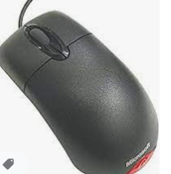
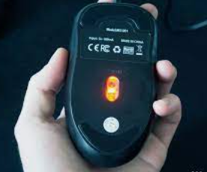
INPUT DEVICES
Wheel mouse
  Contains left, right buttons, and a wheel button at the middle.
  Wheel button is used to scroll the pages up and down very rapidly
Laser Mouse
  Uses the laser beam for its movement
  Laser mouse does not need any mouse pad
  Automatically activated as it gets attached with the computer

Slide 24
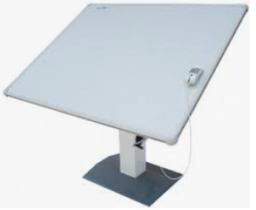
INPUT DEVICES
    Touch Screen
  Touch screen is capable to touch the data directly by using fingers within the display area
    Digitizer
  Used to convert the maps, pictures and drawings into a digital form for storing in the computer system
  Consists of a digitizing tablet and a stylus (pen)
  Has a flat surface on which stylus or a pen is moved to draw shapes, pictures or maps etc.

Slide 25
INPUT DEVICES
Speech Recognition Device
  Allows a person to input data to the computer through speaking
  Converts the human voice in text
  Especially helpful for the disable persons
  Recognize words using software or a device then convert into text or device readable format
  Types of Speech Recognition system
    Single Word Speech Recognition System
    Continuous Type of Words Speech Recognition System

Slide 26
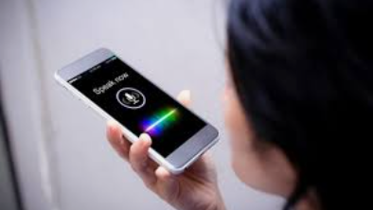
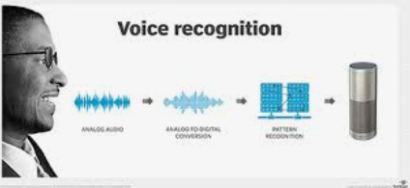
INPUT DEVICES
Single Word Speech Recognition System
  Recognize only single word like "Hello', "Yes", ''No ', at one time
Continuous Type of Words Speech Recognition System
  Recognizes more than one word or a complete sentence
  For example "hello how are you".

Slide 27
INPUT DEVICES
      Uses of Speech Recognition System
      Speech Recognition Systems are especially helpful for the disable persons, who cannot write
      It helps those persons who feel comforts to speak rather than to write
      It facilitates a user in a situation where he/she is unable to edit &review a long text
      It also helps the users, who are quite busy and don't want to type the data due to shortage of time.

Slide 28
INPUT DEVICES
    Data Scanning Devices
    Image Scanner
      Image scanner translates the documents into an electronic (format and stores them into the computer
      Important documents can be preserved in an electronic form by using image scanner for later use
      These documents can also be printed
    Image scanner is further classified into the following
    Flatbed Scanner
      Hand-Held Scanner

Slide 29
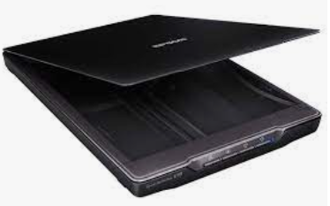
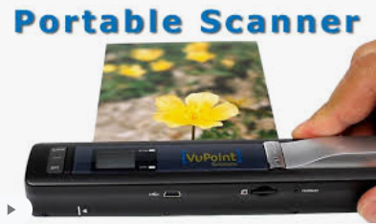
INPUT DEVICES
Flatbed Scanner
  Looks like a photocopier machine having a glass sheet
  Called desktop scanners
  The paper is placed on a glass sheet, and a light source is moved horizontally from one line to other line.
  Hand-Held Scanner
  Works much like a flatbed scanner but it works manually by the user itself.
  For scanning the documents or products, the scanner is dragged slowly with its light on
  Mostly used in the shops to scan the price of the products.

Slide 30
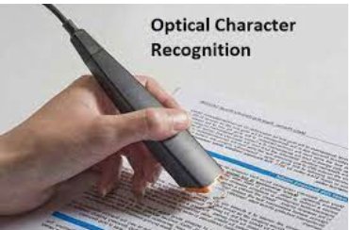
INPUT DEVICES
      OCR (Optical Character Recognition)
  Uses software called "OCR software"
  The scanner first creates an image of the document and then OCR software converts that image into ASCIl text
  Computer interprets the ASCIl text as letters, numbers and special characters

Slide 31
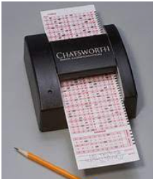
INPUT DEVICES
      OMR(Optical Mark Reader)
  Has the capability to recognize the pre-mentioned marks either of a pen or a pencil
  Specifically helpful for making objective type questions
  The students mark the answer sheet by filling/darkening an oval shape or square
  Answer sheet is fed into the computer and the grading is done by using Optical Mark Reader

Slide 32
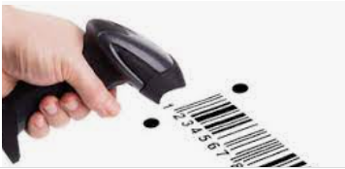
INPUT DEVICES
      BCR (Bar Code Reader)
  Used in the shops, glossary stores
  Contains the photo electric cells that read bar codes consisting of lines having different thickness
  Barcode reader helps shopkeepers to analyze the price of an item immediately

Slide 33
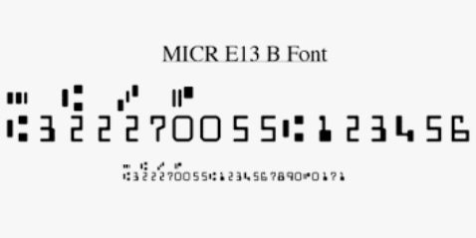
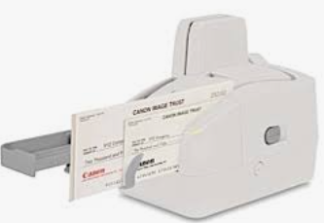
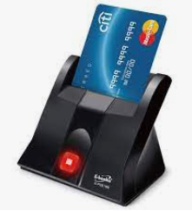
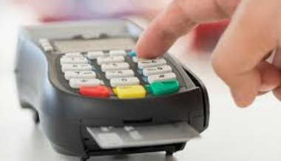
INPUT DEVICES
MICR (Magnetic Ink Character Recognition)
  Used to read the magnetically encoded characters
  It provides a full alphanumeric recognition of printed or handwritten characters by simply scanning
  The MIRC converts the images into machine-readable characters.
      Electronic Card Reader
  Used to scan e-cards / smart cards like visa card, bank credit cards etc.
  Reads the memory card of the ATM debit card or visa card etc.
  The memory card is in the form of a black strip, which is wiped through an electronic device called an Electronic card Reader machine.

Slide 34
INPUT DEVICES
Vision input System
    One of the latest input devices that recognize the vision, image, which appears in the range of its lens
    These are especially used to design industrial Robots

Slide 35
OUTPUT DEVICES
Introduction
The computer output devices are also important peripherals of a computer system.
There are different types of output devices such as monitor, printers, and plotter. In This part we will study about different output devices

Slide 36
OUTPUT DEVICES
Objectives
After completing the part, the student would be able to:
    Distinguish between different output devices
    Explain various types of output devices including printers, monitors
    Explain special function terminals
    Have knowledge about working of different output devices

Slide 37
OUTPUT DEVICES
Monitor
A standard output device which provides visual output from a computer
The first device readily available for a user to view or to display the output
They are of different types with different resolutions, sizes, and characteristics.

Slide 38
OUTPUT DEVICES
Types of Monitors
  CRT (Cathode Ray Tube) Monitor
  LCD (Liquid Crystal Diode) Monitor
  LED (Light Emitted Diode) Monitor

Slide 39
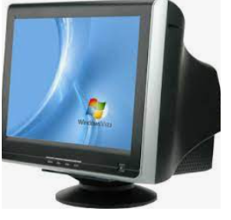
OUTPUT DEVICES
CRT (Cathode Ray Tube) Monitor
Cathode Ray Tube (CRT) technology is an embed vacuum tube technology
These monitors are low cost, reliable and available in colors etc.
Consume much electricity and heavy in weight

Slide 40
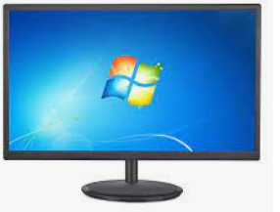
OUTPUT DEVICES
        LCD Monitor
Liquid Crystal Display (LCD) monitors uses Liquid crystals
Very slim and light weight
LCDs are rapidly replacing CRT monitors
Used in notebooks, small computers, pagers, phones and other devices

Slide 41
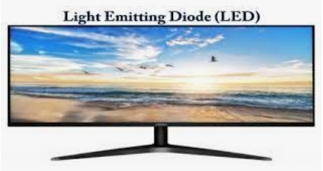
OUTPUT DEVICES
LED (Light Emitted Diode) Monitor
LED is an enhanced version of LCD with the fluorescent lamps having LED backlight
Uses semiconductor diode inside of filament
Semiconductor diode is an electronic component which is used to develop liquid crystal display in LED
Used in many devices such as cell phones, computers, monitors, flash lights and movement sensors etc.

Slide 42
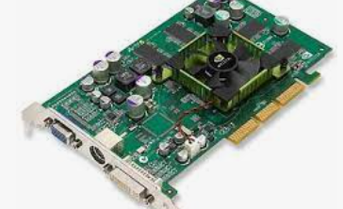
OUTPUT DEVICES
Graphic Adapters
A video adapter is a device that performs graphics processing.
Called graphics card, display adapter, video card etc.
It describes the resolution, refresh rate and number (of colors to be displayed on the monitor
Currently the graphic circuits are built into the chipset.

Slide 43
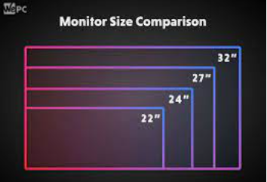
OUTPUT DEVICES
Monitor Size
The monitor size refers to the distance in inches from one corner to other of the viewable area
A CRT monitor size actually measures the distance of the entire front of the CRT monitor
The size of monitor screen is measured in inches
Commonly used sizes are14", 15", 17", 19", and 2l"screen etc.

Slide 44
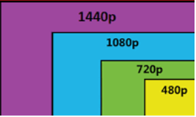
OUTPUT DEVICES
Resolution
Number of horizontal and vertical pixels on the monitor
Pixels are the smallest component of a digital image and are combined to form a comprehensive picture.
More pixels make better picture quality
Monitor resolution is measured in width by height like 640 x 480 resolution
    Means that the width of the screen is640 pixels and 480 is its height

Slide 45
OUTPUT DEVICES
    Printer
      Sometimes a user also needs to take the output in the form of a paper
      This is possible with the help of a printer
      Generally a printer may be black & white but color printers are also available
    Printers are further categorized as:
        Dot Matrix Printer
        Inkjet Printer
        LaserJet Printer

Slide 46
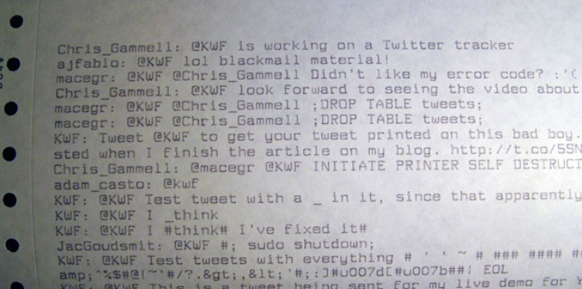
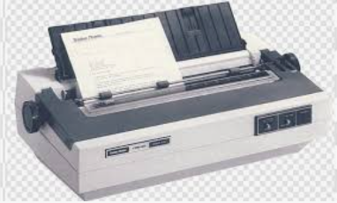
OUTPUT DEVICES
Dot Matrix Printer
  Print one character at a time.
  Uses a ribbon cartridge to print characters on the paper.
  It speed of printing ranges from 30 to 550 characters per second (cps).
  Available in different sizes.
  Dot matrix is low cost printer and consumes less energy
Limitations:
  Dot matrix printers create noise during printing process
  They print the text with low resolution
  The font facility is limited and graphics quality is also not high

Slide 47
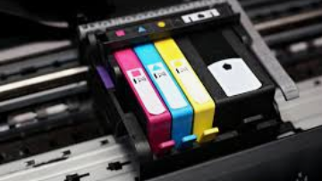
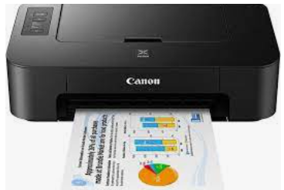
OUTPUT DEVICES
Inkjet Printer
  Used to print all kinds of images
  Printer print one character at a time
  Uses ink bottles in different color combinations
  Uses four ink cartridges
  Graphic quality or text quality depends on the strength of the ink cartridges
    Inkjet printers consume less energy
    The printing quality is high
Limitations
    Inkjet printers are expensive because refilling bottles make a high Cost

Slide 48
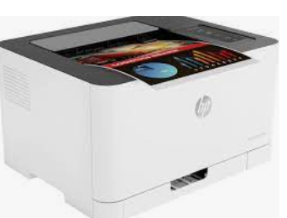
OUTPUT DEVICES
Laser Printer
  Print one page at a time
  Uses tonners to print the desired characters
  Capable to print the high quality graphics images
  A laser beam sends information from the computer to a rotating mirror to produce an image on the drum
  Laser printers are speedier and noiseless
  They can print on both sides of a paper
  Limitations
    Laser printers are expensive

Slide 49
OUTPUT DEVICES
    Multimedia Projector
  Used to display information from the computer on to a large screen
  Helpful in delivering lectures and presentations
  There are further two prominent types of multimedia projector
    LCD Projector (Liquid Crystal Display)
          DLP (Digital Light Processing) Projector

Slide 50
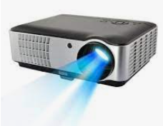
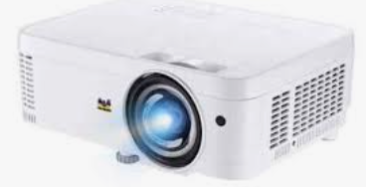
OUTPUT DEVICES
    LCD Projector (Liquid Crystal Display)
  Called digital multimedia projector
  Can adjust the brightness and contrast and produce sharp images
          DLP (Digital Light Processing) Projector
  OLP projectors
  Called digital multimedia projectors
  Lighter in weight and smaller in size
  Produce best quality video images
  Portable in size and lighter in weight

Slide 51
OUTPUT DEVICES
    Voice Response Systems
  Enable computers to talk with a user
  Voice Response Systems keeps an audio response device that helps to produce audio output.
  These systems provide an easy communication way to both a user and a computer.
  Voice response systems are of two types:
    Voice Reproduction System
    Speech Synthesizer

Slide 52
OUTPUT DEVICES
  Voice Reproduction System
Uses a database of pre-recorded responses like words, phrases, or sentences, spoken by human beings or even musical sounds generated through musical instruments
Produces the output by selecting the particular words, phrases etc from the database.
Analog recordings of the pre-recorded sound are converted into digital data and then this data stored on a hard disk or any other secondary storage
Whenever a user wants to produce an audio output, the system selects the required sound from the set of pre-recorded sounds stored in the computer.
The selected sound is then converted back into analog form to a speaker to produce the audio output

Slide 53
OUTPUT DEVICES
Applications of Voice Reproduction system
ATM machine
  Uses voice reproduction system to provide systematic or step by step guidance to customers.
  Helps the customers to make a financial transaction
Automatic Answering Machines
  Used in telephone enquiries like schedule of trains and airplanes etc.
Interactive video games
  Various sounds are produced while playing a video gained from a database of pre-recorded sounds

Slide 54
OUTPUT DEVICES
Applications of Voice Reproduction system
Mobile phone talking alarm clock
  An example of voice reproduction system.
  After every hour mobile phone clock speaks the time from the database of pre-recorded voice messages
Talking toys
  Various exciting sounds are produced

Slide 55
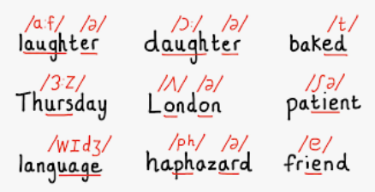
OUTPUT DEVICES
Speech Synthesizer
  Helps to convert the text information into spoken words or sentences
  Helpful for the disable persons who cannot easily read
  Whenever a user feeds the data in the form of text information, the sequences of words are combined into phonemes
  The phonemes are amplified, and passed on to a speaker

Slide 56
OUTPUT DEVICES
Application of speech Synthesizer
Special education sector
  Helpful for the blind persons who cannot read
  Study material or a book is scanned using a scanner
  It is converted into text using OCR software
  Finally presented to the blind person using a speech synthesizer

Slide 57
OUTPUT DEVICES
Vocal problem/ cannot communicate effectively
  A person having disability problem can simply type the information and it is converted into spoken words for him
Language Interpretation
  Helpful for the interpretation or translation into other languages
  Converts an entered text into spoken words in any selected language

