Slide 2
Cybersecurity
refers to the technologies, processes, and practices designed to protect networks, computers, programs, and data from vulnerabilities, attacks, or unauthorized access by cybercriminals over the Internet.

Slide 3
Computer security
Computer security, also known as cybersecurity or IT security, is the protection of information systems from theft or damage to the hardware, the software, and to the information on them, as well as from disruption or misdirection of the services they provide.

Slide 4
Cybersecurity
includes controlling physical access to the hardware, as well as protecting against harm that may come via network access, data and code injection, and due to malpractice by operators, whether intentional, accidental, or due to them being tricked into deviating from secure procedures.

Slide 5
security properties include one or more of the following:
Availability
Integrity
confidentiality
They are the core principles of cybersecurity

Slide 6
1. Availability
means that the information and systems must be available to those who need it.

Slide 7
2. Integrity
we mean that the information must retain its reliability and not be altered from its original state.

Slide 8
3. confidentiality
means that the information that is sensitive or confidential must remain so and be shared only with appropriate users.

Slide 9
Cybersecurity includes different elements such as application security, information security, network security, and disaster recovery

Slide 10
Application security
Application security is the type of cyber security which is developing application by adding security features within applications to prevent it from cyber threats.

Slide 11
Information security
Preservation of confidentiality, integrity and availability of information.
refers to the process and methodology to protect the confidentiality, integrity and availability of computer system from unauthorized access, use, modification and destruction.

Slide 12
network security
Security of network and information systems means the ability of network and information systems to resist, at a given level of confidence, any action that compromises the availability, authenticity, integrity or confidentiality of stored or transmitted or processed data or the related services offered by, or accessible via, those network and information systems.

Slide 13
Network Security
is the process of preventing and protecting against unauthorized intrusion into computer networks.

Slide 14
Disaster recovery
Disaster recovery (DR) is an area of security planning that aims to protect an organization from the effects of significant negative events.
Having a disaster recovery strategy in place enables an organization to maintain or quickly resume mission-critical functions following a disruption.

Slide 15
A disaster recovery (DR) plan is a formal document created by an organization that contains detailed instructions on how to respond to unplanned incidents such as natural disasters, power outages, cyber attacks and any other disruptive events.
The plan contains strategies on minimizing the effects of a disaster, so an organization will continue to operate – or quickly resume key operations.

Slide 16
Ways to secure computers
Updating the operating system regularly
Backup data,
Using strong password
Access control software
Use licensed Anti-virus
Biometrics
Hiring trustworthy employees
Encryption
Using firewalls
Using VPN

Slide 17
Access-control software
Access-control software- for example may allow computers users access only to those files related to their work, and may allow read- only- access which means the user can read files, but cannot change them.

Slide 18
Anti- virus software
Anti- virus software- may also be used. It does not restrict a user’s access, but scans files for virus and in many cases, eradicate them

Slide 19
Biometrics
Biometrics –may also be used to grant or deny access to computers systems. when this type of security is used, employees may be identified by finger prints, retinal patterns in the eye, etc before being granted access to use a computer.

Slide 20
Hiring trustworthy employees
Another way or means for organizations to ensure computer security is to make every effort to hire trustworthy employees.
Trustworthy employees are less likely to commit offences associated with unauthorized access.

Slide 21
Encryption
Encryption- Is the process of encoding messages before they enter the network or airwaves, then decoding them at the receiving end of the transfer, so that recipients can read or hear them.

Slide 22
Firewalls
Firewalls- consists of hardware or software designed to keep unauthorized users out of network system.
Firewalls software can filter incoming and outgoing information and block unauthorized users.

Slide 23
Virtual private network
When a mobile user, remote office, vendor, or customer connects to a company’s network using the Internet, a virtual private network (VPN) provides them with a secure connection to the company network server, as if they had a private line.

Slide 24
VPNs help to ensure that transmitted data is safe from being intercepted by unauthorized people
VPNs securely extend the company’s internal network beyond the physical boundaries of the company.

Slide 25
The secure connection created over the Internet between the user’s computer and the company’s network is called a VPN tunnel

Slide 26
Why Computer Security?
To prevent damage of the hardware.
To prevent theft or damage of the installed software.
To prevent theft or damage of stored data and information.

Slide 27
To prevent the disruption of service.
Likewise, security system keeps the computer system safe by protecting the installed software and the stored data (information).
helps prevent viruses

Slide 28
E-Commerce
It can be broadly defined as the process of buying or selling of goods or services using an electronic medium such as the Internet

Slide 29
E-Commerce
Electronic commerce (e-commerce) is the marketing, buying and selling of merchandise or services over the Internet.

Slide 30
E-Commerce
E-commerce refers to online transactions - buying and selling of goods and/or services over the Internet

Slide 31
Traditional Commerce v/s E-Commerce
Traditional Commerce
Heavy dependency on information exchange from person to person.
E- commerce
Information sharing is made easy via electronic communication channels making little dependency on person to person information exchange.

Slide 32
It is difficult to establish and maintain standard practices in traditional commerce.
Communications of business depends upon individual skills.
A uniform strategy can be easily established and maintain in e-commerce.
In e-Commerce or Electronic Market, there is no human intervention.

Slide 33
Unavailability of a uniform platform as traditional commerce depends heavily on personal communication.
E-Commerce website provides user a platform where al l information is available at one place.

Slide 34
No uniform platform for information sharing as it depends heavily on personal communication.
E-Commerce provides a universal platform to support commercial / business activities across the globe.

Slide 35
E-Commerce - Advantages
Advantages to Organizations
Advantages to Consumers
Advantages to Society

Slide 36
Advantages to Organizations
Using e-commerce, organizations can expand their market to national and international markets with minimum capital investment. An organization can easily locate more customers, best suppliers, and suitable business partners across the globe

Slide 37
E-commerce helps organization to provide better customer services.
E-commerce helps to simplify the business processes and makes them faster and efficient.
E-commerce reduces the paper work.

Slide 38
Advantages to Customers
It provides 24x7 support. Customers can enquire about a product or service and place orders anytime, anywhere from any location.
E-commerce application provides users with more options and quicker delivery of products.

Slide 39
E-commerce application provides users with more options to compare and select the cheaper and better options.

Slide 40
A customer can put review comments about a product and can see what others are buying, or see the review comments of other customers before making a final purchase.

Slide 41
E-commerce provides options of virtual auctions.
It provides readily available information. A customer can see the relevant detailed information within seconds, rather than waiting for days or weeks.

Slide 42
E-Commerce increases the competition among organizations and as a result, organizations provides substantial discounts to customers.

Slide 43
Advantages to Society
Customers need not travel to shop a product, thus less traffic on road and low air pollution.
E-commerce has enabled rural areas to access services and products, which are otherwise not available to them.

Slide 44
E-commerce helps the government to deliver public services such as healthcare, education, social services at a reduced cost and in an improved manner.

Slide 45
E-Commerce - Disadvantages
Technical disadvantages
Non-Technical disadvantages

Slide 46
Technical Disadvantages
There can be lack of system security, reliability or standards owing to poor implementation of e-commerce.
The software development industry is still evolving and keeps changing rapidly.

Slide 47
In many countries, network bandwidth might cause an issue.
Sometimes, it becomes difficult to integrate an e-commerce software or website with existing applications or databases.

Slide 48
There could be software/hardware compatibility issues, as some e-commerce software may be incompatible with some operating system or any other component.

Slide 49
Non-Technical Disadvantages
Initial cost − The cost of creating/building an e-commerce application in-house may be very high. There could be delays in launching an e-Commerce application due to mistakes, and lack of experience.

Slide 50
User resistance − Users may not trust the site being an unknown faceless seller. Such mistrust makes it difficult to convince traditional users to switch from physical stores to online/virtual stores.

Slide 51
Security/ Privacy − It is difficult to ensure the security or privacy on online transactions.
Lack of touch or feel of products during online shopping is a drawback.

Slide 52
Internet access is still not cheaper and is inconvenient to use for many potential customers, for example, those living in remote villages.

Slide 53
Types/Category of e- commerce
Business - to - Business (B2B)
Business - to - Consumer (B2C)
Consumer - to - Consumer (C2C)
Consumer - to - Business (C2B)
Business - to - Government (B2G)
Government - to - Business (G2B)
Government -to -Consumer (G2C)
Government -to -Government (G2G)
Consumer -to -Government (C2G)

Slide 54
Business - to - Business (B2B)
This is when a transaction of goods or services occurs between two businesses.
B2B e-commerce is simply defines as e-commerce between Companies .
This is the type of e-Commerce that deals with relationship between and among businesses.

Slide 55
Business - to - Consumer (B2C)
the company will sell their goods and/or services directly to the consumer.
The consumer can browse their websites and look at products, pictures, read reviews.
Then they place their order and the company ships the goods directly to them.

Slide 56
Consumer - to - Consumer (C2C)
Consumer -to -consumer e-commerce or C2C is simply commerce between private individuals or consumers.
Consumer to consumer, where the consumers are in direct contact with each other.

Slide 57
No company is involved. It helps people sell their personal goods and assets directly to an interested party.

Slide 58
Consumer - to - Business (C2B)
here the businesses are buying from consumers, So the consumer provides a good or some service to the Company.

Slide 59
Business - to - Government (B2G)
B2G e-commerce is commerce between Companies and public sector.
it refers to the use of the Internet for Public Procurement, licensing procedure, and other government-related Operation.

Slide 60
Example: — Business pay taxes or sell goods and services to Govt. agencies

Slide 61
Government - to - Business (G2B)
G2B e-commerce is a business model were all the information and services are provided by the Government to the Business Organizations.
The information is shared through a vast network of different government websites.

Slide 62
The business Organization use that information to apply for various permission needed for starting a new business, and other specifications.
A Business Organization can also download the different forms and submit it online or offline to the related office.

Slide 63
Government -to -Consumer (G2C)
The electronic commerce activities performed between the government and its citizens or consumers, including paying taxes, registering vehicles, and providing information and services, registration for birth, marriage or death certificates.

Slide 64
Government -to -Government (G2G)
Government to government (G2G) is the electronic sharing of data and/or information systems between government agencies, departments or organizations.
The goal of G2G is to support e-government initiatives by improving communication, data access and data sharing.

Slide 65
Consumer -to -Government (C2G)
Consumer to administration or consumer to government e-commerce model enables the consumers to post feedback or request information regarding public sectors directly to the government administration or authorities.

Slide 66
For example, when you pay electricity bill through the government website, payment of health insurance, make payment of taxes, etc.

Slide 67
E-Commerce - Payment Systems
E-commerce sites use electronic payment, where electronic payment refers to paperless monetary transactions.
Electronic payment has revolutionized the business processing by reducing the paperwork, transaction costs, and labor cost.

Slide 68
User friendly and less time-consuming than manual processing, it helps business organization to expand its market reach/expansion.

Slide 69
Modes of electronic payments
Credit Card
Debit Card
Smart Card

Slide 70
Credit Card
Credit card is small plastic card with a unique number attached with an account.
It has also a magnetic strip embedded in it which is used to read credit card via card readers.

Slide 71
When a customer purchases a product via credit card, credit card issuer bank pays on behalf of the customer and customer has a certain time period after which he/she can pay the credit card bill.

Slide 72
actors in the credit card system
The card holder − Customer
The merchant − seller of product who can accept credit card payments.
The card issuer bank − card holder's bank
The acquirer bank − the merchant's bank
The card brand − for example , visa or Mastercard.

Slide 73
Credit Card Payment Process
Step 1. Bank issues and activates a credit card to the customer on his/her request.
Step 2. The customer presents the credit card information to the merchant site or to the merchant from whom he/she wants to purchase a product/service.

Slide 74
Step 3. Merchant validates the customer's identity by asking for approval from the card brand company.
Step 4. Card brand company authenticates the credit card and pays the transaction by credit. Merchant keeps the sales slip.

Slide 75
Step 5. Merchant submits the sales slip to acquirer banks and gets the service charges paid to him/her.
Step 6. Acquirer bank requests the card brand company to clear the credit amount and gets the payment.

Slide 76
Step 7. Now the card brand company asks to clear the amount from the issuer bank and the amount gets transferred to the card brand company.

Slide 77
Smart Card
Smart card is again similar to a credit card or a debit card in appearance, but it has a small microprocessor chip embedded in it.
It has the capacity to store a customer’s work-related and/or personal information.

Slide 78
E-Commerce - Security Systems
Security is an essential part of any transaction that takes place over the internet.
Customers will lose his/her faith in e-business if its security is compromised.

Slide 79
Safe e-payments/transactions requirements
Confidentiality − Information should not be accessible to an unauthorized person. It should not be intercepted during the transmission.
Integrity − Information should not be altered during its transmission over the network.

Slide 80
Availability − Information should be available wherever and whenever required within a time limit specified.
Authenticity − There should be a mechanism to authenticate a user before giving him/her an access to the required information.

Slide 81
Non-Repudiability − It is the protection against the denial of order or denial of payment. Once a sender sends a message, the sender should not be able to deny sending the message. Similarly, the recipient of message should not be able to deny the receipt.

Slide 82
Encryption − Information should be encrypted and decrypted only by an authorized user.
Auditability − Data should be recorded in such a way that it can be audited for integrity requirements.

Slide 83
E-commerce applications
E- banking
E-auction
E-procurement
E- marketing

Slide 84
Decision support systems(DSS)
Decision support systems ( DSS) are special information systems designed to support organizational decision making.
A DSS is designed to support the decision making related to a particular recurring problem in the organization through the combination of hardware, software, data and procedures.

Slide 85
DSS three main components
Data
models and
user interface

Slide 86
Models are used by the DSS to manipulate data.
Example if you have some historic sales data, you can use different models to create a forecast of future sales.
One technique would be to take an advantage of the past sales.

Slide 87
Formula you would use to calculate the average is the model.
The user interface is the way in which the DSS interacts with the user by collecting inputs and displaying outputs and results.

Slide 88
Inputs & outputs
Inputs are data and models
Outputs are graphs and textual reports

Slide 89
Types of Decision Support Systems
Communication-driven
Model-driven
Knowledge-driven
Document-driven
Data-driven

Slide 90
Communication-driven
Allows companies to support tasks that require more than one person to work on the task.
It helps executives and managers work together to come to the final solution to solve problems.

Slide 91
Model-driven
Allows access to and the management of financial, organizational, and statistical models.
Data is collected, and parameters are determined using the information provided by users.
The information is created into a decision-making model to analyze situations.

Slide 92
Knowledge-driven
Provides factual and specialized solutions to situations by using stored facts, procedures, rules, or interactive decision-making structures like flowcharts

Slide 93
Document-driven
Manages unstructured information in different electronic formats.

Slide 94
Data-driven:
Helps companies to store and analyze internal and external data.

Slide 95
Advantages of a Decision Support System
A decision support system increases the speed and efficiency of decision-making activities. It is possible, as a DSS can collect and analyze real-time data.
It promotes training within the organization, as specific skills must be developed to implement and run a DSS within an organization.

Slide 96
It automates monotonous managerial processes, which means more of the manager’s time can be spent on decision-making.
It improves interpersonal communication within the organization.

Slide 97
Disadvantages of a Decision Support System
The cost to develop and implement a DSS is a huge capital investment, which makes it less accessible to smaller organizations.

Slide 98
A company can develop a dependence on a DSS, as it is integrated into daily decision-making processes to improve efficiency and speed. However, managers tend to rely on the system too much, which takes away the subjectivity aspect of decision-making.

Slide 99
A DSS may lead to information overload because an information system tends to consider all aspects of a problem. It creates a dilemma for end-users, as they are left with multiple choices.

Slide 100
Implementation of a DSS can cause fear and backlash from lower-level employees. It is because many of them are not comfortable with new technology and are afraid of losing their jobs to technology.

Slide 101
Database Management
Database Management

Slide 102
Databases
A database is a collection of data organized in a manner that allows access, retrieval, and use of that data.

Slide 103
Data and Information
Data is a collection of unprocessed items, which can include text, numbers, images, audio, and video.
Information is processed data; that is, it is organized, meaningful, and useful.

Slide 104
Database software
often called a database management system (DBMS), allows users to create
computerized database; add, modify, and delete data in the database.
sort and retrieve data from the database and
create forms and reports from the data in the database.

Slide 105
Data Integrity
Data integrity identifies the quality of the data.
Garbage in, garbage out (GIGO) is a computing phrase that points out the accuracy of a computer’s output depends on the accuracy of the input.

Slide 106
Qualities of Valuable Information
Accurate
Verifiable
Timely
Organized
Accessible
Useful
Cost-effective

Slide 107
The Hierarchy of Data
Data is organized in layers.
  Files (sometimes called tables)
  records
  characters

Slide 108
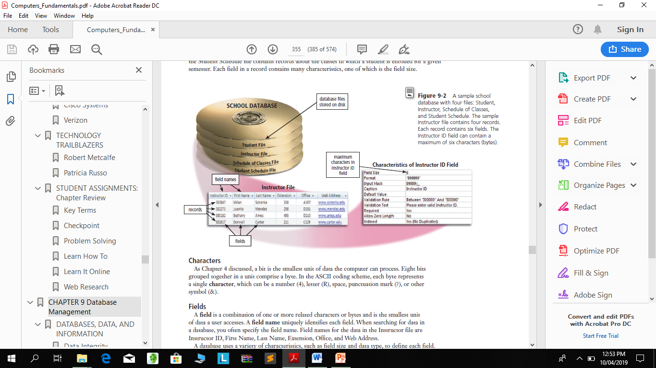

Slide 109
character
Each byte represents a single character, which can be a number (4), letter (R), space, punctuation mark (?), or other
symbol (&).
A data file is a collection of related records stored on a storage medium such as a hard disk or optical disc.

Slide 110
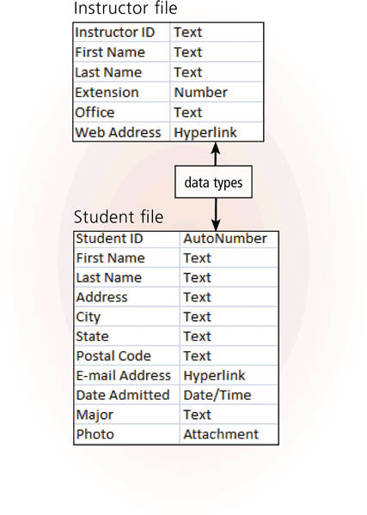
field
A field is a combination of one or more related characters or bytes and is the smallest unit of data a user accesses.
Field name
Field size
Data type

Slide 111
Field name, field size and data type
A field name uniquely identifies each field.
The field size defines the maximum number of characters a field can contain.
The data type specifies the kind of data a field can contain and how the field is used.

Slide 112
The Hierarchy of Data
Common data types include:
Text (also called alphanumeric)
Numeric
AutoNumber
Currency
Date (also called date/time)
Memo
Yes/No

Slide 113
The Hierarchy of Data
Common data types include:
Hyperlink
Object
Attachment

Slide 114
The Hierarchy of Data
A record is a group of related fields.

Slide 115
primary key
A primary key is a field that uniquely identifies each record in a file.
The data in a primary key is unique to a specific record.
In some tables, the primary key
consists of multiple fields, called a composite key.

Slide 116
data file
A data file is a collection of related records

Slide 117
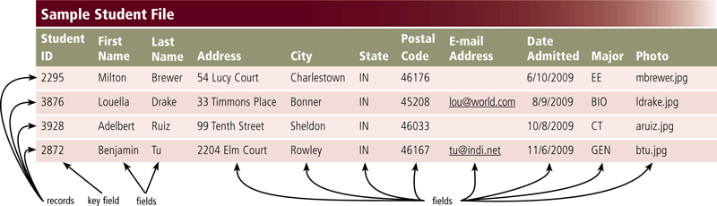

Slide 118
Maintaining Data
File maintenance refers to the procedures that keep data current. File maintenance procedures include
adding records to
modifying records in and
deleting records from a file.

Slide 119
Validation
is the process of comparing data with a set of rules or values to find out if the data is correct.

Slide 120
Validation cont.
Alphabetic/Numeric Check
An alphabetic check ensures that users enter only alphabetic data into a field.
A numeric check ensures that users enter only numeric data into a field.

Slide 121
Validation cont.
A range check determines whether a number is within a specified range.

Slide 122
A consistency check tests the data in two or more associated fields to ensure that the relationship is logical and their data is in the correct format.
For example, the value in a Date Admitted field cannot occur earlier in time than a value in a Birth Date field.

Slide 123
Validation cont.
A completeness check verifies that a required field contains data.
For example, some fields cannot be left blank others require a minimum number of characters.

Slide 124
Validation cont.
A check digit is a number(s) or character(s) that is appended to or inserted in a primary key value.
A check digit often confirms the accuracy of a primary key value.
Bank account, credit card, and other identification numbers often include one or more check digits.

Slide 125
Validation cont.
Other Checks DBMSs that include hyperlink and attachment data types can perform validity checks on data entered in those fields.

Slide 126
Validation cont.
Hyperlink entries can be tested to ensure that the Web address follows the correct format and that the link works.
Similarly, an attachment entry can be validated by confirming that the file exists.

Slide 127
File Processing Versus Databases
File processing system
Each department has its own set of files
Used for many years
Have data redundancy
Isolate data
Database approach
Programs and users share data
Reduce data redundancy
Improve data integrity
Share data
Allows easier access
Reduces development time
Can be more vulnerable

Slide 128
Disadvantages of Databases
more complex than a file processing system
require more memory, storage, and processing power than file processing systems.
database can be more vulnerable than data in file processing systems.
If the database is not operating properly or is damaged or destroyed, users may not be able to perform their jobs.

Slide 129
Disadvantages of Databases
unauthorized users potentially could gain access to a single database file that contains personal and confidential data.

Slide 130
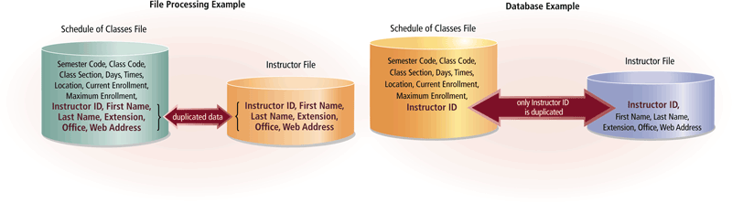
File Processing Versus Databases

Slide 131
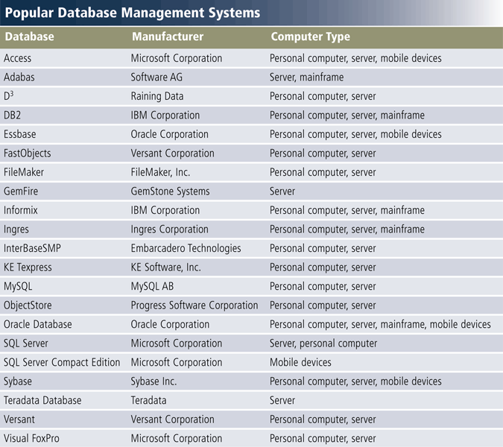
Database Management Systems

Slide 132
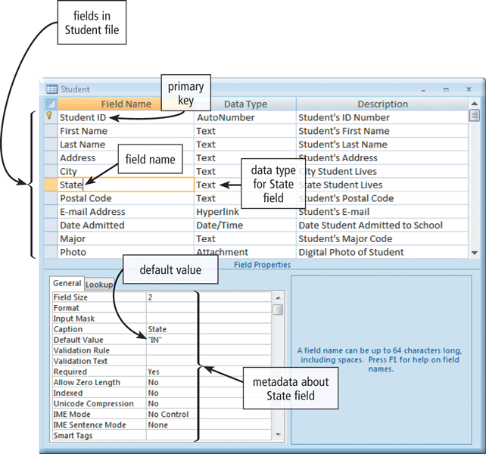
Database Management Systems
A data dictionary contains data about each file in the database and each field in those files.

Slide 133
Database Management Systems
A DBMS provides several tools that allow users and programs to retrieve and maintain data in the database.
query languages
query by example
Forms and
report generators.

Slide 134
Database Management Systems
A query language consists of simple, English-like statements that allow users to specify the data to display, print, or store.
Query by example (QBE) provides a GUI to assist users with retrieving data.

Slide 135
Database Management Systems
A Form is a window on the screen that provides areas for entering or modifying data in a database

Slide 136
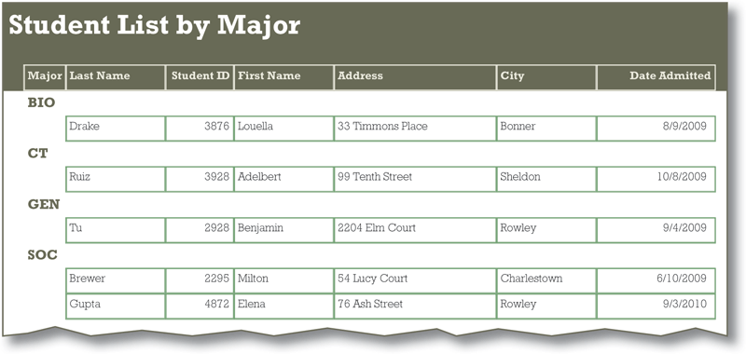
Database Management Systems
A report generator allows users to design a report on the screen, retrieve data into the report design, and then display or print the report.

Slide 137
Data Security
A DBMS provides means to ensure that only authorized users access data at permitted times.
Access privileges
Principle of least privilege

Slide 138
Access privileges
Access privileges define the actions that a specific user or group of users can perform.
Access privileges for data involve establishing who can enter new data, modify existing data, delete unwanted data, and view data.

Slide 139
Principle of least privilege
The principle of least privilege policy, where users' access privileges are limited to the lowest level necessary to perform required tasks.

Slide 140
Database Management Systems
A DBMS provides a variety of techniques
to restore the database to a usable form in case it is damaged or destroyed.
Backup
Log
Recovery utility
Continuous backup

Slide 141
Backup and Recovery
A backup, or copy, of the entire database should be made on a regular basis.
Some DBMSs have their own built-in backup utilities. Others require users to purchase a separate backup utility, or use one included with the operating system.

Slide 142
Recovery utility
A recovery utility uses the logs and/or backups to restore a database when it becomes damaged or destroyed.

Slide 143
log
More complex DBMSs maintain a log, which is a listing of activities that change the contents of the database.

Slide 144
Continuous backup
Continuous backup is a backup plan in which all data is backed up whenever a change is made.

Slide 145
Relational and Object-Oriented Databases
A data model consists of rules and
standards that define how the database organizes data. A data model defines how users view the organization of the data.

Slide 146
Relational and Object-Oriented Database
A relational database is a database that stores data in tables that consist of rows and columns.
Each row has a primary key and each column has a unique name.
A relationship is a link within the data.

Slide 147
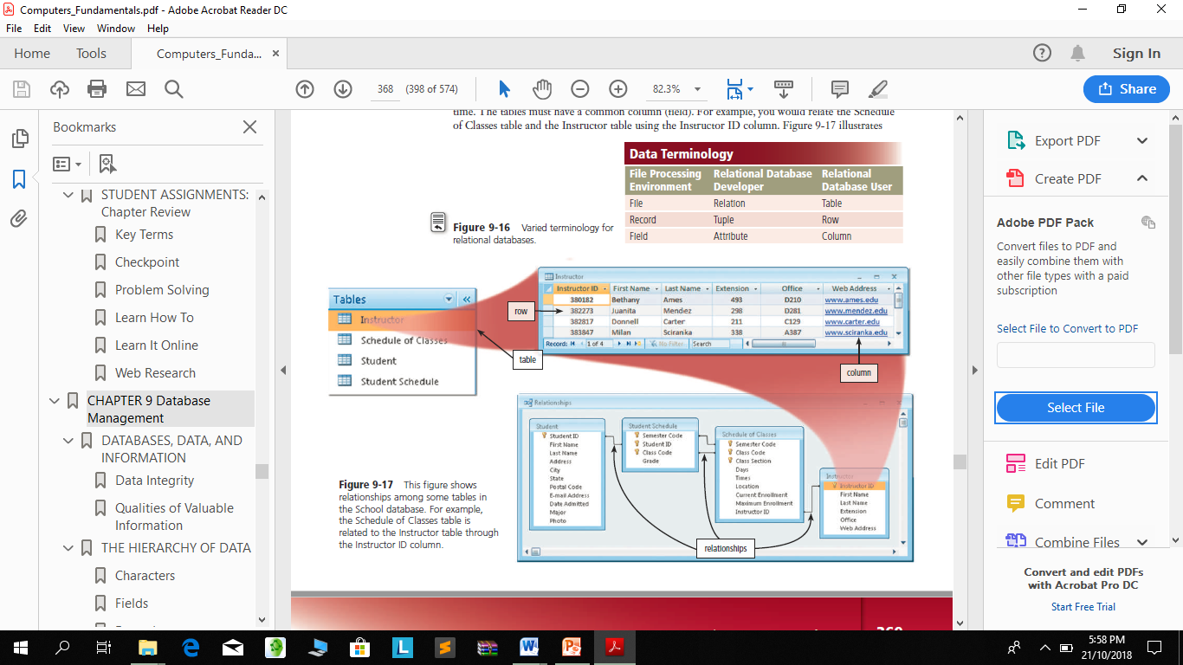
Relational, Object-Oriented, and Multidimensional Databases

Slide 148
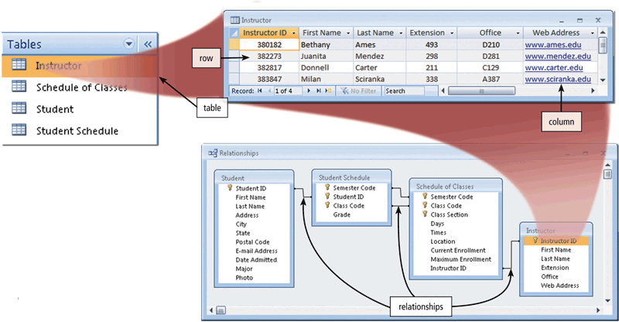
Relational, Object-Oriented, and Multidimensional Databases

Slide 149
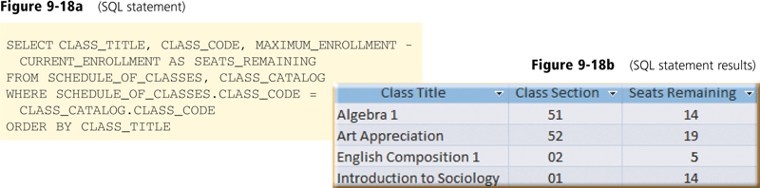
Relational, Object-Oriented, and Multidimensional Databases
SQL Structured Query Language (SQL) is a popular query language that allows users to manage, update, and retrieve data.

Slide 150
Relational, Object-Oriented, and Multidimensional Databases
An object-oriented database (OODB) stores data in objects. An object is an item that contains data, as well as the actions that read or process the data.

Slide 151
A data warehouse is a huge database that stores and manages the data required to analyze historical and current transactions.
A smaller version of a data warehouse is the data mart. A data mart contains a database that helps a specific group or department make decisions.

Slide 152
Database Administration
The role of coordinating the use of the database belongs to the database analysts and administrators.

Slide 153
Role of the Database Analysts and Administrators
The database analysts and administrators are responsible for managing and coordinating all database activities.

Slide 154
Role of the Database Analysts and Administrators
Database Analyst (DA)
Decides on proper field placement, defines data relationship, and identifies users’ access privileges.
Database Administrator (DBA)
Creates and maintains the data dictionary, manages security, monitors performance, and checks backup and recovery procedures.

