Slide 1
Networking
NETWORKING, Network types, Network topologIES and IP addressES

Slide 2
Networking
A computer networking is a process of connecting two or more than two computers with the purpose to share data, provide technical support, and to communicate (especially for the business purpose)

Slide 3
Advantages of networking
Facility of Technical Support
Easy Sharing of Data
Easy Sharing of Hardware Resource
Easy Sharing Software
Sharing devices such as printers saves money.

Slide 4
Files can easily be shared between users.
Ease of communications.
Data is easy to backup as all the data is stored on the file server.

Slide 5
Disadvantages
Purchasing the network cabling and file servers can be expensive.
Managing a large network is complicated, requires training and a network manager usually needs to be employed

Slide 6
If the file server breaks down the files on the file server become inaccessible.
Viruses can spread to other computers throughout a computer network.
There is a danger of hacking, particularly with wide area networks.

Slide 7
Networks
A network is a collection of computers and devices connected together via communications devices and transmission media.

Slide 8
Types of networks
Local Area Network (LAN) is a network that connects computers and devices in a limited geographical area such as a home, school computer laboratory, office building, or closely positioned group of buildings.

Slide 9
Wireless LAN (WLAN)
is a LAN that uses no physical wires.

Slide 10
Metropolitan Area Network (MAN)
Networks are larger than LANs but smaller than WANs .
MANs span an entire geographic area (typically a town or city).
A MAN is often used to connect several LANs together to form a bigger network.

Slide 11
Wide Area Network
A wide area network, or WAN, occupies a very large area, such as an entire country or the entire world.
A WAN can contain multiple smaller networks, such as LANs or MANs.
It generally covers large distances(states, countries, continents). Example Internet

Slide 12
Campus Area Network (CAN)
Larger than LANs, but smaller than metropolitan area networks (MANs).
seen in universities, small businesses.
They can be spread across several buildings that are fairly close to each other so users can share resources.

Slide 13
Networks Defined by Topology
Topology

Slide 14
Network topology
A network topology refers to the layout of the computers and devices in a communications network.

Slide 15
Bus Topology
Bus Topology
A bus topology uses a cable running through the area requiring connectivity.

Slide 16
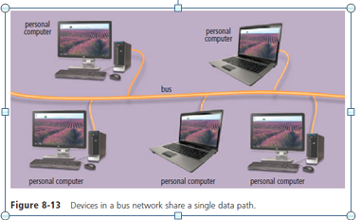
Bus Topology

Slide 17
Characteristics
One cable is used per network segment.
To maintain appropriate electrical characteristics of the cable, the cable requires a terminator (of a specific resistance) at each end of the cable.

Slide 18
Benefits of bus topology
Depending on the media used by the bus, a bus topology can be less expensive.
Installation of a network based on a bus topology is easier than some other topologies, which might require extra wiring to be installed.

Slide 19
computers and other devices can be attached and detached at any point on the bus without disturbing the rest of the network.
failure of one device usually does not affect the rest of the bus network.

Slide 20
Drawbacks
Troubleshooting a bus topology can be difficult because problem isolation might necessitate an inspection of multiple network taps to make sure they either have a device connected or they are properly terminated.
Adding devices to a bus might cause an outage for other users on the bus.

Slide 21
Drawbacks cont.
An error condition existing on one device on the bus can impact performance of other devices on the bus.
A bus topology does not scale well, because all devices share the bandwidth available on the bus.

Slide 22
Also, if two devices on the bus simultaneously request access to the bus, an error condition results.

Slide 23
Ring Topology
Traffic flows in a circular fashion around a closed network loop (that is, a ring).

Slide 24
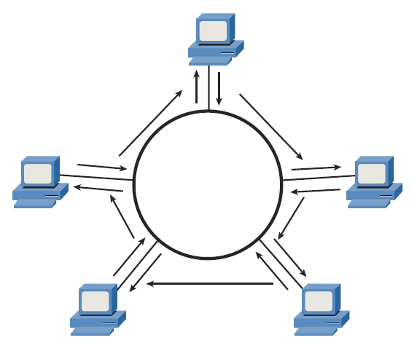
Ring Topology cont.

Slide 25
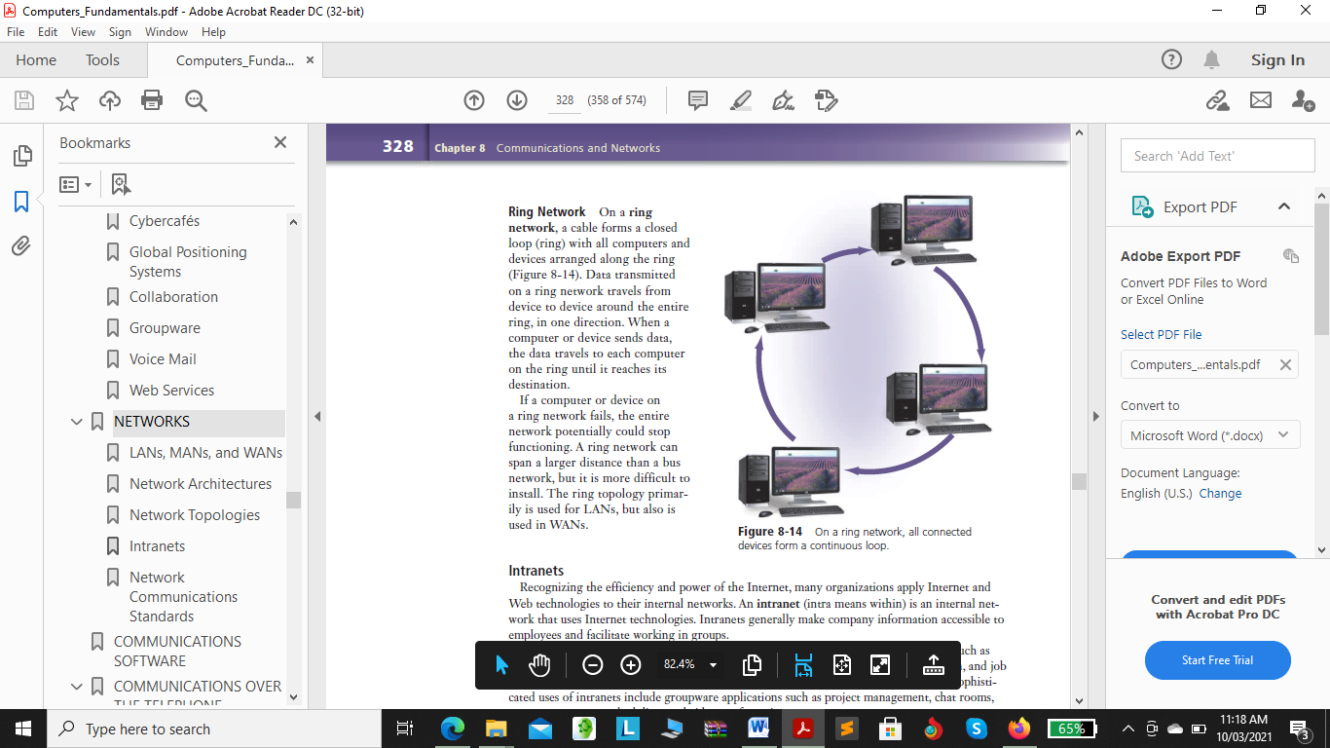

Slide 26
Characteristics
Devices are interconnected by connecting to a single ring, or in some cases (for example, Fiber Distributed Data Interface (FDDI), a dual ring.
Each device on a ring includes both a receiver (for the incoming cable) and a transmitter (for the outgoing cable).
Each device on the ring repeats the signal it receives.

Slide 27
Data transmitted on a ring network travels from device to device around the entire ring, in one direction.
When a computer or device sends data, the data travels to each computer on the ring until it reaches its destination.

Slide 28
Benefits
Troubleshooting is simplified in the event of a cable break, because each device on a ring contains a repeater.

Slide 29
When the repeater on the far side of a cable break doesn’t receive any data within a certain amount of time, it reports an error condition (typically in the form of an indicator light on a network interface card [NIC]).

Slide 30
Drawbacks
Rings have scalability limitations. Specifically, a ring has a maximum length and a maximum number of attached stations.

Slide 31
Drawbacks cont.
Once either of these limits is exceeded, a single ring might need to be divided into two interconnected rings.
A network maintenance window might need to be scheduled to perform this ring division.

Slide 32
Drawbacks cont.
Because a ring must be a complete loop, the amount of cable required for a ring is usually higher than the amount of cable required for a bus topology serving the same number of devices.

Slide 33
Drawbacks cont.
Because a ring must be a complete loop, the amount of cable required for a ring is usually higher than the amount of cable required for a bus topology serving the same number of devices.

Slide 34
Star Topology
A star topology has a central point from which all attached devices radiate.

Slide 35
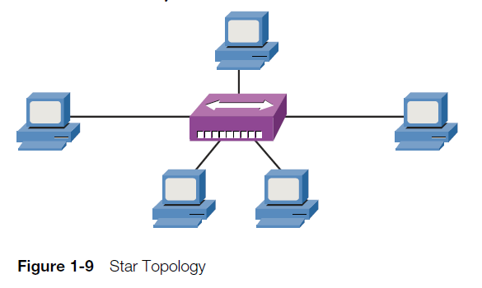
Star Topology cont.

Slide 36
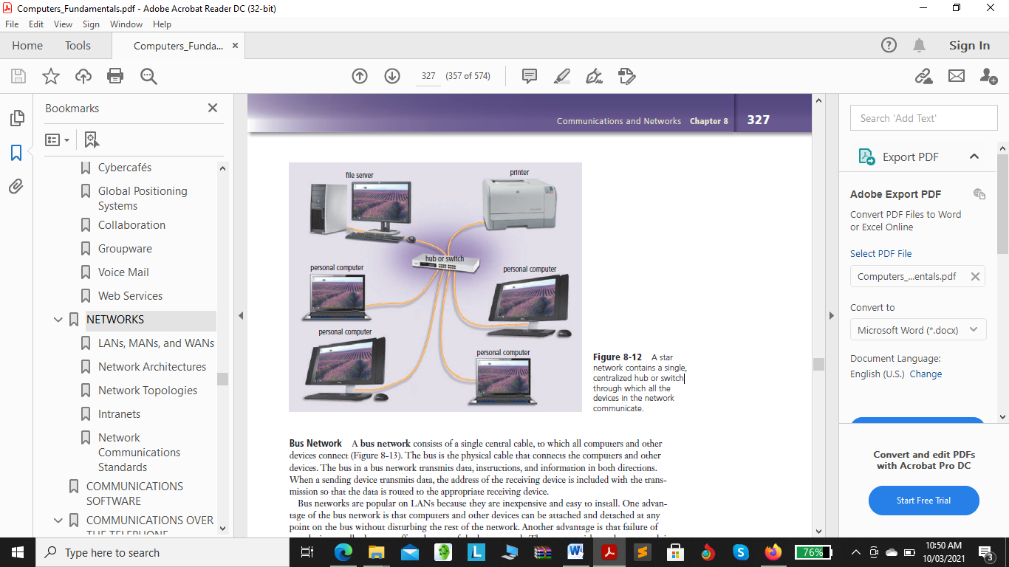

Slide 37
Characteristics
Devices have independent connections back to a central device (for example, a hub or a switch).

Slide 38
Benefits
A cable break only impacts the device connected via the broken cable, and not the entire topology. Troubleshooting is relatively simple, because a central device in the star topology acts as the aggregation point of all the connected devices.

Slide 39
Drawbacks
More cable is required for a star topology, as opposed to bus or ring topologies, because each device requires its own cable to connect back to the central device.
Installation can take longer for a star topology, as opposed to a bus or ring topology, because more cable runs that must be installed.

Slide 40
Hub-and-Spoke Topology
When interconnecting multiple sites (for example, multiple corporate locations) via WAN links, a hub-and-spoke topology has a WAN link from each remote site (that is, a spoke site ) to the main site (that is, the hub site ).

Slide 41
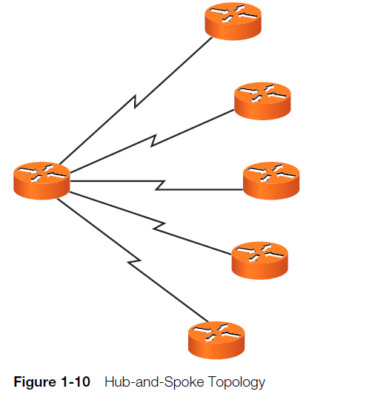
Hub-and-Spoke Topology

Slide 42
Characteristics
Each remote site (that is, a spoke) connects back to a main site (that is, the hub) via a WAN link.
Communication between two remote sites travels through the hub site.

Slide 43
Benefits
Costs are reduced (as compared to a full-mesh or partial-mesh topology) because a minimal number of links are used.
Adding one or more additional sites is easy (as compared to a full-mesh or partial-mesh topology) because only one link needs to be added per site.

Slide 44
Drawbacks
Suboptimal routes must be used between remote sites, because all intersite communication must travel via the main site.
Because all remote sites converge on the main site, this hub site potentially becomes a single point of failure.
Because each remote site is reachable by only a single WAN link, the hub-and-spoke topology lacks redundancy.

Slide 45
Full-Mesh Topology
A full-mesh topology directly connects every site to every other site.

Slide 46
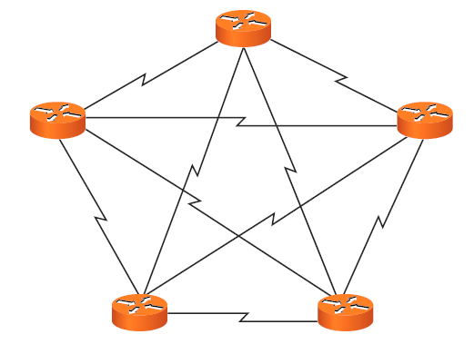
Full-Mesh Topology

Slide 47
Characteristics
Every site has a direct WAN connection to every other site.
The number of required WAN connections can be calculated with the formula w = n * (n-1) / 2 , where w = the number of WAN links and n = the number of sites. For example, a network with 10 sites would require 45 WAN connections to form a fully meshed network: 45 = 10 * (10-1) / 2.

Slide 48
Benefits
An optimal route exists between any two sites.
A full-mesh network is fault tolerant, because one or more links can be lost, and reachability between all sites might still be maintained.
Troubleshooting a full mesh network is relatively easy, because each link is independent of the other links.

Slide 49
Drawbacks
A full-mesh network can be difficult and expensive to scale, because the addition of one new site requires a new WAN link between the new site and every other existing site.

Slide 50
Partial-Mesh Topology
A partial-mesh WAN topology, is a hybrid of hub-and-spoke topology and full-mesh topology. Specifically, a partial-mesh topology can be designed to provide an optimal route between selected sites, while avoiding the expense of interconnecting every site to every other site.

Slide 51
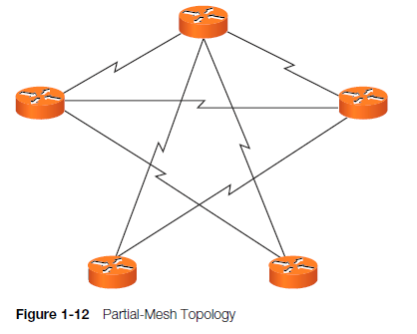
Partial-Mesh Topology

Slide 52
Characteristics
Selected sites (that is, sites with frequent intersite communication) are interconnected via direct links, while sites that have less frequent communication can communicate via another site.
A partial-mesh topology uses fewer links than a full-mesh topology and more links than a hub-and-spoke topology for interconnecting the same number of sites.

Slide 53
Benefits
A partial-mesh topology provides optimal routes between selected sites with higher intersite traffic volumes, while avoiding the expense of interconnecting every site to every other site.
A partial-mesh topology is more redundant than a hub and- spoke topology.

Slide 54
Drawbacks
A partial-mesh topology is less fault tolerance than a full mesh topology.
A partial-mesh topology is more expensive than a hub and- spoke topology.

Slide 55
Network Architectures
The design of computers, devices, and media in a network, sometimes called the network architecture, is categorized as either client/server or peer-to-peer.

Slide 56
Client-Server Networks
In a Client-Server Networks a dedicated
file server provides shared access to files, and a networked printer is available as a resource to the network’s clients.

Slide 57
server
A server controls access to the hardware, software, and other resources on the network and provides a centralized storage area for programs, data, and information.

Slide 58
clients
The clients are other computers and mobile devices on the network that rely on the server for its resources.

Slide 59
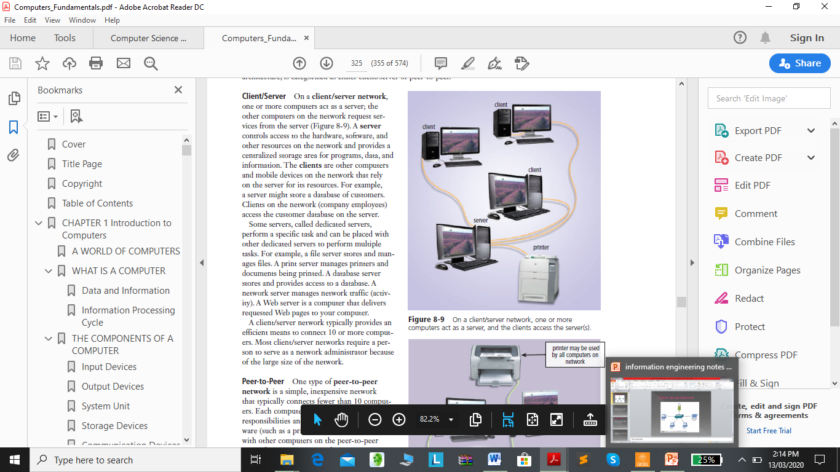
Client-server network

Slide 60
Because resources are located on one or more servers, administration is simpler than trying to administer network resources on multiple peer devices.

Slide 61
Characteristics
Client devices (for example, PCs) share a common set of resources (for example, file or print resources) located on one or more dedicated servers.

Slide 62
Resources sharing is made possible via dedicated server hardware and network operating systems.

Slide 63
Benefits
Client-server networks can easily scale, which might require the purchase of additional client licenses.
Administration is simplified, because parameters, such as file sharing permissions and other security settings, can be administered on a server as opposed to multiple clients

Slide 64
Drawbacks
Because multiple clients might rely on a single server for their resources, the single server can become a single point of failure in the network.

Slide 65
Client- server networks can cost more that peer –to- peer networks.
For example, client-server networks might require the purchase of dedicated server hardware and a network operating system with an appropriate number of licenses.

Slide 66
Peer-to-Peer Networks
Peer-to-peer networks allow interconnected devices (for example, PCs) to share their resources with one another.
Those resources could be, for example, files or printers.

Slide 67
Each of the peers can share files on their own hard drives, and one of the peers has a directly attached printer that can be shared with the other peers in the network.

Slide 68
Each computer, called a peer, has equal responsibilities and capabilities, sharing hardware (such as a printer), data, or information with other computers on the peer-to-peer network

Slide 69
Each computer stores files on its own storage devices
Thus, each computer on the network contains both the server operating system and application software.

Slide 70
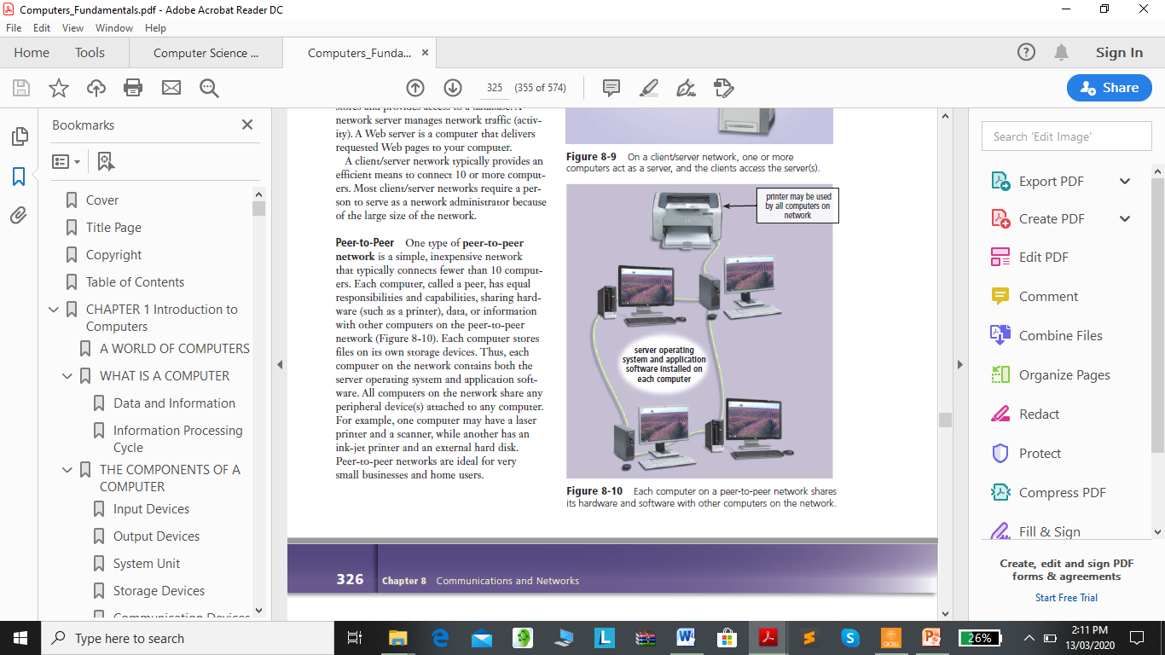
The Peer –to – Peer network

Slide 71
Characteristics
Client devices (for example, PCs) share their resources (for Example, file and printer resources) with other client devices

Slide 72
Resource sharing is made available through the clients’ Operating systems.

Slide 73
Benefits
Peer –to- peer networks can be installed easily because resource sharing is made possible by the clients’ Operating systems, and knowledge of advanced Network Operating Systems is not required.

Slide 74
Peer-to- peer networks typically cost less than client-server networks because there is no requirement for dedicated server resources or advanced Network Operating System software.

Slide 75
Drawbacks
Scalability is limited because of the increased administration burden of managing multiple clients.

Slide 76
Performance might be less than seen in a client-server network because the devices providing network resources might be performing other tasks not related to resource sharing (for example word processing).

Slide 77
Internet Peer-to-Peer(P2P)
describes an Internet network on which users access each other’s hard disks and exchange files directly .

Slide 78
This type of peer-to-peer network sometimes is called a file sharing network because users with compatible software and an Internet connection copy files from someone else’s hard disk to their hard disks.

Slide 79
As more users connect to the network, each user has access to shared files on other users’ hard disks.
When users log off, others no longer have access to their hard disks.

Slide 80
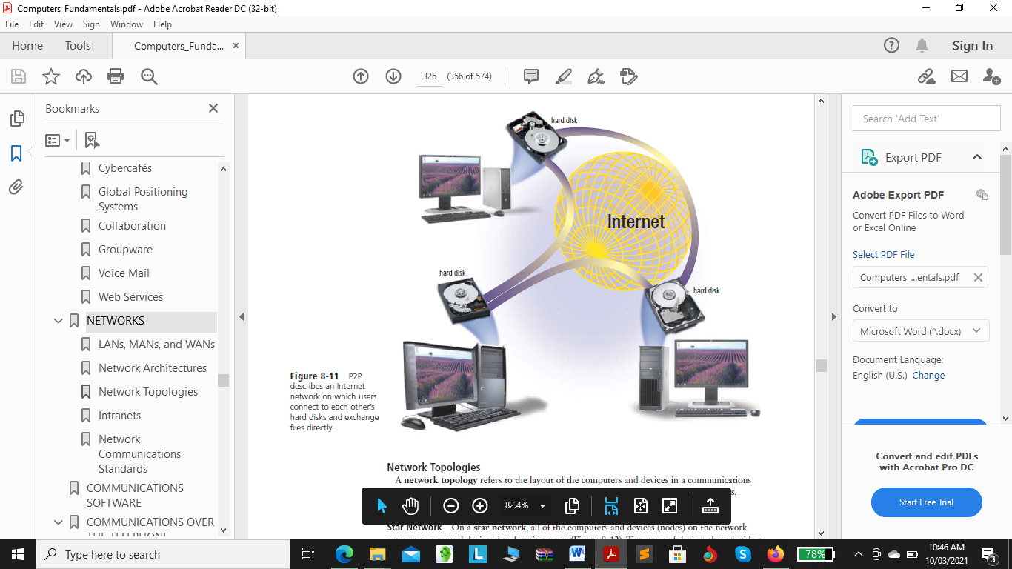

Slide 81
IP ADDRESSES
Used to uniquely identify a device on the network.

Slide 82
The 32-bit IP address is broken up into 4 octets, which are arranged into a dotted-decimal notation scheme.
An octet is a set of 8 bits
Example of an IP version 4:
172.64.126.52

Slide 83
The binary
The binary system uses only 2 values “0 & 1” to represent numbers in positions representing increasing powers of 2.

Slide 84
To most humans, the number 124 represents 100 + 20 + 4.
To the computer, this number is 1111100, which is 64 (2⁶) + 32 (2⁵) + 16 (2⁴) + 8 (2³) + 4 (2²) + 0 + 0

Slide 85
Each position in a binary number represents, right to left, a power of two beginning with 2⁰ & increasing by one power as it moves left: 2⁰, 2¹, 2², 2⁴, etc.

Slide 86
Converting to Decimal
There are 8 bits in an octet & each bit can only be a 1 or a 0.
What is the largest decimal number that can be expressed in an octet?
Eight 1’s (1111 1111)

Slide 87
2⁷
2⁶
2⁵
2⁴
2³
2²
2¹
2⁰
1
1
1
1
1
1
1
1
128
64
32
16
8
4
2
1
The binary number 1111 1111 converts into the decimal number:
128 + 64 + 32 + 16 + 8 + 4 + 2 + 1 = 255

Slide 88
Therefore, the largest decimal number that can be stored in an IP address octet is 255.

Slide 89
IP Address Classes
IP addresses are divided into 5 classes, each of which is designated with the alphabetic letters A to E.
Class D addresses are used for multicasting.
Class E addresses are reserved for testing & some mysterious future use.

Slide 90
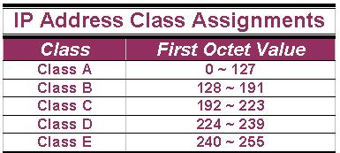
The 5 IP classes are split up based on the value in the 1st octet:

Slide 91
Using the ranges, you can determine the class of an address from its 1st octet value.
An address beginning with 120 is a Class A address, 155 is a Class B address & 220 is a Class C address.

Slide 92
The 32 bits of the IP address are divided into Network & Host portions, with the octets assigned as a part of one or the other.
Network & Host Representation
By IP Address Class
Class
Octet1
Octet2
Octet3
Octet4
Class A
Network
Host
Host
Host
Class B
Network
Network
Host
Host
Class C
Network
Network
Network
Host

Slide 93
Each Network is assigned a network address & every device or interface (such as a router port) on the network is assigned a host address.
There are only 2 specific rules that govern the value of the address.

Slide 94
A host address cannot be designated by all zeros or all ones.
These are special addresses that are reserved for special purposes.

Slide 95
Class A Addresses
Class A IP addresses use the 1st 8 bits (1st Octet) to designate the Network address.
The 1st bit which is always a 0, is used to indicate the address as a Class A address & the remaining 7 bits are used to designate the Network.
The other 3 octets contain the Host address.

Slide 96
There are 128 Class A Network Addresses, but because addresses with all zeros aren’t used & address 127 is a special purpose address, 126 Class A Networks are available.

Slide 97
There are 16,777,214 Host addresses available in a Class A address.
you can use the following formula to compute the number of hosts available in any of the class addresses, where “^{n}” represents the number of bits in the host portion:
(2^{n} – 2) = Number of available hosts

Slide 98
Class B IP Addresses
For a Class A network, there are:
2²⁴ – 2 or 16,777,214 hosts.
Half of all IP addresses are Class A addresses.
You can use the same formula to determine the number of Networks in an address class.
Eg., a Class A address uses 7 bits to designate the network, so (2⁷ – 2) = 126 or there can be 126 Class A Networks.

Slide 99
Class B addresses use the 1st 16 bits (two octets) for the Network address.
The last 2 octets are used for the Host address.
The 1st 2 bit, which are always 10, designate the address as a Class B address & 14 bits are used to designate the Network. This leaves 16 bits (two octets) to designate the Hosts.

Slide 100
So how many Class B Networks can there be?
Using our formula, (2¹⁴ – 2), there can be 16,382 Class B Networks & each Network can have (2¹⁶ – 2) Hosts, or 65,534 Hosts.

Slide 101
Class C IP Addresses
Class C addresses use the 1st 24 bits (three octets) for the Network address & only the last octet for Host addresses. the 1st 3 bits of all class C addresses are set to 110, leaving 21 bits for the Network address, which means there can be 2,097,150 (2²¹ – 2) Class C Networks, but only 254 (2⁸ – 2) Hosts per Network.

Slide 102
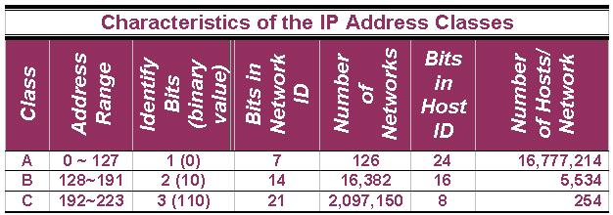
Class C IP Addresses (Cont.)

Slide 103
Special Addresses
A few addresses are set aside for specific purposes.
Network addresses that are all binary zeros, all binary ones & Network addresses beginning with 127 are special Network addresses.

Slide 104
Special Addresses (Cont.)
Within each address class is a set of addresses that are set aside for use in local networks sitting behind a firewall or NAT (Network Address Translation) device or Networks not connected to the Internet.

Slide 105
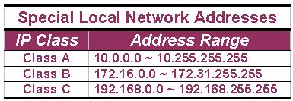
A list of these addresses for each IP address class:

Slide 106
Computer Security

