Slide 1
Python - Basic Operators

Slide 2
Basic Operators
Operators are the constructs which can manipulate the value of operands.
4 + 5 = 9. 4 and 5 are called operands and + is called operator.

Slide 3
Types of Operators in Python
Arithmetic Operators
Comparison (Relational) Operators
Assignment Operators
Logical Operators
Bitwise Operators
Membership Operators

Slide 4
Python Arithmetic Operators
Assume variable a holds 10 and variable b holds 20, then −
Operator | Description | Example
+ Addition | Adds values on either side of the operator. | a + b = 30
- Subtraction | Subtracts right hand operand from left hand operand. | a – b = -10
* Multiplication | Multiplies values on either side of the operator | a * b = 200
/ Division | Divides left hand operand by right hand operand | b / a = 2
% Modulus | Divides left hand operand by right hand operand and returns remainder | b % a = 0

Slide 5
** Exponent | Performs exponential (power) calculation on operators | a**b =10 to the power 20
// | Floor Division - The division of operands where the result is the quotient in which the digits after the decimal point are removed. But if one of the operands is negative, the result is floored, i.e., rounded away from zero (towards negative infinity) − | 9//2 = 4 and 9.0//2.0 = 4.0, -11//3 = -4, -11.0//3 = -4.0

Slide 6
Python Comparison Operators
These operators compare the values on either sides of them and decide the relation among them.
They are also called Relational operators.
Assume variable a holds 10 and variable b holds 20, then −

Slide 7
Operator | Description | Example
== | If the values of two operands are equal, then the condition becomes true. | (a == b) is not true.
!= | If values of two operands are not equal, then condition becomes true. | (a!= b) is true.
> | If the value of left operand is greater than the value of right operand, then condition becomes true. | (a > b) is not true.

Slide 8
< | If the value of left operand is less than the value of right operand, then condition becomes true. | (a < b) is true.
>= | If the value of left operand is greater than or equal to the value of right operand, then condition becomes true. | (a >= b) is not true.
<= | If the value of left operand is less than or equal to the value of right operand, then condition becomes true. | (a <= b) is true.

Slide 9
Python Assignment Operators
Assume variable a holds 10 and variable b holds 20, then
Operator | Description | Example
= | Assigns values from right side operands to left side operand | c = a + b assigns value of a + b into c
+= Add AND | It adds right operand to the left operand and assign the result to left operand | c += a is equivalent to c = c + a
-= Subtract AND | It subtracts right operand from the left operand and assign the result to left operand | c -= a is equivalent to c = c - a

Slide 10
*= Multiply AND | It multiplies right operand with the left operand and assign the result to left operand | c *= a is equivalent to c = c * a
/= Divide AND | It divides left operand with the right operand and assign the result to left operand | c /= a is equivalent to c = c / a
%= Modulus AND | It takes modulus using two operands and assign the result to left operand | c %= a is equivalent to c = c % a
**= Exponent AND | Performs exponential (power) calculation on operators and assign value to the left operand | c **= a is equivalent to c = c ** a
//= Floor Division | It performs floor division on operators and assign value to the left operand | c //= a is equivalent to c = c // a

Slide 11
Python Bitwise Operators
Bitwise operator works on bits and performs bit by bit operation. Assume if a = 60; and b = 13;
in the binary format their values will be 0011 1100 and 0000 1101 respectively.

Slide 12
a = 0011 1100
b = 0000 1101
-----------------
a&b = 0000 1100
a|b = 0011 1101
a^b = 0011 0001
~a = 1100 0011

Slide 13
Operator | Description | Example
& Binary AND | Operator copies a bit to the result if it exists in both operands | (a & b) (means 0000 1100)
| Binary OR | It copies a bit if it exists in either operand. | (a | b) = 61 (means 0011 1101)
^ Binary XOR | It copies the bit if it is set in one operand but not both. | (a ^ b) = 49 (means 0011 0001)

Slide 14
~ Binary Ones Complement | It is unary and has the effect of 'flipping' bits. | (~a ) = -61 (means 1100 0011 in 2's complement form due to a signed binary number.
<< Binary Left Shift | The left operands value is moved left by the number of bits specified by the right operand. |  | a << 2 = 240 (means 1111 0000)
>> Binary Right Shift | The left operands value is moved right by the number of bits specified by the right operand. |  | a >> 2 = 15 (means 0000 1111)

Slide 15
Python Logical Operators
Assume variable a holds True and variable b holds False then −
Operator | Description | Example
and Logical AND | If both the operands are true then condition becomes true. | (a and b) is False.
or Logical OR | If any of the two operands are non-zero then condition becomes true. | (a or b) is True.
not Logical NOT | Used to reverse the logical state of its operand. | Not(a and b) is True.

Slide 16
Python Membership Operators
Python’s membership operators test for membership in a sequence, such as strings, lists, or tuples.
There are two membership operators

Slide 17
Operator | Description | Example
in | Evaluates to true if it finds a variable in the specified sequence and false otherwise. | x in y, here in results in a 1 if x is a member of sequence y.
not in | Evaluates to true if it does not finds a variable in the specified sequence and false otherwise. | x not in y, here not in results in a 1 if x is not a member of sequence y.

Slide 18
Python Identity Operators
Identity operators compare the memory locations of two objects.
There are two Identity operators
Operator | Description | Example
is | Evaluates to true if the variables on either side of the operator point to the same object and false otherwise. | x is y, here is results in 1 if id(x) equals id(y).
is not | Evaluates to false if the variables on either side of the operator point to the same object and true otherwise. | x is not y, here is not results in 1 if id(x) is not equal to id(y).

Slide 19
Python Operators Precedence
Sr.No. | Operator & Description
1 | ** Exponentiation (raise to the power)
2 | ~ + - Complement, unary plus and minus (method names for the last two are +@ and -@)
3 | * / % // Multiply, divide, modulo and floor division
4 | + - Addition and subtraction
5 | >> << Right and left bitwise shift

Slide 20
6 | & Bitwise 'AND'
7 | ^ | Bitwise exclusive `OR' and regular `OR'
8 | <= < > >= Comparison operators
9 | <> == != Equality operators

Slide 21
10 | = %= /= //= -= += *= **= Assignment operators
11 | is is not Identity operators
12 | in not in Membership operators
13 | not or and Logical operators

Slide 22
Python - Decision Making
Decision-making is the anticipation of conditions occurring during the execution of a program and specified actions taken according to the conditions.
Decision structures evaluate multiple expressions, which produce TRUE or FALSE as the outcome.

Slide 23
determine which action to take and which statements to execute if the outcome is TRUE or FALSE otherwise.

Slide 24
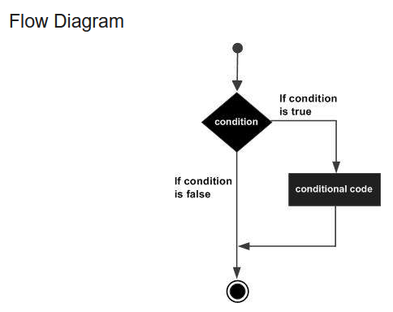
General decision making structure

Slide 25
Python programming language assumes any non-zero and non-null values as TRUE, and any zero or null values as FALSE value.

Slide 26
Types of decision-making statements.
Sr.No. | Statement & Description
1 | if statements An if statement consists of a boolean expression followed by one or more statements.
2 | if...else statements An if statement can be followed by an optional else statement, which executes when the boolean expression is FALSE.
3 | nested if statements You can use one if or else if statement inside another if or else if statement(s).

Slide 27
Python - IF Statement
The IF statement is similar to that of other languages.
The if statement contains a logical expression where the data is compared and a decision is made based on the result of the comparison.

Slide 28
Syntax
if expression:
statement(s)
If the boolean expression evaluates to TRUE, then the block of statement(s) inside the if statement is executed.
In Python, statements in a block are uniformly indented after the : symbol.

Slide 29
If boolean expression evaluates to FALSE, then the first set of code after the end of block is executed.

Slide 30
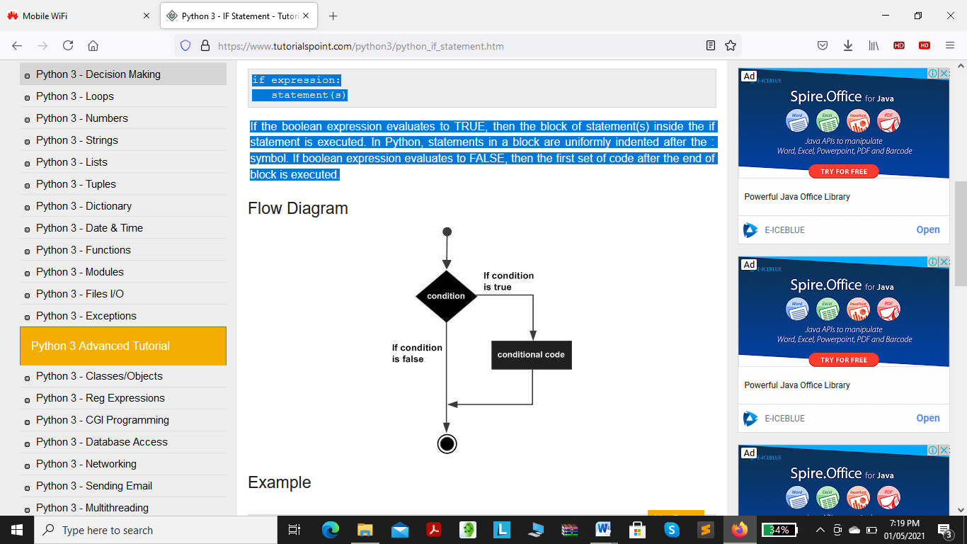
Flow Diagram

Slide 31
Example
var1 = 100
if var1:
print ("1 - Got a true expression value")
print (var1)
var2 = 0
if var2:
print ("2 - Got a true expression value")
print (var2)
print ("Good bye!")

Slide 32
Output
1 - Got a true expression value
100
Good bye!

Slide 33
Python - IF...ELIF...ELSE Statements
An else statement can be combined with an if statement.
An else statement contains a block of code that executes if the conditional expression in the if statement resolves to 0 or a FALSE value.
The else statement is an optional statement and there could be at most only one else statement following if.

Slide 34
Syntax
The syntax of the if...else statement is −
if expression:
statement(s)
else:
statement(s)

Slide 35
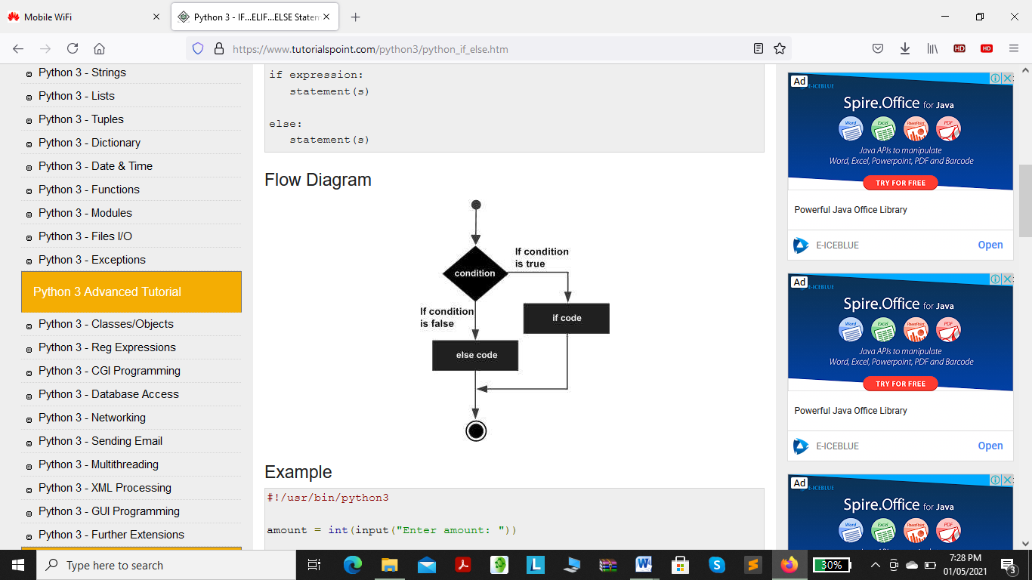
Flow Diagram

Slide 36
The elif Statement
The elif statement allows you to check multiple expressions for TRUE and execute a block of code as soon as one of the conditions evaluates to TRUE.

Slide 37
Similar to the else, the elif statement is optional.
However, unlike else, for which there can be at most one statement, there can be an arbitrary number of elif statements following an if.

Slide 38
syntax
if expression1:
statement(s)
elif expression2:
statement(s)
elif expression3:
statement(s)
else:
statement(s)

Slide 39
Core Python does not provide switch or case statements as in other languages, but we can use if..elif... statements to simulate switch case.

Slide 40
Python - Nested IF Statements
There may be a situation when you want to check for another condition after a condition resolves to true then In such a situation, you can use the nested if construct.

Slide 41
In a nested if construct, you can have an if...elif...else construct inside another if...elif...else construct.

Slide 42
Syntax
The syntax of the nested if...elif...else construct may be −
if expression1:
statement(s)
if expression2:
statement(s)
elif expression3:
statement(s)
else
statement(s)
elif expression4:
statement(s)
else:
statement(s)

Slide 43
Python - Loops
In general, statements are executed sequentially − The first statement in a function is executed first, followed by the second, and so on.
There may be a situation when you need to execute a block of code several number of times.

Slide 44
A loop statement allows us to execute a statement or group of statements multiple times.

Slide 45
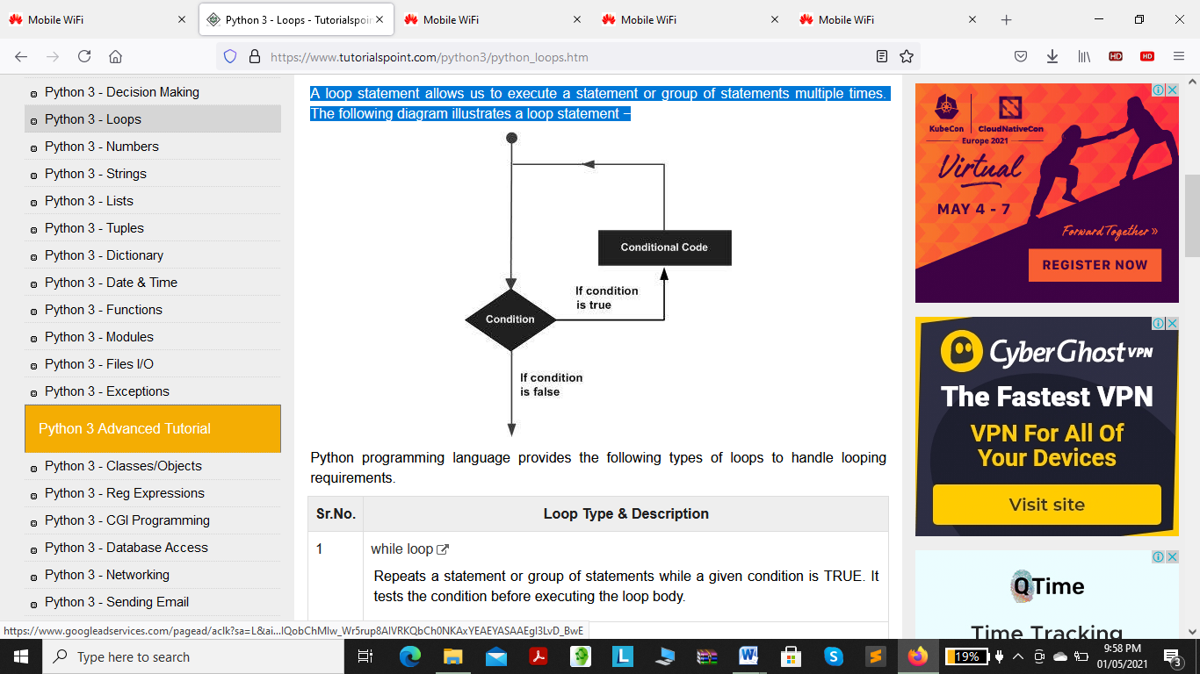
loop statement diagram

Slide 46
Types of loops in python
Sr.No. | Loop Type & Description
1 | while loop Repeats a statement or group of statements while a given condition is TRUE. It tests the condition before executing the loop body.
2 | for loop Executes a sequence of statements multiple times and abbreviates the code that manages the loop variable.
3 | nested loops You can use one or more loop inside any another while, or for loop.

Slide 47
Python - while Loop Statements
Repeats a statement or group of statements while a given condition is TRUE. It tests the condition before executing the loop body.
A while loop statement in Python programming language repeatedly executes a target statement as long as a given condition is true.

Slide 48
Syntax
The syntax of a while loop in Python programming language is −
while expression:
statement(s)

Slide 49
statement(s) may be a single statement or a block of statements with uniform indent.
The condition may be any expression, and true is any non-zero value.
The loop iterates while the condition is true.

Slide 50
When the condition becomes false, program control passes to the line immediately following the loop.

Slide 51
In Python, all the statements indented by the same number of character spaces after a programming construct are considered to be part of a single block of code.
Python uses indentation as its method of grouping statements.

Slide 52
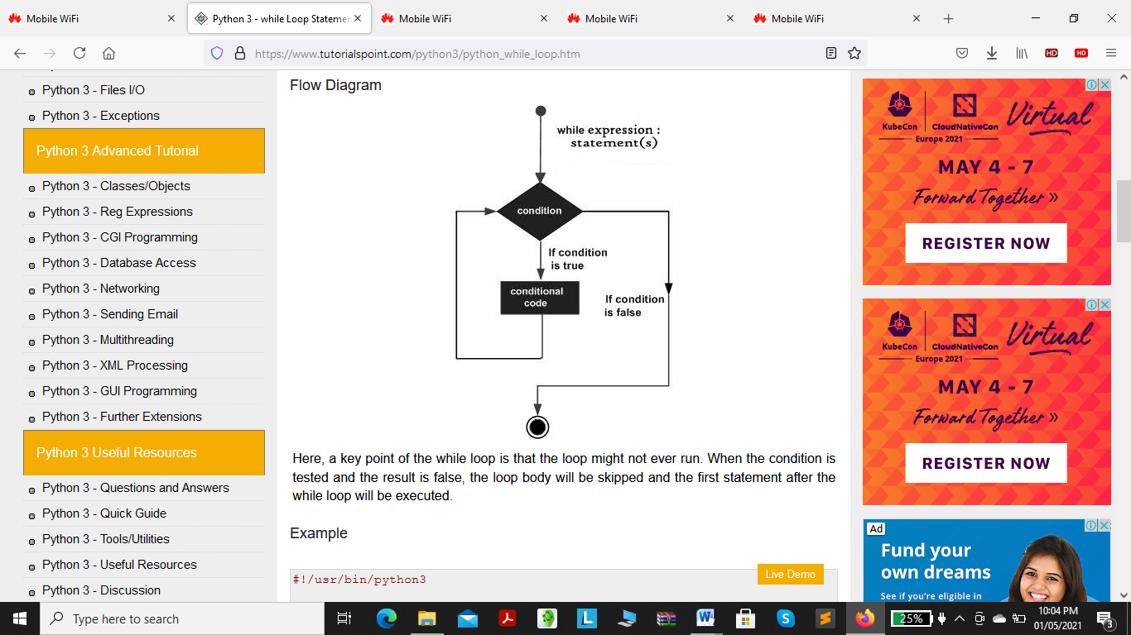
Flow Diagram

Slide 53
a key point of the while loop is that the loop might not ever run.
When the condition is tested and the result is false, the loop body will be skipped and the first statement after the while loop will be executed.

Slide 54
Example
count = 0
while (count < 9):
print ('The count is:', count)
count = count + 1
print ("Good bye!")

Slide 55
Output
The count is: 0
The count is: 1
The count is: 2
The count is: 3
The count is: 4
The count is: 5
The count is: 6
The count is: 7
The count is: 8
Good bye!

Slide 56
The block here, consisting of the print and increment statements, is executed repeatedly until count is no longer less than 9.
With each iteration, the current value of the index count is displayed and then increased by 1.

Slide 57
The Infinite Loop
A loop becomes infinite loop if a condition never becomes FALSE.
Cautious must be taken when using while loops because of the possibility that this condition may never resolves to a FALSE value.

Slide 58
This results in a loop that never ends and such a loop is called an infinite loop.

Slide 59
An infinite loop might be useful in client/server programming where the server needs to run continuously so that client programs can communicate with it and when required.

Slide 60
Example
var = 1
while var == 1 : # This constructs an infinite loop
num = int(input("Enter a number :"))
print ("You entered: ", num)
print ("Good bye!")

Slide 61
result /output
Enter a number :20
You entered: 20
Enter a number :29
You entered: 29
Enter a number :3
You entered: 3
Enter a number :11
You entered: 11

Slide 62
The above example goes in an infinite loop and you need to use CTRL+C to exit the program.

Slide 63
Using else Statement with Loops
If the else statement is used with a for loop, the else statement is executed when the loop has exhausted iterating the list.
If the else statement is used with a while loop, the else statement is executed when the condition becomes false.

Slide 64
Example an else statement with a while statement that prints a number as long as it is less than 5, otherwise the else statement gets executed.

Slide 65
count = 0
while count < 5:
print (count, " is less than 5")
count = count + 1
else:
print (count, " is not less than 5")

Slide 66
Output
0 is less than 5
1 is less than 5
2 is less than 5
3 is less than 5
4 is less than 5
5 is not less than 5

Slide 67
Python - for Loop Statements
Executes a sequence of statements multiple times and abbreviates the code that manages the loop variable.
The for statement in Python has the ability to iterate over the items of any sequence, such as a list or a string.

Slide 68
Syntax
for iterating_var in sequence:
statements(s)
If a sequence contains an expression list, it is evaluated first.
Then, the first item in the sequence is assigned to the iterating variable iterating_var.

Slide 69
Next, the statements block is executed. Each item in the list is assigned to iterating_var, and the statement(s) block is executed until the entire sequence is exhausted.

Slide 70
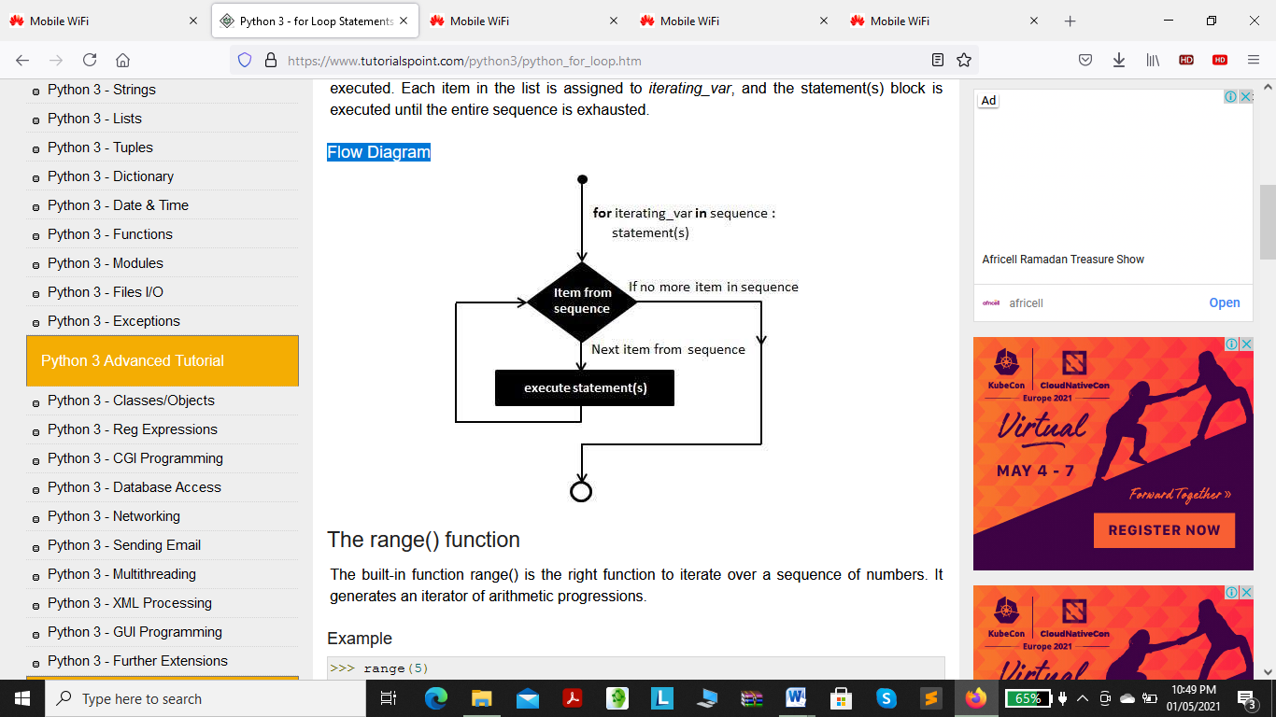
Flow Diagram

Slide 71
The range() function
The built-in function range() is the right function to iterate over a sequence of numbers.
It generates an iterator of arithmetic progressions.

Slide 72
Example
range(5)
range(0, 5)
list(range(5))
[0, 1, 2, 3, 4]

Slide 73
Example
range() generates an iterator to progress integers starting with 0 up to n-1.
To obtain a list object of the sequence, it is type casted to list().
Now this list can be iterated using the for statement.

Slide 74
for var in list(range(5)):
print (var)
Output
0
1
2
3
4

Slide 75
Example
for letter in 'Python': # traversal of a string sequence
print ('Current Letter :', letter)
print()
fruits = ['banana', 'apple', 'mango']
for fruit in fruits: # traversal of List sequence
print ('Current fruit :', fruit)
print ("Good bye!")

Slide 76
Output
Current Letter : P
Current Letter : y
Current Letter : t
Current Letter : h
Current Letter : o
Current Letter : n

Slide 77
Current fruit : banana
Current fruit : apple
Current fruit : mango
Good bye!

Slide 78
Iterating by Sequence Index
An alternative way of iterating through each item is by index offset into the sequence itself.
example −
fruits = ['banana', 'apple', 'mango']
for index in range(len(fruits)):
print ('Current fruit :', fruits[index])
print ("Good bye!")

Slide 79
Output
Current fruit : banana
Current fruit : apple
Current fruit : mango
Good bye!

Slide 80
the len() built-in function, provides the total number of elements in the tuple as well as the range() built-in function to give us the actual sequence to iterate over.

Slide 81
Using else Statement with Loops
If the else statement is used with a for loop, the else block is executed only if for loops terminates normally (and not by encountering break statement).
If the else statement is used with a while loop, the else statement is executed when the condition becomes false.

Slide 82
Python - Nested loops
one or more loops can be used inside any other while, or for loop.
Python allows the usage of one loop inside another loop.

Slide 83
Syntax
for iterating_var in sequence:
for iterating_var in sequence:
statements(s)
statements(s)

Slide 84
The syntax for a nested while loop statement in Python
while expression:
while expression:
statement(s)
statement(s)

Slide 85
A final note on loop nesting is that you can put any type of loop inside any other type of loop.
For example a for loop can be inside a while loop or vice versa.

Slide 86
Loop Control Statements
The Loop control statements change the execution from its normal sequence.
When the execution leaves a scope, all automatic objects that were created in that scope are destroyed.

Slide 87
Python control statements.
1. break statement
2. continue statement
3. pass statement

Slide 88
break statement
Terminates the loop statement and transfers execution to the statement immediately following the loop.
The break statement is used for premature termination of the current loop. After abandoning the loop, execution at the next statement is resumed.

Slide 89
The break statement can be used in both while and for loops.
When using nested loops, the break statement stops the execution of the innermost loop and starts executing the next line of the code after the block.

Slide 90
Syntax
The syntax for a break statement in Python is as follows −
break

Slide 91
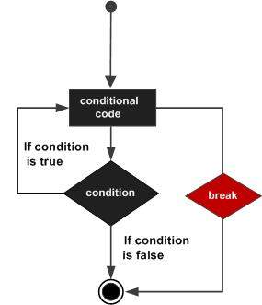
Flow Diagram

Slide 92
Example
for letter in 'Python': # First Example
if letter == 'h':
Break
print ('Current Letter :', letter)
var = 10 # Second Example
while var > 0:
print ('Current variable value :', var)
var = var -1
if var == 5:
Break
print ("Good bye!")

Slide 93
Output
Current Letter : P
Current Letter : y
Current Letter : t
Current variable value : 10
Current variable value : 9
Current variable value : 8
Current variable value : 7
Current variable value : 6
Good bye!

Slide 94
Python - continue statement
Causes the loop to skip the remainder of its body and immediately retest its condition prior to reiterating.

Slide 95
The continue statement in Python returns the control to the beginning of the current loop.
When encountered, the loop starts next iteration without executing the remaining statements in the current iteration.

Slide 96
The continue statement can be used in both while and for loops.

Slide 97
Syntax
Continue

Slide 98
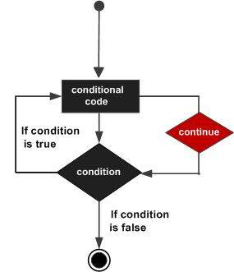
Flow Diagram

Slide 99
Example
for letter in 'Python': # First Example
if letter == 'h':
Continue
print ('Current Letter :', letter)
var = 10 # Second Example
while var > 0:
var = var -1
if var == 5:
Continue
print ('Current variable value :', var)
print ("Good bye!")

Slide 100
Output
Current Letter : P
Current Letter : y
Current Letter : t
Current Letter : o
Current Letter : n
Current variable value : 9
Current variable value : 8
Current variable value : 7
Current variable value : 6
Current variable value : 4
Current variable value : 3
Current variable value : 2
Current variable value : 1
Current variable value : 0
Good bye!

Slide 101
Python - pass Statement
The pass statement in Python is used when a statement is required syntactically but you do not want any command or code to execute.
The pass statement is a null operation; nothing happens when it executes.

Slide 102
Syntax
Pass
Example
for letter in 'Python':
if letter == 'h':
Pass
print ('This is pass block')
print ('Current Letter :', letter)
print ("Good bye!")

Slide 103
Output
Current Letter : P
Current Letter : y
Current Letter : t
This is pass block
Current Letter : h
Current Letter : o
Current Letter : n
Good bye!

