Slide 1
Intro. to Computing & I.S
2021/2022 lecture notes

Slide 2
Computing
Computing is the process of using computer technology to complete a given goal-oriented task.
May encompass the design and development of software and hardware systems for a broad range of purposes - often processing and managing any kind of information - to aid in the pursuit of scientific studies, making intelligent systems, and creating and using different media for entertainment and communication.

Slide 3
Information System
An information system (IS) can be any organized combination of
People
Hardware
Software
Communications networks
Data resources and
policies and procedures that stores, retrieves, transforms, and disseminates information in an organization.

Slide 4
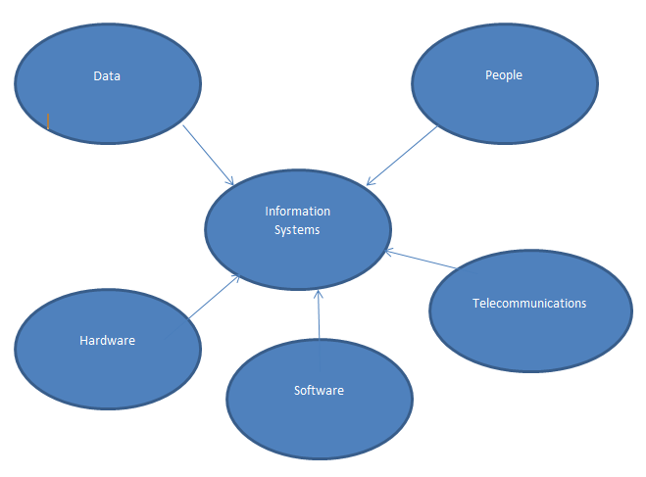
The 5 key elements/components of information systems

Slide 5
THE COMPONENTS OF INFORMATION SYSTEMS
People: are individuals/users that use information systems or the information it produces. They develop and operate information systems.
Hardware: is the physical parts/components like the keyboard, printer, central processing unit, monitor etc.

Slide 6
THE COMPONENTS OF INFORMATION SYSTEMS cont.
Software: is a series of related instructions, organized for a common purpose, that tells the computer what task(s) to perform and how to perform them.
Network: A group of interconnected (via cable and/ wireless) computers and peripherals that is capable of sharing software and hardware resources between many users.

Slide 7
THE COMPONENTS OF INFORMATION SYSTEMS cont
Data: is a collection of unprocessed items or raw facts, which can include text, numbers, images, audio, and video.
Procedure: which are operating instructions for the people who will use an information system or are the policies and methods to be followed in using, operating, and maintaining an information system.

Slide 8
The basic physical/ Hardware components of the Personal Computer
INPUT DEVICES
OUTPUT DEVICES
THE MOTHERBOARD
THE PROCESSOR
MAIN MEMORY
POWER SUPPLY
STORAGE DEVICES

Slide 9
THE MOTHERBOARD
The motherboard which is sometimes called a system board/main board is the main circuit board of the system unit.
The motherboard connect all of the parts of a computer together.

Slide 10
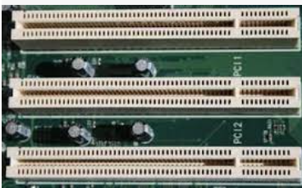
The motherboard cont.
CPU, memory, hard drive, videos cards, sound cards, power supply, fans, heat sinks etc. all connect to the motherboard.
Expansion slot is a socket on the motherboard that can hold an adapter card.

Slide 11
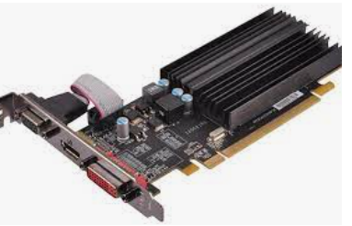
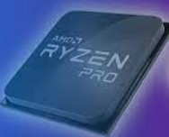
The motherboard cont.
video card: converts computer output into a video signal that travels through a cable to the monitor, which displays an image on the screen.

Slide 12
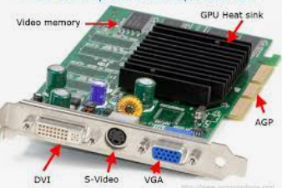
The motherboard cont.
Adapter card, sometimes called an expansion card, is a circuit board that enhances the functions of a component of the system unit and/or provides connections to peripherals.
peripheral: Device that connects to the system unit and is controlled by the processor in the computer.
Examples of peripherals are printers, scanners, and keyboards.

Slide 13
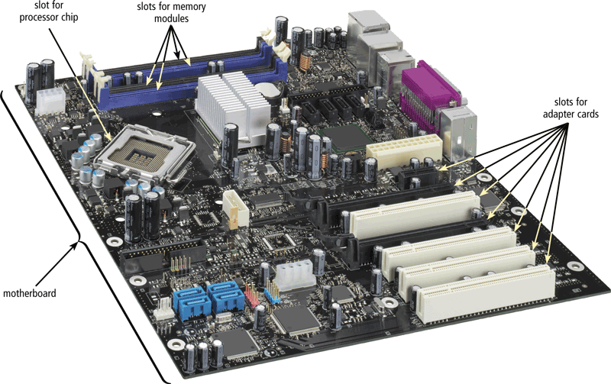
Two main components on the motherboard are the processor and memory

Slide 14
THE PROCESSOR
Processor or microprocessor the electronic component that interprets and carries out the basic instructions that operate the computer.

Slide 15
THE PROCESSOR CONT.
The processing power of a computer is measured in terms of its speed of operation, the amount of memory it has and the number of input/output devices it can handle
All computer operations are under the control of the CPU.

Slide 16
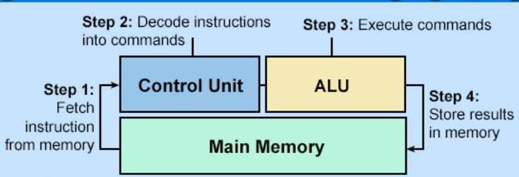
Machine Cycle
For every instruction, a processor repeats a set of four basic operations, which comprise a machine cycle .
1. Fetching
2. Decoding
3. Executing and if necessary
4. Storing

Slide 17
Machine Cycle Cont.
Fetching is the process of obtaining a program instruction or data item from memory.
Decoding refers to the process of translating the instruction into signals the computer can execute.
Executing is the process of carrying out the commands.
Storing, in this context, means writing the result to memory (not to a storage medium).

Slide 18
Machine Cycle Cont.
Processors contain a control unit and an arithmetic logic unit (ALU).
The control unit is the component of the processor that directs and coordinates most of the operations in the computer.

Slide 19
Machine Cycle Cont.
Arithmetic logic unit (ALU):component of the processor that performs arithmetic, comparison, and other operations.

Slide 20
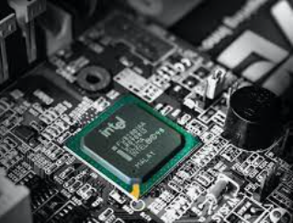
THE PROCESSOR FUNCTIONS
Controls the transmission of data from input devices to memory.
Process the data held in the main memory.
Controls the transmission of information from main memory to output devices.

Slide 21
MAIN MEMORY
Memory consists of electronic components that store instructions waiting to be executed by the processor, data needed by those instructions, and the results of processing the data (information).
It is volatile
It is only for temporal storage of data

Slide 22
MAIN MEMORY CONT.
A bit (short for binary digit) is the smallest unit of data the computer can process.
1 kilobyte (Kb) = 1,000 bytes (or to be exact, 1024 bytes)
1 Megabyte (Mb) = 1,000,000 (1 million) bytes
1 Gigabytes (Gb) =1,000,000,000 (1 billion) bytes
1 Terabytes (Tb) = 1,000,000,000,000 (1 trillion) bytes

Slide 23
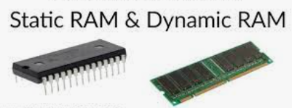
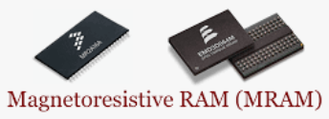
Types of RAM chips
Dynamic RAM
Static RAM
Magnetoresistive RAM

Slide 24
Static RAM (SRAM) | Dynamic RAM (DRAM)
Contains fewer memory cells per unit area (low density) (lesser storage capacity). | More memory cells or compared to static RAM per unit area (high density) (Higher storage capacity)
Access time is less and hence faster memories. (higher speed of operation). | Access time is greater than static RAM. (Lower speed of operation).
The storage elements used in the static memory are latches or flip-flops | In dynamic memory, information is stored in the form of a charge on a capacitor
Refreshing circuitry is not essential | Refreshing circuitry is essential to maintain the charge on the capacitor after every few milliseconds.
Hardware required is less | Extra hardware required for refreshing so the design is complicated.
Used as cache memory | Used as the main memory

Slide 25
Read Only Memory (ROM)
Non-volatile, with its contents permanently fixed into the memory chip at the manufacturing stage.
The data on most ROM chips cannot be modified.

Slide 26
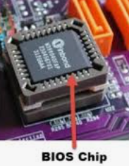
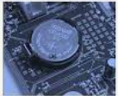
Read Only Memory (ROM)
These ROM chips, called firmware, contain permanently written data, instructions, or information.
Example: ROM, flash memory, and CMOS.
CMOS (complementary metal oxide semiconductor)
  Battery powered semiconductor chip
  Stores the system time, date and hardware settings
Notes:
ROM contains the BIOS which is the firmware for the motherboard.

Slide 27
ROM TYPES
(PROM)
Erasable (EPROM) and
Electrically erasable (EEPROM).

Slide 28
Programmable Read-Only Memory (PROM)
PROM : Memory chip on which data can be written only once
Once a program has been written onto a PROM, it remains there forever.
  Used in Implantable Medical devices
  Used in Radio-Frequency Identification (RFID)tags.
  Used in High definition Multimedia Interfaces(HDMI)

Slide 29
Programmable Read-Only Memory (PROM)
PROM is manufactured as a blank memory
Need a special device called a PROM programmer or PROM burner to write data to PROM.
It is called one- time programming device.

Slide 30
Erasable Programmable Read-Only Memory (EPROM)
EPROM: is a special type of memory that retains its contents until it is exposed to ultraviolet light using an EPROM eraser.
  Use as program storage chip in Micro controllers
  Use as BIOS chip in computers
  As program storage chip in modem, video card etc

Slide 31
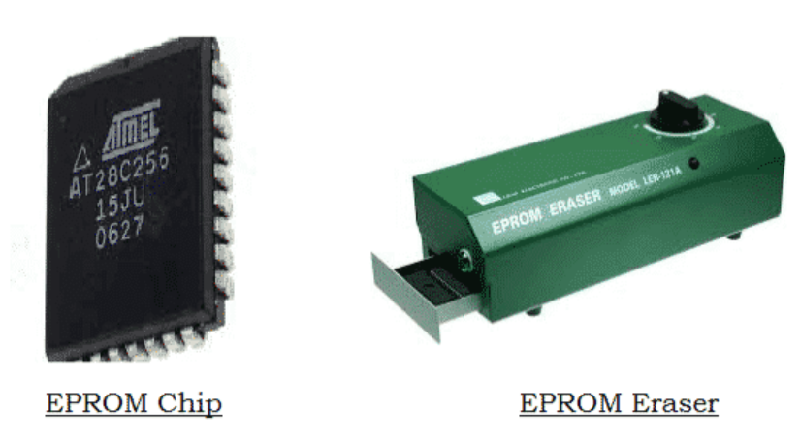
Erasable Programmable Read-Only Memory (EPROM)
The ultraviolet light clears its contents, making it possible to reprogram the memory.
To write to and erase an EPROM, you need a special device called a PROM programmer or PROM burner.

Slide 32
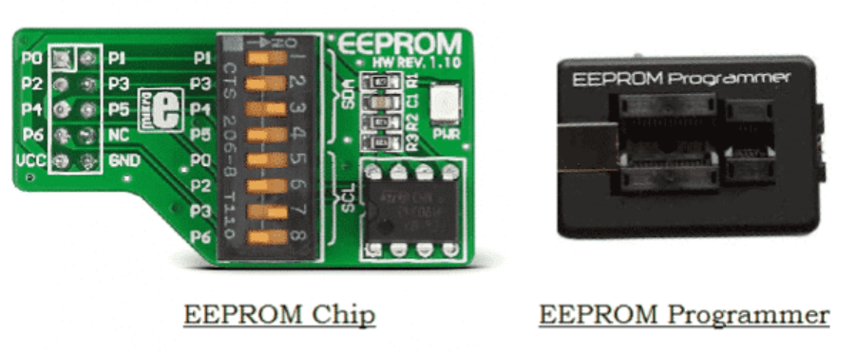
Electrically Erasable Programmable Read-Only Memory (EEPROM)
EEPROM : is a special type of PROM that can be erased by exposing it to an electrical charge instead of ultra violet rays
Any byte can be erased at a time instead of the entire chip
Can be erased and re programmed for around ten thousand times
  Used as BIOS chip in computers
  Use as storage for re-programmable calibration information in test-equipment

Slide 33
Complementary metal-oxide semiconductor (CMOS)
CMOS technology provides high speeds and consumes little power.
They can keep the calendar, date, and time current even when the computer is off.

Slide 34
Storage Devices
The hard disk is used for storing software including the operating system, other systems software, application programs and data.
Holds data, instructions, and information for future use.
Holds data items permanently.

Slide 35
Storage Devices
Storage device: records (writes) and/or retrieves (reads) items to and from storage media.
Storage medium: also called secondary storage, is the physical material on which a computer keeps data, instructions, and information.

Slide 36
Output Devices
Any hardware component that conveys information to one or more people.
  Example: printer, speakers.

Slide 37
Input Devices
Any hardware component that allows you to enter data and instructions into a computer.
Five widely used input devices are the keyboard, mouse, microphone, scanner, and Webcam.

Slide 38
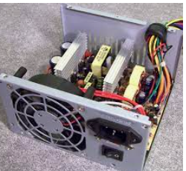
POWER SUPPLY
The power supply is the component of the system unit that converts the wall outlet alternating current (AC) power into direct current (DC) power.
Built into the power supply is a fan that keeps the power supply cool

Slide 39
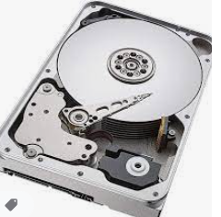
Hard Drive
Hard disk: a storage device that contains one or more inflexible, circular platters that use magnetic particles to store data, instructions, and information.

Slide 40
Hard Disks
Hard disks can store data using
    longitudinal recording
    perpendicular recording

Slide 41

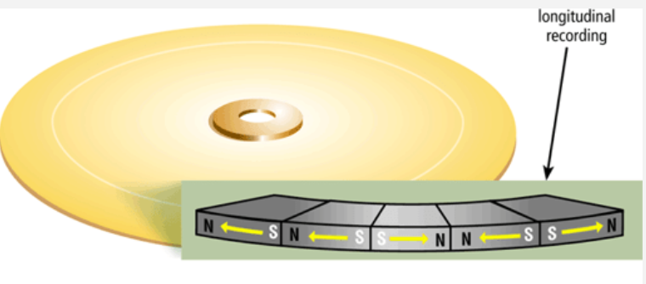
longitudinal recording
Aligned the magnetic particles horizontally around the surface of the disk.

Slide 42
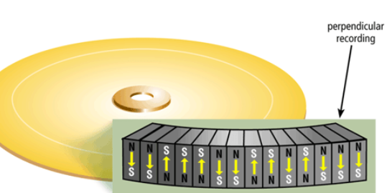
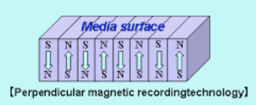
Perpendicular recording
Align the magnetic particles vertically, or perpendicular to the disk’s surface, making much greater storage capacities possible.

Slide 43
Perpendicular recording cont.
Experts estimate that hard disks using perpendicular recording provide storage capacities about 10 times greater than disks that use longitudinal recording.

Slide 44
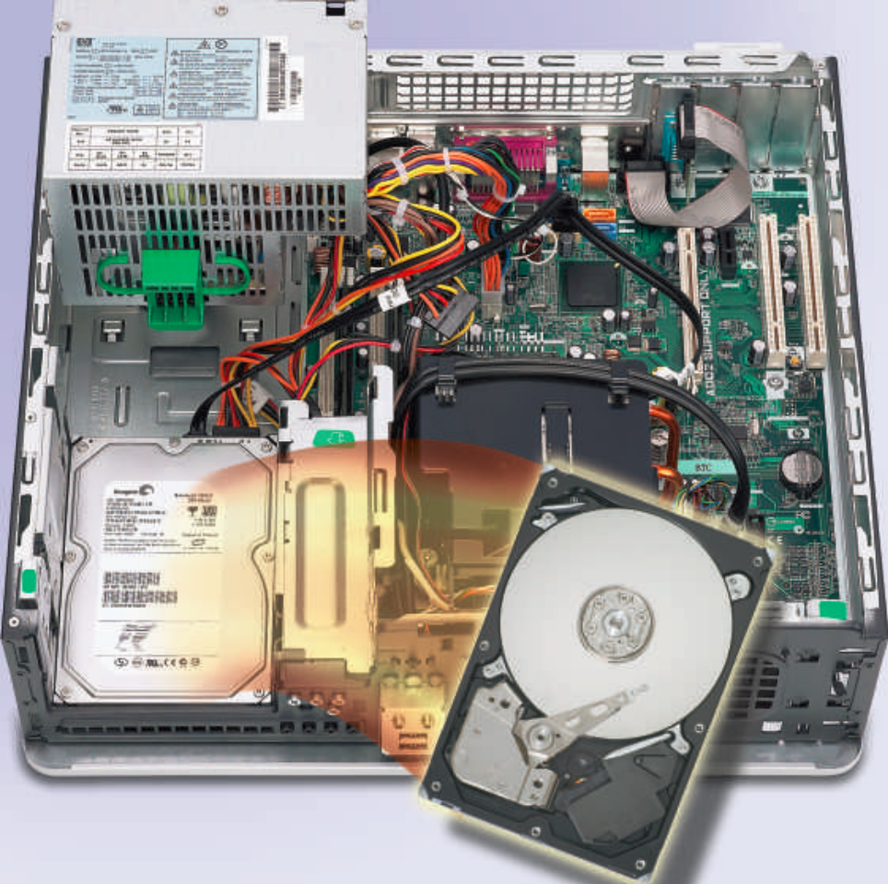
Hard Disks

Slide 45
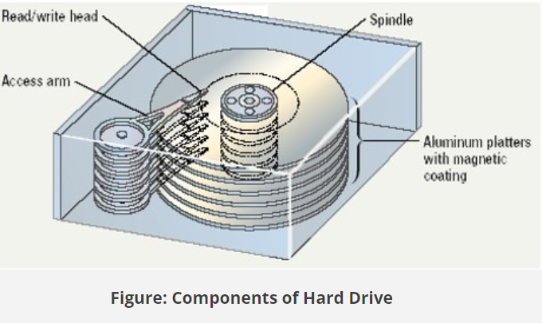
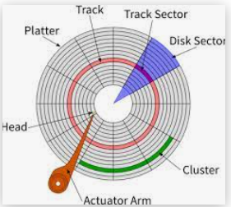
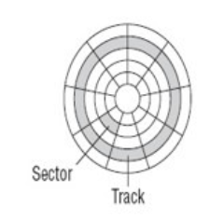
Characteristics of a Hard Disk
Capacity
Platters
Read/write heads
Cylinders
Sectors and tracks
Revolutions per minute
Transfer rate
Access time

Slide 46
Characteristics of a Hard Disk
A storage device is the computer hardware that records and/or retrieves items to and from storage media.
Writing is the process of transferring data, instructions, and information from memory to a storage medium.
Reading is the process of transferring these items from a storage medium into memory.

Slide 47
Access time
The speed of storage devices is defined by access time.
Access time measures the amount of time it takes a storage device to locate an item on a storage medium.

Slide 48
Capacity
The capacity of a hard disk is determined from whether it uses longitudinal or perpendicular recording, the number of platters it contains, and the composition of the magnetic coating on the platters.
Capacity is the number of bytes (characters) a storage medium can hold

Slide 49
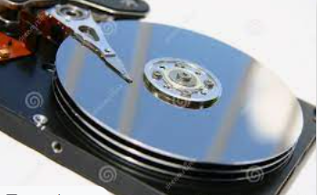
Platter
A platter is made of aluminum, glass, or ceramic and is coated with an mixture material that allows items to be recorded magnetically on its surface.

Slide 50
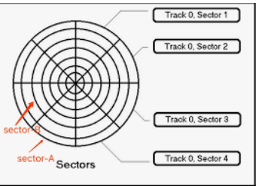
Sectors and tracks
Magnetic disks store data and instructions in tracks and sectors

Slide 51
sectors and tracks
Track: a narrow recording band that forms a full circle on the surface of the disk.

Slide 52
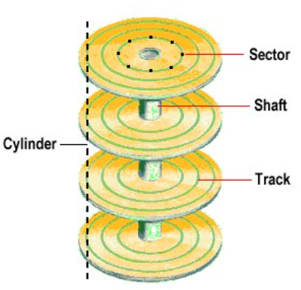
Cylinder
Cylinder is the vertical section of a track that passes through all platters

Slide 53
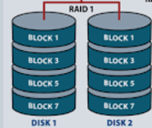
Hard drive cont
Physical Hard Disk can be grouped to form one or more logical unit for data redundancy
A group of two or more integrated hard disks is called a RAID (redundant array of independent disks).

Slide 54
Computer Software
Software: series of related instructions, organized for a common purpose, that tells the computer what task(s) to perform and how to perform them.

Slide 55
THE TWO CATERGORIES OF SOFTWARE
System software consists of the programs that control or maintain the operations of the computer and its devices.
Serves as the interface between the users, the application software, and the computer’s hardware.

Slide 56
THE TWO CATERGORIES OF SOFTWARE
Application software consists of programs designed to make users more productive and/or assist them with personal tasks.

Slide 57
THE TWO TYPES OF SYSTEM SOFTWARE
Operating system
Utility programs

Slide 58
The operating system
A set of programs that coordinates all the activities among computer hardware devices.

Slide 59
Operating System Functions
Starting and shutting down a computer
Providing a user interface
Managing programs
Managing memory
Coordinating tasks
Configuring devices
Establishing an Internet connection
Monitoring performance
Providing file management and other utilities
Automatically updating
Control a network and administer security

Slide 60
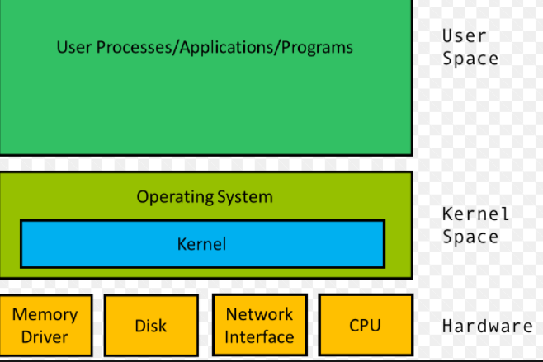
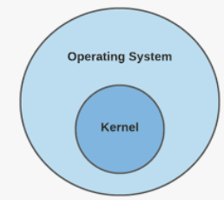
The kernel
The core of an operating system that manages
    Memory and devices
    Maintains the computer’s clock
    Starts programs
    Allocates resources, such as devices, programs, data, processes and information

Slide 61
The three basic categories of operating systems
Stand-alone operating system
Server operating system
Embedded operating system

Slide 62
1. Stand-alone operating system
Operating system that works on a desktop computer, notebook computer, or mobile computing device.
Sometimes called client operating systems
  Example: Windows 10, 7, vista, XP, 2000, Mac OS X, UNIX, and Linux.

Slide 63
2. server operating system
An operating system that is designed specifically to support a network.
Examples:
  Windows Server 2008
  UNIX and Linux: Multipurpose operating systems because they are both stand-alone and server operating systems.
  Solaris: proprietary Unix by Sun Microsystems use by Oracle
  Novell’s NetWare: NOS developed by Novell, Inc

Slide 64
3. Embedded operating system
Operating system on most mobile devices and many consumer electronics.
Popular embedded operating systems include:
  Windows Embedded CE
  Windows Phone 7
  Palm OS
  iPhone OS
  BlackBerry
  Google Android
  embedded Linux

Slide 65
Utility Programs
A utility program: a type of system software that assists users with controlling or maintaining the operation of a computer, its devices, or its software.

Slide 66
Functions of utility programs
Securing a computer from unauthorized access-e.g windows firewall
Protecting against viruses- e.g. Antivirus
Removing spyware and adware- e.g Windows defender
Filtering Internet content- e.g. windows Firewall
Compressing files- e.g WinZip
Playing media files- e.g Windows media player
Burning optical discs- e.g Windows Media Player
Maintaining a computer- e.g Disk cleanup

Slide 67
Application software varieties
Packaged software: mass-produced, copyrighted retail software that meets the needs of a wide variety of users, not just a single user or company.
  Example: Microsoft Office
Custom software: Performs functions specific to a business or industry
Used when company cannot find packaged software that meets its unique requirements
Company may use programmers to develop tailor-made custom software

Slide 68
Web application
A Web site that allows users to access and interact with software from any computer or device that is connected to the Internet.
Apps like gmail, yahoo, email, word processing, and game programs.

Slide 69
Open source software
Software provided for use, modification, and redistribution.
Has no restrictions from the copyright holder regarding modification of the software’s internal instructions and its redistribution.
  Example: Apache Web Server, Mozilla Firefox

Slide 70
Shareware
Software that is distributed free on a trial basis with the understanding that the user may need or want to pay for it later
Copyrighted software that is distributed at no cost for a trial period.
To use a shareware program beyond that period, you send payment to the program developer.
  Eg Adobe Acrobat 8 Professional, Getright, PHP Debugger

Slide 71
Freeware
Copyrighted software provided at no cost to a user by an individual or a company that retains all rights to the software.
  Example: Adobe Reader, Skype, Team Viewer, Yahoo Messenger

Slide 72
Public-domain software
A software been donated for public use and has no copyright restrictions.
Can be publicly modified, distributed or sold without any restrictions and at no cost
  E.g LINUX, Apache, SQLite

