Slide 1
How applications are distributed ?
Freeware vs. Free software
What is a freeware?
Software for no cost (or a voluntary fee)
Fully functional for an unlimited time
Free software that is fully functional for a limited time only and then requires an activation cost is called a shareware
Notes:
Gratis versus libre is the distinction between "for zero price" (gratis) and "freedom" (libre). Gratis appears in many English dictionaries, including the Oxford English Dictionary. However, libre does so less commonly, and no English adjective signifies "liberty" exclusively and as distinct from "at no monetary cost". This distinction is often important in dealing with laws concerning the use of information, such as copyright and patents. The terms are often used in the free software and open source communities, as well as the broader free culture movement, to categorize computer programs according to the licenses and legal restrictions that cover them. Both this expression and the term gratis are used to distinguish freeware (gratis software) from free (libre) software.
Proprietary software is software covered by copyright, patent, or trademark law or controlled by a single legal entity. When the term is used by Richard Stallman, it is pejorative^{[1][2]}. The term is often contrasted with open source, and in this situation, the pejorative connotation isn't there.^{[3][4][5]}
Well known examples of proprietary software include Microsoft Windows, RealPlayer, iTunes, Adobe Photoshop, Mac OS X, WinZip and some versions of Unix.
Shareware, like freeware, is proprietary software available at zero price, but differs in that it is free only for a trial period, after which some restriction is imposed or it is completely disabled. Proprietary software which is no longer marketed by its owner and is used without permission by users is called abandonware and may include source code. Some abandonware has its source code placed in the public domain either by its author or copyright holder and is therefore free software, not proprietary software.

Slide 2
Different kinds of application software

Slide 3
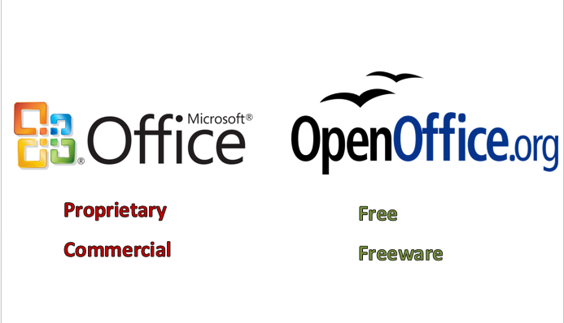
Office Productivity Software

Slide 4
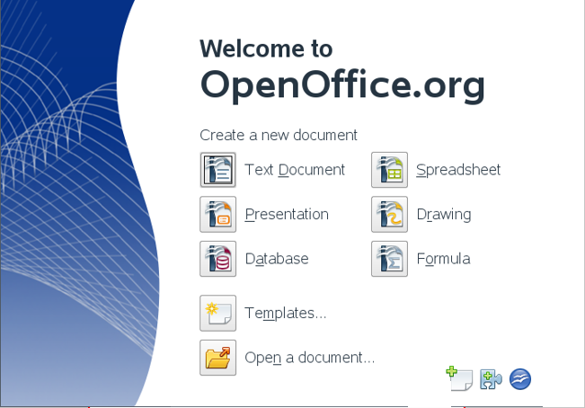
Office Productivity Software

Slide 5
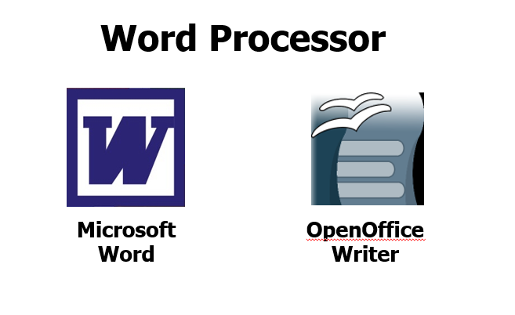
Office Productivity Software
Creates text documents
Graphics and other objects are supported
Professional quality can be achieved
Simple web pages may be created

Slide 6
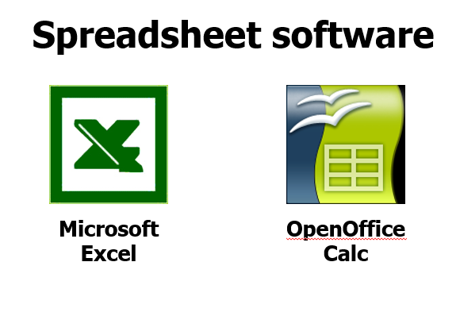
Office Productivity Software

Slide 7
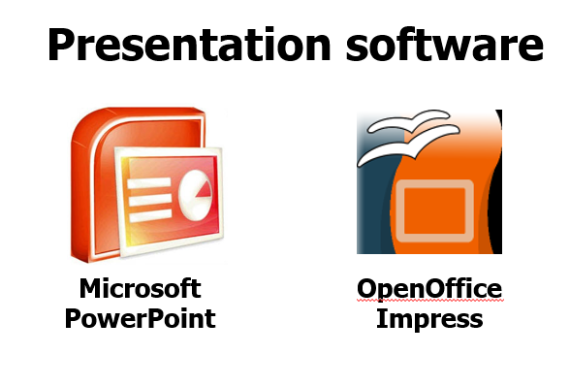
Office Productivity Software

Slide 8
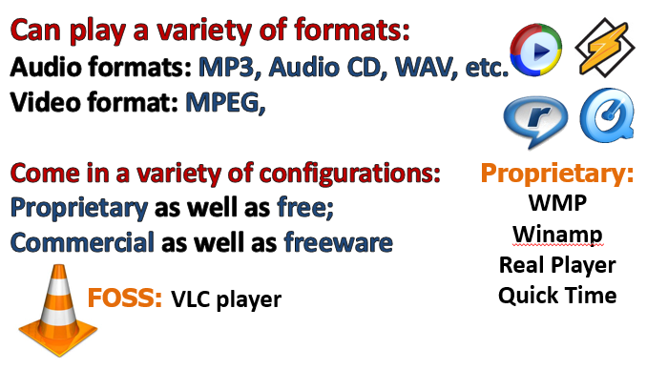
Entertainment Software
Multimedia Software

Slide 9
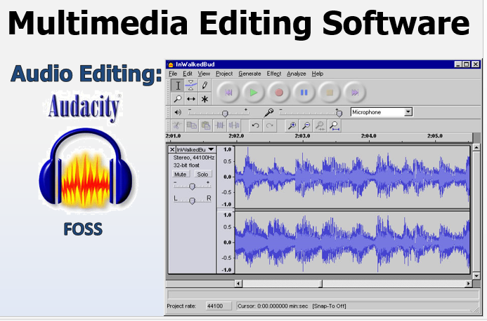
Entertainment Software

Slide 10
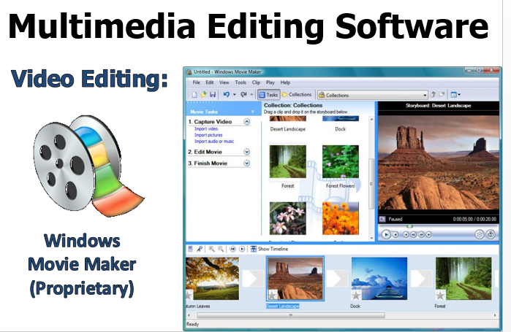
Entertainment Software

Slide 11
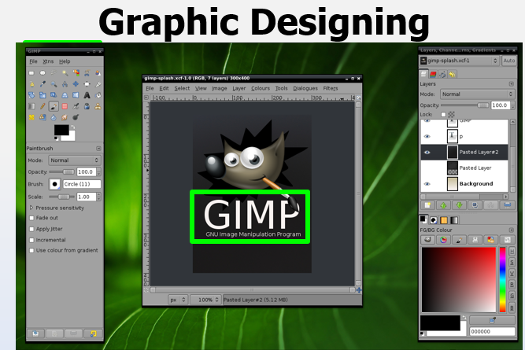
Graphics/ Design Software
Adobe Illustrator
Adobe Photoshop
GIMP
Notes:
Adobe Illustrator: http://images.amazon.com/images/G/01/software/detail-page/illustrator-flash.jpg
Adobe Photoshop: http://www.conceiva.com/products/lightbox/images/photoshop.jpg
GIMP: http://crunchbang.org/images/crunchbang-screens-03/crunchbang-gimp.png

Slide 12
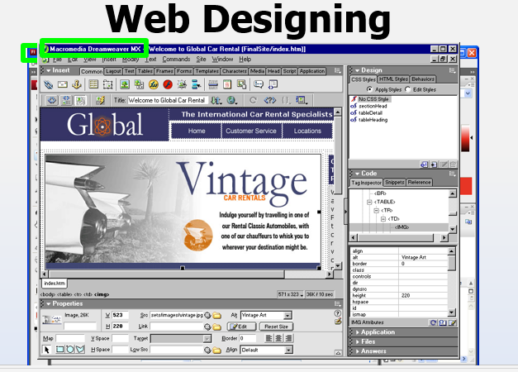
Graphics/ Design Software
e.g. Adobe Dreamweaver
Notes:
Adobe Flash: http://opennfo.files.wordpress.com/2007/08/flash_cs3_screenshot.png
Adobe Dreamweaver:

Slide 13
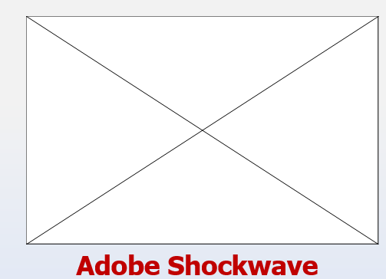
Graphics/ Design Software
Animation Designing
Notes:
To view the animation, you should download the animation “stick_humor2.swf” from the course website and save it in your C:\ directory. You may have to restart the presentation again
Adobe Illustrator: http://images.amazon.com/images/G/01/software/detail-page/illustrator-flash.jpg
Adobe Photoshop: http://www.conceiva.com/products/lightbox/images/photoshop.jpg
GIMP: http://crunchbang.org/images/crunchbang-screens-03/crunchbang-gimp.png

Slide 14
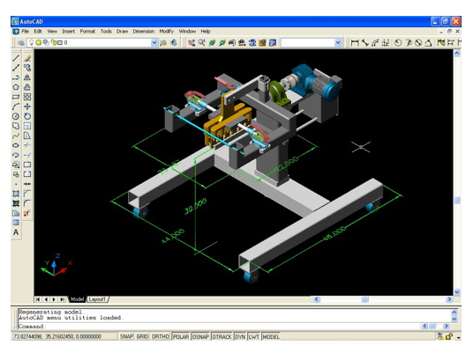
Graphics/ Design Software
AutoCAD
Notes:
http://www.file-extensions.org/imgs/app-picture/166/autocad.jpg

Slide 15
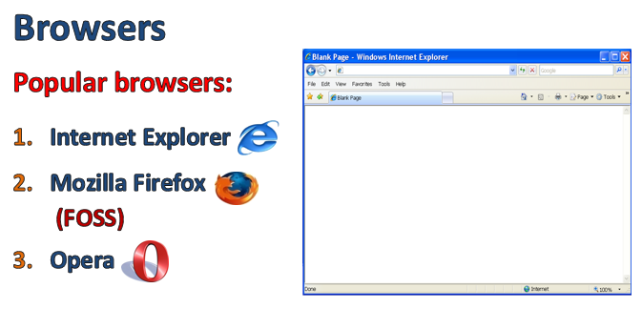
Communications Software
Internet software

Slide 16
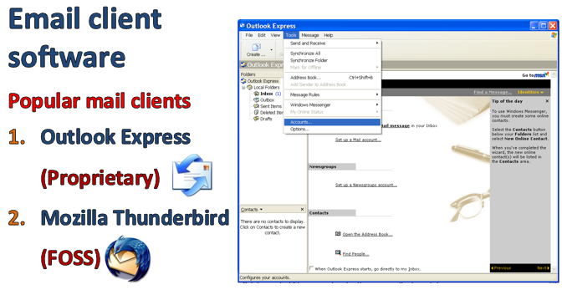
Communications Software
Internet software

Slide 17
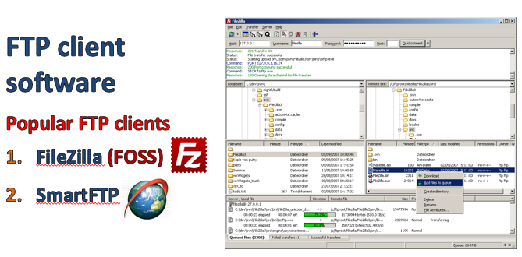
Communications Software
Internet software

Slide 18
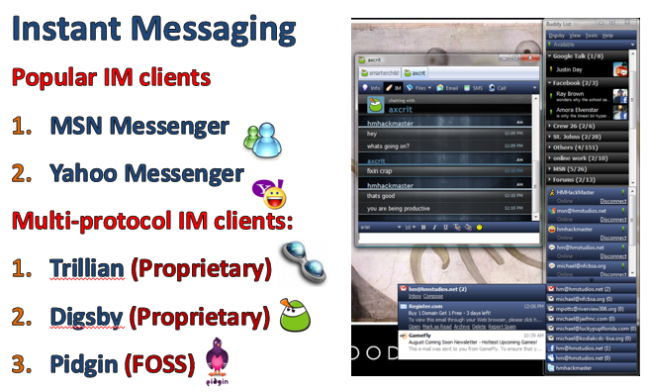
Communications Software
Internet software

Slide 19
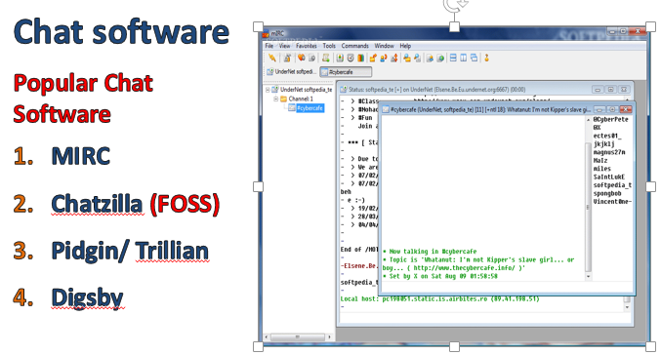
Communications Software
Internet software

Slide 20
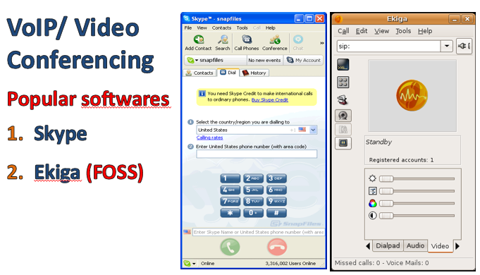
Communications Software
Internet software

Slide 21
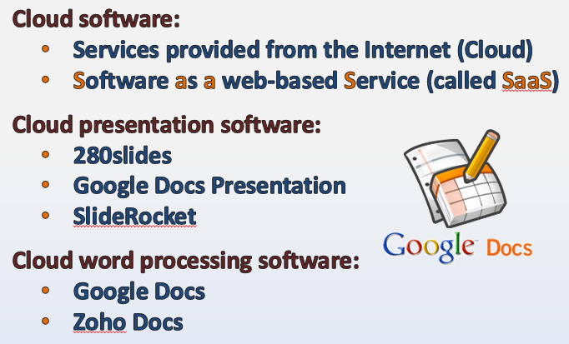
Cloud-based Software

Slide 22
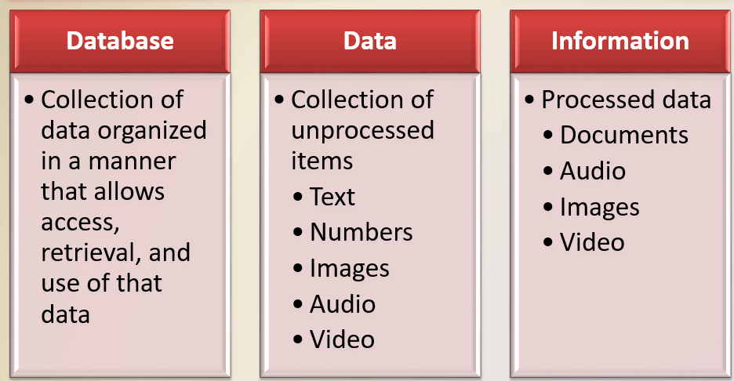
Databases, Data, and Information

Slide 23
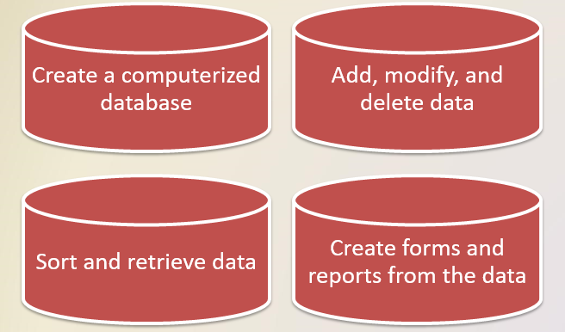
Databases, Data, and Information
Database software, often called a database management system (DBMS), allows users to:

Slide 24
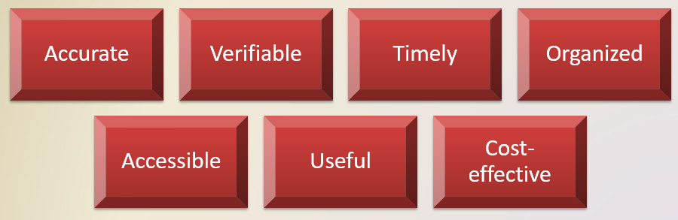
Databases, Data, and Information
Valuable information should have the following characteristics:

Slide 25
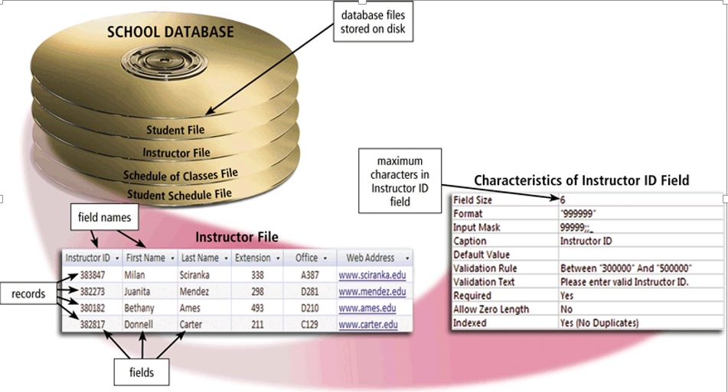
The Hierarchy of Data
Data is organized in layers
  Files, records, fields, characters

Slide 26
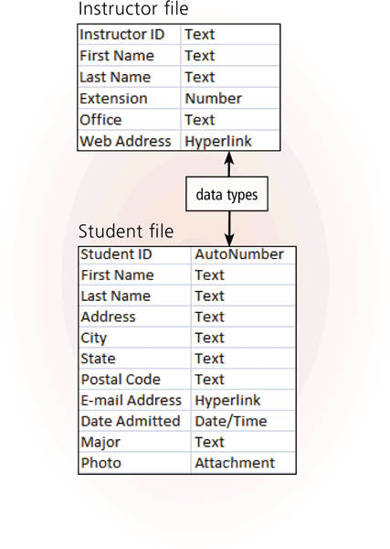
The Hierarchy of Data
A character is one byte
  Numbers, letters, space, punctuation marks, or other symbols
A field is a combination of one or more related characters
  Field name
  Field size
  Data type

Slide 27
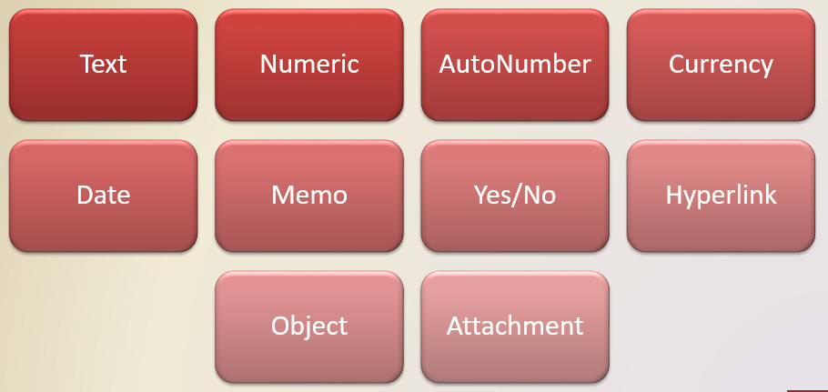
The Hierarchy of Data
Common data types include:

Slide 28
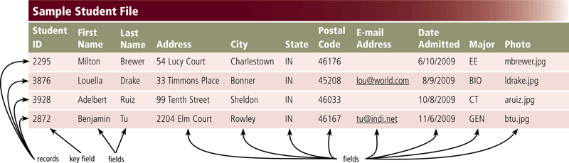
The Hierarchy of Data
A record is a group of related fields
  A primary key uniquely identifies each record
A data file is a collection of related records

Slide 29
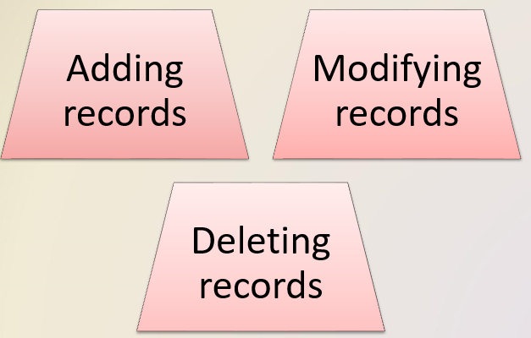
Maintaining Data
File maintenance refers to the procedures that keep data current

Slide 30
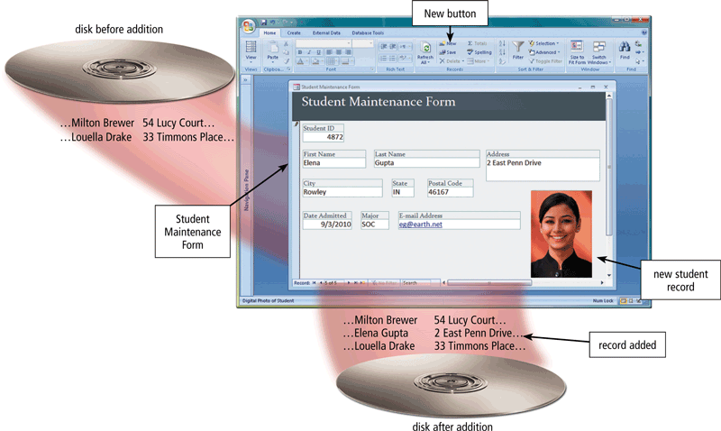
Maintaining Data
Users add new records to a file when they obtain new data

Slide 31
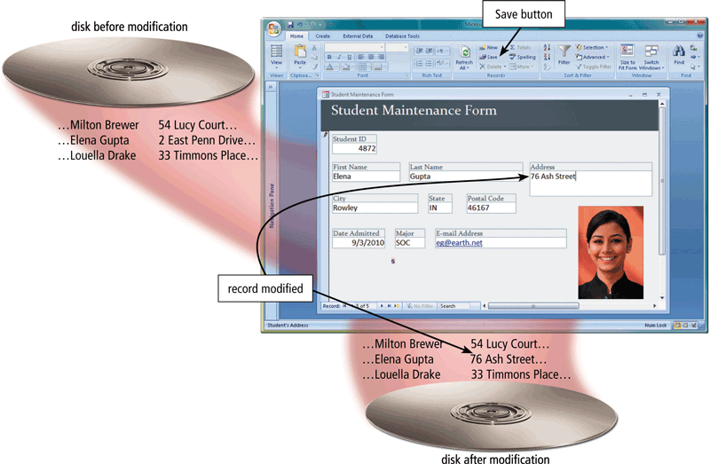
Maintaining Data
Users modify a record to correct inaccurate data or update old data

Slide 32
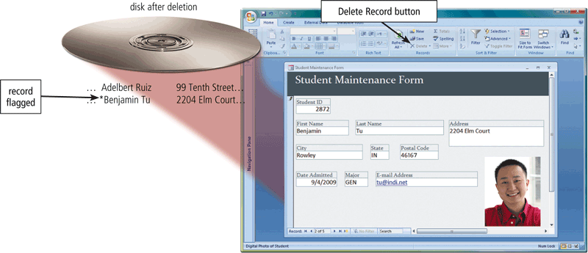
Maintaining Data
When a record no longer is needed, a user deletes it from a file

Slide 33
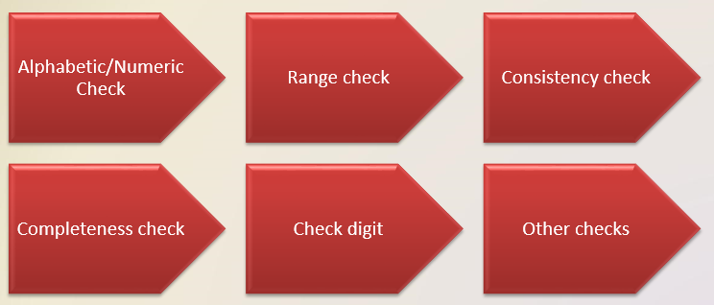
Maintaining Data
Validation compares data with a set of rules or values to find out if the data is correct

Slide 34
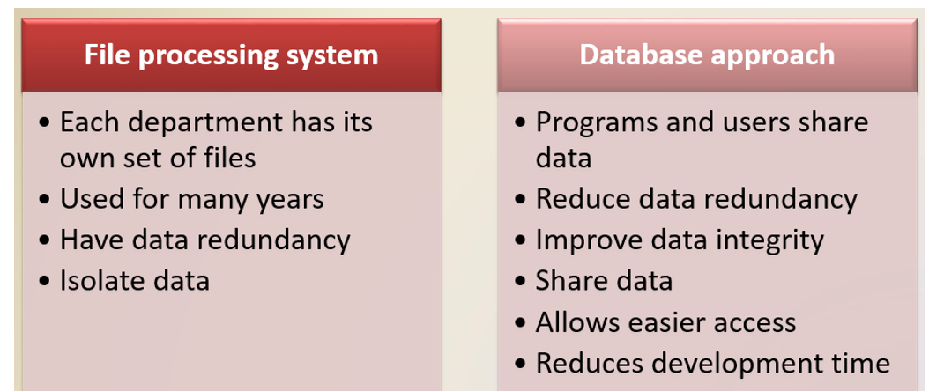
File Processing Versus Databases

Slide 35
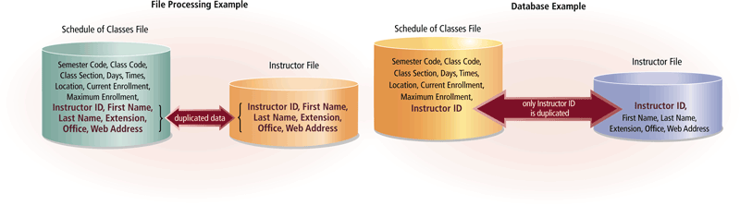
File Processing Versus Databases

Slide 36
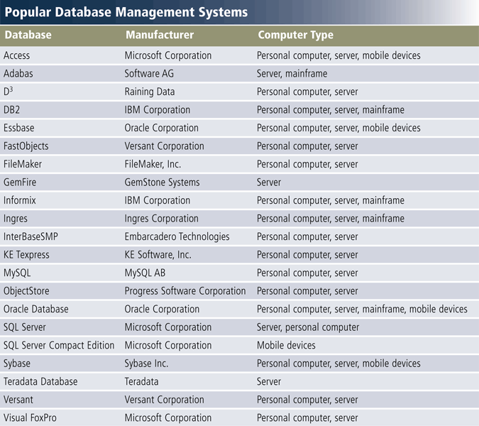
Database Management Systems

Slide 37
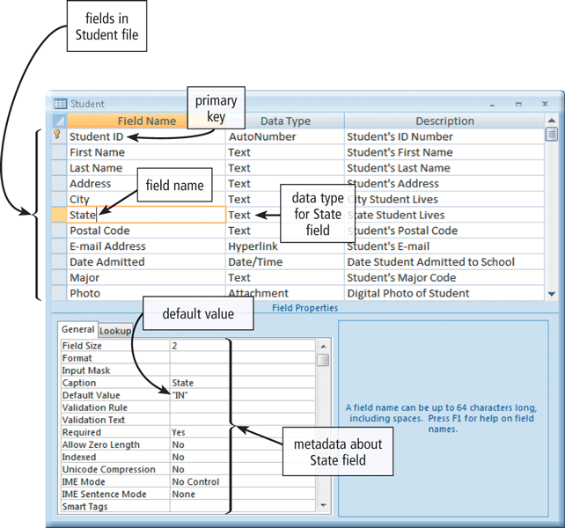
Database Management Systems
A data dictionary contains data about each file in the database and each field in those files

Slide 38
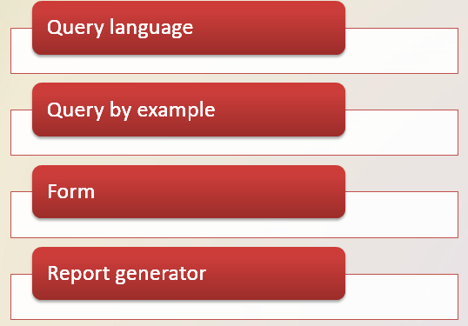
Database Management Systems
A DBMS provides several tools that allow users and programs to retrieve and maintain data in the database

Slide 39
Database Management Systems
A query language consists of simple, English-like statements that allow users to specify the data to display, print, or store
Query by example (QBE) provides a GUI to assist users with retrieving data

Slide 40
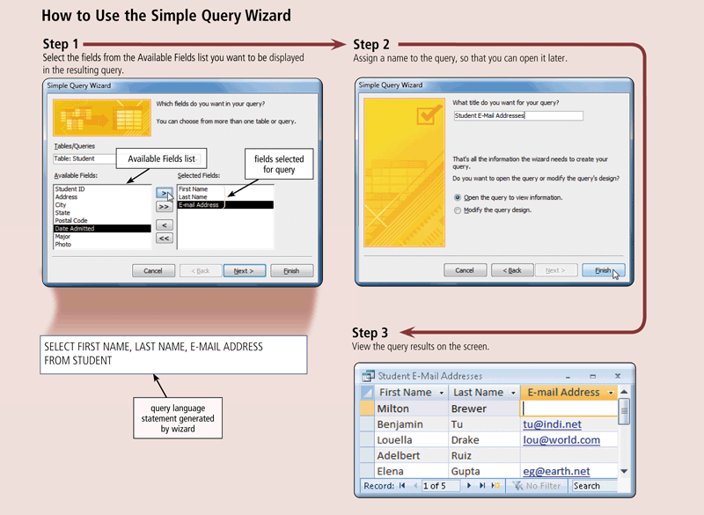
Database Management Systems

Slide 41
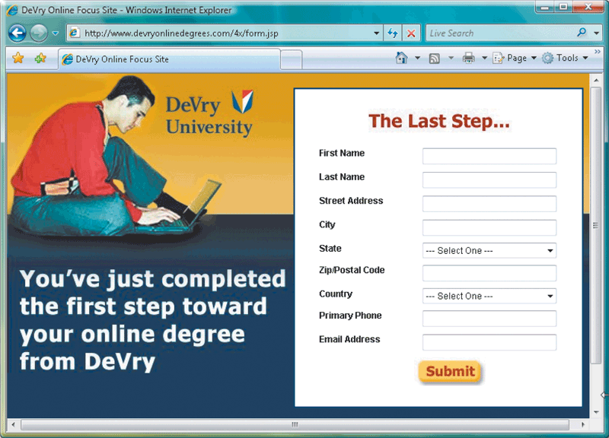
Database Management Systems
A form is a window on the screen that provides areas for entering or modifying data in a database

Slide 42
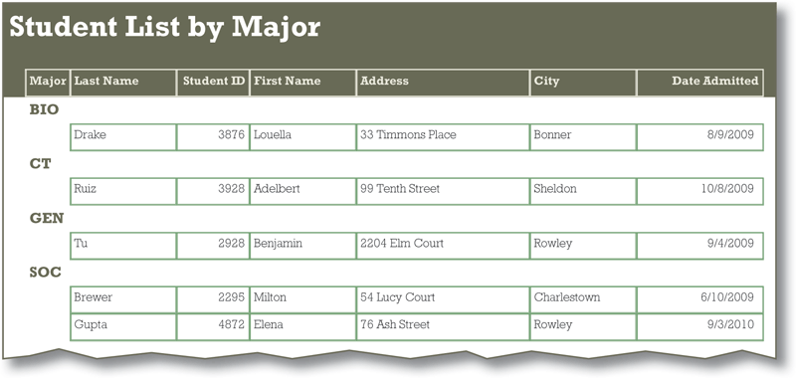
Database Management Systems
A report generator allows users to design a report on the screen, retrieve data into the report design, and then display or print the report

Slide 43
Database Management Systems
A DBMS provides means to ensure that only authorized users access data at permitted times
  Access privileges
  Principle of least privilege

Slide 44
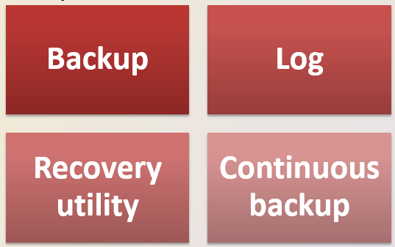
Database Management Systems
A DMBS provides a variety of techniques to restore the database to a usable form in case it is damaged or destroyed

Slide 45
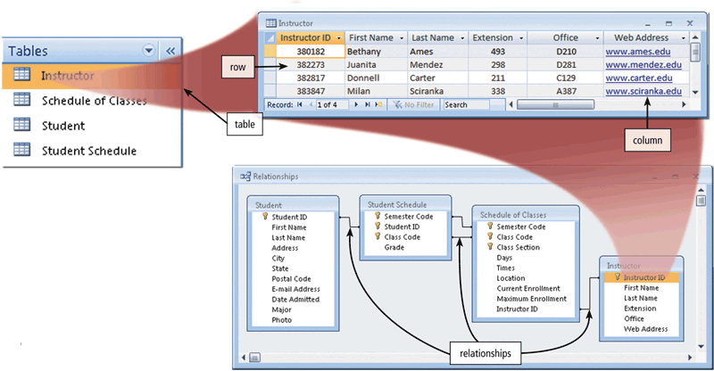
Relational Databases
A data model consists of rules and standards that define how the database organizes data
A relational database stores data in tables that consist of rows and columns
  Each row has a primary key
  Each column has a unique name
A relationship is a link within the data

Slide 46
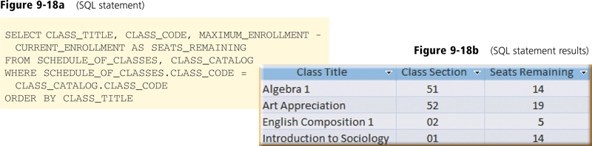
Relational Databases
Structured Query Language (SQL) is a query language that allows users to manage, update, and retrieve data

Slide 47
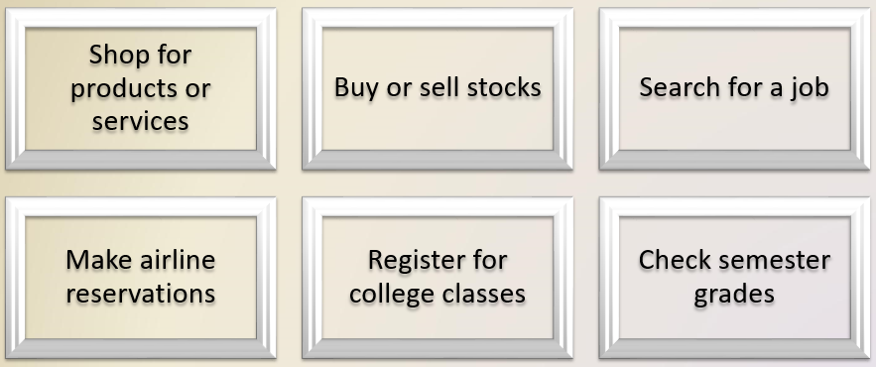
Web Databases
Databases on the Web allow you to:

Slide 48
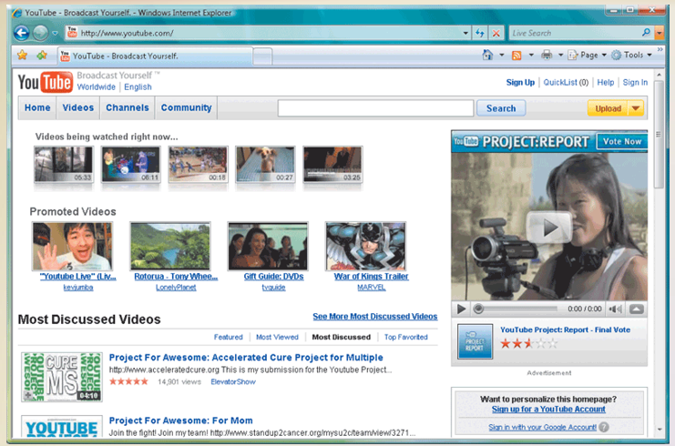
Web Databases

Slide 49
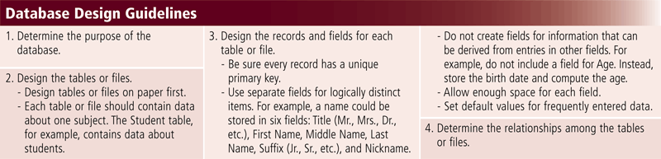
Database Administration
It is important to have a carefully designed database

Slide 50
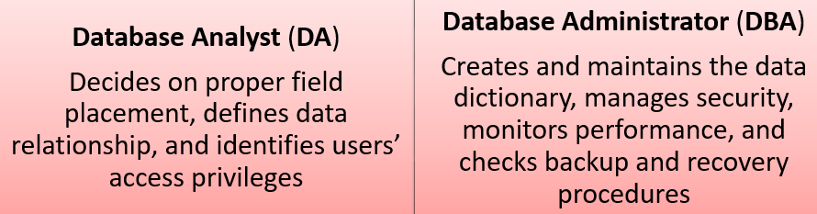
Database Administration
Database analysts and administrators are responsible for managing and coordinating all database activities

Slide 51
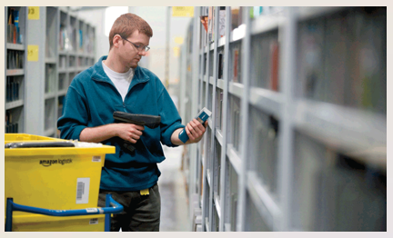
Database Administration
Employees should learn how to use the data in the database effectively
  Interact with database
  Identify new data for the database
  Maintain the database

