Slide 1
Introduction to Information and Communication Technology
CPS 111

Slide 2
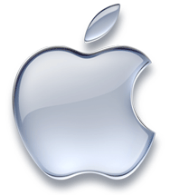

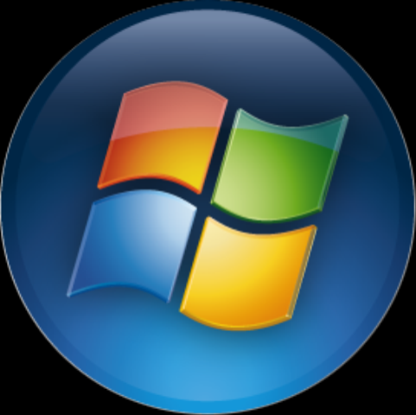
Operating Systems

Slide 3
Introduction
When you turn on your computer, it's nice to think that you're in control.
There's the trusty computer mouse, which you can move anywhere on the screen,
There's a lot going on inside, and the real man behind the curtain handling the necessary tasks is the operating system.
­

Slide 4
How Stuff works?
Not all computers have operating systems.
The computer that controls the microwave oven in your kitchen, for example, doesn't need an operating system.
It has one set of tasks to perform, very straightforward input to expect (a numbered keypad and a few pre-set buttons) and simple, never-changing hardware to control.
An operating system would be unnecessary baggage
Instead, the computer in a microwave oven simply runs a single hard-wired program all the time.

Slide 5
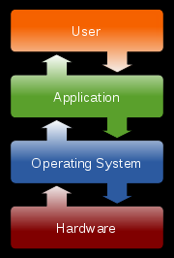
The Role of An Operating System
User/ programmer convenience:
  simple, consistent way for applications
  to interact with the hardware.
Greater resource utilization:
  manages the hardware and software
  resources of the computer system, often invisibly.

Slide 6
Benefit for application developers
App developers do not need to know much about the HW while they are developing their app
Don’t have to manage hardware complexity: Application developers can design software for an OS and it will run on all machines that support that OS.
The OS hides and manages the hardware complexity and provide an Application Programmer Interface (API).
Notes:
API: set of functions, procedures, methods, classes or protocols that an operating system, library or service provides to support requests made by computer programs

Slide 7
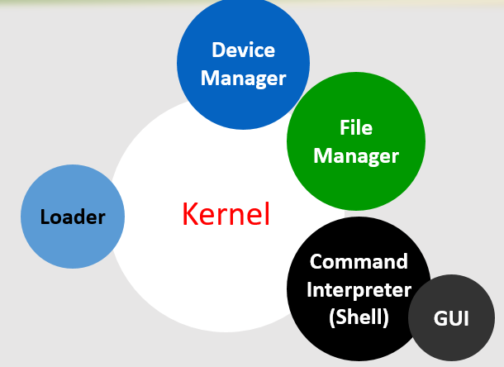
Operating System Components

Slide 8
Operating System Components
Loader:
usually a part of the operating system's kernel and usually loaded at system boot time and stays in memory until the system is rebooted, shut down, or powered off.
Kernel
The heart of the OS
Responsible for all the essential operations like managing resources, task scheduling, etc.
Also contains low-level HW interfaces.
Notes:
In computer science, the kernel is the central component of most computer operating systems (OS). Its responsibilities include managing the system's resources (the communication between hardware and software components).^{[1]} As a basic component of an operating system, a kernel provides the lowest-level abstraction layer for the resources (especially memory, processors and I/O devices) that application software must control to perform its function. It typically makes these facilities available to application processes through inter-process communication mechanisms and system calls.
These tasks are done differently by different kernels, depending on their design and implementation. While monolithic kernels will try to achieve these goals by executing all the code in the same address space to increase the performance of the system, microkernels run most of their services in user space, aiming to improve maintainability and modularity of the codebase.^{[2]} A range of possibilities exists between these two extremes.
In computing, a device driver or software driver is a computer program allowing higher-level computer programs to interact with a hardware device.
A driver typically communicates with the device through the computer bus or communications subsystem to which the hardware is connected. When a calling program invokes a routine in the driver, the driver issues commands to the device. Once the device sends data back to the driver, the driver may invoke routines in the original calling program. Drivers are hardware-dependent and operating-system-specific. They usually provide the interrupt handling required for any necessary asynchronous time-dependent hardware interface.

Slide 9
Core Tasks of an Operating System
Processor management
Memory management
Device management
Storage management
Application Interface
User Interface
Security

Slide 10
Processor Management
Various programs compete for the attention of the microprocessor.
The OS plays the role of the honest referee, making sure that each application gets the necessary attention required for its proper execution.
It tries to optimally manages the limited processing capacity of the microprocessor to the greatest good of all the users & apps

Slide 11
Memory Management
The OS ensures that:
  Each application has enough private memory
  Applications do not run into other application’s private memory.
The OS is responsible for efficient utilization of hierarchical system memory (e.g. RAM, cache, etc.).
Notes:
Memory management is the act of managing computer memory. In its simpler forms, this involves providing ways to allocate portions of memory to programs at their request, and freeing it for reuse when no longer needed. The management of main memory is critical to the computer system.
Virtual memory systems separate the memory addresses used by a process from actual physical addresses, allowing separation of processes and increasing the effectively available amount of RAM using disk swapping. The quality of the virtual memory manager can have a big impact on overall system performance.
Garbage collection is the automated allocation, and deallocation of computer memory resources for a program. This is generally implemented at the programming language level and is in opposition to manual memory management, the explicit allocation and deallocation of computer memory resources.

Slide 12
Storage Management
A file system is a collection of directories, subdirectories, and files organized in a logical order
The OS is responsible for maintaining the file system through indexing of filenames and their disk location.
The OS can find any file in a logical and timely fashion

Slide 13
Device Management
Applications talk to devices through the OS and OS talks to and manages devices through device drivers
Example: When we print to a laser printer, we do not need to know its details. All we do is to tell the printer device driver about what needs to be printed and it takes care of the details
Notes:
In computing, a device driver or software driver is a computer program allowing higher-level computer programs to interact with a hardware device. A driver typically communicates with the device through the computer bus or communications subsystem to which the hardware is connected. When a calling program invokes a routine in the driver, the driver issues commands to the device. Once the device sends data back to the driver, the driver may invoke routines in the original calling program. Drivers are hardware-dependent and operating-system-specific. They usually provide the interrupt handling required for any necessary asynchronous time-dependent hardware interface.

Slide 14
Application Interface
Application developers do not need to know much about the hardware
The OS provides all applications with a straight-forward and consistent interface to hardware
Example: An application uses the OS to store data on the disk drive without knowing exact physical characteristics of the disk.

Slide 15
User Interface
Users communicate with the computer using a consistent user interface provided by the OS
This UI can be a command-line interface in which a user types in the commands. Example:
copy a:/file1.html c:/file1.html
Or, it can be a graphical UI, where Windows, Icons, Menus, and a Pointing device (such as a mouse) is used to receive and display information. Example:
With the help of the mouse, drag file1.html from drive a to drive c
Notes:
The user interface (also known as Human Computer Interface or Man-Machine Interface (MMI)) is the aggregate of means by which people—the users—interact with the system—a particular machine, device, computer program or other complex tool. The user interface provides means of:
Input, allowing the users to manipulate a system output, allowing the system to produce the effects of the users' manipulation.

Slide 16

Security
Provide password-protected authentication of a user before allowing access
Restricts the action that can be performed on the computer, customized for each user

Slide 17
Types of Operating Systems
Classification according to type of computers and applications they support
  Real-Time Operating System (RTOS)
  Single-User, Single Task
  Single-User, Multi-Tasking
  Multi-User

Slide 18
RTOS
Used to run computers embedded in machinery, robots, scientific instruments and industrial systems
An important part of an RTOS is managing the resources of the computer so that a particular operation executes in precisely the same amount of time every time it occurs
Examples: QNX: is a commercial Unix-like real-time operating system, aimed primarily at the embedded systems
Notes:
Typically, it has little user interaction capability, and no end-user utilities, since the system will be a "sealed box" when delivered for use.
In a complex machine, having a part move more quickly just because system resources are available may be just as catastrophic as having it not move at all because the system was busy
A Real-Time Operating System (RTOS; generally pronounced as "R-toss") is a multitasking operating system intended for real-time applications. Such applications include embedded systems (programmable thermostats, household appliance controllers), industrial robots, spacecraft, industrial control (see SCADA), and scientific research equipment.
A RTOS facilitates the creation of a real-time system, but does not guarantee the final result will be real-time; this requires correct development of the software. An RTOS does not necessarily have high throughput; rather, an RTOS provides facilities which, if used properly, guarantee deadlines can be met generally (soft real-time) or deterministically (hard real-time). An RTOS will typically use specialized scheduling algorithms in order to provide the real-time developer with the tools necessary to produce deterministic behavior in the final system. An RTOS is valued more for how quickly and/or predictably it can respond to a particular event than for the given amount of work it can perform over time. Key factors in an RTOS are therefore a minimal interrupt latency and a minimal thread switching latency.
An early example of a large-scale real-time operating system was Transaction Processing Facility developed by American Airlines and IBM for the Sabre Airline Reservations System.
Design philosophies
Two basic designs exist:
Event-driven (priority scheduling) designs switch tasks only when an event of higher priority needs service, called pre-emptive priority.
Time-sharing designs switch tasks on a clock interrupt, and on events, called round robin.
Time-sharing designs switch tasks more often than is strictly needed, but give smoother, more deterministic multitasking, giving the illusion that a process or user has sole use of a machine.
Early CPU designs needed many cycles to switch tasks, during which the CPU could do nothing useful. So early OSes tried to minimize wasting CPU time by maximally avoiding unnecessary task-switches.
More recent CPUs take far less time to switch from one task to another; the extreme case is barrel processors that switch from one task to the next in zero cycles. Newer RTOSes almost invariably implement time-sharing scheduling with priority driven pre-emptive scheduling.

Slide 19
Single-User, Single Task
OS designed to manage the computer so that one user can effectively do one thing at a time
Example: MS-DOS is an example single-tasking single-user OS with a command line interface.

Slide 20
Single-User, Multi-Tasking
Most popular OS
Used by most of PCs and Laptops
Lets a single user interact with several programs, simultaneously
Examples: Windows, Mac OS, Linux
Notes:
In computing, multitasking is a method by which multiple tasks, also known as processes, share common processing resources such as a CPU. In the case of a computer with a single CPU, only one task is said to be running at any point in time, meaning that the CPU is actively executing instructions for that task. Multitasking solves the problem by scheduling which task may be the one running at any given time, and when another waiting task gets a turn. The act of reassigning a CPU from one task to another one is called a context switch. When context switches occur frequently enough the illusion of parallelism is achieved. Even on computers with more than one CPU (called multiprocessor machines), multitasking allows many more tasks to be run than there are CPUs.

Slide 21
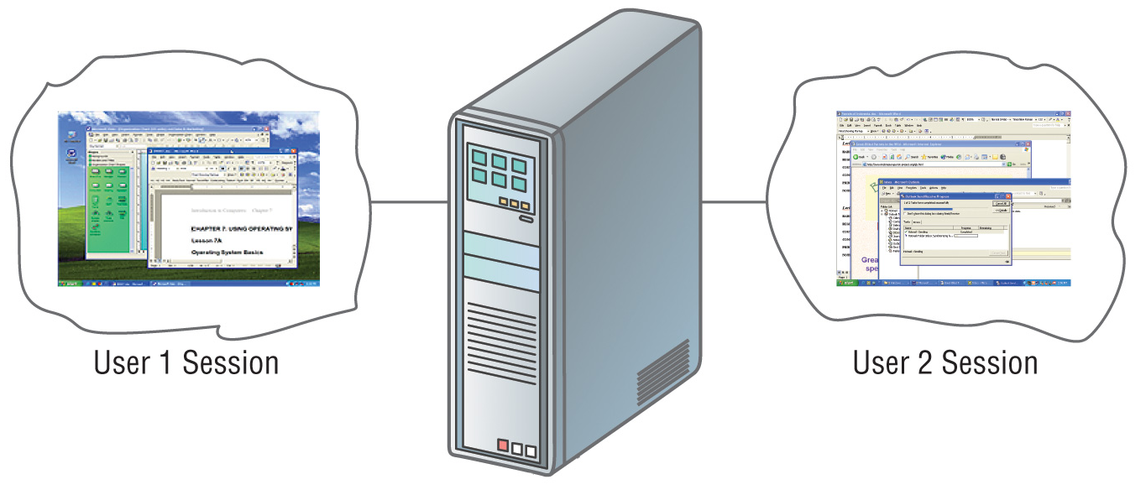
Multi-User
A multi-user OS allows many users to take advantage of the computer's resources, simultaneously
Examples: Linux, Unix, Windows Server
Notes:
The OS must make sure that the requirements of the various users are balanced, and that the programs they are using each have sufficient and separate resources so that a problem with one user doesn't affect any of the other users
Multi-user is a term that defines an operating system or application software that allows concurrent access by multiple users of a computer. Time-sharing systems are multi-user systems. Most batch processing systems for mainframe computers may also be considered "multi-user", to avoid leaving the CPU idle while it waits for I/O operations to complete. However, the term "multitasking" is more common in this context.
An example is a Unix server where multiple remote users have access (such as via Secure Shell) to the Unix shell prompt at the same time. Another example uses multiple X Window sessions spread across multiple terminals powered by a single machine - this is an example of the use of thin client.

Slide 22
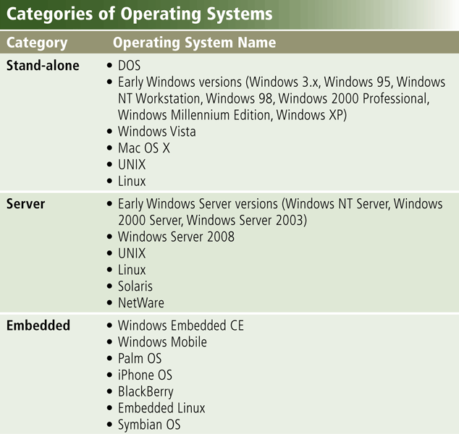
Types of Operating Systems

Slide 23
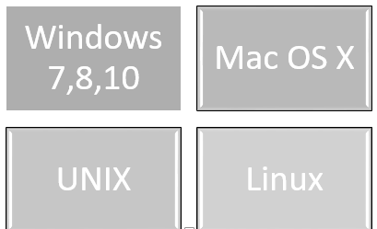
Stand-Alone Operating Systems
A stand-alone operating system is a complete operating system that works on a desktop computer, notebook computer, or mobile computing device

Slide 24
Stand-Alone Operating Systems
Windows 10 is one of Microsoft’s fastest, most efficient operating system to date and is available in multiple editions:
Windows Home
Windows pro
Windows pro for workstation
Windows pro education and enterprise

Slide 25
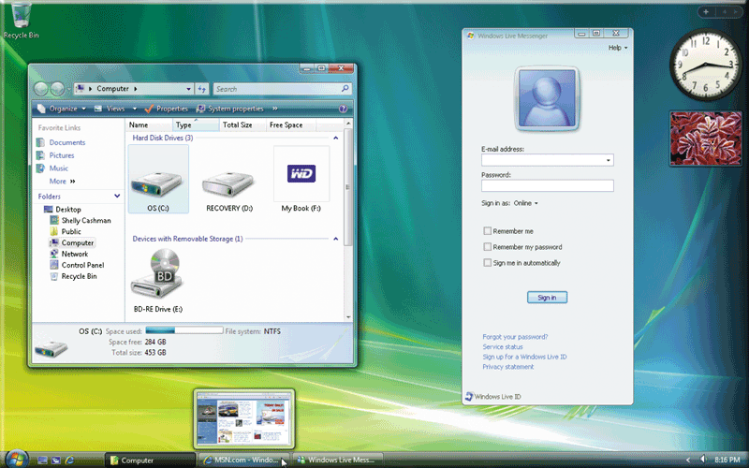
Stand-Alone Operating Systems

Slide 26
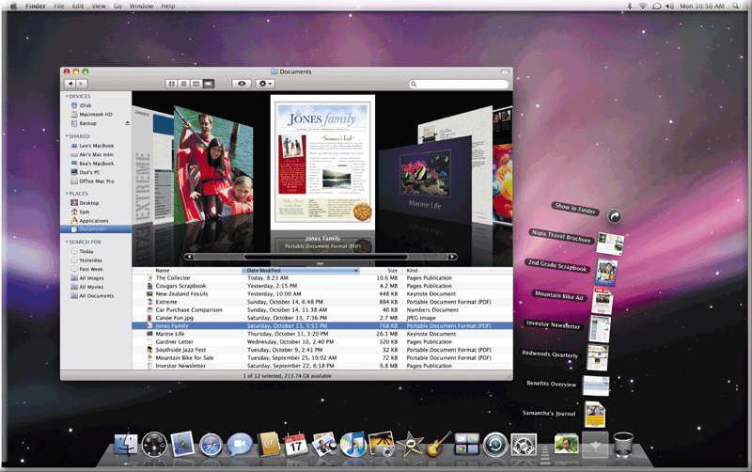
Stand-Alone Operating Systems
The Macintosh operating system has set the standard for operating system ease of use

Slide 27
Stand-Alone Operating Systems
UNIX is a multitasking operating system developed in the early 1970s
Linux is an open-source, popular, multitasking UNIX-type operating system
Notes:
Linux is an open source, free to use operating system widely used for computer hardware and software, game development, tablet PCS, mainframes etc.
Unix is an operating system commonly used in internet servers, workstations and PCs by Solaris, Intel, HP etc.

Slide 28
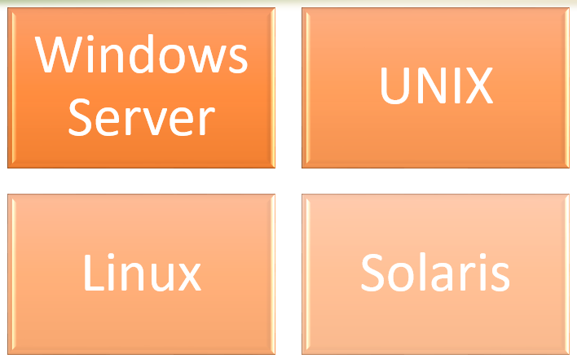
Server Operating Systems

Slide 29
Embedded Operating Systems
An embedded operating system resides on a ROM chip on a mobile device or consumer electronic device
Windows Embedded CE
Windows Mobile
Palm OS
iPhone OS
Blackberry
Embedded Linux
Symbian OS

Slide 30
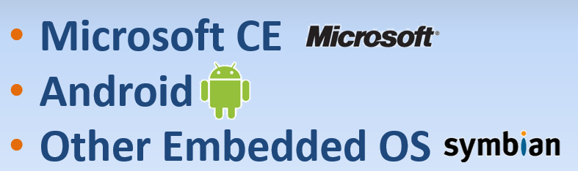
Embedded Operating Systems
Notes:
An embedded operating system is an operating system for embedded computer systems. These operating systems are designed to be very compact and efficient, forsaking many functions that non-embedded computer operating systems provide, and which may not be used by the specialized applications they run. They are frequently also real-time operating systems.
Examples of embedded operating systems could include the software used in Automated teller machines, Cash Registers, CCTV systems, jukeboxes and suchlike.

Slide 31
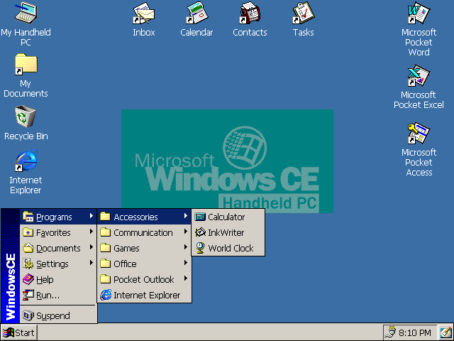
Windows CE
Notes:
Windows CE is optimized for devices that have minimal storage—a Windows CE kernel may run in under a megabyte of memory. Devices are often configured without disk storage, and may be configured as a “closed” system that does not allow for end-user extension (for instance, it can be burned into ROM). Windows CE conforms to the definition of a real-time operating system, with a deterministic interrupt latency. It supports 256 priority levels and uses priority inheritance for dealing with priority inversion. The fundamental unit of execution is the thread. This helps to simplify the interface and improve execution time.

Slide 32
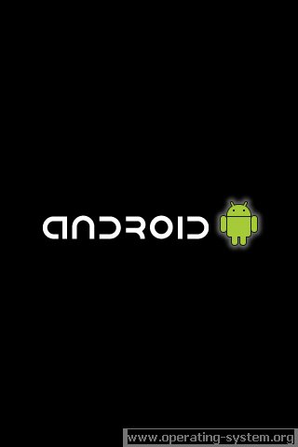
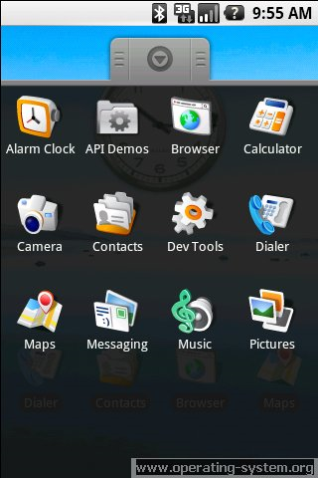
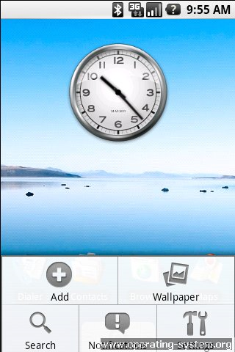
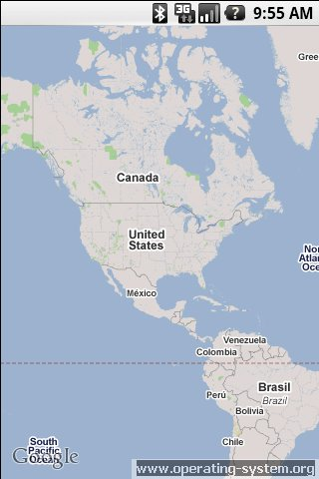
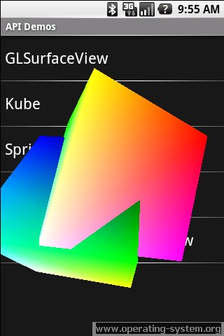
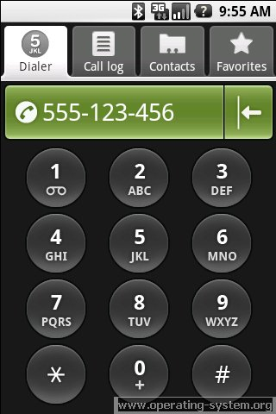
Android

Slide 33
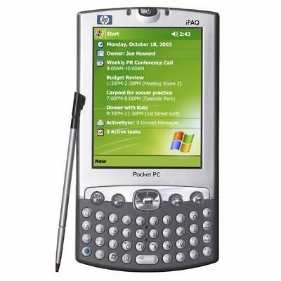
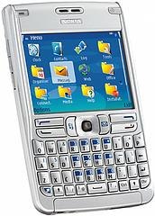
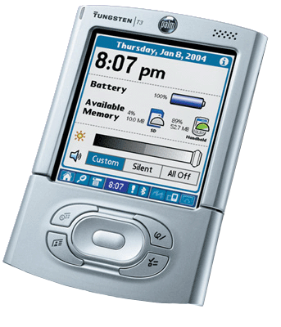
Palm OS
Symbian OS
Notes:
A Pocket PC, abbreviated P/PC or PPC, is a hardware specification for a handheld-sized computer (Personal digital assistant) that runs the Microsoft Windows Mobile operating system. It may have the capability to run an alternative operating system like NetBSD, Linux, Android or others. It has many of the capabilities of modern desktop PCs. Currently there are thousands of applications for handhelds adhering to the Microsoft Pocket PC specification, many of which are freeware. Some of these devices also include mobile phone features. Microsoft compliant Pocket PCs can also be used with many other add-ons like GPS receivers, barcode readers, RFID readers, and cameras.
In 2007, with the advent of Windows Mobile 6, Microsoft dropped the name Pocket PC in favor of a new naming scheme. Devices without an integrated phone are called Windows Mobile Classic devices instead of Pocket PCs. Devices with an integrated phone and a touch screen are called Windows Mobile Professional devices and devices without a touch screen are called Windows Mobile Standard devices.^{[1]}

Slide 34
Communication Networks

Slide 35
Networking
Networks is a set of technologies – including hardware, software and media – that can be used to connect computers together, enabling them to communicate, exchange information and share resources in real time
Notes:
Types of networks are as follows. A wide area network (WAN) covers a wide geographical area, such as a country. A metropolitan area network (MAN) covers a city or suburb. A local area network (LAN) covers a limited area such as an office or a building. Most large networks have a host computer, a mainframe or midsize central computer to control the network. Any device attached to a network is called a node. MANs and LANs may be connected to the internet by a high-speed network called a backbone.
Two types of LANs are client/server and peer-to-peer. A client/server LAN consists of microcomputers that request data (clients) and powerful computers that provide data (servers). A file server, for example, stores programs and data files; other servers are database server, print server, web server, and mail server. In a peer-to-peer LAN, there is no server; microcomputers on a network communicate with each other directly. Several standard components of a LAN are the connection or the cabling system, microcomputers with network interface cards (NIC), network operating system (Novel NetWare, Microsoft Windows NT/2000, Unix, or Linux), and other shared devices (printers, storage devices). Other components are a router, a special computer that helps to communicate messages when networks are tied together; a bridge, an interface used to connect the same types of networks; a gateway, an interface that allows communication between dissimilar networks; and a hub, a common connection point for devices in a network.

Slide 36
Benefits
Resource sharing (cost savings)
Personal communication
Data backups
Reliability (reduced errors/inconsistencies)
Greater performance (distributed computing)
Personalized/ contextualized services

Slide 37
Network Design Issues
  Media; Topology; Protocol;
  Addressing; Naming;
  Example networking application.

Slide 38
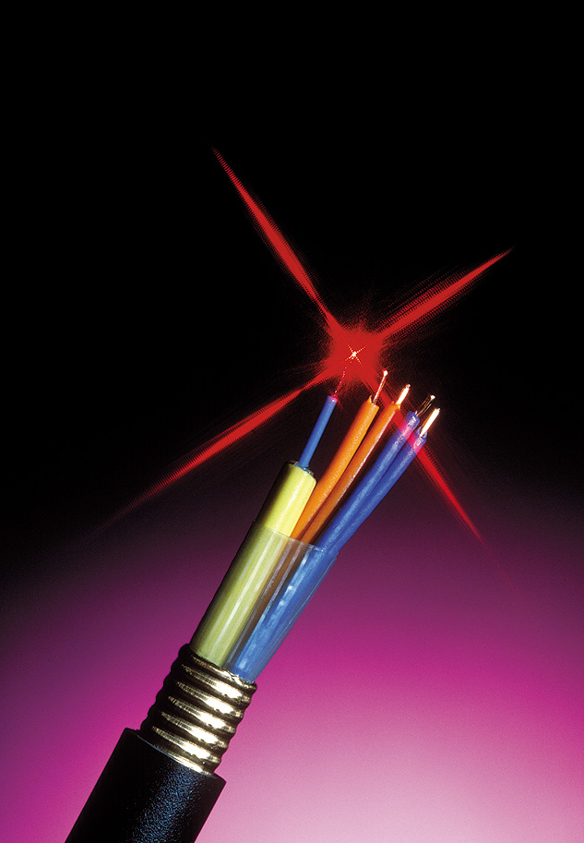
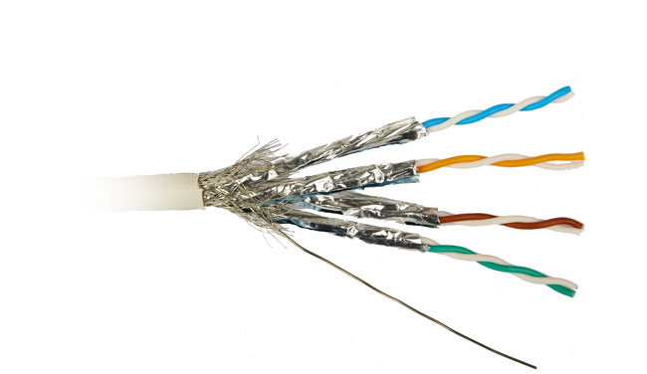
Transmission media
Wired Media
  1) Copper pair:
    Unshielded Twisted Pair (UTP)
    Shielded Twisted Pair (STP)
  2) Coaxial Cable
  3) Optical Fiber
Notes:
The electromagnetic spectrum consists of fields of electrical energy and magnetic energy, which travel in waves. A part of the electromagnetic spectrum is the radio frequency spectrum, fields of electrical and magnetic energy that carry communications signals, which vary according to frequency. A range or a band of frequencies that a transmission can carry in a given period of time is called bandwidth. The wider the band, the faster data can be transmitted. Broadband connections are very high speed.
A communications channel is the path over which information travels in a telecommunications system. Channels may be wired or wireless.
Three types of wired channels are the following. (1) Twisted-pair wire, or standard telephone wire, consists of two strands of insulated copper wire twisted around each other; it is used for both voice and data transmission. (2) Coaxial cable consists of insulated copper wire wrapped in other materials; it is better than twisted-pair for resisting noise. (3) Fiber-optic cable consists of thin strands of glass or plastic that transmit beams of light rather than electricity; it is very fast and noise-resistant.

Slide 39
Transmission media
Wireless Channels
Four types of wireless channels
  Infrared transmission :
    sends data via infrared-light waves
  Broadcast radio :
    sends data over long distances, between states, regions, and countries
  Microwave radio :
    transmits voice and data as super high-frequency radio waves
  Communications satellites:
    are microwave relay stations in orbit around the earth.

Slide 40
Network Topology
Network topology is the study of the physical (real) and logical (virtual) interconnections between nodes
Topology types:
  Point to Point
  Bus
  Star
  Ring
  Mesh
  Hybrid

Slide 41
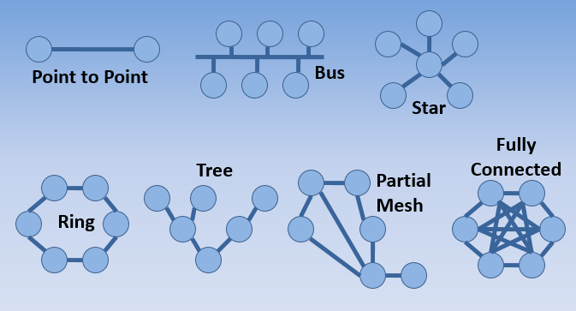
Network Topology
Point-to-point (PTP) topology connects two nodes directly together. The following examples is pure point to point links: A workstation communicating along a parallel cable to a printer.

Slide 42
Protocol
The rules governing the syntax, semantics, and synchronization of communication
Defines
  1) format Messages
  2) order of messages sent and received among network entities
  3) action(s) taken on transmission and receipt of message
Notes:
A protocol is a set of conventions that control the exchange of data between hardware and/or software components in a communications network. (8) OSI is an international standard that defines seven layers of protocols for worldwide computer communications.

Slide 43
Protocol
TCP/IP is the most dominant suite of protocols and is used on the Internet.
TCP/IP suite of protocols is often organized in a hierarchy of layers (OSI layers)

Slide 44
Addressing
Each station must be addressable
Two kinds of addresses:
  1) Physical addressing (MAC addresses)
  2) Logical addressing (IP addresses)
The communicating applications (source/ destination applications) must also be identifiable
Identified through TCP ports
A socket (IP address + TCP port) identifies both an application and the machine it’s on

Slide 45
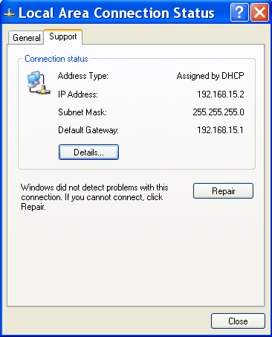
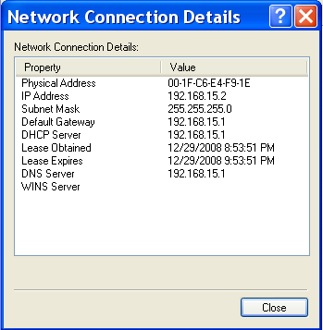
Physical Addressing: MAC

Slide 46
Logical Addressing: IP
IP Version 4; Address: 32 bits Possible addresses 4,294,967,296
IP Version 6; Address: 128 bits possible addresses = 2³²
Hierarchical addressing
  2 parts: a network part and a host part.
  Machines in a LAN have the same network part; they differ in host parts
  How is the network part of an IP address defined? Subnet mask

Slide 47
IP (Internet Protocol)
IP Address
  192.168.15.2 (decimal)
  11000000 10101000
  00001111 00000010 (binary)
Subnet Mask:
  255.255.255.0 (decimal)
  11111111 11111111
  11111111 00000000 (binary

Slide 48
Applications Identification
How to identify source/ destination application communicating?
The source/ destination applications are identified through TCP ports
Common TCP Ports:
HTTP: 80; SMTP:25; DNS: 53

Slide 49
Naming
Machine addresses are difficult to memorize
Solution: Provide recognizable names to numerically addressed Internet resources.
Examples:
  google.com; stanford.edu; niit.edu.pk

Slide 50
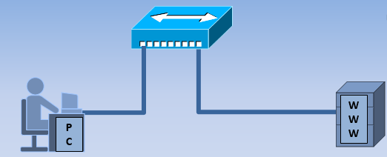
Example application
Let’s assume that a student (in the niit.edu.pk LAN) wishes to access NUST-SEECS website hosted at www.niit.edu.pk
niit.edu.pk

Slide 51
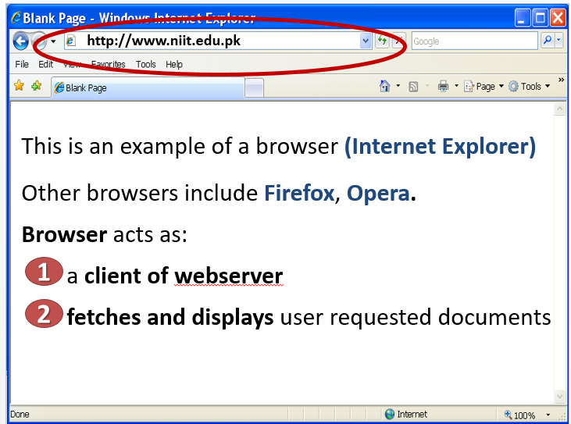

Slide 52
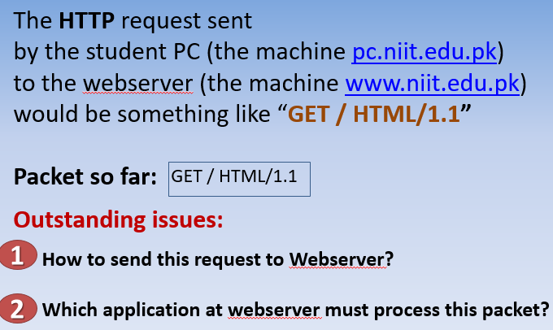
Example application (contd.)

Slide 53
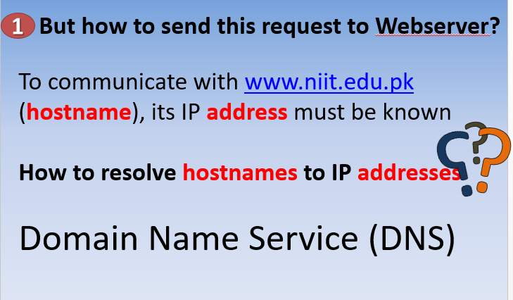
Example application (contd.)

Slide 54
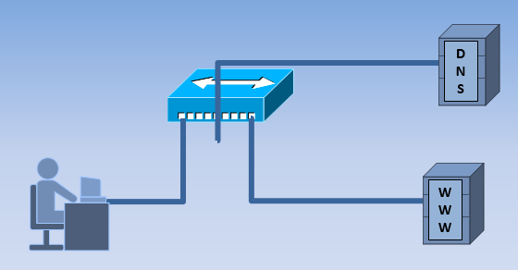
Example application (contd.)

Slide 55
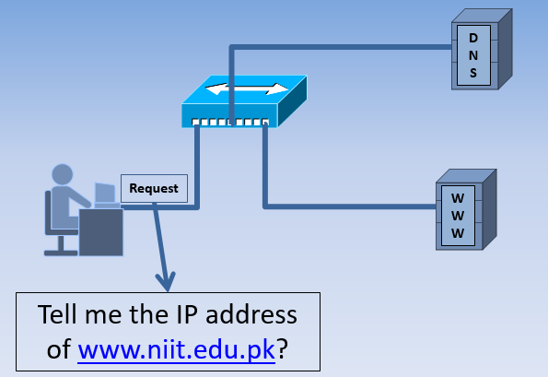
DNS Client/Server Exchange

Slide 56
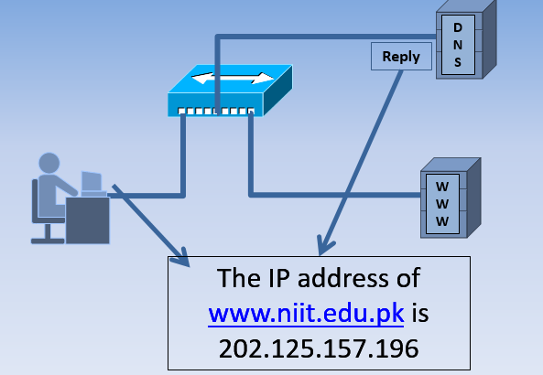
DNS Client/Server Exchange

Slide 57
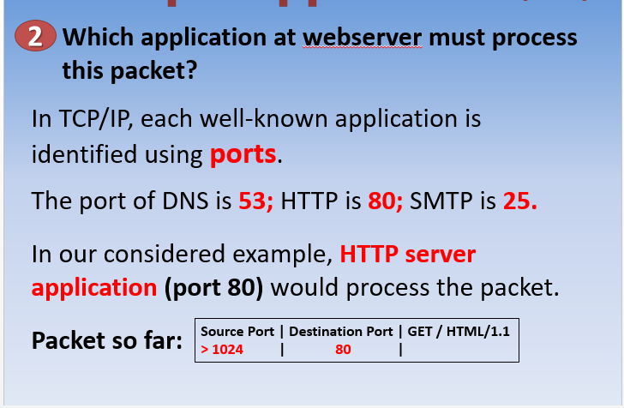
DNS Client/Server Exchange

Slide 58
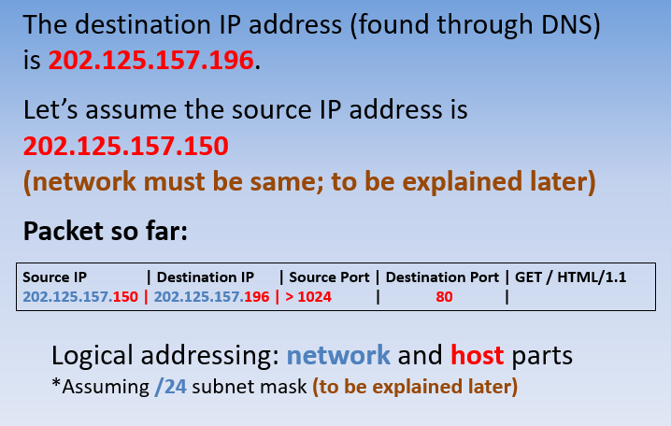
DNS Client/Server Exchange

Slide 59
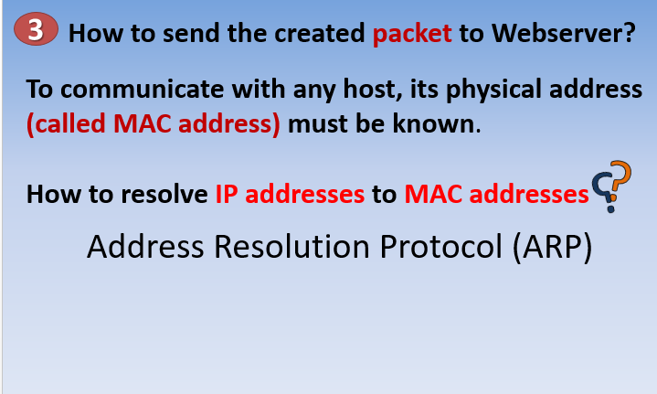
DNS Client/Server Exchange

Slide 60
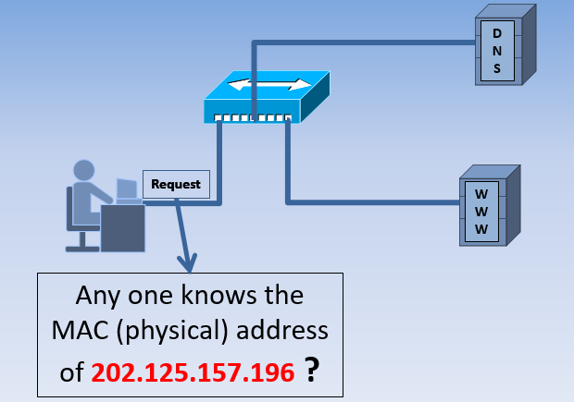
ARP Client/Server Exchange

Slide 61
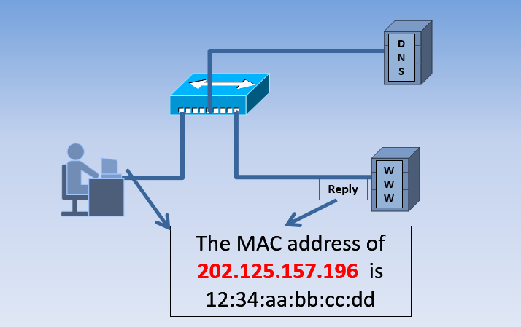
ARP Client/Server Exchange

Slide 62
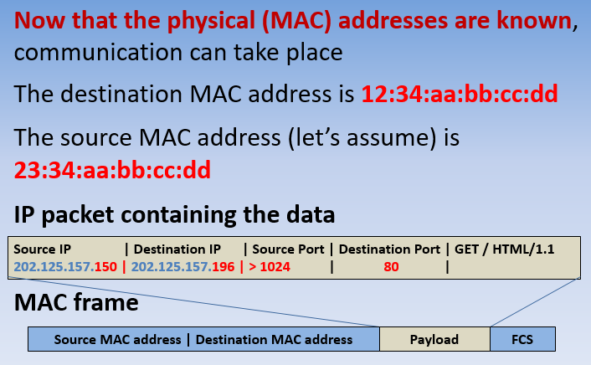
ARP Client/Server Exchange

Slide 63
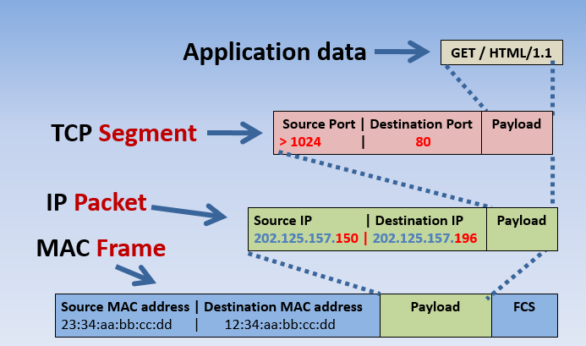
Encapsulation

Slide 64
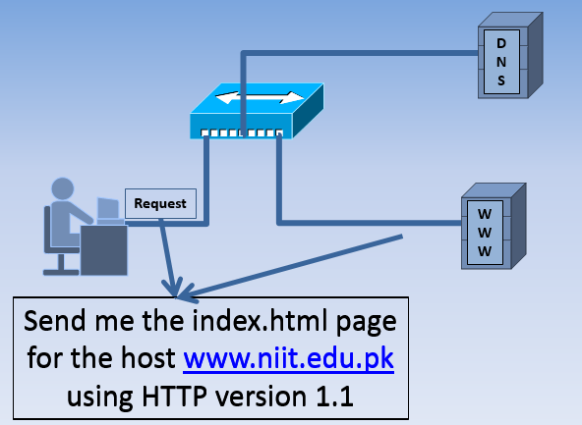
HTTP Client/Server Exchange

Slide 65
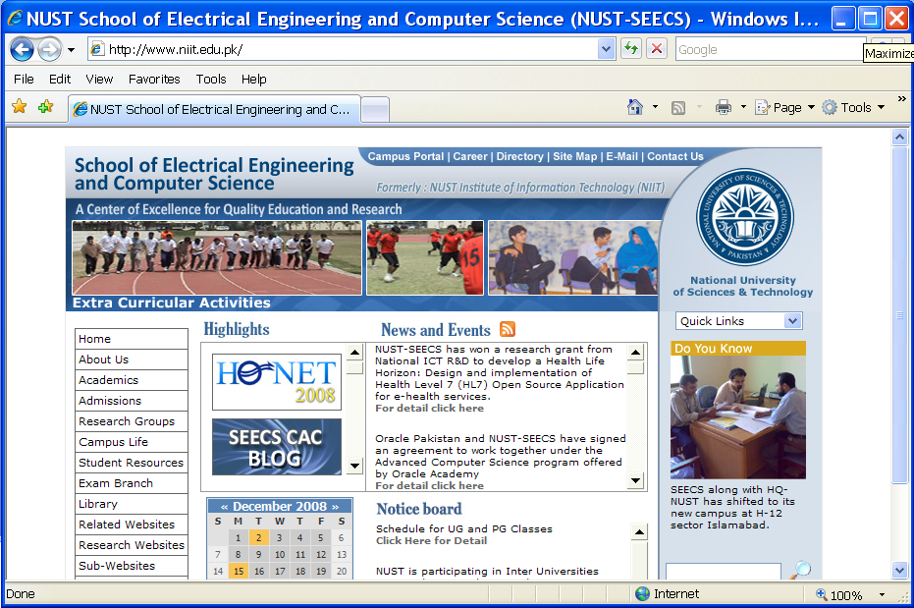
HTTP Client/Server Exchange

Slide 66
Summary
We’ve discussed basic types of 1) network media; 2) network topologies; 3) addressing schemes; 4) name resolution techniques.
We’ve studied an example of data transfer between a browser and a webserver.

