Slide 1
Introduction to Information and Communication Technology
CPS 111

Slide 2
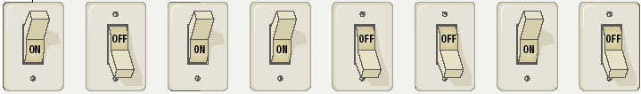
Data Representation
Bits and bytes
Binary digits are in bits
A byte comprises of 8 bits and represents 1 character

Slide 3
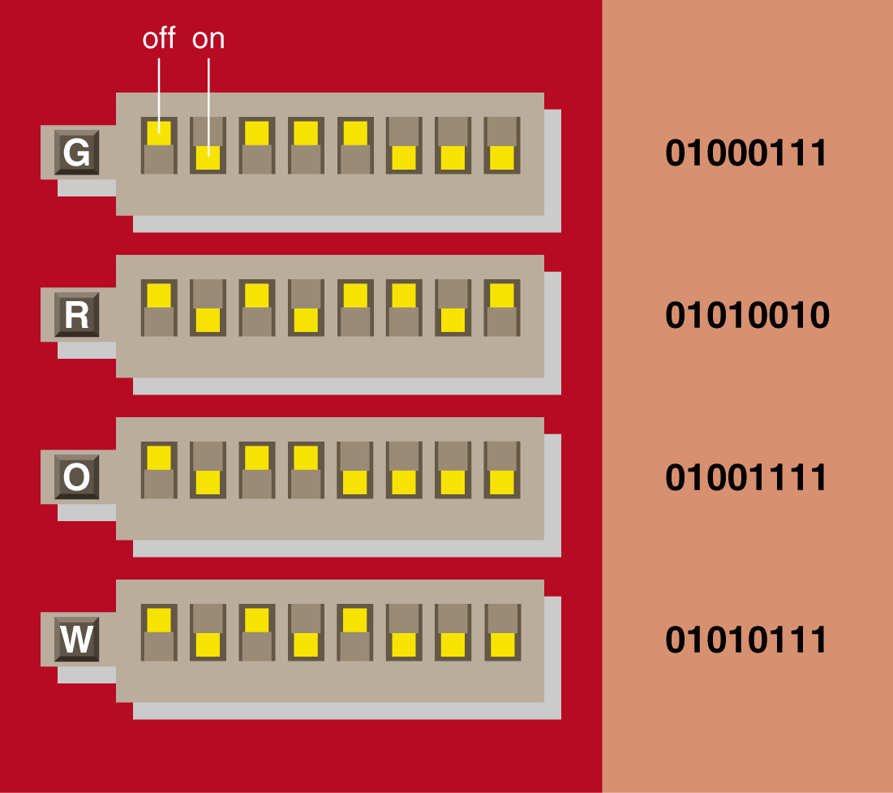
Bits and bytes
A binary digital system

Slide 4
Text codes
Converts letters into binary format
Is there a need of a standard code?
  ASCII
    (American English symbols)
  Extended ASCII
    (Graphics and other symbols)
  Unicode
    (All languages on the planet)

Slide 5
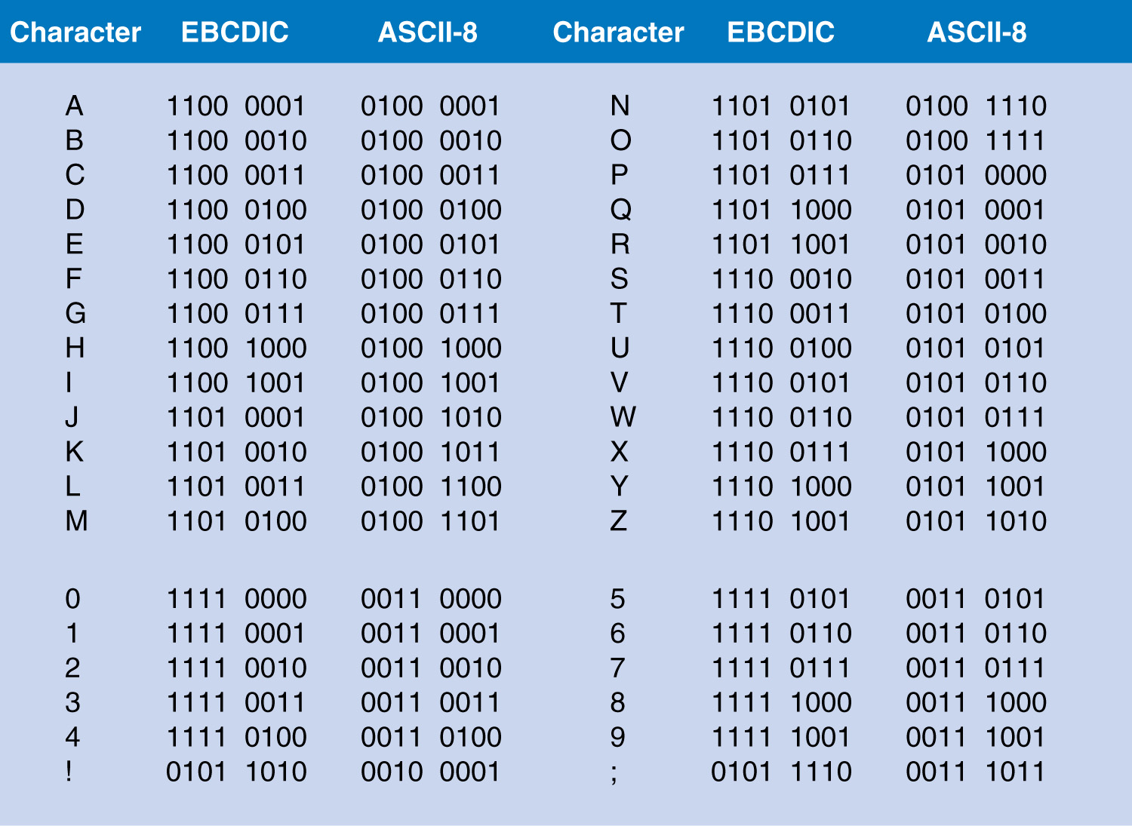
Notes:
Extended Binary Coded Decimal Interchange Code is an eight-bit character encoding used mainly on IBM mainframe and IBM midrange computer operating systems

Slide 6
How computers process data?
The basis of the processing part of the computer is the binary system, which has only two digits: 1 and 0.
These two digits, called bits, correspond to the on and off states of electricity used in computers.
A group of 8 bits, called a byte, represents one character in the computer.
Storage capacities are expressed in multiples of bytes:
1,000 bytes = 1 kilobyte
1 million bytes = 1 megabyte
1 billion bytes = 1 gigabyte
1 trillion bytes = 1 terabyte
1 quadrillion bytes = 1 petabyte

Slide 7
How computers process data?
Letters, numbers, and special characters are represented within a computer by binary coding schemes
ASCII: The code most widely used in microcomputers
EBCDIC: Used with large computers
Notes:
Unicode: a subset of ASCII that uses 16 bits for each character.

Slide 8
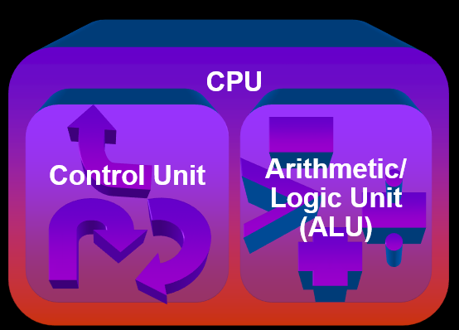
Central Processing Unit

Slide 9

System Clock
Synchronizes all computer operations
Faster clock speed means the CPU can execute more instructions each second
Units: MHz and GHz

Slide 10
CPU Registers
Temporary storage location used by the CPU
High speed memory in CPU that stores:
    Instruction while being decoded
    Location from where instruction was fetched
    Data while the ALU processes it
    Results of a calculation

Slide 11
Control Unit
Directs and coordinates most of the computer operations
4 basic operations:
  Fetch – obtain a program instruction or data item from memory
  Decode - translate the instruction into commands
  Execute - carry out the command
  Store - write the result to memory
Notes:
The control unit is the circuitry that controls the flow of data through the processor, and coordinates the activities of the other units within it. In a way, it is the "brain within the brain", as it controls what happens inside the processor, which in turn controls the rest of the PC.

Slide 12
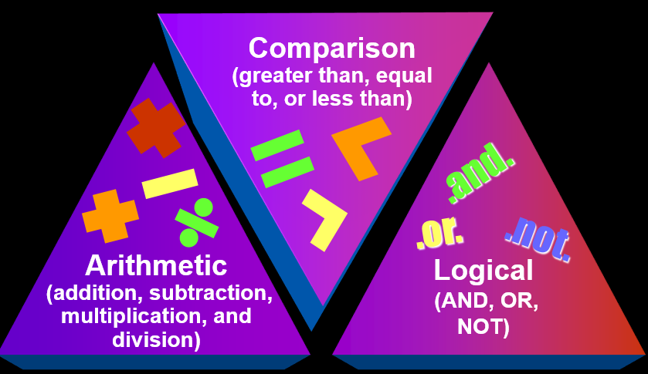
Arithmetic and Logic Unit
Notes:
In computing, an arithmetic logic unit (ALU) is a digital circuit that performs arithmetic and logical operations. The ALU is a fundamental building block of the central processing unit (CPU) of a computer, and even the simplest microprocessors contain one for purposes such as maintaining timers. The processors found inside modern CPUs and graphics processing units (GPUs) have inside them very powerful and very complex ALUs; a single component may contain a number of ALUs.

Slide 13

Arithmetic and Logic Unit
Performs the execution part of the machine cycle

Slide 14
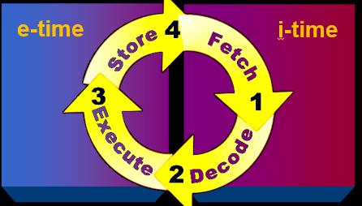
Machine Cycle
4 operations of the CPU comprise a machine cycle
Also called an instruction cycle
    Instruction time– time to fetch and decode
    Execution time– time to execute and store
Notes:
The shortest interval in which an elementary operation can take place within the processor. It is made up of some number of clock cycles.
The computer can only do one thing at a time. Each action must be broken down into the most basic steps. One round of steps from getting an instruction back to getting the next instruction is called the Machine Cycle.
An instruction cycle (also called fetch-and-execute cycle, fetch-decode-execute cycle, and FDX) is the time period during which a computer reads and processes a machine language instruction from its memory or the sequence of actions that the central processing unit (CPU) performs to execute each machine code instruction in a program.
The name fetch-and-execute cycle is commonly used. The instruction must be fetched from main memory, and then executed by the CPU. This is fundamentally how a computer operates, with its CPU reading and executing a series of instructions written in its machine language. From this arise all functions of a computer familiar from the user's end.

Slide 15
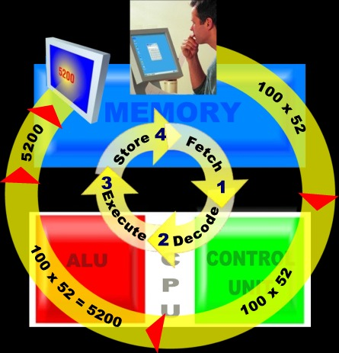
Machine Cycle
Example

Slide 16
Memory
nonvolatile memory
Does not lose its contents when the computer’s power is turned off
volatile memory
Loses its contents when the computer's power is turned off

Slide 17
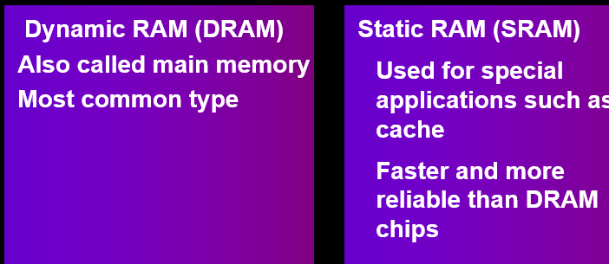
Memory
2 basic types of RAM chips

Slide 18
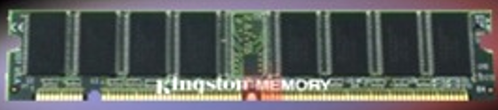
Memory
2 basic types of memory modules
SIMM and DIMM
single inline memory modules (SIMMs)
dual inline memory modules (DIMMs)

Slide 19
Memory Cache
Also called cache store or RAM cache
Limited very fast memory
Lower access time
Stores frequently used instructions/ data to speed up processing
  When the processor needs an instruction or data, it first searches cache.
  If it cannot locate the item in cache, then it searches RAM.

Slide 20
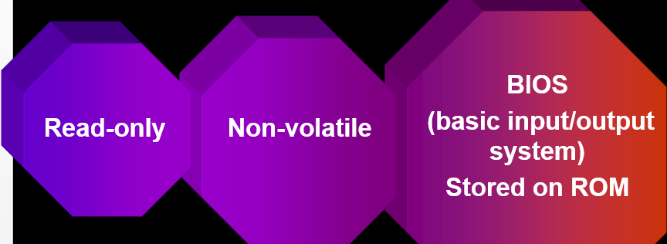
Read Only Memory (ROM)
Fixed start-up instructions

Slide 21
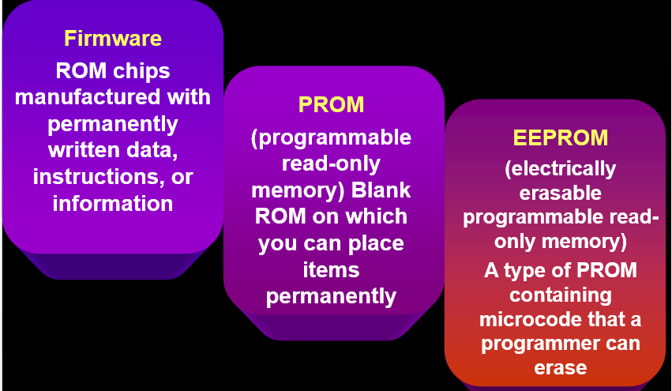
Types of ROM
Notes:
In computing, firmware is a computer program that is embedded in a hardware device, for example a microcontroller. It can also be provided on flash memory or as a binary image file that can be uploaded onto existing hardware by a user.
As its name suggests, firmware is somewhere between hardware and software. Like software, it is a computer program which is executed by a microprocessor or a microcontroller. But it is also tightly linked to a piece of hardware, and has little meaning outside of it.
A programmable read-only memory (PROM) or field programmable read-only memory (FPROM) is a form of digital memory where the setting of each bit is locked by a fuse or antifuse. Such PROMs are used to store programs permanently. The key difference from a strict ROM is that the programming is applied after the device is constructed. They are frequently seen in video game consoles, or such products as electronic dictionaries, where PROMs for different languages can be substituted.
EEPROM (also written E²PROM and pronounced e-e-prom or simply e-squared), which stands for Electrically Erasable Programmable Read-Only Memory, is a type of non-volatile memory used in computers and other electronic devices to store small amounts of data that must be saved when power is removed, e.g., calibration tables or device configuration.

Slide 22
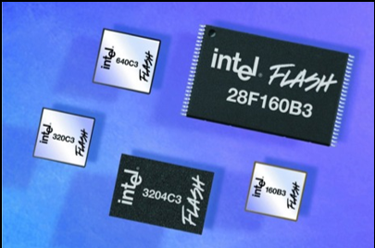
Flash Memory
Nonvolatile EEPROM memory that can be erased and reprogrammed
Stores data and programs on many handheld computers and devices
Notes:
Flash memory is non-volatile computer memory that can be electrically erased and reprogrammed. It is a technology that is primarily used in memory cards and USB flash drives for general storage and transfer of data between computers and other digital products. It is a specific type of EEPROM (Electrically Erasable Programmable Read-Only Memory) that is erased and programmed in large blocks; in early flash the entire chip had to be erased at once. Flash memory costs far less than byte-programmable EEPROM and therefore has become the dominant technology wherever a significant amount of non-volatile, solid state storage is needed. Example applications include PDAs (personal digital assistants), laptop computers, digital audio players, digital cameras and mobile phones. It has also gained popularity in the game console market, where it is often used instead of EEPROMs or battery-powered SRAM for game save data.

Slide 23
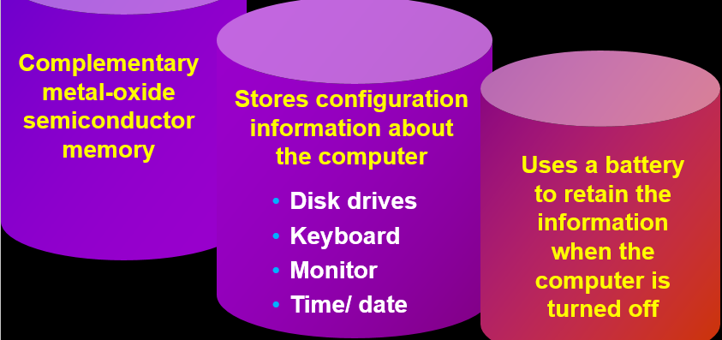
CMOS Memory
Flexible start-up instructions
Notes:
Non-volatile BIOS memory refers to the memory on a personal computer motherboard containing BIOS settings and sometimes the code used to initialize the computer and load the operating system. The non-volatile memory was historically called CMOS RAM or just CMOS because it traditionally used a low-power CMOS memory chip (the Motorola MC146818, or one of its higher-capacity clones), which was powered by a small battery when the system power was off. The term remains in wide use in this context, but has also grown into a misnomer. The non-volatile BIOS storage in contemporary computers might be in an EEPROM or flash memory chip and not in a volatile CMOS RAM. In these cases, the battery back-up is meant to keep the RTC chip synchronized. The NVRAM normally has a storage capacity of 512 Bytes, which is enough for all BIOS-settings.

Slide 24
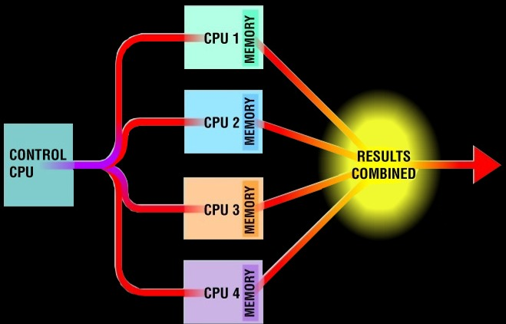
Parallel Processing
Multiple processors simultaneously execute a program
Requires special software to divide up a problem and bring the results back

Slide 25
How can different CPUs be compared
Clock Speed
MIPS
Flops

Slide 26
What factors affect CPU speed
Registers
Cache Memory
System and I/O Bus
Computer’s Clock
Notes:
Registers: Super fast private memory
Cache: fast memory usually made of SRAM

Slide 27
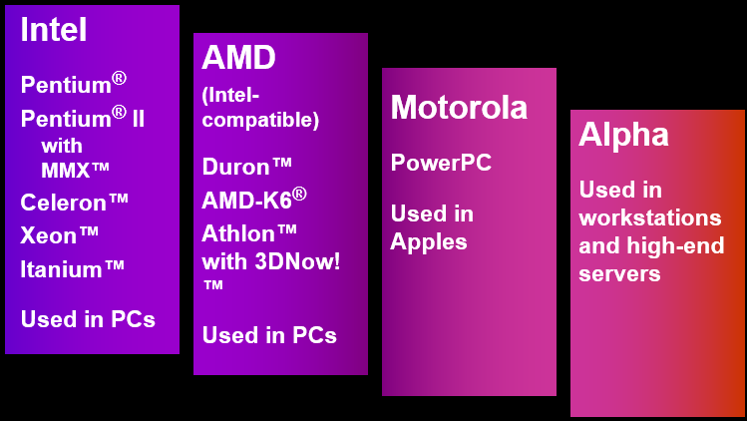
Common Microprocessors

Slide 28
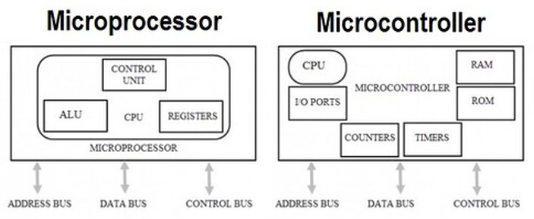
Difference between a microprocessor and microcontroller
Microcontroller is a complete microprocessor system (CPU, RAM, ROM, I/O) on a chip
Microprocessor requires other devices

Slide 29
Which (microprocessor or microcontroller) are more common
Microcontrollers (embedded systems) are much more common
55 % of all CPUs sold are 8-bit uC

Slide 30
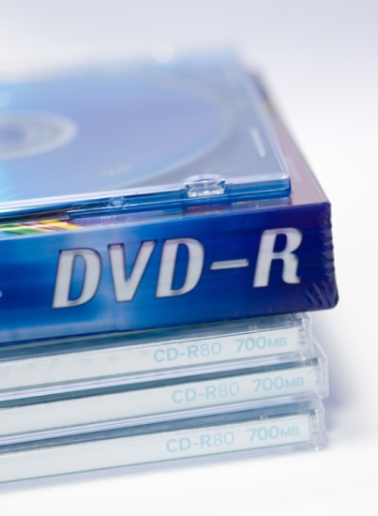
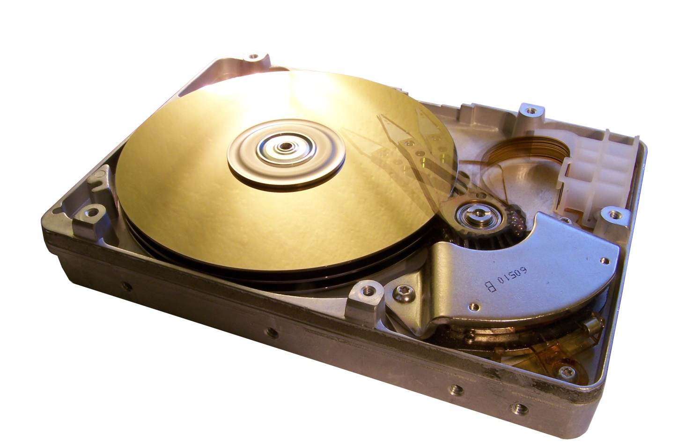
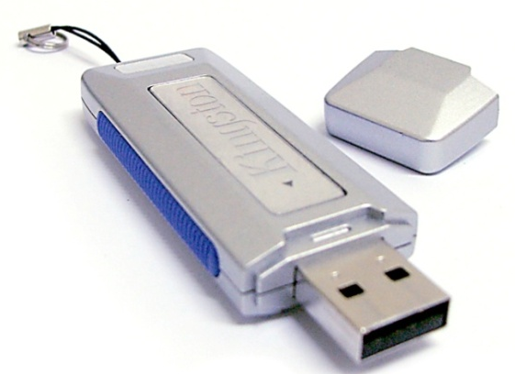
Storage Devices
Notes:
Kinds of storage devices:
Magnetic devices use a magnet
Optical devices use lasers
Solid-state devices have physical switches
Media is the material storing data
Storage devices manage the media
Motivations for studying storage devices:
1. Storage devices are essential components of computers.
2. We can improve our computer’s performance through disk optimization.

Slide 31
Hierarchy of memory/ Storage Devices
Reg.
Cache
RAM
Hard Disk
Notes:
A ranking of computer memory devices, with devices having the fastest access time at the top of the hierarchy, and devices with slower access times but larger capacity and lower cost at lower levels.
The hierarchical arrangement of storage in current computer architectures is called the memory hierarchy. It is designed to take advantage of memory locality in computer programs. Each level of the hierarchy has the properties of higher bandwidth, smaller size, and lower latency than lower levels. Most modern CPUs are so fast that for most program workloads, the locality of reference of memory accesses and the efficiency of the caching and memory transfer between different levels of the hierarchy are the practical limitation on processing speed. As a result, the CPU spends much of its time idling, waiting for memory I/O to complete.
The levels of memory in a computer. From fastest to slowest speed, they are:
Processor registers – fastest possible access (usually 1 CPU cycle), only hundreds of bytes in size
Level 1 (L1) cache – often accessed in just a few cycles, usually tens of kilobytes
Level 2 (L2) cache – higher latency than L1 by 2 to 10 times, often 512 KB or more
Main memory – may take hundreds of cycles, but can be multiple gigabytes.
Secondary and Tertiary storage – several seconds latency, can be huge

Slide 32
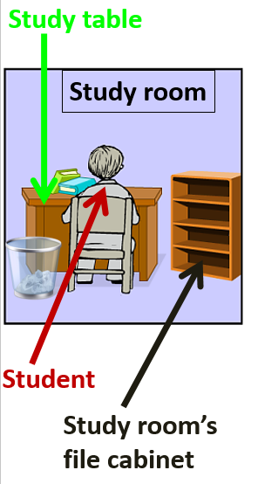
Analogy
home library (RAM)
study room file cabinet (cache memory)
study table (CPU registers)
city library (disk)
Notes:
Analogy:
The student has a study table at home, that can keep 1 to 2 books. He has a file cabinet at a hand span's length that can store 10 books. The bigger file cabinet is kept in the home library that can store up to 100 books. The city library (5 kms away), on the other hand, has many cabinets and can store thousands of books. The student is not very intelligent in the sense that he needs to be told everything that is to be done, i.e., he needs to be given data and instructed what to do with it.
Note the hierarchical structure: 1 book on study table; 10 books on study room's file cabinet; 100 books in home library; and 1000s of books in the city library. The study room file cabinet only stores the book that the students needs at this time, or will need very soon. Due to their small size, the study table and study room's file cabinet can store a limited number of data/ instructions only. The city library acts a repository (collection) of instructions to solve problems (called programs) and data.
The student can only work (process) data/ instructions that are on his study table. The student can extend his hand to the study room's file cabinet (cache) to fetch some book/ instructions in a very short time. He has hired a very efficient assistant called Northbridge that will bring him the data/ instructions he requires from the home library (RAM) to the study room file cabinet (cache memory) and then to his study table (CPU registers) in a short time. The student prefers that most of the instructions/data are present on the study room file cabinet (cache memory) since it requires minimal waiting. If the instructions/ data are not present on the study room final cabinet, the assistant Northbridge can fetch the data from the home library in a short time. The thing the student dislikes most is that the required instruction/ data is not available even in the home library (RAM); in such a case, another assistant Southbridge (who is quite lazy and slow) has to co-ordinate with the city librarian (disk controller) to get the books delivered; this often takes a long time and the student has to sit idle all this while to his dismay.

Slide 33
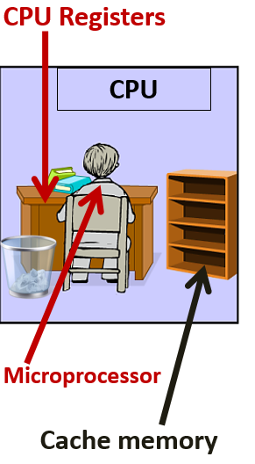
Computers
Notes:
Let's now explain what the analogy meant: the student is the CPU; the study table (used to store the books temporally) is CPU registers; the file cabinet at a hand span's length is the cache memory; the file cabinet in the home library is the RAM; the file cabinet in the Library is the hard disk; the assistant to fetch documents from home library is the Northbridge chip; the assistant to fetch documents from the city library is the Southbridge chip. The CPU can only decode instructions and operate on data in the CPU registers (that is a kind of very quick memory private to the CPU). The programs/instructions stored on hard disk firstly have to be brought to RAM by Southbridge. When these instructions/data are referred to by the CPU, they are taken to the CPU registers and are stored in the cache en-route in case the data/instructions are referred to again---in such a case, the request would be fulfilled by the cache itself and the data would not have to brought from RAM.
It's obvious that if the student has to perform efficiently, most of the data should be in the study room file cabinet (cache memory).
Caching usually adopts two approaches to ensure that requested data/information is available:
1) Hold on the recently used instructions/ data since usually if you refer once to an instruction/ data, chances are that you would refer to it again soon.
2) Predict what instructions/ data, the CPU would require next. The better the prediction, the better the performance of the CPU.

Slide 34
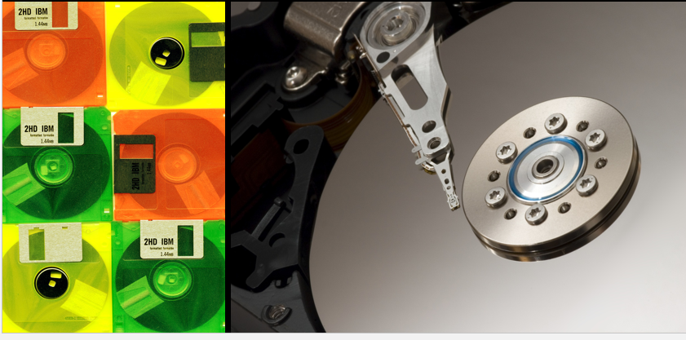
Magnetic storage
Notes:
Nonvolatile
Information isn’t lost when computer is turned off.
Many types – Depends on your needs
Most common form of storage
Hard drives, floppy drives, tape
All magnetic drives work the same

Slide 35
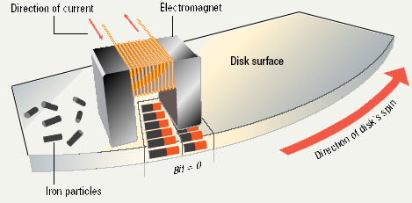
How they function
Data storage and retrieval
  Media is covered with iron oxide
  Read/write head is a magnet
  Magnet writes charges on the media
    Positive charge is a 1
    Negative charge is a 0
  Magnet reads charges
  Drive converts charges into binary

Slide 36
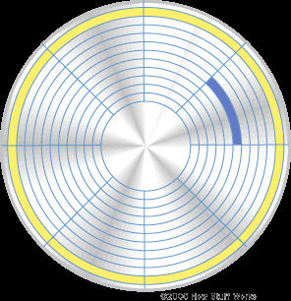
Data organization
Sector
  Disks must be formatted before use
  Format draws tracks on the disk
  Tracks is divided into sectors
Tracks
cylinders
Sectors
clusters
Platter
Track

Slide 37
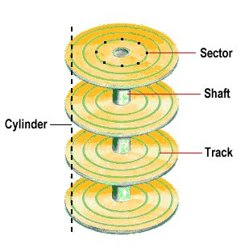
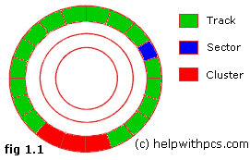
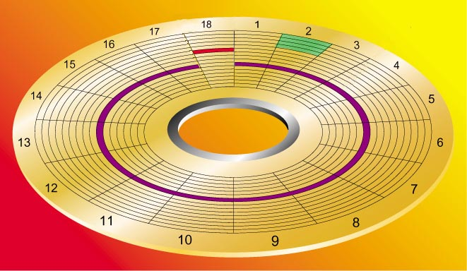
Data organization

Slide 38
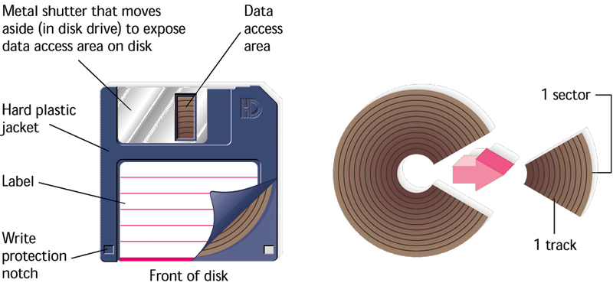
Floppy drive:
Made from plastic
Easily damaged
Diskettes
  Also known as floppy disks
  Read with a disk drive

Slide 39
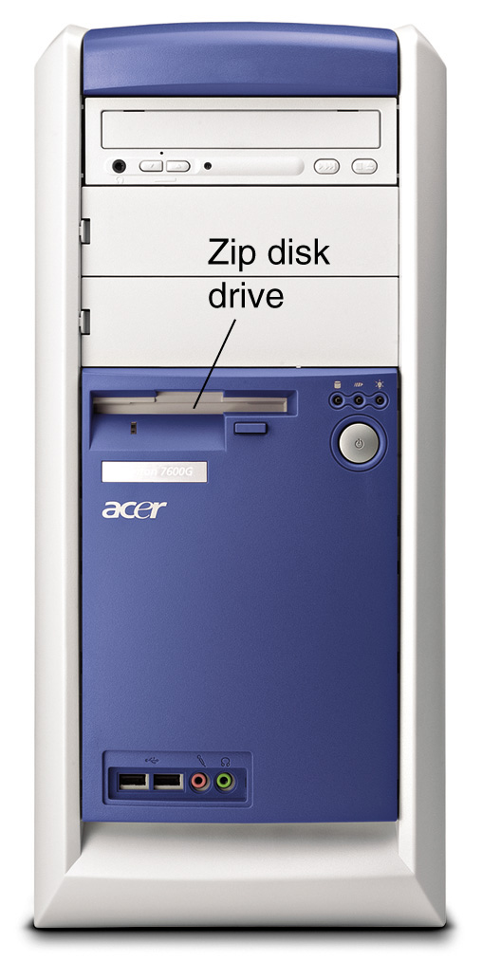
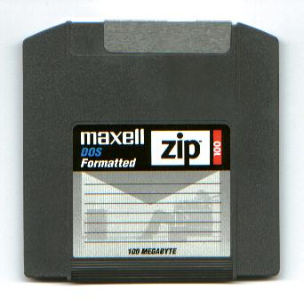
Floppy drive:
Spins at 300 RPM
Takes .2 second to find data
Holds up to 1.44 MB data
ZIP disk is an example
  high-capacity floppy disk
  (~100 MB)

Slide 40
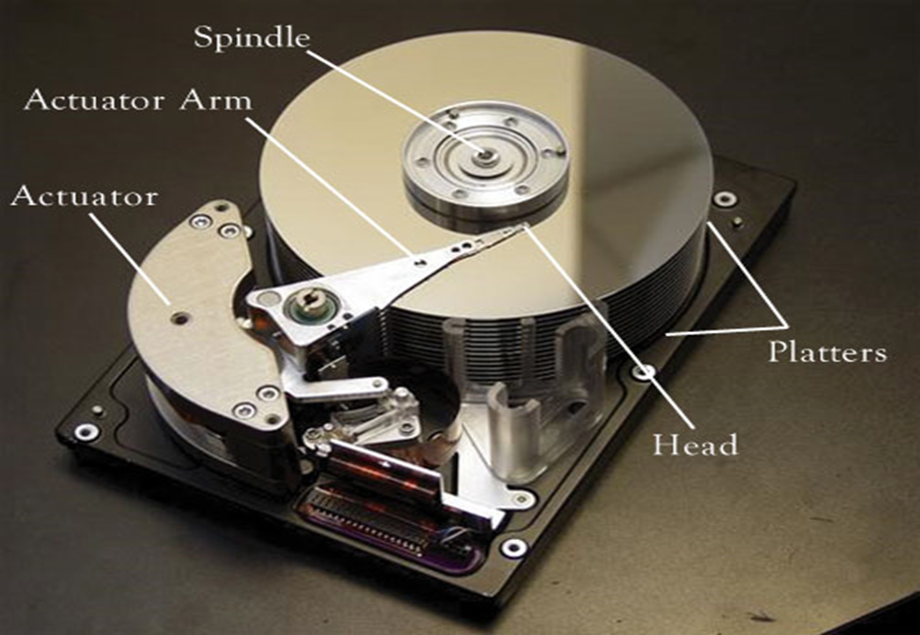
Hard disk:
Thick and rigid; Large capacity; High speed; Magnetic
  Use Metal Platters; Each platter has 2 sides
Sensitive (Hard disk crash) -You can lose data
  Primary storage device in a computer

Slide 41
Hard disk drive
Spins at 5400, 7200, 10000, 15000 RPM
Takes 6 to 12 milliseconds to find data
Holds up to 1.5 TB data
Most commonly used storage media

Slide 42
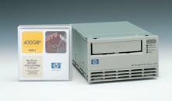
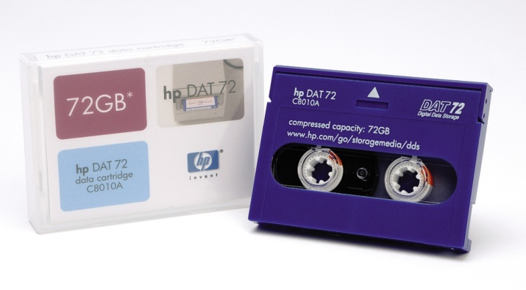
Tape drive:
Sequential access (not random)
Can store very large amounts of data
Commonly used for:
  Backups
  Infrequently used data

Slide 43
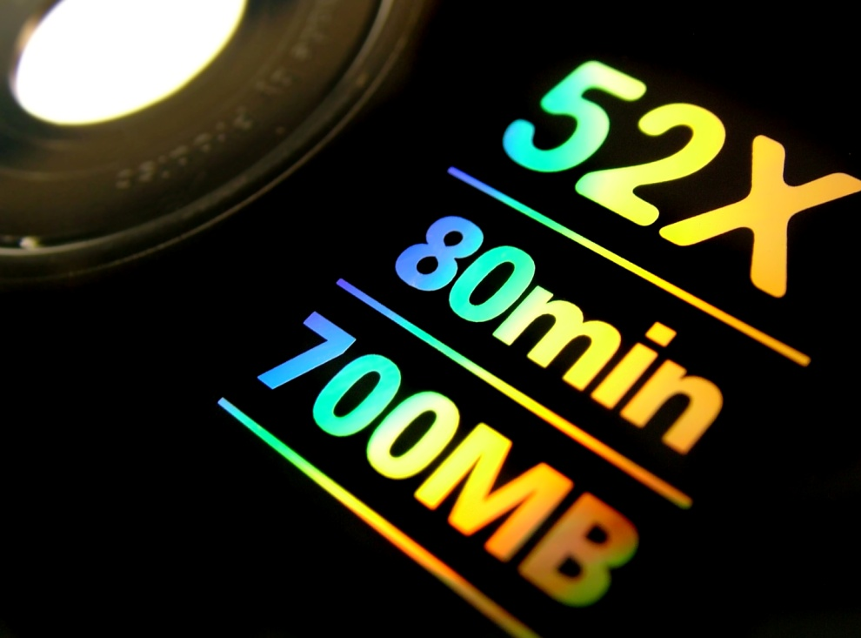

Optical Storage

Slide 44
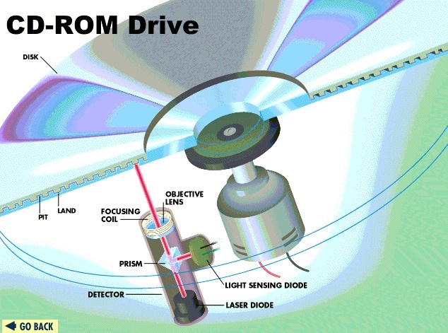
How they function:
Optical Disks: CD and DVD
Uses reflected light
Data is read by lasers
Size varies – 3.5” to 14”
Rotation speed is important
    24X speed accesses 3.6 MB per second
    Lands (1s) reflect data; Pits (binary 0s) scatter data

Slide 45
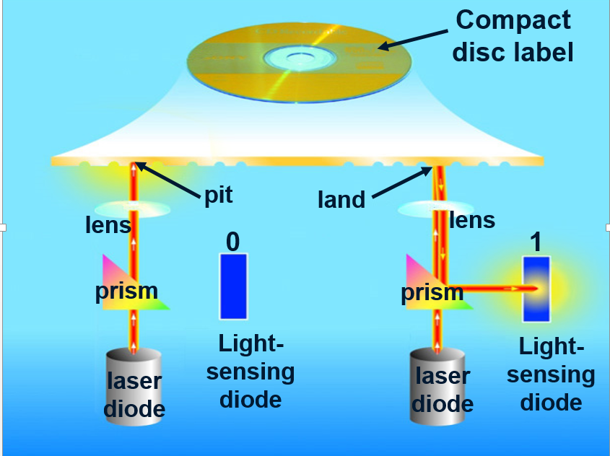
How they function:

Slide 46
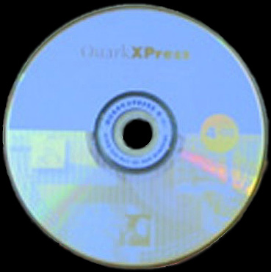
Read only optical drives:
CD-ROM (Capacity: 650 MB)
CD speed is based on the original CD speed (150 kbps); 10 X will read 1,500 Kbps
DVD-ROM (Capacity up to 18 GB)
Use both sides of the disk; can read CD-ROMs

Slide 47
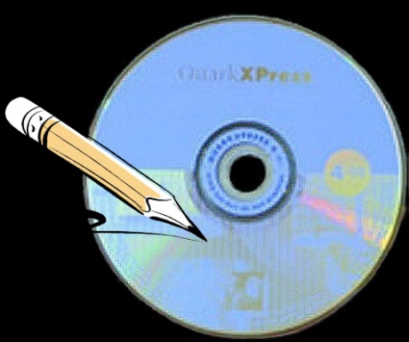
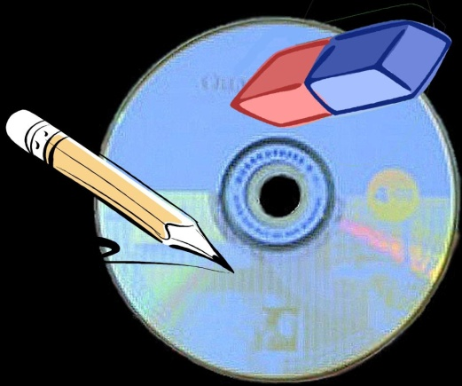
Recordable optical drives:
CD-R (Capacity: 650/700 MB)
Can record once; cannot be changed
Can keep adding until disk full
CD-RW (Capacity up to 650/700 MB)
Can record and can rewrite too (up to 100 times)
Cannot be read in all CD players

Slide 48
Recordable optical drives:
DVD-R (Capacity: 4.7/ 8.5 GB)
Several formats; none standardized
Cannot be read in all players
DVD-RAM
Allows reusing DVD media; Not standardized; Easily writable
Cannot be read in all players
Notes:
DVD-RW is a re-recordable format similar to CD-RW or DVD+RW. The data on a DVD-RW disc can be erased and recorded over numerous times without damaging the medium. ... DVD-RAM discs can be recorded and erased repeatedly but are compatible only with devices manufactured by the companies that support the DVD-RAM format

Slide 49
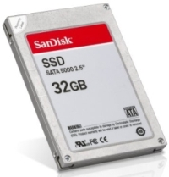

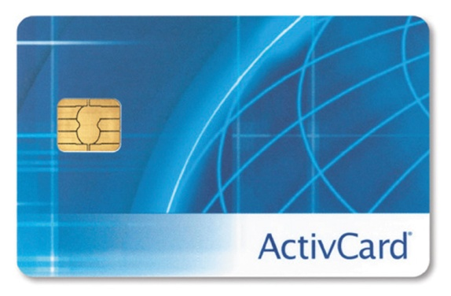
Solid-state storage
Data is stored physically
Very fast

Slide 50
How they function:
A solid-state drive (SSD) is a data storage device that uses solid-state memory to store persistent data.
No moving parts
(unlike magnetic/ optical storage)
Notes:
Costly
“Flash” memory for laptops, cameras, MP3.
Lower read time --- they are much faster than hard drives.

Slide 51
Flash memory:
  Found in cameras and USB drives
  Long term updateable storage

Slide 52
Smart card:
  A Credit cards with a chip
  Chip stores data
  May be used as electronic cash
  Hotels use for electronic keys

Slide 53
Solid State Disks (SSD):
  Extremely fast
  A type of storage device used in computers.
  Non-volatile storage media
  Stores persistent data on solid-state flash
SSDs are faster, more durable, more compact, and consume less energy than HDD

Slide 54
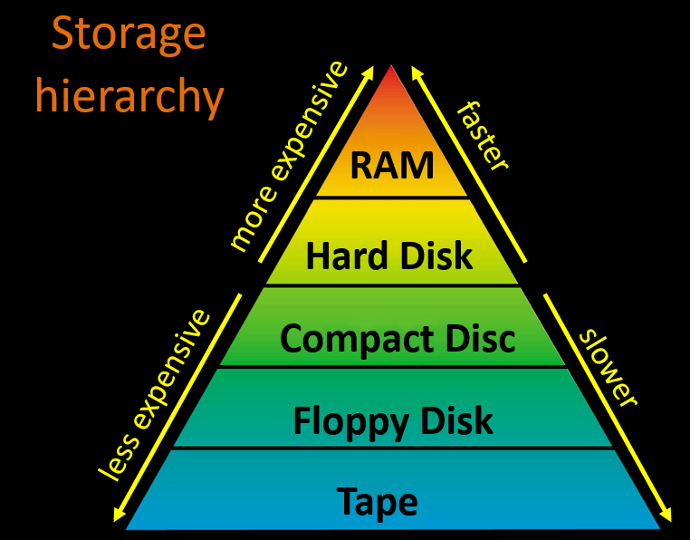
Performance comparison
Storage hierarchy
Notes:
A ranking of computer memory devices, with devices having the fastest access time at the top of the hierarchy, and devices with slower access times but larger capacity and lower cost at lower levels.
The hierarchical arrangement of storage in current computer architectures is called the memory hierarchy. It is designed to take advantage of memory locality in computer programs. Each level of the hierarchy has the properties of higher bandwidth, smaller size, and lower latency than lower levels. Most modern CPUs are so fast that for most program workloads, the locality of reference of memory accesses and the efficiency of the caching and memory transfer between different levels of the hierarchy are the practical limitation on processing speed. As a result, the CPU spends much of its time idling, waiting for memory I/O to complete.
The levels of memory in a computer. From fastest to slowest speed, they are:
Processor registers – fastest possible access (usually 1 CPU cycle), only hundreds of bytes in size
Level 1 (L1) cache – often accessed in just a few cycles, usually tens of kilobytes
Level 2 (L2) cache – higher latency than L1 by 2 to 10 times, often 512 KB or more
Main memory – may take hundreds of cycles, but can be multiple gigabytes.
Secondary and Tertiary storage – several seconds latency, can be huge

Slide 55
Performance comparison
Average access time
  Depends on: (i) RPM, (ii) time to access track
Hard disk: 6 to 12 ms
CD drive: 80 to 800 ms
In contrast, RAM access time is in nanoseconds
Transfer rate
Hard disk: 15 – 160 Mbps;
CD drive: base rate = 150 Kbps
Floppy disks: 45 Kbps

Slide 56


Slide 57
Formatting
  Disk formatting is the process of preparing a hard disk or other storage medium for use, including setting up an empty file system.
  2 levels of formatting:
  Low-level: drawing tracks and sectors on disk
  High-level: creating filesytem and bootsector (sometimes called quick or logical format)
Notes:
Each track and sector is labeled
Some are reserved
Listing of where files are stored
File Allocation Table (FAT)
FAT32
NTFS
Data is organized in clusters
Size of data the OS handles

Slide 58
File Systems
A file system is a logical method of configuring data on a disk’s surface.
Listing of where files are stored
Common file systems include:
  File Allocation Table (FAT)
  FAT32
  NTFS
  EXT2/EXT3 (Linux)

Slide 59


Slide 60
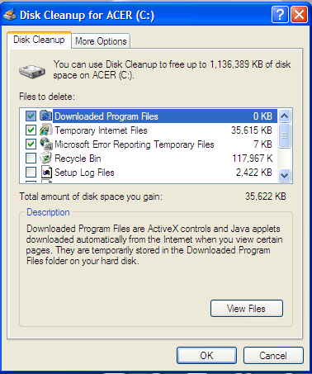
Deleting unneeded files
Searches temporary files on disk
  Internet cache files
  unnecessary program files
Safely delete them

Slide 61
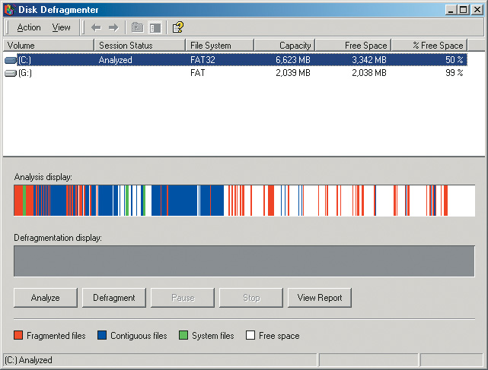
Disk defragmentation
Defragment a disk
  Files fragment when resaved
  Fragmented files load slower
  Defragment puts the fragments together
  Disks should be defragged monthly

Slide 62
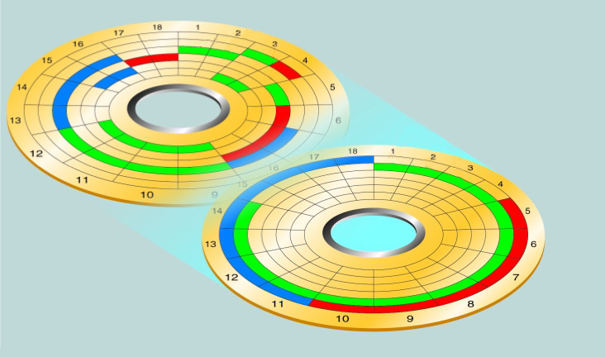
Disk defragmentation
file 1 after defragmenting
disk after defragmentation process

Slide 63
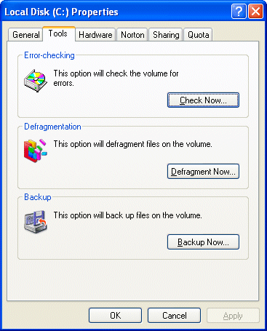
Scanning HDD for errors
Scan a disk for errors
  Bad spots on the media
  Find and fix the error
    Move data to a good spot
    Mark the spot as bad
  Disks should be scanned monthly

Slide 64
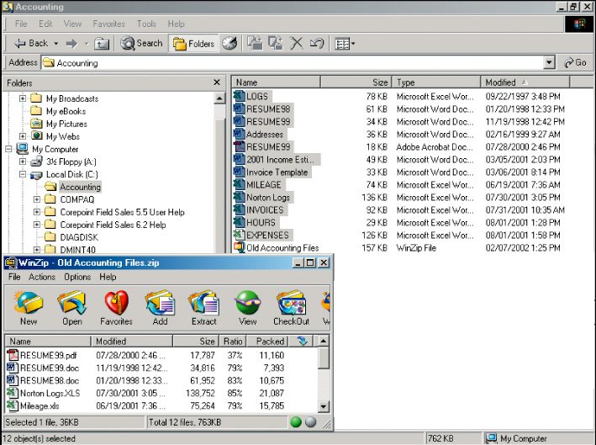
File compression
  Shrinks the size of a file
  Takes up less space on disk
  Reduce a disks performance
  Will increase disk capacity
  WinZip and WinRAR

