Slide 1
Database Management
Database Management

Slide 2
Databases
A database is a collection of data organized in a manner that allows access, retrieval, and use of that data.

Slide 3
Data and Information
Data is a collection of unprocessed items, which can include text, numbers, images, audio, and video.
Information is processed data; that is, it is organized, meaningful, and useful.

Slide 4
Database software
Often called a database management system (DBMS)
Allows users to create computerized database; add, modify, and delete data in the database.
DBMS Allows users to sort and retrieve data from the database and create forms and reports from the data in the database.

Slide 5
Data Integrity
Data integrity identifies the quality of the data.
Garbage in, garbage out (GIGO) is a computing phrase that points out the accuracy of a computer’s output depends on the accuracy of the input.

Slide 6
Qualities of Valuable Information
Accurate
Verifiable
Timely
Organized
Accessible
Useful
Cost-effective

Slide 7
The Hierarchy of Data
Data is organized in layers:
    Files (sometimes called tables)
    records
    characters

Slide 8
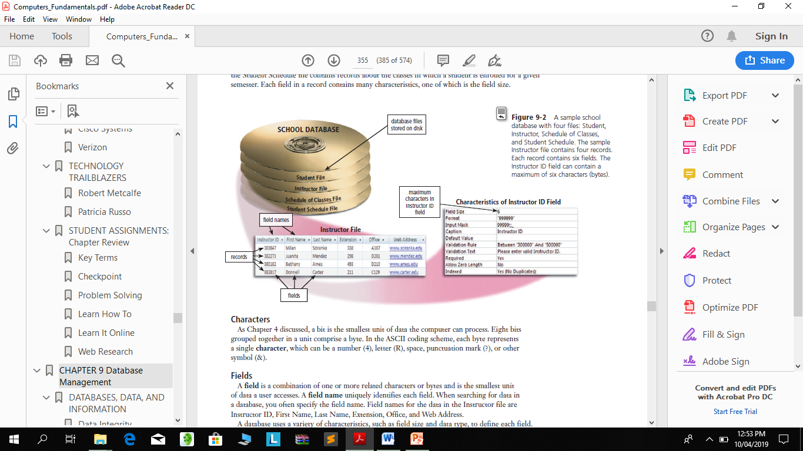

Slide 9
Character
Each byte represents a single character, which can be a number (4), letter (R), space, punctuation mark (?), or other symbol (&).
A data file is a collection of related records stored on a storage medium such as a hard disk or optical disc.

Slide 10
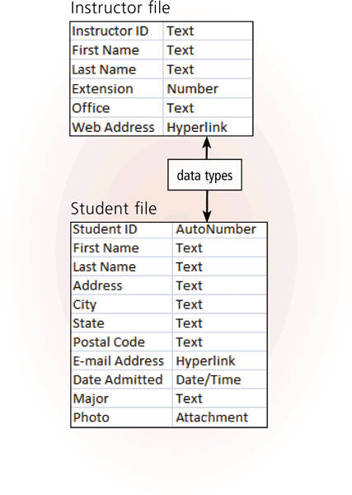
Field
A field is a combination of one or more related characters or bytes and is the smallest unit of data a user accesses.
Field name
Field size
Data type

Slide 11
Field name, field size and data type
A field name uniquely identifies each field.
The field size defines the maximum number of characters a field can contain.
The data type specifies the kind of data a field can contain and how the field is used.

Slide 12
The Hierarchy of Data
Common data types include:
Text (also called alphanumeric)
Numeric
AutoNumber
Currency
Date (also called date/time)
Memo
Yes/No

Slide 13
The Hierarchy of Data
Common data types include:
Hyperlink
Object
Attachment

Slide 14
The Hierarchy of Data
A record is a group of related fields.

Slide 15
Primary key
A primary key is a field that uniquely identifies each record in a file.
The data in a primary key is unique to a specific record.
In some tables, the primary key consists of multiple fields, called a composite key.

Slide 16
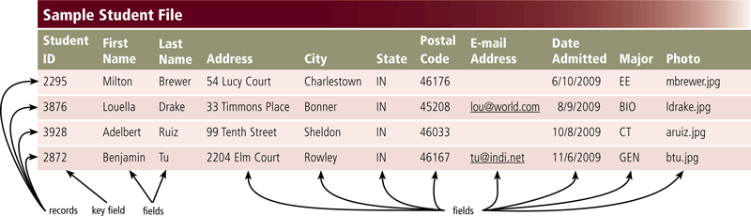
Data file
A data file is a collection of related records

Slide 17
Maintaining Data
File maintenance refers to the procedures that keep data current.
File maintenance procedures include
  adding records to
  modifying records in and
  deleting records from a file.

Slide 18
Validation
The process of comparing data with a set of rules or values to find out if the data is correct.

Slide 19
Validation cont.
Alphabetic/Numeric Check
An alphabetic check ensures that users enter only alphabetic data into a field.
A numeric check ensures that users enter only numeric data into a field.

Slide 20
Validation cont.
A range check determines whether a number is within a specified range.
A consistency check tests the data in two or more associated fields to ensure that the relationship is logical and their data is in the correct format.
  For example, the value in a Date Admitted field cannot occur earlier in time than a value in a Birth Date field.

Slide 21
Validation cont.
A completeness check verifies that a required field contains data.
  For example, some fields cannot be left blank others require a minimum number of characters.

Slide 22
Validation cont.
A check digit is a number(s) or character(s) that is appended to or inserted in a primary key value.
A check digit often confirms the accuracy of a primary key value.
Bank account, credit card, and other identification numbers often include one or more check digits.

Slide 23
Validation cont.
Other Checks DBMSs that include hyperlink and attachment data types can perform validity checks on data entered in those fields.

Slide 24
Validation cont.
Hyperlink entries can be tested to ensure that the Web address follows the correct format and that the link works.
Similarly, an attachment entry can be validated by confirming that the file exists.

Slide 25
File Processing Versus Databases
File processing system
Each department has its own set of files
Used for many years
Have data redundancy
Isolate data
Database approach
Programs and users share data
Reduce data redundancy
Improve data integrity
Share data
Allows easier access
Reduces development time
Can be more vulnerable

Slide 26
Disadvantages of Databases
More complex than a file processing system
Require more memory, storage, and processing power than file processing systems.
Database can be more vulnerable than data in file processing systems.
If the database is not operating properly or is damaged or destroyed, users may not be able to perform their jobs.

Slide 27
Disadvantages of Databases
unauthorized users potentially could gain access to a single database file that contains personal and confidential data.

Slide 28
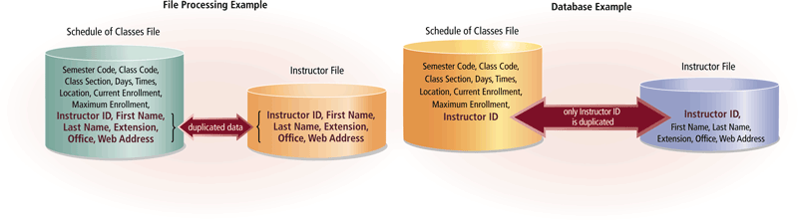
File Processing Versus Databases

Slide 29
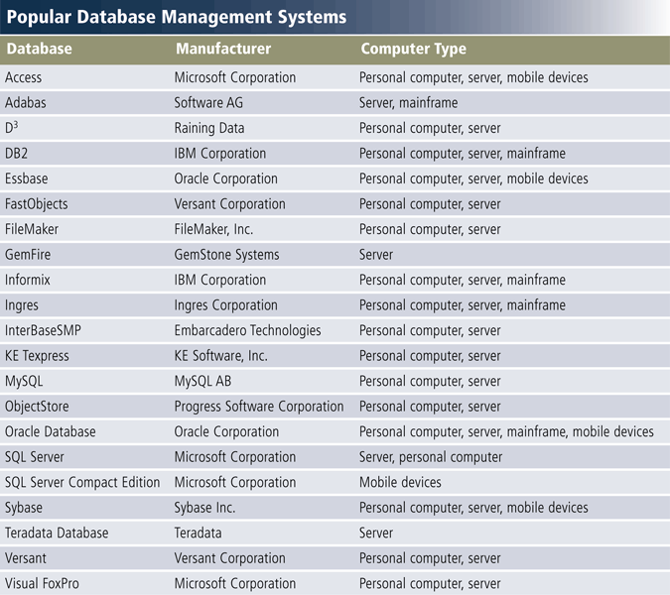
Database Management Systems

Slide 30
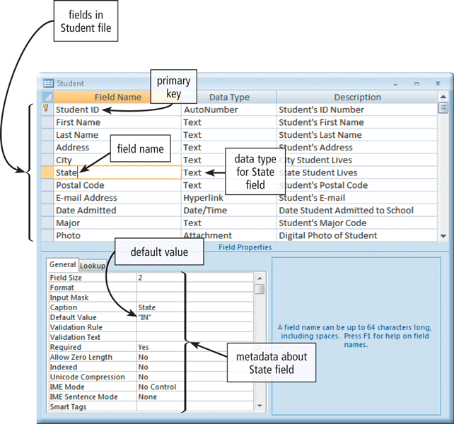
Database Management Systems
A data dictionary contains data about each file in the database and each field in those files.

Slide 31
Database Management Systems
A DBMS provides several tools that allow users and programs to retrieve and maintain data in the database.
query languages
query by example
Forms and
report generators.

Slide 32
Database Management Systems
A query language consists of simple, English-like statements that allow users to specify the data to display, print, or store.
Query by example (QBE) provides a GUI to assist users with retrieving data.

Slide 33
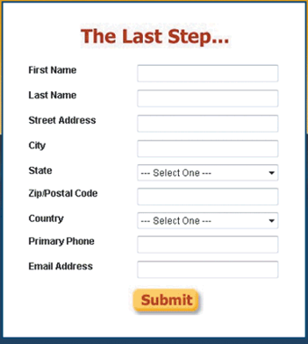
Database Management Systems
A Form is a window on the screen that provides areas for entering or modifying data in a database

Slide 34
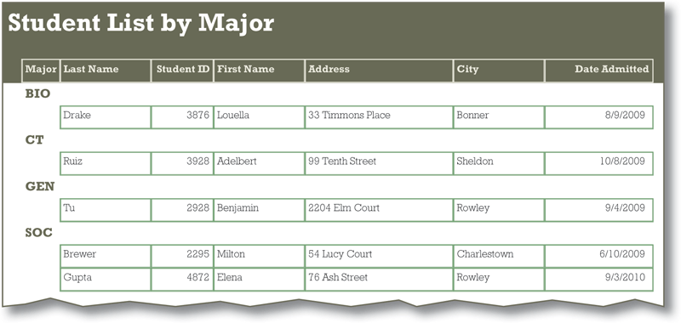
Database Management Systems
A report generator allows users to design a report on the screen, retrieve data into the report design, and then display or print the report.

Slide 35
Data Security
A DBMS provides means to ensure that only authorized users access data at permitted times.
Access privileges
Principle of least privilege

Slide 36
Access privileges/ Principle of least privilege
Access privileges define the actions that a specific user or group of users can perform.
  Access privileges for data involve establishing who can enter new data, modify existing data, delete unwanted data, and view data.
The principle of least privilege policy, where users' access privileges are limited to the lowest level necessary to perform required tasks.

Slide 37
Database Management Systems
A DBMS provides a variety of techniques
to restore the database to a usable form in case it is damaged or destroyed.
Backup
Log
Recovery utility
Continuous backup

Slide 38
Backup and Recovery
A backup, or copy, of the entire database should be made on a regular basis.
Some DBMSs have their own built-in backup utilities. Others require users to purchase a separate backup utility, or use one included with the operating system.

Slide 39
Recovery utility and Log
A recovery utility uses the logs and/or backups to restore a database when it becomes damaged or destroyed.
More complex DBMSs maintain a log, which is a listing of activities that change the contents of the database

Slide 40
Continuous backup
Continuous backup is a backup plan in which all data is backed up whenever a change is made.

Slide 41
Relational, Multidimensional and Object-Oriented
A data model consists of rules and standards that define how the database organizes data.
A data model defines how users view the organization of the data.

Slide 42
Relational, Multidimensional and Object-Oriented
A relational database is a database that stores data in tables that consist of rows and columns.
Each row has a primary key and each column has a unique name.
A relationship is a link within the data.

Slide 43
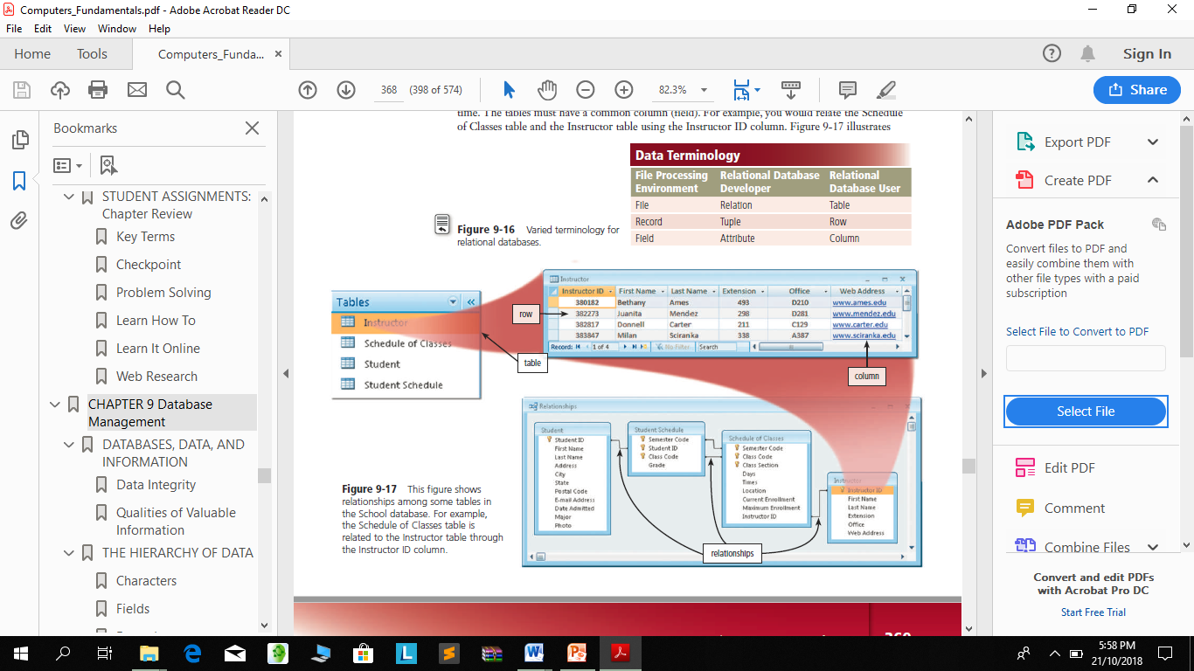
Relational, Multidimensional and Object-Oriented

Slide 44
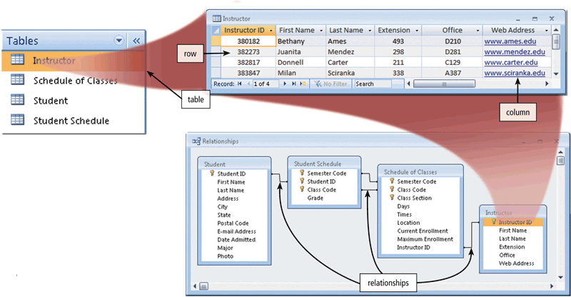
Relational, Multidimensional and Object-Oriented

Slide 45
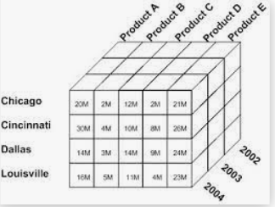
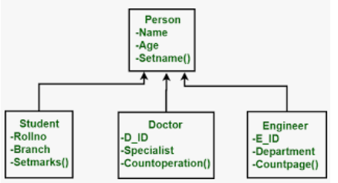
Relational, Multidimensional and Object-Oriented

Slide 46
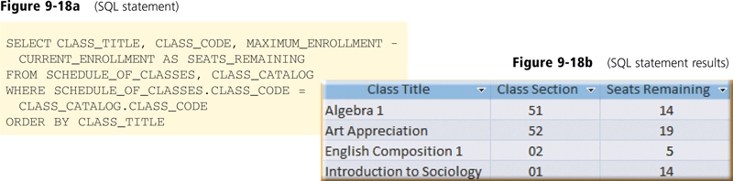
Relational, Multidimensional and Object-Oriented
SQL Structured Query Language (SQL) is a popular query language that allows users to manage, update, and retrieve data.

Slide 47
Relational, Multidimensional and Object-Oriented
An object-oriented database (OODB) stores data in objects.
An object is an item that contains data, as well as the actions that read or process the data.

Slide 48
Relational and Object-Oriented Databases
A data warehouse is a huge database that stores and manages the data required to analyze historical and current transactions.
A smaller version of a data warehouse is the data mart.
A data mart contains a database that helps a specific group or department make decisions.

Slide 49
Database Administration
The role of coordinating the use of the database belongs to the database analysts and administrators.

Slide 50
Role of the Database Analysts and Administrators
The database analysts and administrators are responsible for managing and coordinating all database activities.

Slide 51
Role of the Database Analysts and Administrators
Database Analyst (DA)
Decides on proper field placement, defines data relationship, and identifies users’ access privileges.
Database Administrator (DBA)
Creates and maintains the data dictionary, manages security, monitors performance, and checks backup and recovery procedures.

